Slide 1
CMS Rebuild Update
June Updates for July’s ChMC
Jo Williams

Slide 2
CMS Rebuild - Progress to date
Summary of progress to date
Of the five options provided, we have now shortlisted two options to take forward into further analysis A follow up Must Reads Workshop has been held which generated some great conversations on possible improvements in the process, an additional session will be scheduled in the near future to continue these discussions Internal teams are revisiting the GSR process to see if additional improvements can be identified and built into the Ideal “To Be” process The requirements log has been refined and republished for review, with instructions to advise before COP 22nd June 2021. There have been no objections so these will be taken through to the next stage, where they can be explored in more detail. We will continue to work with customers throughout these stages and will be establishing dedicated a Design Sub Group (DSG) meetings. SDEP tool is still being investigated to ascertain the duplication or replication of requirements. The CMS Rebuild Team continue to work with the CSSC and REC team to input to the schedule reviews and identify any consequential impacts on the CMS processes Additional conversations regarding the TOG Mod have continued to ensure we are aligned with the latest updates Work has commenced on identifying the mandatory and optional data fields for all processes Preparation for the next stage of the project has now commenced

Slide 3
CMS Rebuild Start Up and Initiation
Start Up and Initiation Details
The CMS Rebuild Team have mobilised in June with the two vendors. However, we are not yet able to determine the right solution due to: The fluidity of CSSC/Rec Code and consequence on CMS contacts Impacts to customers of an incremental or single implementation The need to finalise the high level requirements for the Must Read and GSR contacts On-going discussion on SDEP and potential duplication of functionality/process We want to ensure customers can make a fully informed decision without these current levels of risk and uncertainty. So we will be continuing into the next stage of the project undertaking detailed analysis work on the external influences and the requirements. We will continue with the high levels of collaboration with customers, through the introduction of a dedicated Design Sub Group (DSG) to ensure that detailed requirements and “to be” processes are fully understood and agreed. However, as promised, we will also use the Change Pack process to consult formally on design proposals to ensure all customer views are represented and considered.

Slide 4
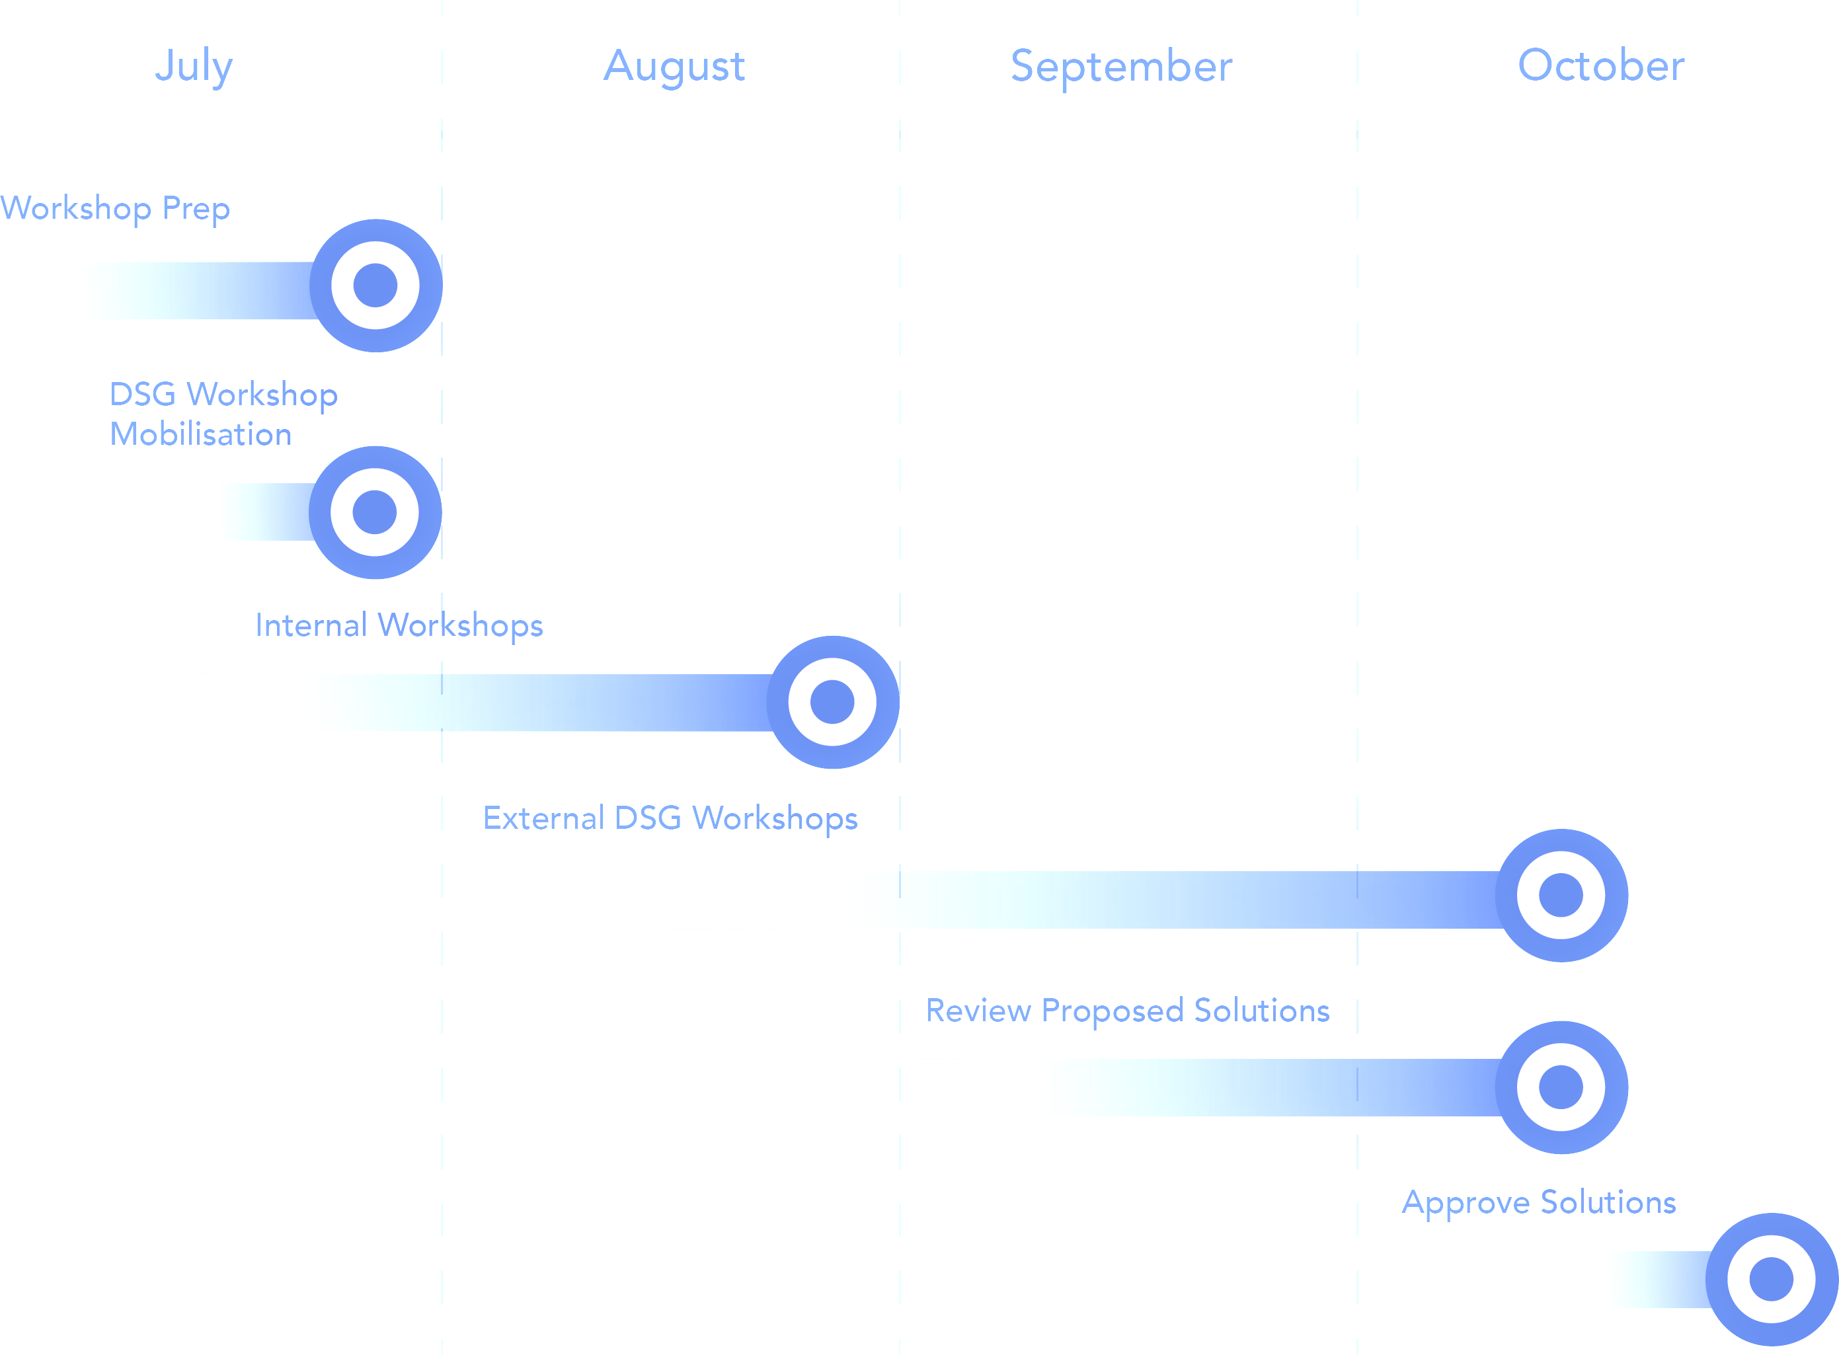
CMS Rebuild Timeline
Timeline and Summary
Further workshops will be required to:
Understand level and complexity of impact to customers
Identification of any consequential impacts
Firm up requirements
The outputs of these workshops will then be used as inputs to the DSG and once the solutions have been chosen these can then feed the Change Pack process
We will be targeting September / October with a preferred solution

