Slide 1
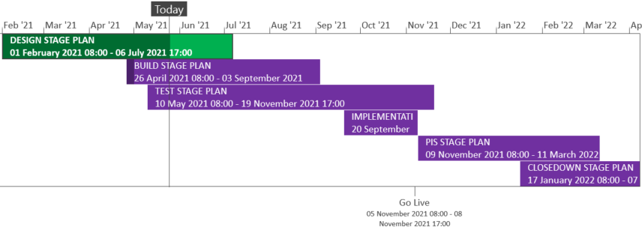
XRN5289 – November 21 Major Release - Status Update
 | Overall Project RAG Status
 | Schedule | Risks and Issues |  | Cost
RAG Status
Status Justification
Schedule | Finalising design phase governance and admin BER approved 12th May Delivery scope approved 12th May High level delivery plan is approved Detailed delivery plan is currently in approval Build has commenced Implementation approach is in review and will be shared in July ChMC Decision in June ChMC: None
Risks and Issues | RISK:XRN5142 - Unknown volumes for data cleanse Mitigation - Regular touch points with DCC to understand the expected volume and plan cleanse accordingly
Cost | Forecast to complete design against approved EQR Forecast to complete delivery against approved BER
Scope | XRN4941 - MOD0692 - Auto updates to meter read frequency​ XRN5007 - Enhancement to reconciliation process where prevailing volume is zero​ XRN5072 - Application and derivation of TTZ indicator and calculation of volume and energy – all classes​ XRN5142 - New allowable values for DCC Service Flag in DXI File from DCC​ XRN5180 - Inner tolerance validation for replacement reads and read insertions​ Descoped - XRN5091 - Deferral of creation of Class change reads at transfer of ownership​ Descoped - XRN5186 - MOD0701 – Aligning capacity booking under the UNC and arrangements set out in relevant NExAs​ Descoped - XRN5187 - MOD0696 – Addressing inequalities between capacity booking under the UNC and arrangements set out in the relevant NExAs
Complete
On Track
At Risk
Overdue
Not Baselined
Slide updated on 28th May 2021

