Slide 1
AQ Taskforce Update CoMC
17th March 2021
Version 0.1

Slide 2
Background
AQ taskforce established to resolve the underlying issues which have led to AQ errors. The team consists of business SME’s, technical resources including architects, as well as our IT suppliers
Immediate focus was to confirm the scope and breadth of the problem and develop a detailed plan of action
The resolution of defects and a more in-depth assessment of the root cause of all AQ defects raised to negate these issues occurring in the first place
Taskforce identified that historic AQ adjustment issue and sought to develop a methodology, tooling and billing principles in which to udertake invoicing. All taskforce activity on this work has now ceased and will move to BAU.

Slide 3
Taskforce Objectives
Continue resolution of known defects
Undertake detailed root cause analysis assessment of the AQ functionality and upstream processes
Review the AQ functionality and business process for both monthly and annual activities
Identify system and process solutions to resolve any issues
Use data / MI to drive greater insight
Continue to provide support, progress reporting & status to you on the taskforce activities

Slide 4
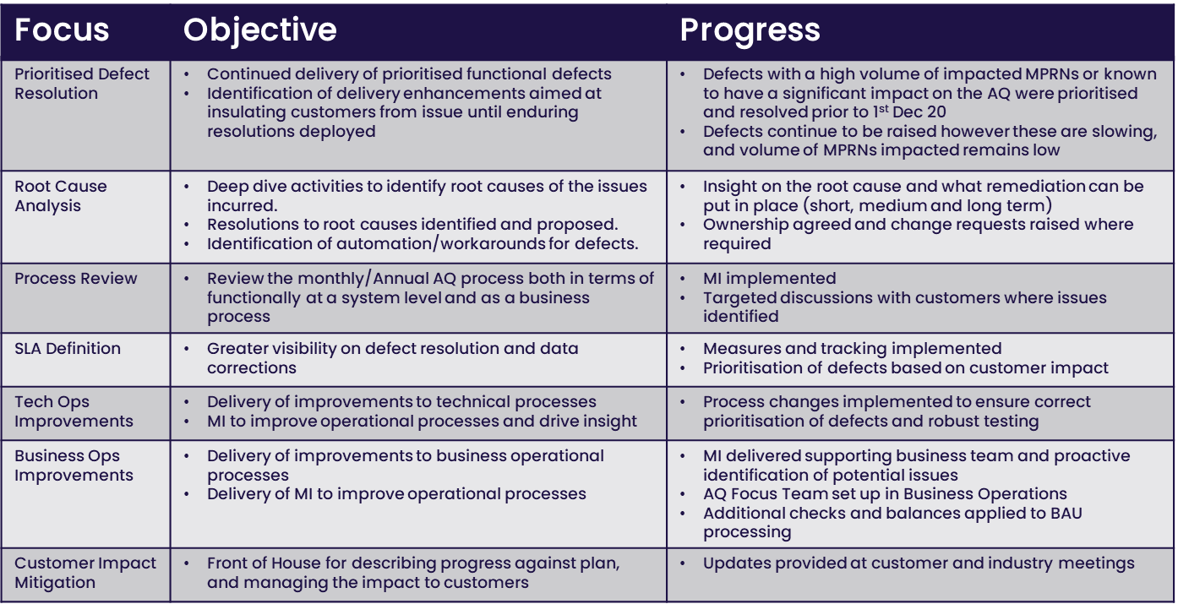
AQ Taskforce Focus Areas

Slide 5
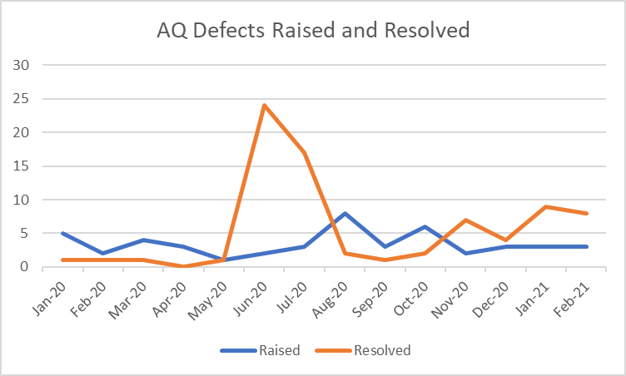
AQ Defects – Raised & Resolved

Slide 6
Next Steps
Defect summary and progress will continue to be provided at industry and customer meetings, for CoMC this will be under ‘Issue Management’ agenda item
Focus will continue on the resolution of AQ defects and maturing the newly created AQ operational team

