Slide 1
CSSC Programme Dashboard
March 2021

Slide 2
Programme Update
Programme Health – RAG |  |  | Return to Green Plan
Overall Programme Status | Previous | Current | The programme is now at Amber-Green status. SIT Functional testing has completed with milestone approval being requested at this month’s Delivery Group. There are very few defects remaining but all within the allowable tolerance to exit this phase. All other test phases continue to track to plan The Switching Programme has introduced a Change Freeze which commenced on 19th February. Only Go-live critical changes will be considered for implementation from this point onwards.
Programme Plan | Previous | Current
Risk Profile | Previous | Current
Resources | Previous | Current
Executive Summary |  |  |  | Upcoming Activities & Milestones (Next Month)
Key Programme Updates To date, all Xoserve key internal and external milestones have been met Transition: External activities have progressed with the Transition Test Plan v0.1 and Transition Plan/Runbook iteration 3 and Live Rehearsal Scenarios and Data requirements are all out for industry review. Internal planning activities continue alongside engagement with the SI. Extraordinary DSG sessions have introduced Transition as a dedicated topic and will remain of the key focus areas in the months to come. SoLR; An Ofgem policy decision has been made to implement their favoured SoLR solution. This solution will see supplier short codes transferring to the recipients portfolios in the event of a supplier of last resort process instigation. Change Packs are currently out for industry representation. This process did not form part of the Switching Programme requirements, however Ofgem did include as part of the DB4 consultation. Internal Testing: UAT Assurance is currently tracking to plan. SIT integration continues for Programme CR deliveries. Defect rate continues to be low. Data Migration: DM NF Cycle 2 commenced on time, however defects have been encountered for this phase and the SI are monitoring closely to ensure that milestone completion date is met. Market Trials: Xoserve CR to remove Market Trials from the Switching Programme MAD Log is currently out for industry impact analysis. This is expected to be tabled the Ofgem Change Advisory Group within the next week or so. |  |  |  | DMT NFR: Continue test execution Internal Test: Continue SIT & UAT assurance DES:& Secondary APIs Continue development and system test activities. Transition: Continue Live Rehearsal & Transition planning SoLR: Detailed Design to commence MAP C: Detailed Design in progress Market Trials: Closure following Switching Programme approval REC: Continue REC schedule review as per Ofgem timelines

Slide 3
Green Workstream Updates
RAG Previous MONTH | RAG Current MONTH | WORK STREAM | SUMMARY
 |  | DES & Secondary API | Overall green. We have seen resource constraints which has now been resolved. Internal & External SIT support in progress. On track to delivery to internal testing ahead of external programme testing phases.
 |  | Testing | The overall status remains Green. Planning underway for all upcoming test phases such as UEPT, E2E, OT Internal testing is tracking to plan
 |  | Service Management | Xoserve have submitted our requirements traceability matrix ahead of the Service Design assurance activity undertaken by the SI. A CR is anticipated to be raised to align Switching Programm SLAs to match Xoserve’s existing response times. Our existing resolution times are more stringent than the Programme’s hence needs no change.
 |  | Batch | The overall status is green, with testing support underway.
 |  | Gemini | The overall status is green. Planning underway to undertake a connected Gas Day testing with UK Link.
 |  | Reporting | An internal CR will be raised to incorporate the impact of one newly identified report that will need changes.
 |  | UK Link | Status continues to be Green with work underway to impact assess and deliver Switching Programme changes raised through the last few months whilst supporting test phases.

Slide 4
Green Workstream Updates
RAG Previous MONTH | RAG Current MONTH | WORK STREAM | SUMMARY
 |  | REC | REC consultation continues with Xoserve actively engaged in relevant RDUG meetings as well as reviewing REC schedules
 |  | Data Migration & Provision | DM NF Cycle 2 commenced on time, however defects have been encountered for this phase and the SI are monitoring closely to ensure that milestone completion date is met.
 |  | Market Trials | The CR to remove Market Trials milestones from the Switching Programme Plan has been raised and is currently undergoing industry-wide impact assessments. Amber in the PoaP reflects the fact that Market Trials is imminently being de-scoped
 |  | Environments | Workstream continues to be Green with all activities continuing to track to plan.
 |  | MAP C | Detailed Design has commenced and is progressing to plan.
 |  | SoLR | This workstream will commence this month. Pending Ofgem decision and this is to be discussed at the Ofgem Design Authority Workgroup

Slide 5
Key Programme Risks (1/4)
REF | RAG | WORKSTREAM | DESCRIPTION | MITIGATING ACTIONS | LATEST UPDATE | TARGET RESOLUTION DATE
64569 |  | Data | There is a risk that the environment for DM live rehearsal will not be ready in time because of late running DM NF, and insufficient time allowed on the CSSIP for a full refresh to a new data copy (4 weeks) leading to late start to smoke test and test prep (TE700) | Clarity required from SI on what is or isn't needed for the various sub phases of live rehearsal | DM NF due to complete 02/04. CSSIP shows environment to be made available for smoke testing 1/4, with smoke testing for Xoserve starting on 12/04. The Xoserve UK Link environment will not be available until 3/5 at the earliest. Confirmation required form SI that early smoke tests are for the API layer only, and no further smoke tests will be schedule before May | 02/04/21
55549 |  | Programme | There is a risk that that the approval of the CSS Physical Design does not take into consideration the complete E2E impacts of the Switching Programme because the CSS design is solely focused on the core CSS and primary interactions with CSS. Leading to an inaccurate critical path being followed for the Programme and subsequent downstream delays to the delivery timeline. | 1. Raise with Ofgem to identify owner/RACI 2. E2E CSS design needs to be in place involving all components/systems/interactions which needs to be form the architectural baseline that the Programme is governed against. | Continues to be monitored until Tranche 1 of E2E is complete | 01/03/21
64158 |  | Programme | There is a risk that that the Operational Choreography CR that is in progress may be approved because it might be deemed necessary by the central programme leading to further plan considerations (at both the central and individual PUI's plans) and cost implications to Xoserve | This has been raised with SI/DCC & Ofgem. This is being tracked collectively via the MAD log actions. Should this CR be approved, this action will be addressed with central bodies | CR has now been issued and is undergoing PIA | 01/03/21
64171 |  | Transition and Cutover | There is a risk that the SoLR process might kick off during the transition period because of a supplier going out of business at that time leading to Landmark needing to cater to additional volumes and also the potential for additional requirements for PUIs to undertake to ensure Transition timelines are maintained | Raise the risk with Ofgem and SI to understand what non-functional considerations have been applied to enable Lankmark to manage the increased volumes Raise with the SI to include a transition test scenario if relevant to mitigate this possibility | Current understanding is that SoLR events are unlikely to occur during the Go-live range. This is on the Ofgem risk register as well. Will be monitored and await formal confirmation of whether or not this is an accepted risk | 30/04/21

Slide 6
Key Programme Risks (2/4)
REF | RAG | WORKSTREAM | DESCRIPTION | MITIGATING ACTIONS | LATEST UPDATE | TARGET RESOLUTION DATE
64695 |  | Data | There is a risk that Live rehearsal and transition test artefacts may not be reviewed in the detail required because of late delivery by the SI leading to review of live rehearsal artefacts crashing into transition artefact reviews, and rushed review missing important issues | Check and review with the teams, report any issues | We currently have 5 test artefacts for review this week for live rehearsal and transition - this is too many to guarantee a thorough review. | 26/02/21
64642 |  | Service Management | There is a risk that the CSS implementation plan does not capture all Service Management activities because of DCC and SI requesting information or completion of documents at the last minute or not currently within scope, I.e recent Service Design Assurance exercise leading to additional time, and therefore impact and cost on CSS staff, and potentially also changing of scope and requirements. | Any concerns to be raised with SI and DCC and CSSC Management team | New Risk - Any concerns to be raised with SI and DCC and CSSC Management team | 31/12/21
64572 |  | Data | There is a risk that Xoserve will be expected to complete Live rehearsal preparation in a very reduced timeframe because of delays in completion / approval of the LR Test Plan document, with knock on impacts to scenarios, data and scripting leading to poor quality / incomplete preparation, or delays to start of live rehearsal testing | Check and review with the teams, report any issues | LR Test plan was due for approval 01/12/20 and has not yet been completed. | 26/03/21
55513 |  | Programme | There is a risk that in the Programme participants might interpret business rules differently because business rules underpinning the CSS Interfaces have not been published alongside the interface document as well as discrepancies between business rules defined within REC and captured in ABACUS. Leading to significant process mismatches at a later stage (i.e. SIT, UEPT) and potential rework and timeline slippages. | Xoserve to publish design assumptions as part of the RAID reporting to the SI to ensure visibility of Xoserve design assumptions around business rules and processes. | Continues to be monitored until Tranche 1 of E2E is complete | 01/03/21
61894 |  | Service Management | There is a risk that the CSS proposed SLA's do not align to current service model/SLA's because DCC/Ofgem are proposing a new set of SLA's for all parties regardless of existing arrangements, leading to target operating model changes and potential contractual changes with 3rd party suppliers (considerable increase in operational cost) | Our working assumption is that existing SLAs will prevail however, there are ongoing discussions taking place with DCC to understand their expectation. REC review - no such SLA's imposed on us currently. | This was tabled at the Design Forum on 25/01 and discussed. Xoserve will be sending through our feedback (previously shared with DCC) to Ofgem. | 26/02/21

Slide 7
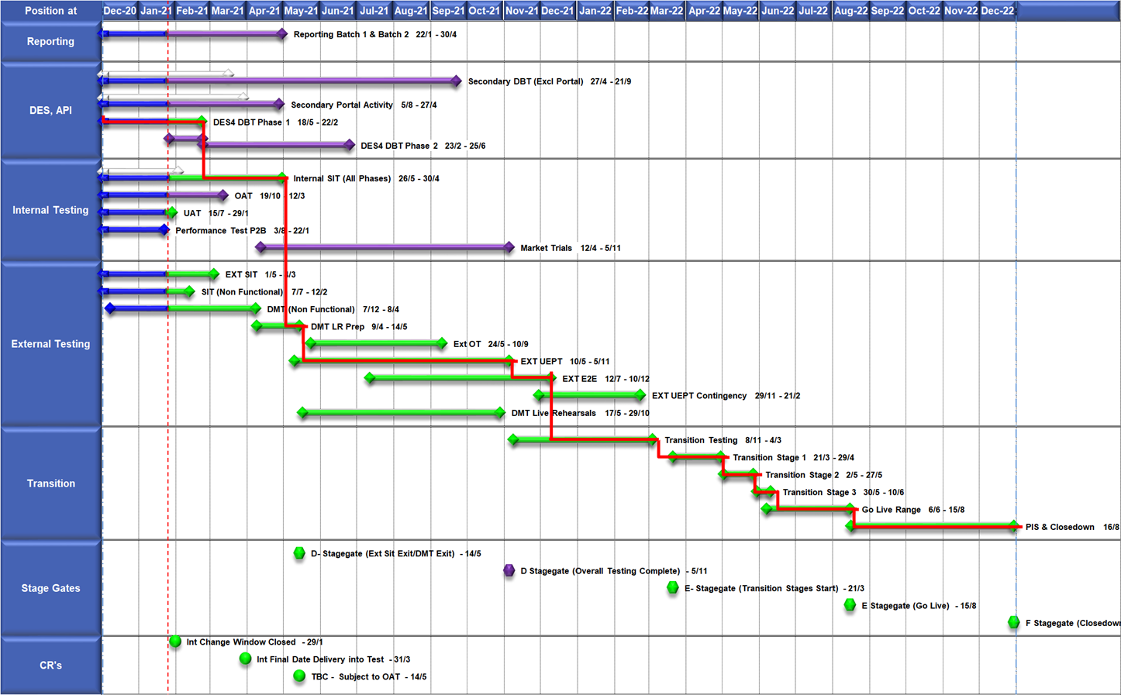
High Level Plan

Slide 8
Switching Programme CR Position – CRs impacting Xoserve
CR Name | CR Ref | High Level Cost IA Cost | Date Raised | Status
Programme Plan Re-Baseline | CR-D002 | £0.00 | 07/11/2019 | Approved - Complete
Updates to the CSS Physical Interface Design (PhID). | CR-D008 | £17,250.00 | 22/01/2020 | Approved - Internal CR Created
CSS_Exception_Handling_Strategy_v0.2 | CR-D014 | £0.00 | 26/02/2020 | Approved - Internal CR Created
Provide_CSS_RegistrationID_to_PUI_and_LPs | CR-D016 | £12,643.00 | 07/08/2020 | Approved - Internal CR Created
Licence Exempt Network Customer Identifier – ABACUS Data Model update | CR-E51 | £0.00 | 29/10/2019 | Approved - Complete
Amendments to the DMS artefact suite | CR-D019 | £6,500.00 | 16/03/2020 | Approved - Internal CR Created
Migration of Terminated Gas RMPS | CR-D022 | £0.00 | 10/06/2020 | Approved - Internal CR Created
Amendments to the NC-0079 for REL (Retail Energy Location) Data Migration and Reconciliation | CR-D024 | £20,000.00 | 06/07/2020 | Approved - Internal CR Created
DMS - PHID Alignment Parties | CR-D026 | £0.00 | 06/07/2020 | Approved - Internal CR Created
Request For a New or Upgraded DMT Environment | CR-D027 | £256,009.00 | 07/08/2020 | Approved - Internal CR Created
Enable TLS connection pooling for all directly connected parties to CSS] | CR-D028 | £2,500.00 | 13/07/2020 | Approved - Internal CR Created
Message Header Format for PKI Certificate Identification] | CR-D029 | £2,500.00 | 13/07/2020 | Approved - Internal CR Created
SIT Functional Test Re Plan Enabling Parallel Testing | CR-D030 | £56,000.00 | 20/07/2020 | Approved - Internal CR Created
DM_Validation Catalogue_Shipper_Effective_Date_Change_ | CR-D032 | £0.00 | 03/08/2020 | Approved - Internal CR Created
Compression During Data Migration | CR-D034 | £500.00 | 09/09/2020 | Approved - Internal CR Created
Uplift to the CSS Interface Specifications | CR-D038 | £70,000.00 | 07/10/2020 | Approved - Internal CR Created
Uplift to Business Data Validation Rules | CR-D039 | £20,000.00 | 25/09/2020 | Approved - Internal CR Created
Programme Plan Re-Baseline | CR-D042 | £14,913,000.00 | 28/09/2020 | Approved - Internal CR Created
MAD Log Changes for UIT Environment Verification | CR-D057 | £0.00 | 25/01/2021 | Pending PIA
Discontinuance of Xoserve Consequential Change Market Trials | CR-D058 | £0.00 | 25/01/2021 | Pending PIA
Changes to Support Energy Company Data | CR-D059 | £25,500.00 | 25/01/2021 | Pending SI Response
Operational Choreography Detection 0.5 | CR-D060 | £538,625.00 | 25/01/2021 | Pending PIA
Operational Choreography Rectification 0.3 | CR-D061 | £0.00 | 25/01/2021 | Pending PIA

Slide 9
Switching Programme CR Position – CRs not impacting Xoserve
CR Name | CR Ref | High Level Cost IA Cost | Date Raised | Status
Non_Mandatory_MPAS_Metered_Indicator_v0.4 | CR-D001 | £0.00 | 27/01/2020 | Complete - No Xoserve Impact
REC Manager Procurement Timelines | CR-D003 | £0.00 | 02/12/2019 | Complete - No Xoserve Impact
MPAS Related MPAN Disconnection | CR-D004 | £0.00 |  | Withdrawn
Introduction of Validation Message to Logical Mode | CR-D005 | £61,000.00 | 25/11/2019 | Withdrawn
Modification of Related MPAN Cleanse Checkpoint Milestones | CR-D006 | £0.00 | 27/11/2019 | Complete - No Xoserve Impact
ABACUS Corrections and Re-alignments | CR-D007 | £0.00 | 04/12/2019 | Complete - No Xoserve Impact
ECOES REL API Webmethod | CR-D009 | £0.00 | 17/12/2019 | Complete - No Xoserve Impact
CSSIA Uplift to Implement IG Recommendations | CR-D010 | £0.00 | 17/12/2019 | Complete - No Xoserve Impact
Update 3 E2Es to align to CSSIA | CR-D011 | £0.00 | 10/06/2020 | Complete - No Xoserve Impact
CSS_Physical_Interface_Design_Updates_mpxn_v0.2 | CR-D012 | £0.00 | 30/01/2020 | Complete - No Xoserve Impact
Messaging_Requirements_Revisions_REC_Code_Manager_and_CSS_v0.1 Clean | CR-D013 | £0.00 | 28/01/2020 | Complete - No Xoserve Impact
Amendment_of_Xoserve_Consequential_Change_Milestone_Delivery_Dates_v0.2[DRAFT] | CR-D015 | £0.00 | 26/02/2020 | Withdrawn
CSS_Handling_of_MPAS_Business_Dates_v0.2[DRAFT] | CR-D017 | £3,500.00 | 20/07/2020 | Complete - No Xoserve Impact
Confirmation_Responses_to_Outbound_Synchronisations_v0.2[DRAFT] | CR-D018 | £0.00 | 02/03/2020 | Withdrawn
Regulatory Workstream – Programme Milestones Refresh | CR-D020 | £0.00 | 16/03/2020 | Withdrawn
Remove MPAS Interface | CR-D021 | £0.00 | 29/04/2020 | Withdrawn
DSP_Specific_ SIT_ Functional_Exit_Criteria | CR-D023 | £0.00 | 29/05/2020 | Complete - No Xoserve Impact
Changes to support enhanced Solar arrangements | CR-D025 | £0.00 |  | Not Received
CSS Role-based access control (RBAC) | CR-D031 | £48,530.00 | 24/07/2020 | Withdrawn
A Quality Analysis Activity of the Data being used for the DMT Non-Functional Test Phase​​ | CR-D033 | £0.00 |  | Withdrawn
CSS Change from UTC to Local Time | CR-D035 | £0.00 | 22/09/2020 | Complete - No Xoserve Impact
Xoserve CR for DES AI Removal | CR-D036 | £0.00 | 24/09/2020 | Complete - No Xoserve Impact
Provide_CSS_RegistrationID_to_LPs | CR-D037 | £0.00 | 06/10/2020 | Complete - No Xoserve Impact
UEPT Tranche Regulatory Change | CR-D040 | £0.00 | N/A | Complete - No Xoserve Impact
NCT-0073 Functional Script Master Changes | CR-D041 | £0.00 | 25/09/2020 | Complete - No Xoserve Impact
Update to the End to End Testing Plan | CR-D043 | £0.00 | 05/10/2020 | Complete - No Xoserve Impact
Request For a New DMT Environment for DMT Live Rehearsal | CR-D044 | £0.00 | 23/10/2020 | Complete - No Xoserve Impact
NC-0079 Adding Post Load Integrity Check Document | CR-D045 | £0.00 | 09/11/2020 | Complete - No Xoserve Impact
Uplift to the Code of Connection | CR-0046 | £0.00 | 09/11/2020 | Complete - No Xoserve Impact
Correctional Changes to MAD Log v2.0 & POAP v2.0 | CR-D047 | £0.00 | 13/11/2020 | Complete - No Xoserve Impact
Changes to Data Milestones in MAD Log v2.0 & POAP v2.0 | CR-D048 | £0.00 | 09/11/2020 | Complete - No Xoserve Impact
Consequential Changes to Testing Milestones in MAD Log | CR-D049 | £0.00 | 13/11/2020 | Withdrawn
CSS Environments for Faster Switching Enduring Service | CR-D050 | £0.00 |  | Withdrawn
Changes to Data Validation Rules | CR-D051 | £0.00 | 30/11/2020 | Complete - No Xoserve Impact
Additional and Further Correctional Changes to MAD Log v2.0 | CR-D052 | £0.00 | 05/12/2020 | Complete - No Xoserve Impact
Additional Onward Dependencies for MAD Log | CR-D053 | £0.00 | 18/12/2020 | Complete - No Xoserve Impact
Changing from GetOrganised to Landmark SFTP for SI receiving files | CR-D054 | £0.00 | 18/12/2020 | Complete - No Xoserve Impact
Amendments to the Data Cleansing Catalogue | CR-D055 | £0.00 | 18/12/2020 | Complete - No Xoserve Impact
Removal of Transition Stage 1 Delta files from the Data Migration Solution | CR-D062 | £108,990.00 | 27/01/2021 | On Hold
Uplift to SMS CoCo | CR-D063 | £0.00 | 29/01/2021 | Complete - No Xoserve Impact
Changes to SIT Functional Test Scenarios | CR-D064 | £0.00 | 29/01/2021 | Complete - No Xoserve Impact
Uplift to the Code of Connection | CR-D065 | £0.00 | 29/01/2021 | Complete - No Xoserve Impact

Slide 10
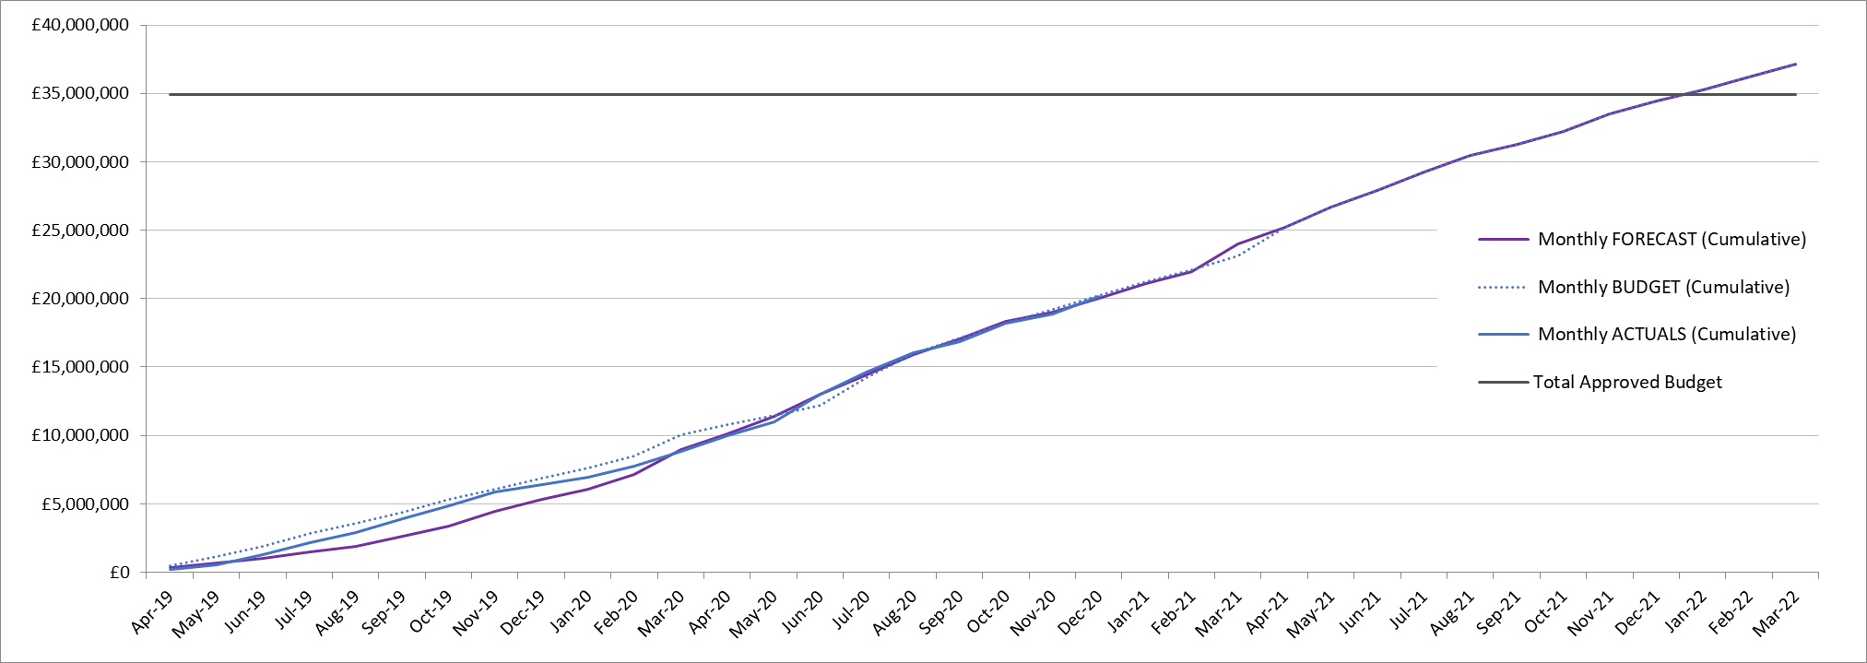
Finance Update

