Slide 1
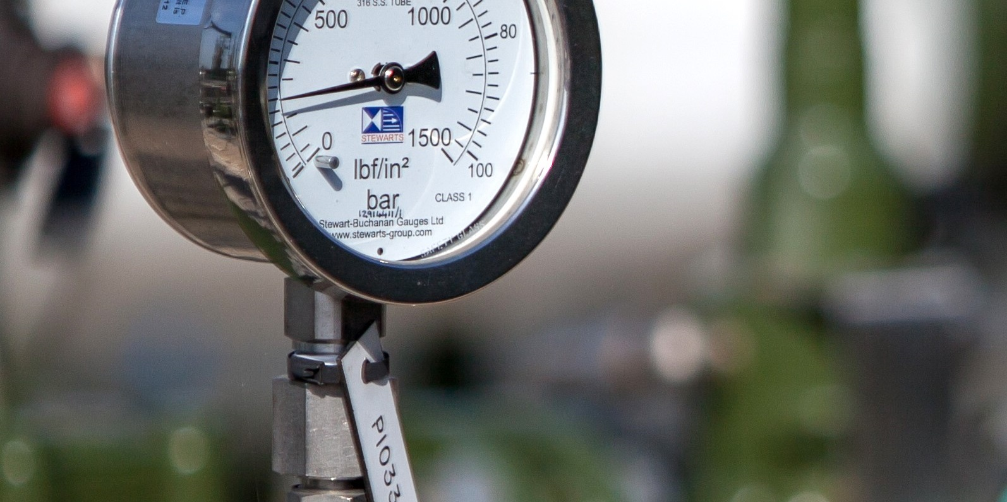


EU Update
Transmission Workgroup
4th March 2021
Phil Hobbins
Philip.Hobbins@nationalgrid.com
Notes:
2 points to mention – both follow ups to the Q4 2020 questionnaire that we issued to terminal operators

Slide 2
FUNC Issue: Harmonisation of Interfaces on EU Capacity Booking Platforms
Equinor raised this FUNC issue in 2019 Gas-Func 2.0 - View issue (gasncfunc.eu)
Seeks to replace the ‘interactive’ data exchange solution with ‘document-based’ Edigas-XML for capacity-related processes between shippers and EU capacity booking platforms
Following consultation, ENTSOG recommends that booking platform operators be obliged to offer the ‘document-based’ Edigas-XML / AS4 solution, which requires:
An amendment to the EU Interoperability Code – drafting at Annex I_Issue Solution_Interfaces of Capacity Booking Platforms (2).pdf
Amendments to the ‘Common Data Exchange Solutions Table’ on the ENTSOG website
    These amendments are now being consulted on by ENTSOG until 26th March 2021 Public Consultation – Amendment of the Common Data Exchange Solution Table Survey (surveymonkey.com)
    An explanatory video is also available at Explanatory Video on Annex II of the FUNC solution “Missing Harmonisation on Capacity Booking Platforms” on Vimeo
Notes:
An indicative central case view in a range ideally in a world where expanded Wobbe Index was available

