Slide 1
CSSC Programme Dashboard
February 2021

Slide 2
Programme Update
Programme Health – RAG |  |  | Return to Green Plan
Overall Programme Status | Previous | Current | The programme is now at Amber-Green status. All external test phases and Xoserve’s internal deliveries continue to track to plan
Programme Plan | Previous | Current
Risk Profile | Previous | Current
Resources | Previous | Current
Executive Summary |  |  |  | Upcoming Activities & Milestones (Next Month)
Key Programme Updates To date, all Xoserve key internal and external milestones have been met Programme Re-plan: Following the Ogem programme re-baseline, caveated with the actions to mitigate concerns that Xoserve raised. Main actions have been closed, hence this not be reported on, going forward. Costs: Costs continue to be monitored closely Missing design changes DCC and SI undertook a detailed review and have confirmed that all changes have either been included with physical interface design or is in-flight as a CR. This closes out our concern. External SIT: Testing is continiung to plan with regression and Witness Testing underway currently External NFR SIT: Testing continues to plan with all Peak of Peak testing concluding successfully Internal Testing: UAT Assurance is currently ongoing with minimal defects being both via UAT testing & UAT assurance carried out by our SMEs. SIT integration continues for Programme CR deliveries. Defect rate continues to be low. Transition: Internal planning activities continue alongside engagement with the SI Data Migration: DM NF continues with the Programme. There is a potential of a slight delay (at the central level), however the SI are working to try and contain the delay as much as possible in order to protect the baselined completion dates. UEPT Data has been transferred to Landmark to plan and REL extract has commenced. |  |  |  | DMT NFR: Continue test execution External SIT: Continue External SIT support External NFR: Continue test execution Internal Test: Continue SIT & UAT assurance DES:& Secondary APIs Continue development and system test activities. Transition: Continue Transition planning

Slide 3
Green Workstream Updates
RAG Previous MONTH | RAG Current MONTH | WORK STREAM | SUMMARY
 |  | DES & Secondary API | Overall green. Internal & External SIT support in progress. Resource constraints have been highlighted and mitigation actions are in progress to manage delivery timelines.
 |  | Testing | The overall status remains Green. External SIT support in progress, no Xoserve defects are open at this point. Planning underway for all upcoming test phases such as UEPT, E2E, OT
 |  | Service Management | Following discussions with Ofgem and DCC via the Switching Programme Design Forum, Xoserve will be submitting feedback regarding Service Management SLAs by 29/01. Preparations also underway to submit our response to the Service Design assurance activity in February.
 |  | Batch | The overall status is green, with testing support underway.
 |  | Gemini | The overall status is green. Planning underway to undertake a connected Gas Day testing with UK Link.
 |  | Reporting | An internal CR will be raised to incorporate the impact of one newly identified report that will need changes.
 |  | UK Link | Status continues to be Green with work underway to impact assess and deliver Switching Programme changes raised through the last few months whilst supporting test phases.

Slide 4
Green Workstream Updates
RAG Previous MONTH | RAG Current MONTH | WORK STREAM | SUMMARY
 |  | REC | REC consultation continues with Xoserve actively engaged in relevant RDUG meetings as well as reviewing REC schedules
 |  | Data Migration & Provision | DM NF continues with the Programme. There is a potential of a slight delay (at the central level), however the SI are working to try and contain the delay as much as possible in order to protect the baselined completion dates. UEPT Data has been transferred to Landmark to plan and REL extract has commenced.
 |  | Market Trials | The CR to remove Market Trials milestones from the Switching Programme Plan has been raised and is currently undergoing industry-wide impact assessments
 |  | Environments | Workstream continues to be Green with all activities continuing to track to plan.

Slide 5
Key Programme Risks (1/4)
REF | RAG | WORKSTREAM | DESCRIPTION | MITIGATING ACTIONS | LATEST UPDATE | TARGET RESOLUTION DATE
62741 |  | Programme | There is a risk that SIT NFR testing will be deemed invalid if carried out as currently planned because SIT Functional would not have reached the necessary level of code stability for Non functional testing to be carried out leading to additional costs related to resources and environments required to support further cycles of NFR testing once a stable code level has been achieved. High volumes of defects are currently being found in SIT which in turn is impacting progression and therefore delays in completing the SIT cycles required to establish a suitable level of code stability. The current timelines still plan for NFR testing to be carried out prior to the completion of sufficient functional SIT required to establish a stable code set. | Escalate to the SI via all established forums to instigate a near term plan review to ensure these phases are re-planned appropriately. | This risk is still relevant and will continue to be monitored until SIT is complete.. | 03/03/21

Slide 6
Key Programme Risks (2/4)
REF | RAG | WORKSTREAM | DESCRIPTION | MITIGATING ACTIONS | LATEST UPDATE | TARGET RESOLUTION DATE
55513 |  | Programme | There is a risk that in the Programme participants might interpret business rules differently because business rules underpinning the CSS Interfaces have not been published alongside the interface document as well as discrepancies between business rules defined within REC and captured in ABACUS. Leading to significant process mismatches at a later stage (i.e. SIT, UEPT) and potential rework and timeline slippages. | Xoserve to publish design assumptions as part of the RAID reporting to the SI to ensure visibility of Xoserve design assumptions around business rules and processes. | This is likely to become more evident as tests such as connected 'Day in Life processing of CSS' is undertaken. Leaving this risk to be monitored | 27/02/21
61894 |  | Service Management | There is a risk that the CSS proposed SLAs do not align to current service model/SLA's because DCC/Ofgem are proposing a new set of SLA's for all parties regardless of existing arrangements, leading to target operating model changes and potential contractual changes with 3rd party suppliers (considerable increase in operational cost) | Our working assumption is that existing SLAs will prevail however, there are ongoing discussions taking place with DCC to understand their expectation. REC review - no such SLA's imposed on us currently. | Update from meeting held on 17/11 • Tony advised that within the response, parties should confirm a) that the incident is in their scope b) provide acceptance of the incident c) detail high level actions taken d) change the status from New to In Progress. DCC will provide written clarification to Xoserve around what is expected within the response time. • DCC advised that they fully expected push back from all parties around the SLAs. Xoserve will provide DCC with high level risks around the proposed SLA’s whilst continuing with an internal impact assessment. We all agreed that the SLAs do not stop the processes being developed and agreed. • DCC are currently working on creating scenarios for each priority level which will be shared with parties. This will also provide clarity around some of the terminology used within the descriptions. Awaiting further info from DCC. In the meantime, we have an internal session planned to map out the types of incidents that we think we could receive and align to priority level. | 26/02/21

Slide 7
Key Programme Risks (3/4)
REF | RAG | WORKSTREAM | DESCRIPTION | MITIGATING ACTIONS | LATEST UPDATE | TARGET RESOLUTION DATE
55549 |  | Programme | There is a risk that that the approval of the CSS Physical Design does not take into consideration the complete E2E impacts of the Switching Programme because the CSS design is solely focused on the core CSS and primary interactions with CSS. Leading to an inaccurate critical path being followed for the Programme and subsequent downstream delays to the delivery timeline. | 1. Raise with Ofgem to identify owner/RACI 2. E2E CSS design needs to be in place involving all components/systems/interactions which needs to be form the architectural baseline that the Programme is governed against. | This is likely to become more evident as tests such as connected 'Day in Life processing of CSS' is undertaken. Leaving this risk to be monitored | 26/02/21
64158 |  | Programme | There is a risk that that the Operational Choreography CR that is in progress may be approved because it might be deemed necessary by the central programme leading to further plan considerations (at both the central and individual PUI's plans) and cost implications to Xoserve | This has been raised with SI/DCC & Ofgem. This is being tracked collectively via the MAD log actions. Should this CR be approved, this action will be addressed with central bodies | This CR has now been to CAT and will be with PUIs for a detailed impact assessment | 26/02/21
64171 |  | Transition and Cutover | There is a risk that the SoLR process might kick off during the transition period because of a supplier going out of business at that time leading to Landmark needing to cater to additional volumes and also the potential for additional requirements for PUIs to undertake to ensure Transition timelines are maintained | Raise the risk with Ofgem and SI to understand what non-functional considerations have been applied to enable Lankmark to manage the increased volumes Raise with the SI to include a transition test scenario if relevant to mitigate this possibility | This has been discussed at SI Transition Group on 05/01. Ofgem is aware and tracking this risk | 30/04/21
64378 |  | Data Migration | There is a risk that DM NF may not complete on time because of cycle 1 running behind schedule and Additional CR functional testing to be completed at the start of the cycle (previously unscheduled) leading to a delay in completing DM NF and possible impact to DM Live rehearsal | Discuss with SI project and programme teams | Awaiting recover plan for cycle 1 and schedule of CR testing | 26/02/21

Slide 8
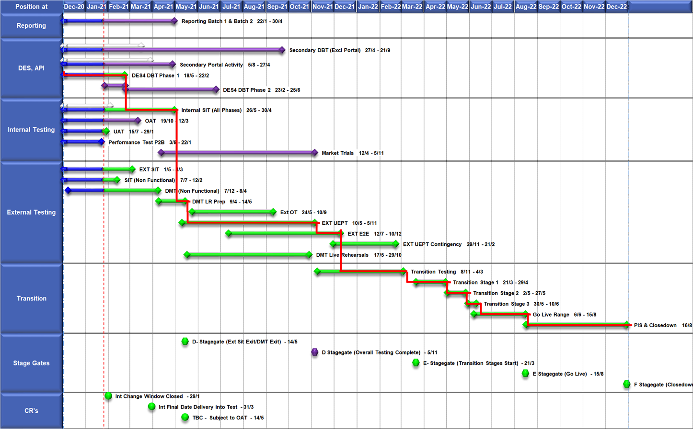
High Level Plan

Slide 9
Switching Programme CR Position – CRs impacting Xoserve
CR Name | CR Ref | High Level Cost IA Cost | Date Raised | Status
Programme Plan Re-Baseline | CR-D002 | £0.00 | 07/11/2019 | Approved - Complete
Updates to the CSS Physical Interface Design (PhID). | CR-D008 | £17,250.00 | 22/01/2020 | Approved - Internal CR Created
CSS_Exception_Handling_Strategy_v0.2 | CR-D014 | £0.00 | 26/02/2020 | Approved - Internal CR Created
Provide_CSS_RegistrationID_to_PUI_and_LPs | CR-D016 | £12,643.00 | 07/08/2020 | Approved - Internal CR Created
Licence Exempt Network Customer Identifier – ABACUS Data Model update | CR-E51 | £0.00 | 29/10/2019 | Approved - Complete
Amendments to the DMS artefact suite | CR-D019 | £6,500.00 | 16/03/2020 | Approved - Internal CR Created
Migration of Terminated Gas RMPS | CR-D022 | £0.00 | 10/06/2020 | Approved - Internal CR Created
Amendments to the NC-0079 for REL (Retail Energy Location) Data Migration and Reconciliation | CR-D024 | £20,000.00 | 06/07/2020 | Approved - Internal CR Created
DMS - PHID Alignment Parties | CR-D026 | £0.00 | 06/07/2020 | Approved - Internal CR Created
Request For a New or Upgraded DMT Environment | CR-D027 | £256,009.00 | 07/08/2020 | Approved - Internal CR Created
Enable TLS connection pooling for all directly connected parties to CSS] | CR-D028 | £2,500.00 | 13/07/2020 | Approved - Internal CR Created
Message Header Format for PKI Certificate Identification] | CR-D029 | £2,500.00 | 13/07/2020 | Approved - Internal CR Created
SIT Functional Test Re Plan Enabling Parallel Testing | CR-D030 | £56,000.00 | 20/07/2020 | Approved - Internal CR Created
DM_Validation Catalogue_Shipper_Effective_Date_Change_ | CR-D032 | £0.00 | 03/08/2020 | Approved - Internal CR Created
Compression During Data Migration | CR-D034 | £500.00 | 09/09/2020 | Approved - Internal CR Created
Uplift to the CSS Interface Specifications | CR-D038 | £70,000.00 | 07/10/2020 | Approved - Internal CR Created
Uplift to Business Data Validation Rules | CR-D039 | £20,000.00 | 25/09/2020 | Approved - Internal CR Created
Programme Plan Re-Baseline | CR-D042 | £14,913,000.00 | 28/09/2020 | Approved - Internal CR Created
MAD Log Changes for UIT Environment Verification | CR-D057 |  | 25/01/2021 | Pending PIA
Discontinuance of Xoserve Consequential Change Market Trials | CR-D058 |  | 25/01/2021 | Pending PIA
Changes to Support Energy Company Data] | CR-D059 |  | 25/01/2021 | Pending PIA
Operational Choreography Detection 0.5 | CR-D060 |  | 25/01/2021 | Pending PIA
Operational Choreography Rectification 0.3 | CR-D061 |  | 25/01/2021 | Pending PIA
Removal of Transition Stage 1 Delta files from the Data Migration Solution | CR-D062 |  | 27/01/2021 | Pending PIA

Slide 10
Switching Programme CR Position – CRs not impacting Xoserve
CR Name | CR Ref | High Level Cost IA Cost | Date Raised | Status
Non_Mandatory_MPAS_Metered_Indicator_v0.4 | CR-D001 | £0.00 | 27/01/2020 | Complete - No Xoserve Impact
REC Manager Procurement Timelines | CR-D003 | £0.00 | 02/12/2019 | Complete - No Xoserve Impact
MPAS Related MPAN Disconnection | CR-D004 | £0.00 |  | Withdrawn
Introduction of Validation Message to Logical Mode | CR-D005 | £61,000.00 | 25/11/2019 | Withdrawn
Modification of Related MPAN Cleanse Checkpoint Milestones | CR-D006 | £0.00 | 27/11/2019 | Complete - No Xoserve Impact
ABACUS Corrections and Re-alignments | CR-D007 | £0.00 | 04/12/2019 | Complete - No Xoserve Impact
ECOES REL API Webmethod | CR-D009 | £0.00 | 17/12/2019 | Complete - No Xoserve Impact
CSSIA Uplift to Implement IG Recommendations | CR-D010 | £0.00 | 17/12/2019 | Complete - No Xoserve Impact
Update 3 E2Es to align to CSSIA | CR-D011 | £0.00 | 10/06/2020 | Complete - No Xoserve Impact
CSS_Physical_Interface_Design_Updates_mpxn_v0.2 | CR-D012 | £0.00 | 30/01/2020 | Complete - No Xoserve Impact
Messaging_Requirements_Revisions_REC_Code_Manager_and_CSS_v0.1 Clean | CR-D013 | £0.00 | 28/01/2020 | Complete - No Xoserve Impact
Amendment_of_Xoserve_Consequential_Change_Milestone_Delivery_Dates_v0.2[DRAFT] | CR-D015 | £0.00 | 26/02/2020 | Withdrawn
CSS_Handling_of_MPAS_Business_Dates_v0.2[DRAFT] | CR-D017 | £3,500.00 | 20/07/2020 | Complete - No Xoserve Impact
Confirmation_Responses_to_Outbound_Synchronisations_v0.2[DRAFT] | CR-D018 | £0.00 | 02/03/2020 | Withdrawn
Regulatory Workstream – Programme Milestones Refresh | CR-D020 | £0.00 | 16/03/2020 | Withdrawn
Remove MPAS Interface | CR-D021 | £0.00 | 29/04/2020 | Withdrawn
DSP_Specific_ SIT_ Functional_Exit_Criteria | CR-D023 | £0.00 | 29/05/2020 | Complete - No Xoserve Impact
Changes to support enhanced Solar arrangements | CR-D025 | £0.00 |  | Not Received
CSS Role-based access control (RBAC) | CR-D031 | £48,530.00 | 24/07/2020 | Withdrawn
A Quality Analysis Activity of the Data being used for the DMT Non-Functional Test Phase​​ | CR-D033 | £0.00 |  | Withdrawn
CSS Change from UTC to Local Time | CR-D035 | £0.00 | 22/09/2020 | Complete - No Xoserve Impact
Xoserve CR for DES AI Removal | CR-D036 | £0.00 | 24/09/2020 | Complete - No Xoserve Impact
Provide_CSS_RegistrationID_to_LPs | CR-D037 | £0.00 | 06/10/2020 | Complete - No Xoserve Impact
UEPT Tranche Regulatory Change | CR-D040 | £0.00 | N/A | Complete - No Xoserve Impact
NCT-0073 Functional Script Master Changes | CR-D041 | £0.00 | 25/09/2020 | Complete - No Xoserve Impact
Update to the End to End Testing Plan | CR-D043 | £0.00 | 05/10/2020 | Complete - No Xoserve Impact
Request For a New DMT Environment for DMT Live Rehearsal | CR-D044 | £0.00 | 23/10/2020 | Complete - No Xoserve Impact
NC-0079 Adding Post Load Integrity Check Document | CR-D045 | £0.00 | 09/11/2020 | Complete - No Xoserve Impact
Uplift to the Code of Connection | CR-0046 | £0.00 | 09/11/2020 | Complete - No Xoserve Impact
Correctional Changes to MAD Log v2.0 & POAP v2.0 | CR-D047 | £0.00 | 13/11/2020 | Complete - No Xoserve Impact
Changes to Data Milestones in MAD Log v2.0 & POAP v2.0 | CR-D048 | £0.00 | 09/11/2020 | Complete - No Xoserve Impact
Consequential Changes to Testing Milestones in MAD Log | CR-D049 | £0.00 | 13/11/2020 | Withdrawn
CSS Environments for Faster Switching Enduring Service | CR-D050 | £0.00 |  | Withdrawn
Changes to Data Validation Rules | CR-D051 | £0.00 | 30/11/2020 | Complete - No Xoserve Impact
Additional and Further Correctional Changes to MAD Log v2.0 | CR-D052 | £0.00 | 05/12/2020 | Complete - No Xoserve Impact
Additional Onward Dependencies for MAD Log | CR-D053 | £0.00 | 18/12/2020 | Complete - No Xoserve Impact
Changing from GetOrganised to Landmark SFTP for SI receiving files | CR-D054 | £0.00 | 18/12/2020 | Complete - No Xoserve Impact
Amendments to the Data Cleansing Catalogue | CR-D055 | £0.00 | 18/12/2020 | Complete - No Xoserve Impact

