Slide 1
Customer Relationship Management KVI Relationship Survey Q3 Results
CoMC Update January 2021
Alison Jennings

Slide 2
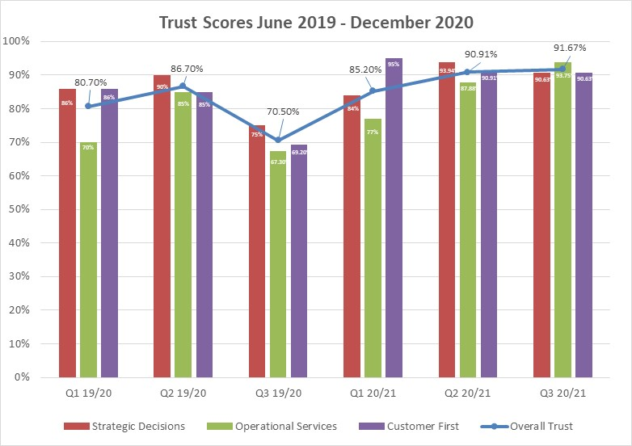
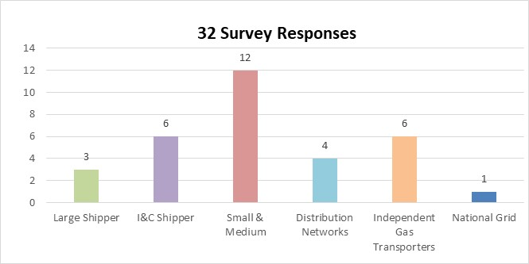
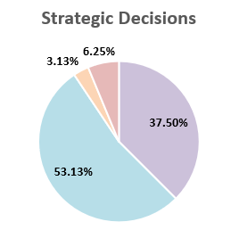
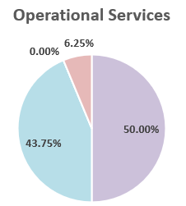
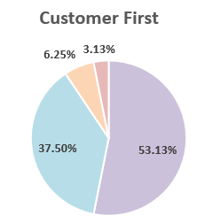
KVI Relationship Management - December 2020
Relationship Management Trust
91.67%
Up from:
90.91% Sep 20
70.50% Dec 19
Response Volumes June 2019 - December 2020
Q1 19/20 | Q2 19/20 | Q3 19/20 | Q1 20/21 | Q2 20/21 | Q3 20/21
33 | 20 | 52 | 61 | 33 | 32
Observations:
All 3 Trust categories are performing above 90% for the first time
Operational Services is performing at the highest level since we started measuring Trust
Customer verbatim themes:
Xoserve's positive Customer Centric approach
Optimism towards Project Mercury
Positive relationships and support from Xoserve colleagues
Positive query management experience since the launch of new platform
Opportunities to improve ticket resolution RFT
Process guidance and information needs to be more accessible
90.63%
93.75%
90.63%
Previously scored:
93.94% Sep 20
75.00% Dec 19
Previously scored:
87.88% Sep 20
67.30% Dec 19
Previously scored:
90.91% Sep 20
69.20% Dec 19

Slide 3
Segment Trust Scores
Segment | Survey Month | Overall Trust | Strategic Decisions | Operational Services | Customer First | Response Vol
All Segments | Dec-20 | 91.67% | 90.63% | 93.75% | 90.63% | 32
 | Sep-20 | 90.91% | 93.94% | 87.88% | 90.91% | 33
 | Dec-19 | 70.50% | 75.00% | 67.30% | 69.20% | 52
Large Shippers | Dec-20 | 88.89% | 100.00% | 100.00% | 66.67% | 3
 | Sep-20 | 100.00% | 100.00% | 100.00% | 100.00% | 3
 | Dec-19 | 88.10% | 92.90% | 78.60% | 92.19% | 14
I&C Shippers | Dec-20 | 100.00% | 100.00% | 100.00% | 100.00% | 6
 | Sep-20 | 91.67% | 100.00% | 87.50% | 87.50% | 8
 | Dec-19 | 86.10% | 91.60% | 83.40% | 83.30% | 12
Small & Medium Shippers | Dec-20 | 100.00% | 100.00% | 100.00% | 100.00% | 12
 | Sep-20 | 94.87% | 100.00% | 92.31% | 92.31% | 13
 | Dec-19 | 90.90% | 90.90% | 91.00% | 91.00% | 11
DN’s | Dec-20 | 66.67% | 50.00% | 75.00% | 75.00% | 4
 | Sep-20 | 58.33% | 50.00% | 50.00% | 75.00% | 4
 | Dec-19 | 12.50% | 25.00% | 0.00% | 12.50% | 8
IGT’s | Dec-20 | 83.33% | 83.33% | 83.33% | 83.33% | 6
 | Sep-20 | 100.00% | 100.00% | 100.00% | 100.00% | 5
 | Dec-19 | 53.00% | 60.00% | 60.00% | 40.00% | 5
NGT | Dec-20 | 100.00% | 100.00% | 100.00% | 100.00% | 1
 | Sep-20 | - | - | - | - | 0
 | Dec-19 | 16.70% | 0.00% | 50.00% | 0.00% | 2

