Slide 1
Xoserve’s
Customer Experience (CX) Transformation
Dec’20 CoMC Update

Slide 2
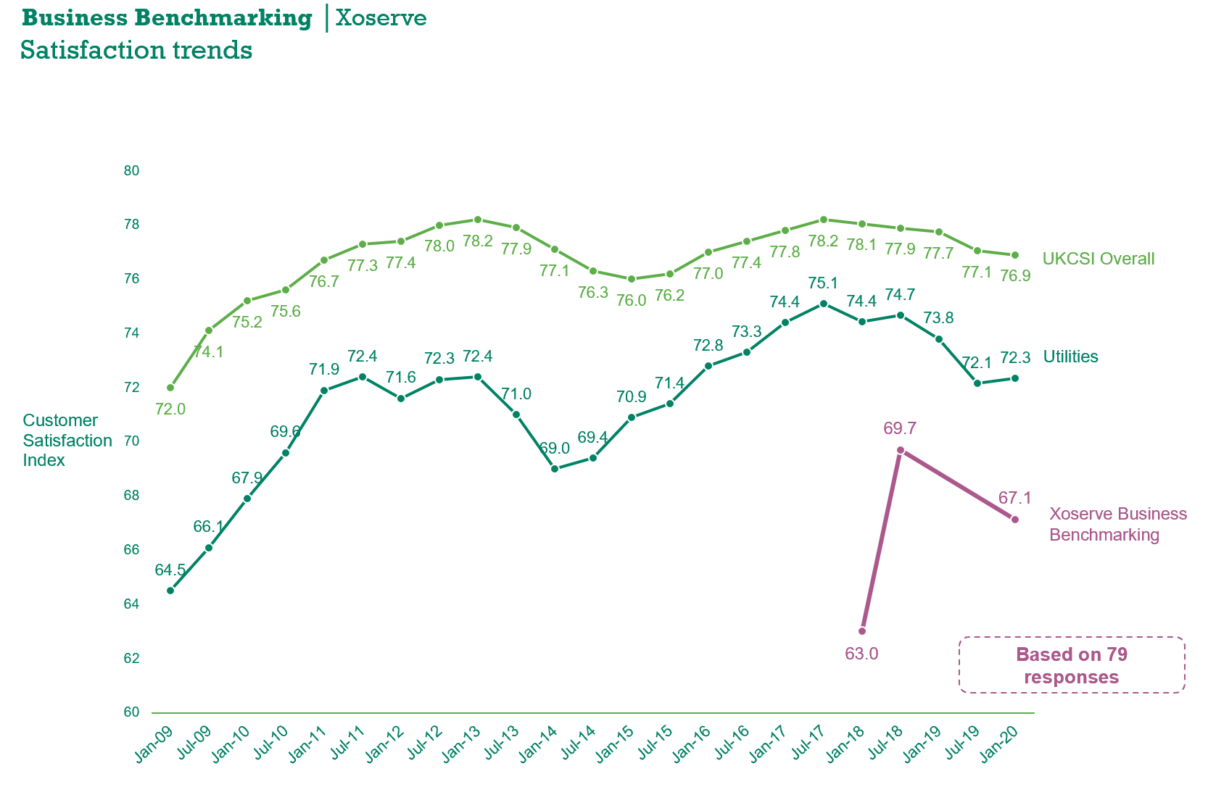
Customer Experience Transformation: Summary
Customer Centricity is at the very heart of our strategy. Our organisational goal is to ensure year-on-year improvements to our Institute of Customer Service (ICS) Customer Satisfaction (CSAT) scores.
Following last year’s disappointing CSAT scores, Andy Szabo, our newly appointed Chief Customer Officer, mobilised a programme of work entitled our Customer Experience (CX) Transformation Programme as a way to centrally manage and control all in-flight customer service improvement initiatives.
Utilising the customer experience investment funding approved within BP20, this internal programme will aim demonstrate customer value through significant improvements in Right First Time (RFT), On-time Delivery (OTD) and Customer Effort (CE) metrics across all customer touchpoints.

Slide 3
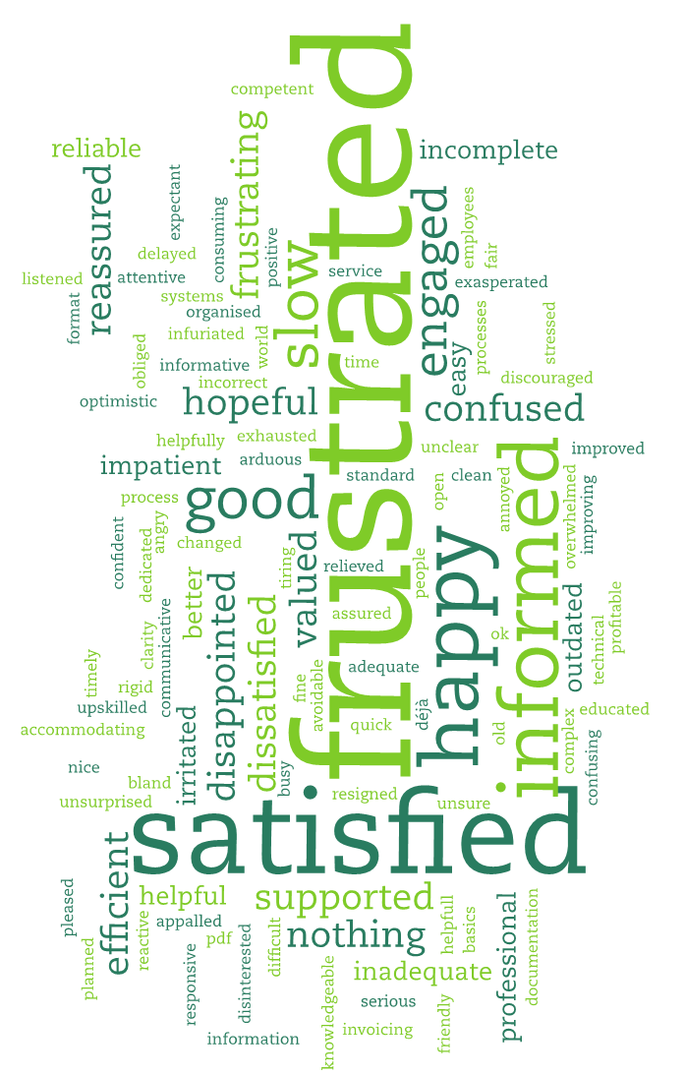
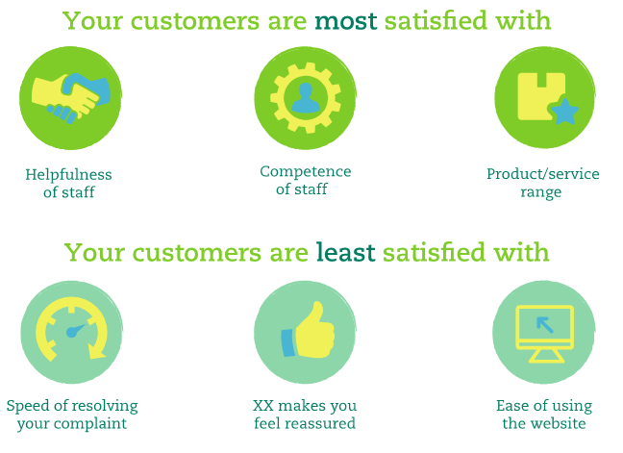
Customer Experience: What our customers are telling us?
Our 2019/20 Institute of Customer Satisfaction CSAT annual survey results provided a clear indication that the levels of customer service, across all areas of the business, provisioned to our customer base are far from the standards that are expected.
In direct response to this, and utilising investments signed-off within Business Plan 2020, we’ve initiated a 3-year programme of work to transform how our customers interact and conduct business with us, targeting an end-state whereby all customers are consistently delighted by the service experience provisioned.

Slide 4
Customer Experience: What’s our vision?
Minimise the number of queries and complaints
We will provide our customers with as much data, information and insight as necessary, to allow them to run their businesses without having to interact with us as much as they do today on queries, issues and/or complaints.
Grow customer self-service capability
We will provision self-service capability via our digital channels to permit customers to obtain data, information and insight without the need to interact with an Xoserve operative.
Automate clunky and time consuming operational processes
We will automate as much of our work as possible, whilst also reducing as much waste and effort that our customers have to expend when conducting business with us via the operational processes for which Xoserve, as the industry appointed CDSP, are accountable for.
Provide our workforce with the tools and skills to provision a world class customer experience
Where a customer contact is needed, they are met with friendly, empowered people who are eager to build great customer relationships, predicting and solving problems quickly in a consistent manner and have a deep understanding of our customers’ needs.

Slide 5
Customer Experience: We’re on a journey…..
Website navigation improvements
Better training and educational content
Single sign-on capability
One stop shop for Xoserve products / services
Self-serve of data services via Xoserve.com
Customer Experience measure
Customer Training developed and enhanced
“Contact Us” form enhancements
Digital / Xoserve.com investment
Digital / Xoserve.com investment
Individual Query / Incident updates accessible via Xoserve.com
Fewer customer username / password resets
Greater access for customers to Xoserve SMEs
Desired Customer Outcomes on the 2022/23/24 horizon
Key Performance Measures developed
Customer Journeys identified to drive customer focused improvement
and measures
Continuous Improvement Capability
CRM Platform
Enhancement
Join / Leave customer journey optimisation
Change
customer journey optimisation
Earlier proactive identification of customer painpoints
Move our customers as much as possible from a position of self-service to total eradication of the need to interact with Xoserve
Target future product and service development to support individual customers and the wider UK energy industry to drive industry improvements using insights from across the UK Link platforms
Automate internal Xoserve processes to support ‘cost to serve’ reductions to our customers.
Intelligent virtual assistance via Xoserve.com to enhance 24/7customer support.
Service Management Toolset Replacement
Greater personalisation of services for individual customers
Targeted Customer Communications
More meaningful and frequent updates for queries, issues, and incidents
CRM Proof of Value undertaken, driving the first phases of implementation
Continuous Improvement Capability
Reduction in manual effort and errors associated
with customer reporting
dispatch
CRM Platform
Roll-Out
Enhanced distribution list management
Improved sentiment analysis tools
Better understanding of individual customer needs
Automation Platform Enhancement
New Customer Complaints procedure
High quality and consistent level of service across the Xoserve product range.
Automation Platform Roll-Out
Customer visibility of all CMS contact types along their lifecycle
New website delivered
CMS Replacement project mobilised
CMS Re-build
Automation of manual validation effort associated with CAP, COM and Ad-Hoc invoices
Customer engagement to develop new CMS requirements
New CMS process and platform stability
Completed
Work in progress (BP20)
Planned (BP21)

Slide 6
Customer Experience: Key Components
Delivering upon all of our DSC CDSP obligations across all of our operational teams.
Every process should meet availability targets and meet DSC SLA’s and we should deliver this without creating technical debt.
All process owners will be leaning their processes, removing unnecessary steps and workarounds, removing errors, ensuring security and reducing customer effort.
We measure every customer interaction end 2 end, so that we can easily see where problems occur, spot patterns early and deploy corrective action early.
CX Transformation Programme
Operational Processes
Digital / Xoserve.com
CRM & Automation Platform
CMS Rebuild
Customer Training & Education
Service Management Improvements
Working with customers via the existing DSC Change Delivery governance routes to capture all customer pain points with today’s CMS system and the processes it supports.
Aim to agree CMS Rebuild high-level delivery scope and solution options with customers by spring 2021 .
Our customers will engage with us through a well designed, secure and engaging experience, which is consistent i.e. all web traffic through Xoserve.com, all call traffic through the same number, all customer contact tracked through the same system etc.
Increased levels of self-serve, by bringing together information such as product access, support tickets and data provision will make it easier for customers to do business with us.
CRM platform rolled-out across Xoserve to provision our workforce with a toolset that allows for the 360 degree view of all customers, to aid our understanding of what matters most to each individual customer so that products and services can be tailored accordingly.
Make it significantly easier for our customers and their operational teams to conduct business with us.
The knowledge and expertise of our people is our most valuable asset, a theme that has been continually recognised by our customers in the last 3-years’ worth of ICS surveys. Given the finite number of SMEs in Xoserve, we aim to provision as much relevant and quality training material online to allow our customers to self-serve and tap into the Xoserve knowledge hub without having to contact our workforce in the first instance.
Every system should meet availability targets, be stable with minimal defects and importantly be secure, supporting all processes in their customer agreed performance targets.
Customers will feel a marked improvement in customer experience levels whenever they need to reach out to Xoserve for a technical issue or request.

Slide 7
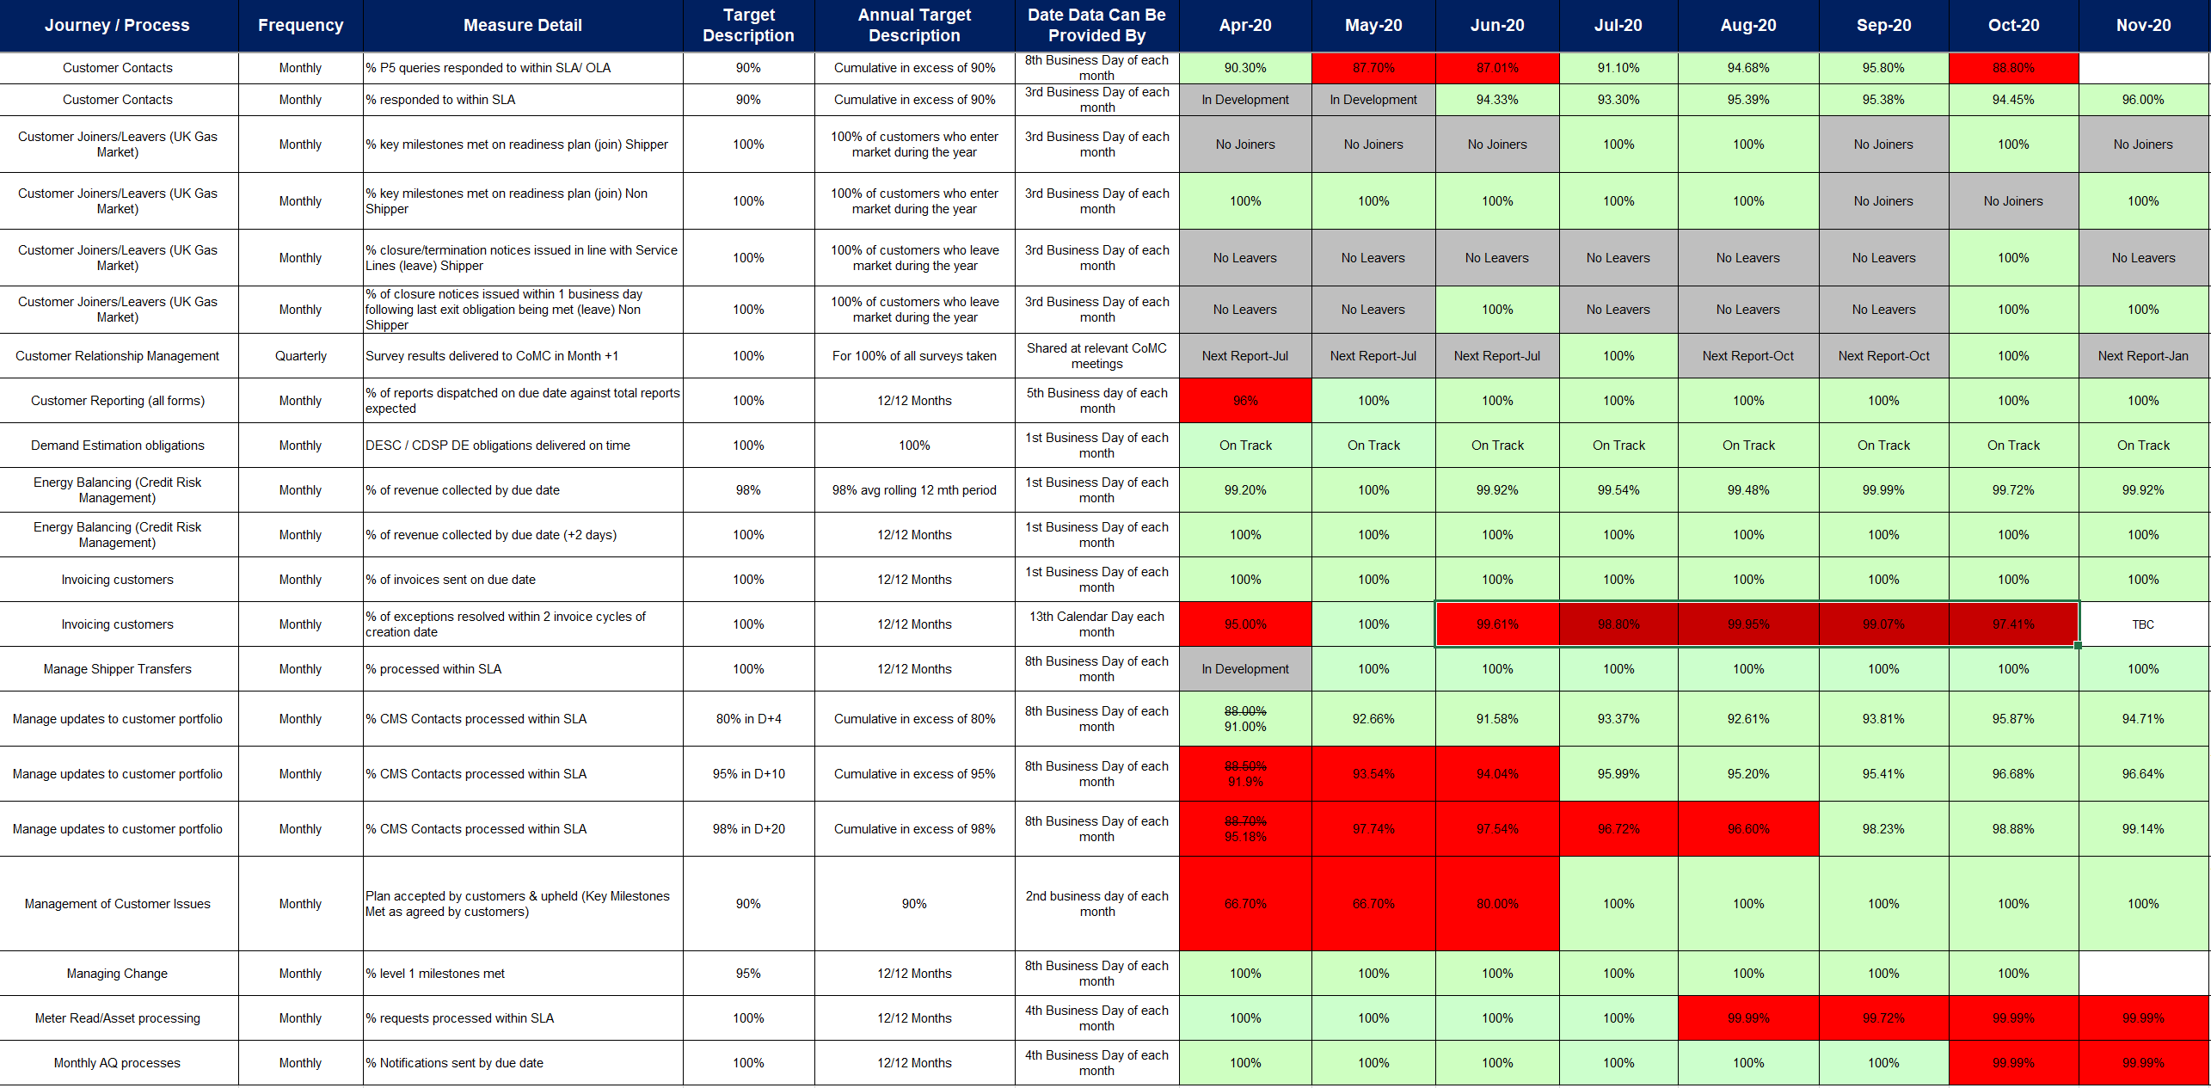
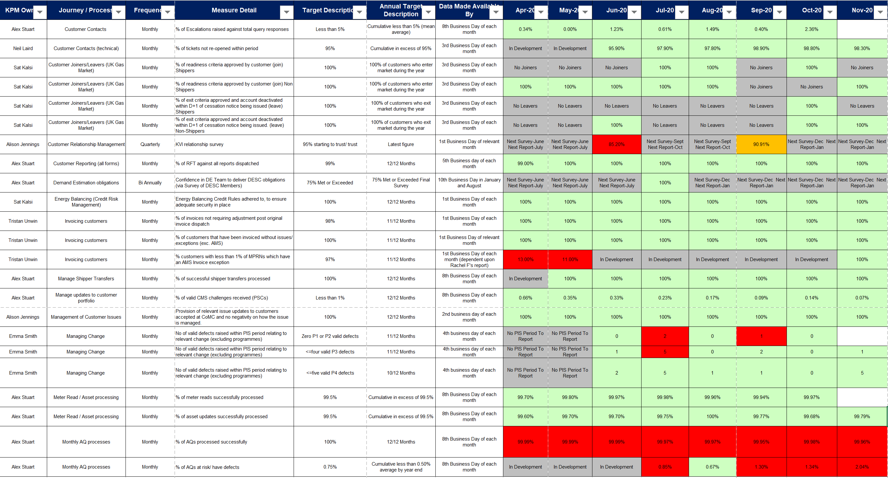
Customer Experience: Operational Processes
Operational Processes
As part of the CX programme, our internal Business Optimisation Team have helped us to mobilise a monthly ‘Optimisation Performance Management’ session for all KPM and Business Process Owners to come together to review current operational performance as well as acting a forum to discuss improvement opportunities.
Key Performance Measures (KPMs)
Switching
c.5.5million shipper switches successfully facilitated through UK Link, all within DSC SLA obligations.
Invoicing
44 RFT and Cycle Time KPM metrics agreed with customers and reported monthly to CoMC to provide visibility of holistic Xoserve operational performance.
100% of all scheduled invoices issued on behalf of the DNs & National Grid issued on schedule date.
Month-on-month improvement witnessed in cumulative KPM cycle time metric. Cumulative year to date RFT metric stable at c.85%.
£4.9bn worth of invoices issued to our Shipper customers on behalf of the DNs and NG.
Delivery of merged ASP file (incorporating ASP online file + mismatch file) and AML file to ensure all customers received their full supporting information on the day of the Amendment invoice being issued. This provided our customers with confidence the invoice was correct and enough time to fully validate their invoice ahead of the payment due date.
Current focus remains that of gaining UK Link stability in the AQ arena via the efforts of our dedicated AQ Task Force, as well as building on our operational exception reporting to gain earlier visibility of Meter Read and AQ related system exceptions.

Slide 8
Customer Experience: Operational Processes
Operational Processes
Other Operational Achievements
In 2020 thus far UK Link has successfully processed c.1.2billion meter reads within our DSC SLA obligations.
Xoserve Customer Operations Call Centre has consistently met its telephone line DSC Grade of Service obligations every month this year in answering 90% of all inbound calls within 30-seconds.
In response to customer feedback that Join journey agreements were taking too long to process we have agreed a 2-week processing SLA with Transporters. Since being agreed, 100% of all join requests are being processed within this SLA.
Continuous improvement techniques applied across the CCO department to ensure that 100% of scheduled operational reports issued to customers on-time year-to-date.
Successful completion of the 5-yearly Seasonal Normal Review process which saw AQ’s updated within UK Link for all c.25m MPRNs.
Our Advocates and CDS teams facilitated the closure of c100k Must Read requests [which had since had valid meter reads accepted into UK Link] with permission from DNs/IGTs that led to a c.£5.2m cost avoidance for the shipper community and saved DN/IGT customers c.7000 man-days in unnecessary workload*
Xoserve’s Demand Estimation team’s work with DESC to revise the CWV formula has resulted in improvements in the EUC demand models which means more accurate NDM Allocation and less reconciliation. Initial analysis from our DE team also suggests a downstream benefit of c. 20-30% reduction in UIG as a result (based on a simulation for Gas Year 2019/20).
* based upon assumption of £50.00 charge per MUR request and 15 reads being able to be taken per manday.

Slide 9
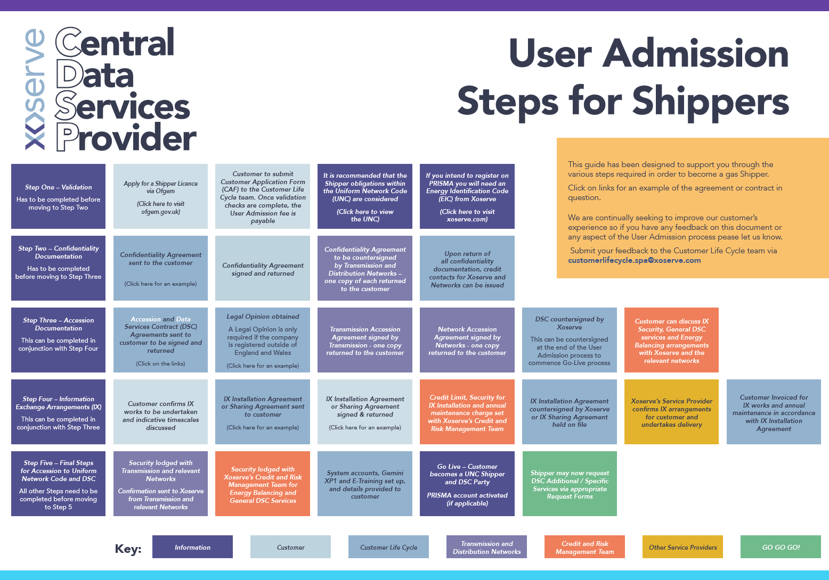
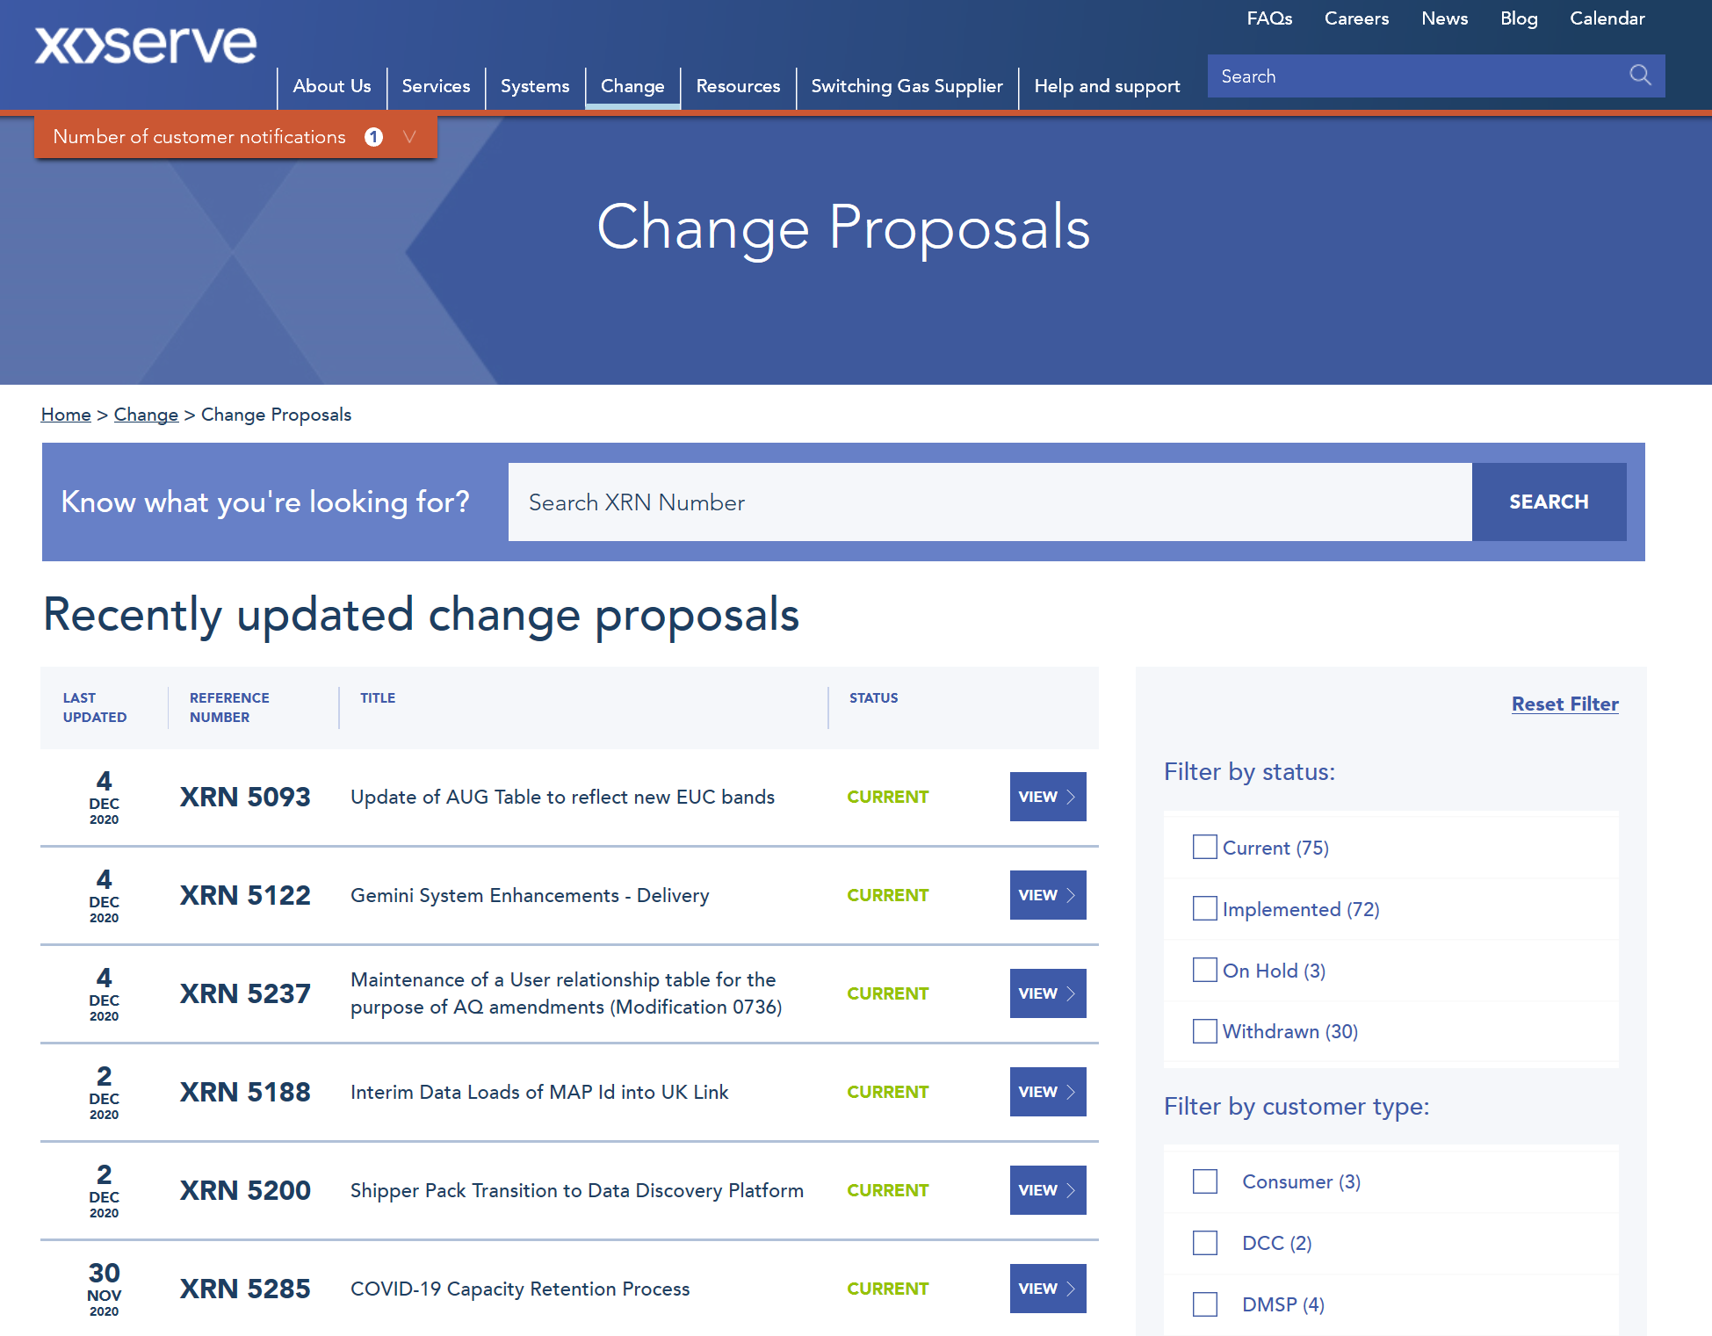
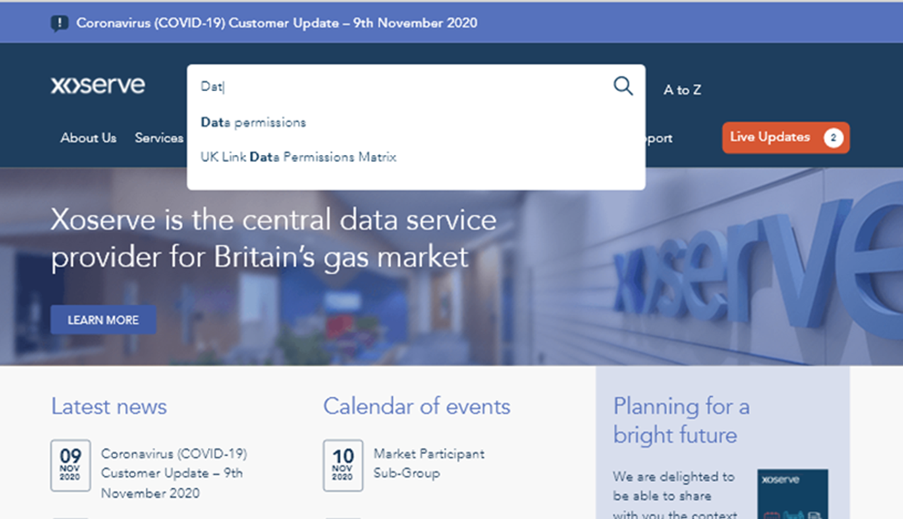
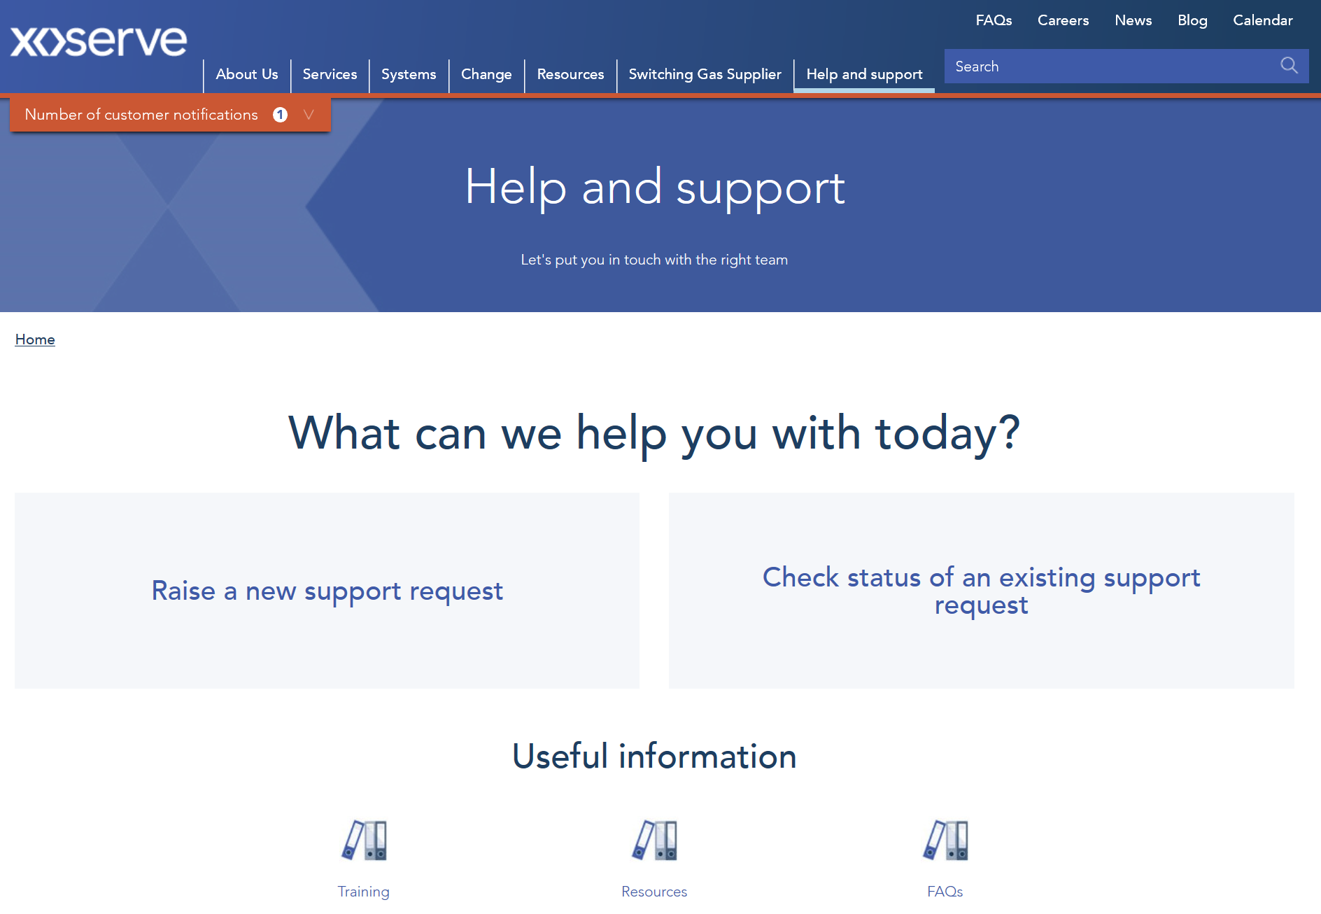
Customer Experience: Digital / Xoserve.com
Digital / Xoserve.com
Xoserve.com improvements
Agreement with Transporters to accept electronic Join Journey agreements to increase efficiency, reduce postal costs and to work within COVID restrictions.
Updates to the change area of Xoserve.com, with the flow and content changed in collaboration with customers
New Market Entry overview video developed and live on website to accompany newly published Join Journey training and educational material.
Enhancements to the Xoserve.com ‘Help and Support’ feature to allow customers to (1) easily raise queries or technical support requests into Xoserve and (2) check the status of existing query/technical support tickets.
Dedicated project team mobilised to introduce Homepage and Navigation improvements to Xoserve.com over the next 3-months.

Slide 10
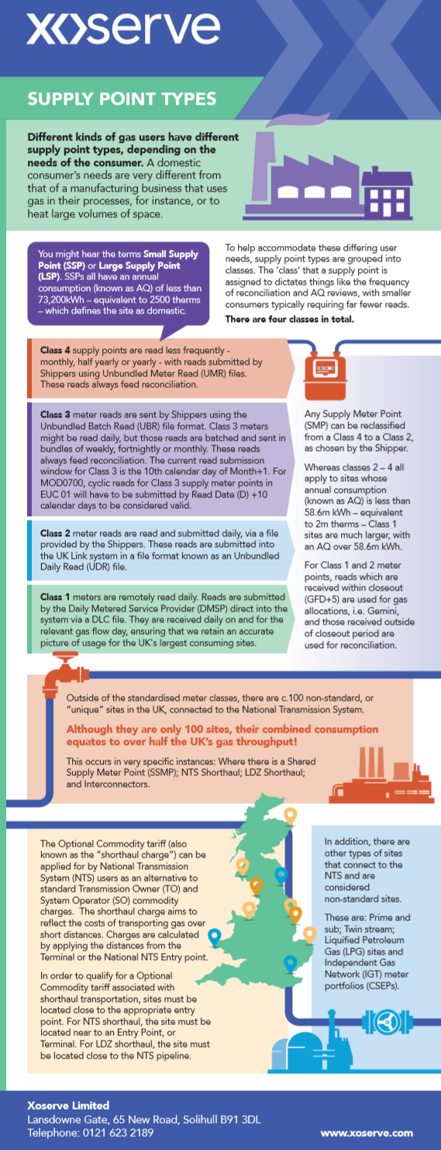
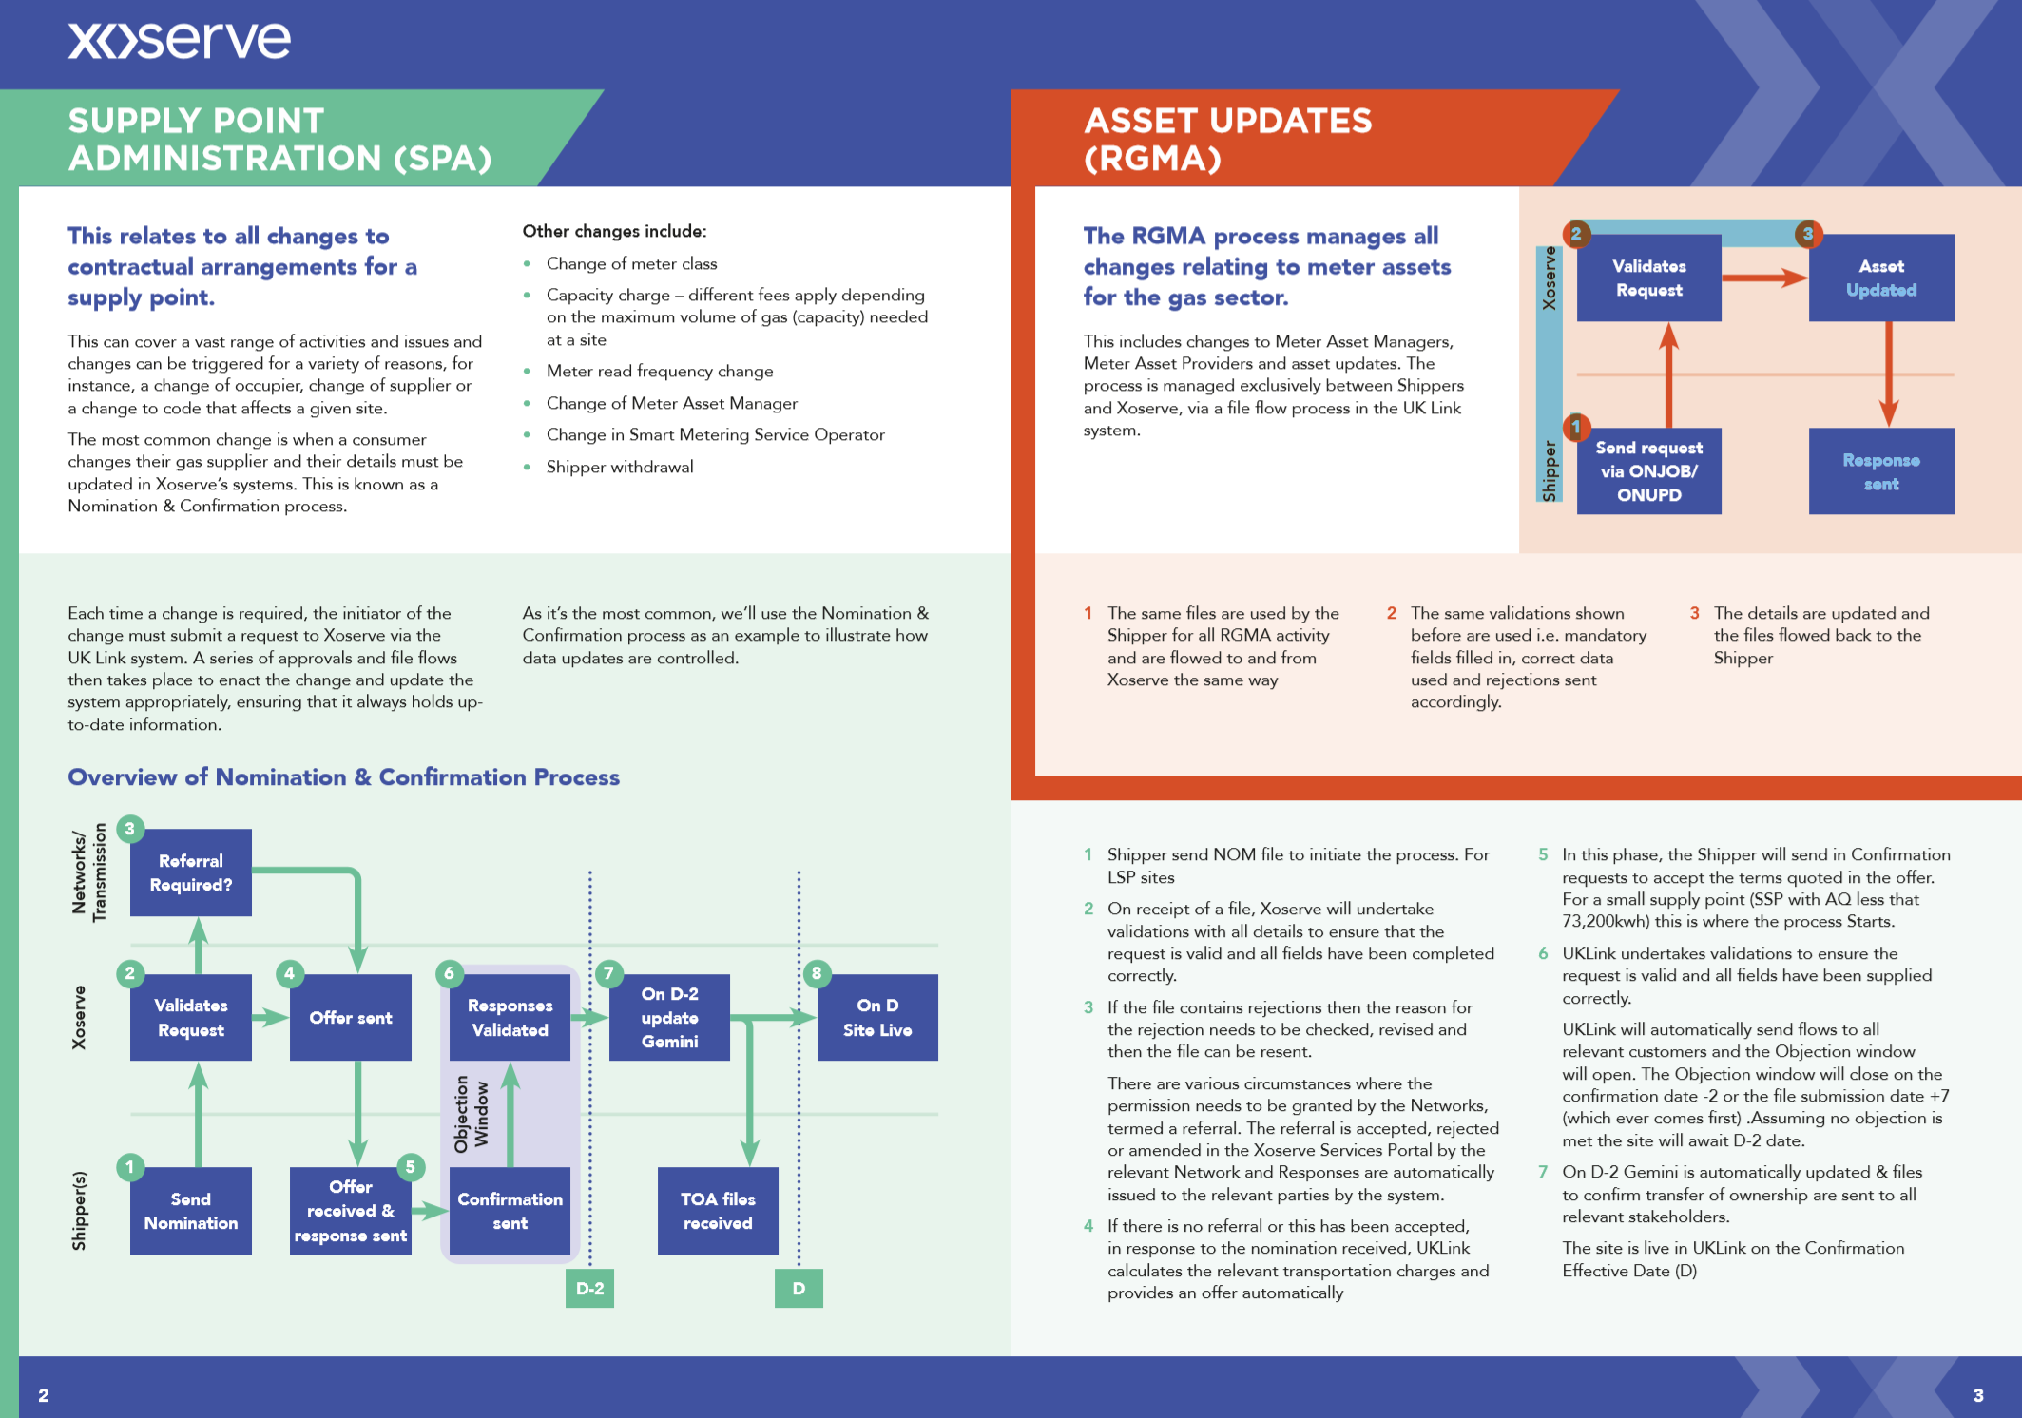
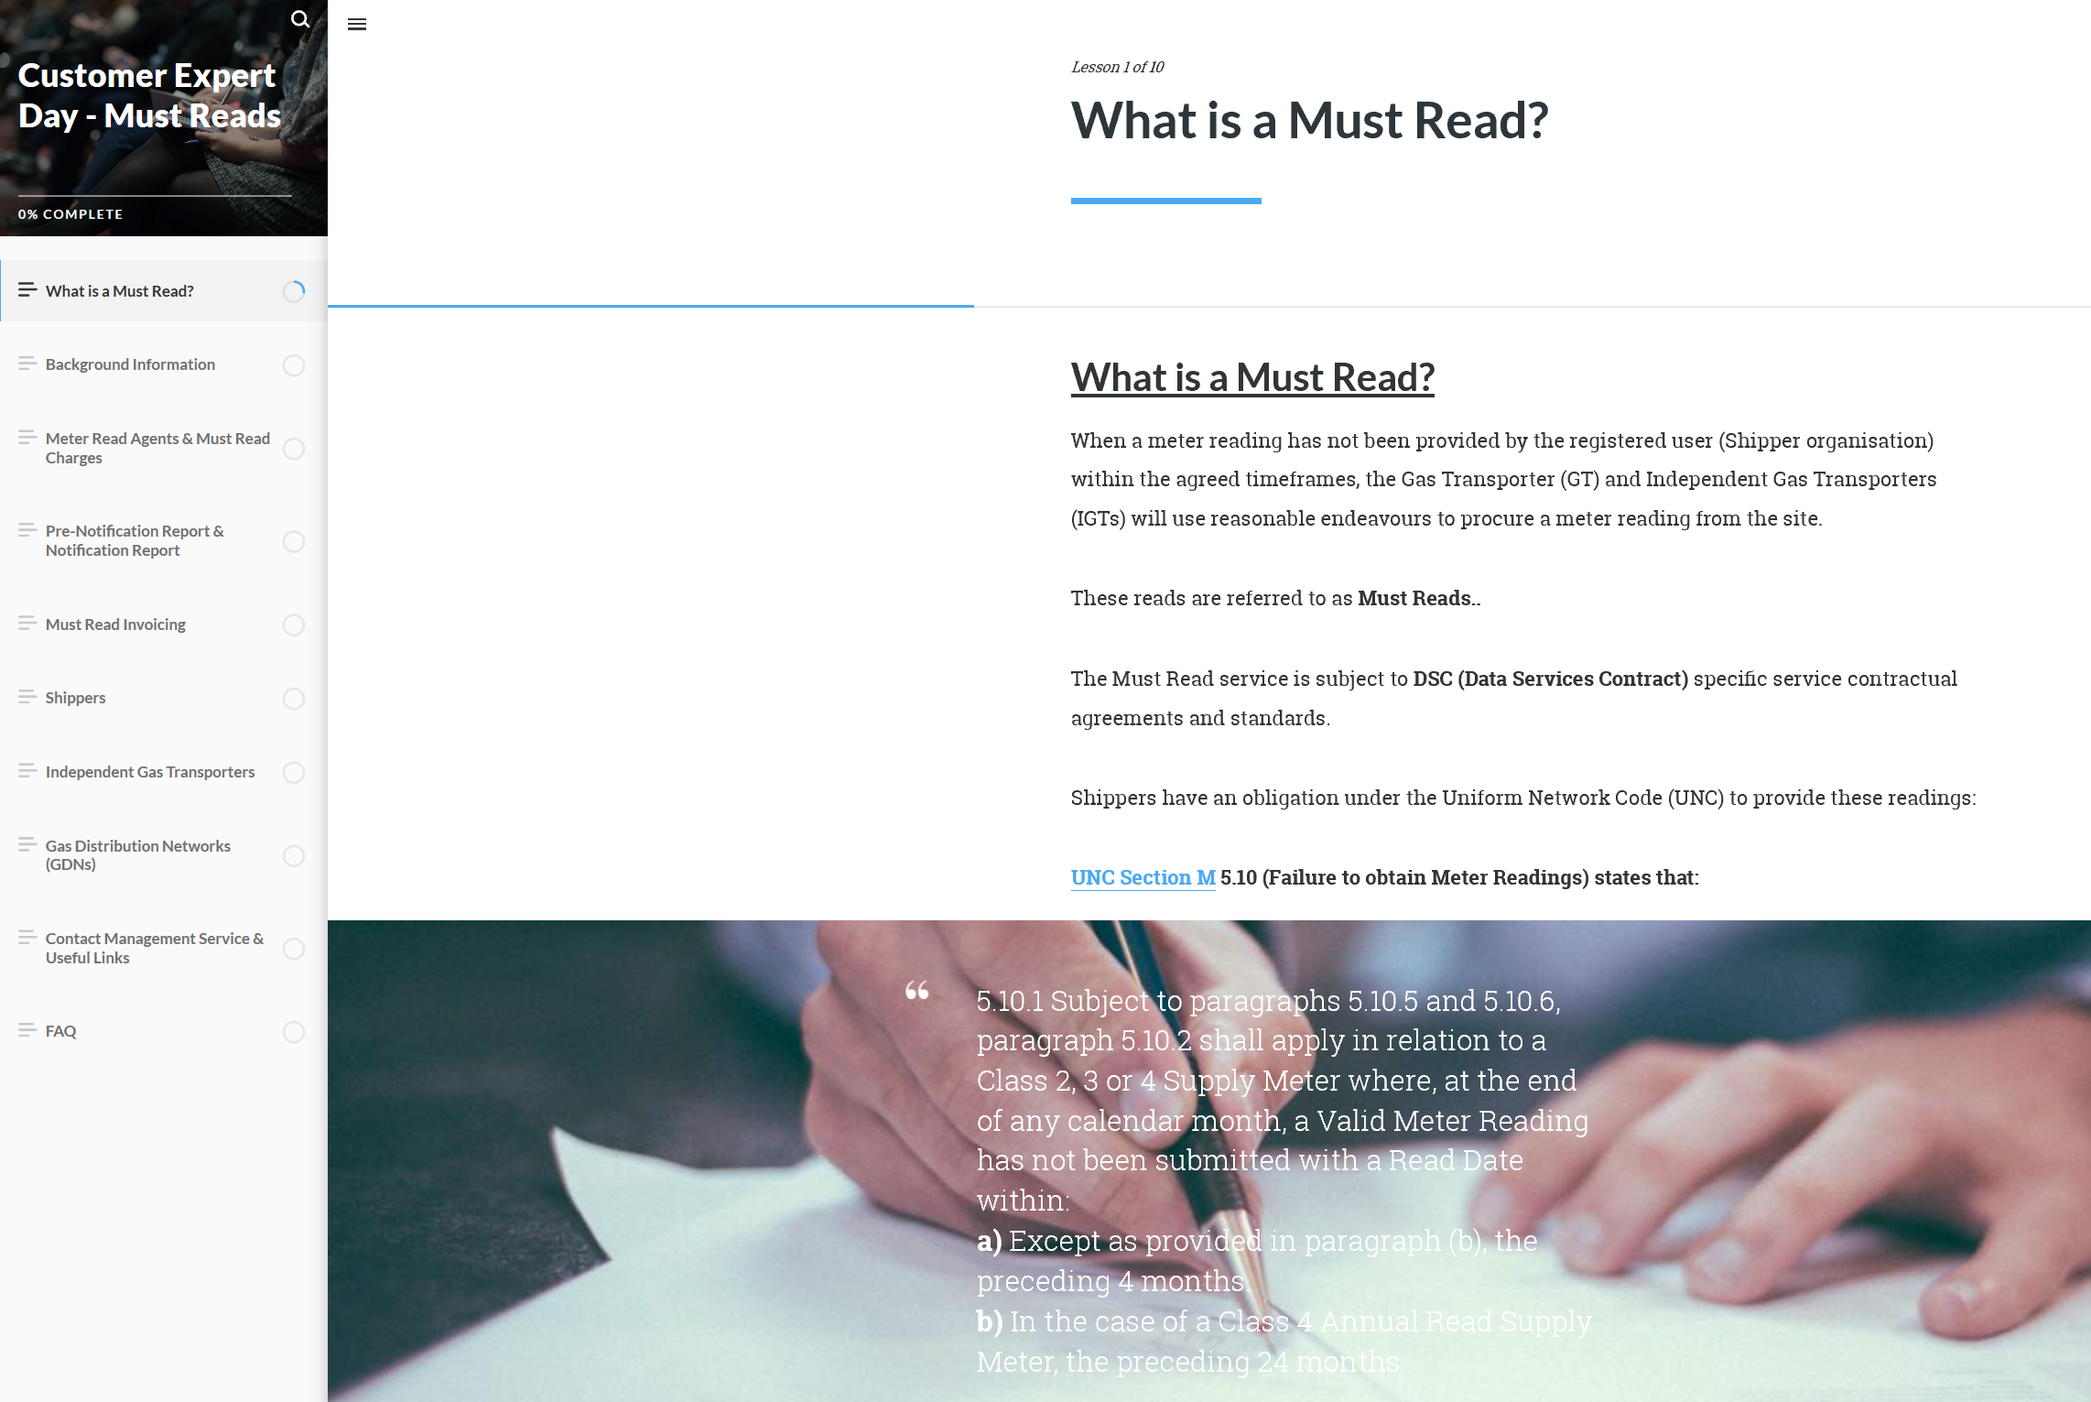
Customer Experience: Customer Training & Education
Customer Training & Education
Training & Education Iniatitives
In 2020 YTD, our customer training team have coordinated 22 training events attended by 762 customers, covering a variety of topics including:
Expert Days
Induction Days
Non-Standard Sites Training
Invoicing Discovery Events
UK Link Release Training Events
Urgent COVID UNC Modification Training Sessions
11 E-Learning modules have been developed and made available on Xoserve.com for customers to access self-serve training, covering topics including:
AQ
Classes
Change Training June 2020 and Nov 2020
COVID UNC Modifications
Gas Traders Information
IX
Invoicing for IGTs
Must Reads
SPA
Termination
We have also created 6 easy to understand videos accessible via Xoserve.com to support customers in understanding Xoserve’s key processes which have had over 1600 views collectively

Slide 11
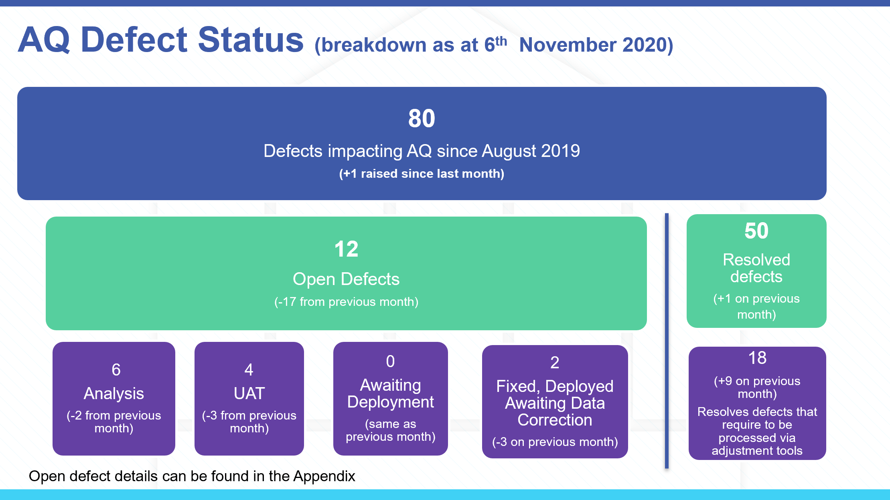
Customer Experience: Service Management Improvements
Service Mgt Improvements
Tech Ops / Service Mgt Improvement Iniatitives
Monthly Xoserve TechOps System Incident update to customers provided at CoMC.
Successful implementation of our new Service Management platform ServiceNow, replacing our legacy ServiceDesk+ application.
c.13,000 customer raised technical support requests, incidents and service/access requests YTD.
Outstanding technical/incident ticket backlog reduced by 55% from January 2020.
Average handling time to resolve a technical customer query reduced by 60% (10 days to 4 days) and on a continuing improvement trend.
Resolved 98%+ of technical customer queries right first time without requiring any further intervention.

Slide 12
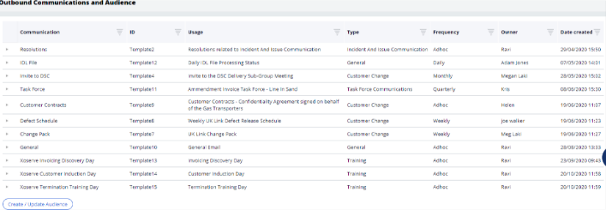
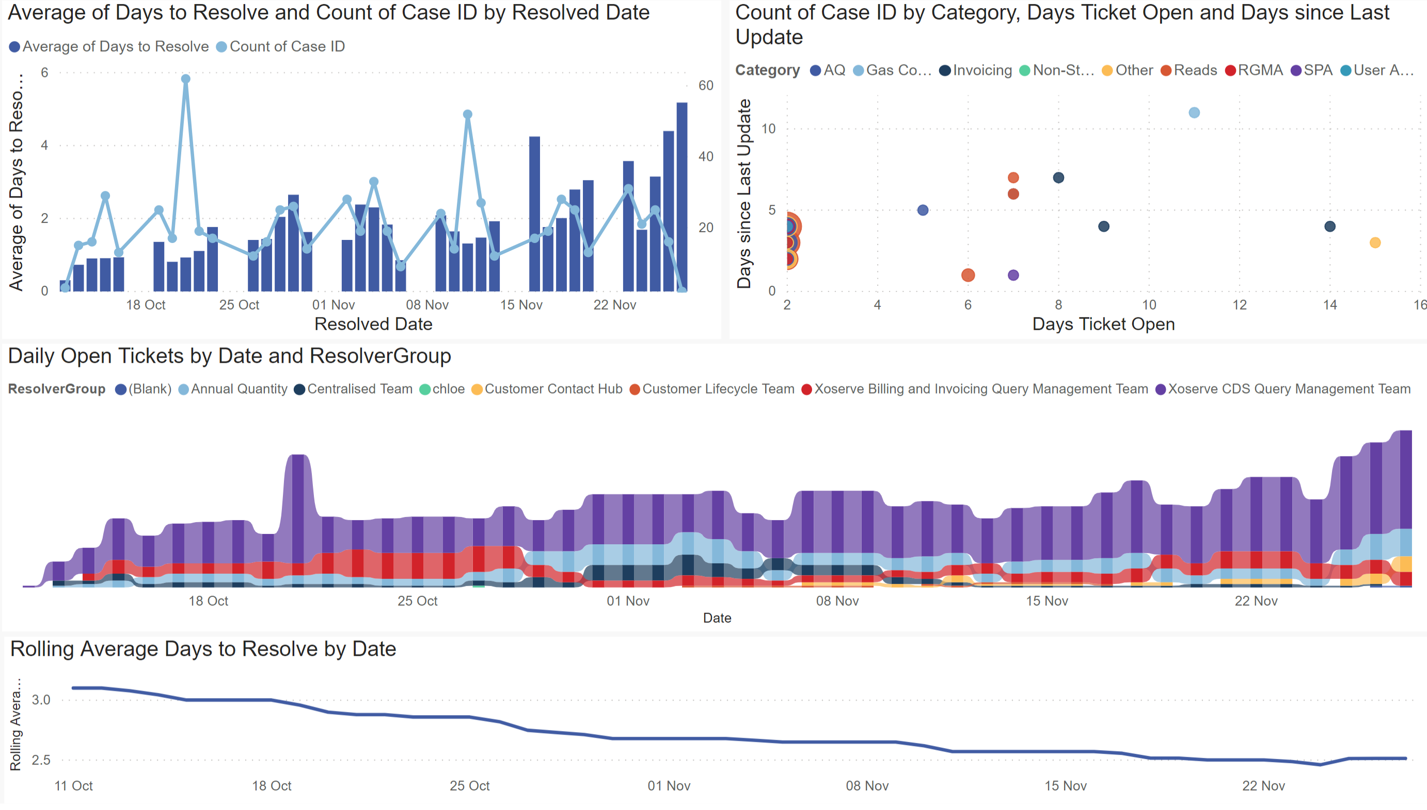
Customer Experience: CRM & Automation Platform
CRM & Automation Platform
CRM and Automation Implementation Update
PEGA CRM and Automation platform launched and in-use across the Xoserve CCO department to:
Capture over 400 customer interaction types
Produce customer ‘Day After Reports’ to share internally and externally with customers
Track our Customer meetings to provide full visibility of where essential updates can be provided
Issue customer communications with real time distribution list updates (21x centralised customer distribution lists currently in-use)
Track real-time customer sentiment
Customer Query Management functionality successfully implemented into PEGA CRM.
50% reduction in customer query resolution times since the start of the year.
90-95% RFT success rates for customer queries, for which on average c.800 queries are received into our operational teams each month from Shippers/DNs/iGTs/NTS.

Slide 13
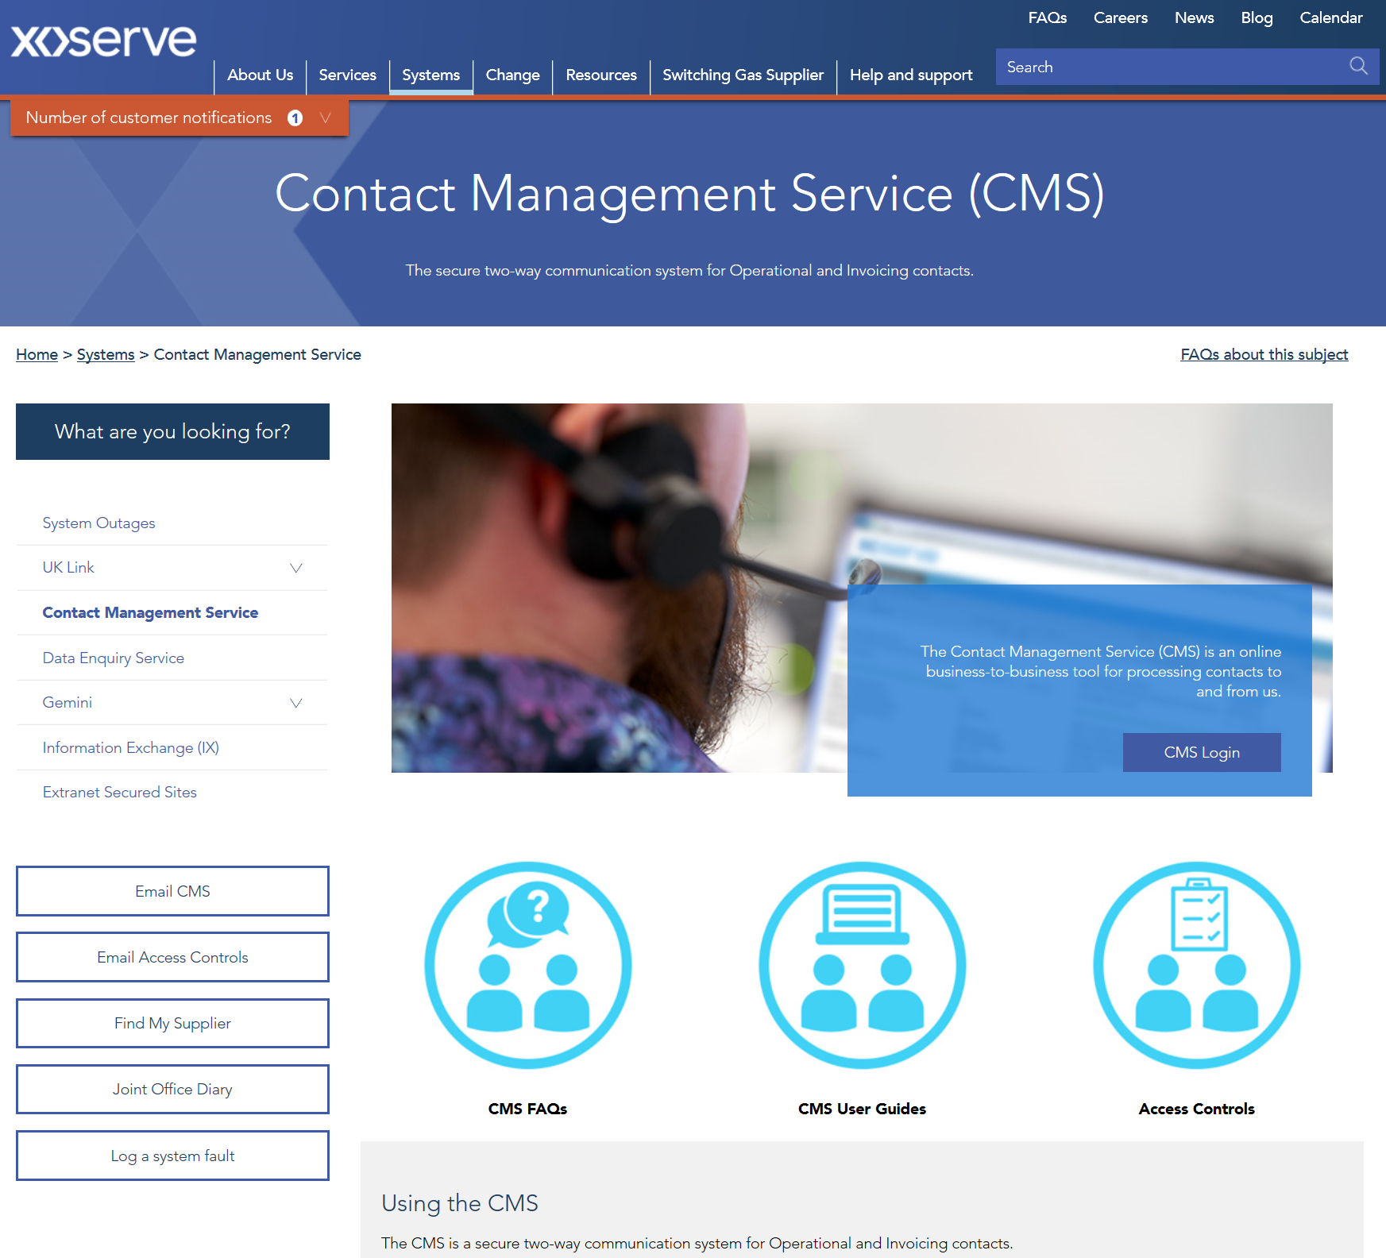
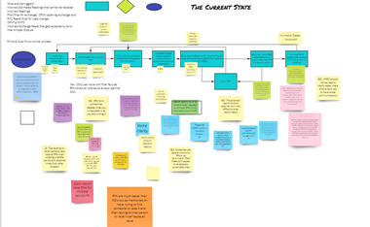
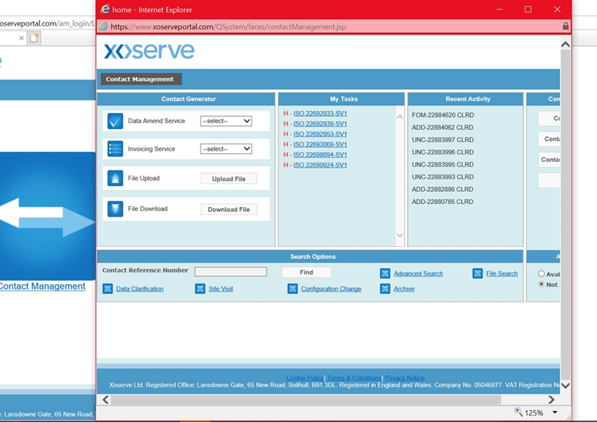
Customer Experience: CMS Rebuild
CMS Rebuild
CMS Rebuild ‘Capture’ phase update
127 customer responses received from the CMS feedback questionnaire, of which 116 were frequent users of CMS
6 ‘Capture’ scoping workshops held to-date; 5 for Address Amendments and 1 for Consumption Adjustment
Processes mapped out and pain points against the process captured
Ideal state requirements captured
Common themes identified
56 attendees from our customer base attended the Address Amendments workshops, for which:
108 pain points captured
145 high-level requirements captured
Training hints and tips have been identified to aid with current process
35 attendees from our Shipper Community attended the Consumption Adjustment workshop, for which at the time of presentation publishing the outputs are still being collated.
13 more workshops in the diary for requirements gathering
Target: March’21 to present Capture outcomes (scope & high-level solutions options) to customers at CoMC

Slide 14
Customer Experience: COVID Support
3 implemented
3 rejected
1 still in flight
Provided industry support for 7 COVID-related UNC Modifications
Dedicated COVID
pages with
sector specific
FAQs
2 Training Sessions on COVID Modifications – over 100 customer attendees
Fortnightly Customer Updates via email and on Xoserve.com
Many dozens of one-to-one Shipper explanations via email, phone or video call
Monthly COVID updates at DSC Contract Management Committee
Updates to the Demand Estimation systems gave the flexibility to remove COVID periods from the models

Slide 15
Customer Experience: We believe we’re on the right track…
Customer Relationship / Trust KVI
Our cumulative KPM metrics for both Cycle Time and RFT are on an upwards trajectory since they were embedded across Xoserve, but we acknowledge there’s still room for improvement, particularly within the areas of AQ and Invoicing Exceptions.
The quarterly leading indicators of the customer relationship/trust and customer change satisfactions survey’s both suggest that our customers in 2020 are more trusting of Xoserve as a service provider and are receiving better levels of support and engagement in the delivery of changes.
BP20 CX Programme Mobilised
BP20 CX Programme Mobilised
Every customer-facing team within Xoserve is eager to provision a level of service that our customers are delighted with, all of our customer operatives have their OKRs (Objectives and Key Results) tailored to focus on improving our customers experience of Xoserve, via Cycle Time, Right First Time, and Customer Effort targets.
If there’s any specific feedback of positive or negative customer experience that you’d like to share with us to help us improve, please do not hesitate to share it with us via our customer feedback survey.
Alternatively, please feel free to discuss any customer experience you’d like to share with your advocate, or reach out directly to a member of the CCO management team below:
Alison.Jennings@Xoserve.com
Alex.Stuart@Xoserve.com
Tristan.Unwin@Xoserve.com
Linda.Whitcroft@Xoserve.com
Emma.Smith@Xoserve.com
Customer Change Satisfaction KVI
BP20 CX Programme Mobilised

