Slide 1
2.1 - DSC Change Budget BP20 (Financial Year To Date)

Slide 2
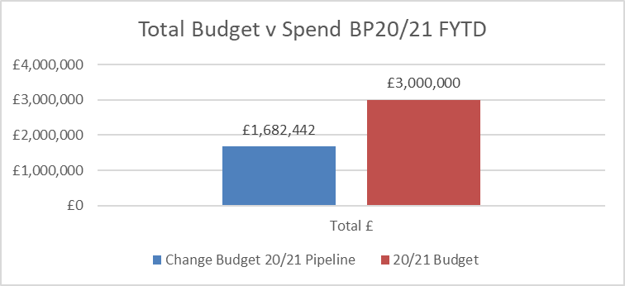
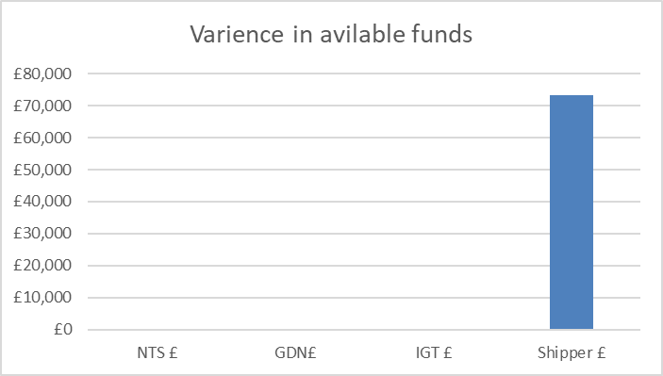
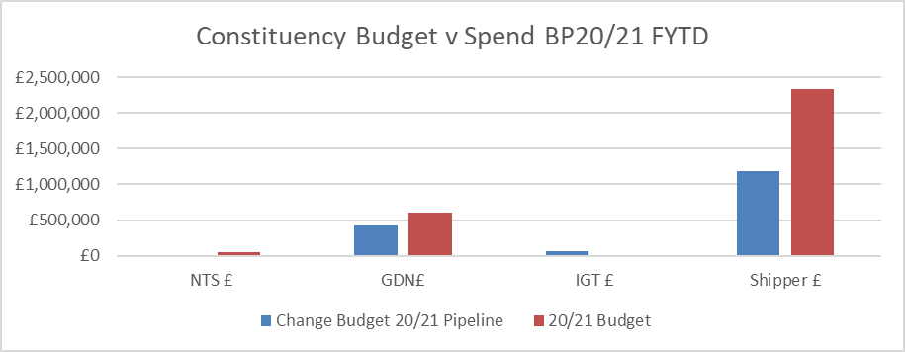
Budget v Spend BP20/21 Financial Year To Date (FYTD)
Overall increase in available funds of £73k for FY 20/21
Shippers (overall +£73k available funds)
£60k removed from XRN4645 (XRN was split into 2 parts A/B. B was withdrawn and A is listed separately in the finance tracker
£17k added to cost of XRN5168 as BER was higher than HLSO
£5k removed from XRN 5172 as BER was lower than HLSO
£20k removed from XRN 4923 as change withdrawn
£5k removed from XRN4645a as BER was lower than HLSO

Slide 3
DSC Change Budget BP21 - Draft 2

Slide 4
Background
The initial draft (recommended in August ChMC) has been through consultation as part of the wider business plan cycle
Some changes are required based on the output from the consultation
IGTs have reduced their budget with some changes originally earmarked for draw-down from the DSC Change Budget now to be potentially progressed via other means
This has caused the overall budget to be reduced by £450k
The IGT share of indirect costs has also reduced as a result of the reduction (% of the total direct costs dictates % share of indirect costs). So all other constituencies now pick up a slightly larger % share of indirect costs
The impact of this has almost entirely been mitigated (less than 1% change in total budgets for Shippers, DNs and NTS from draft 1) by a reduction in Contingency (-£50k) and Market Trials (-£50k) forecasted costs which have both been reduced in line with consultation to more accurately reflect the overall size of the budget

Slide 5
Combined BP21 Change Budget - Draft 2
Constituency discussions have provided Xoserve with a steer as to what is required / desired for delivery using BP21 funds. This has driven out a requirement for a total budget of £3.58m broken down as shown in the pie chart below
This represents a 12% reduction from initial draft (-£0.45m)

Slide 6
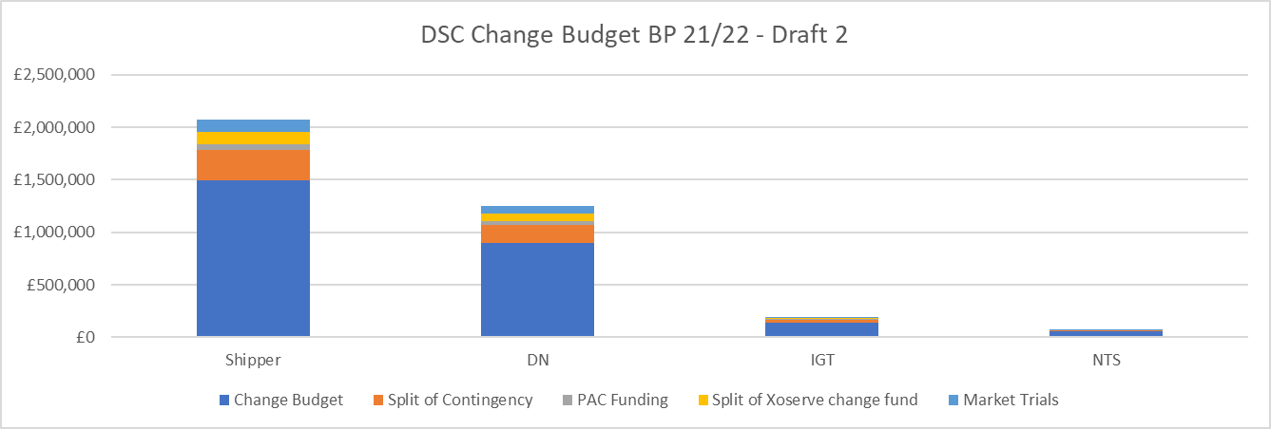
Constituency View

Slide 7
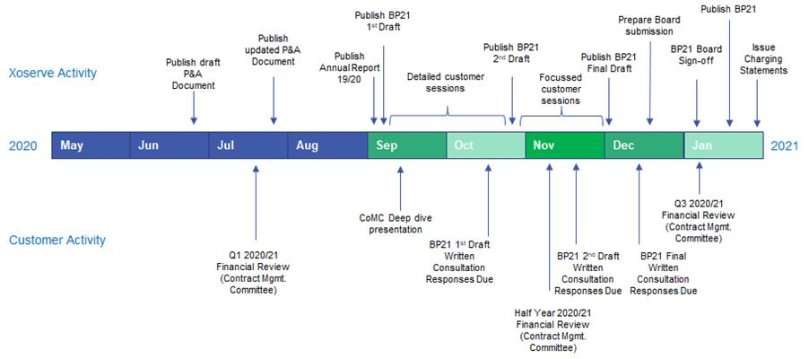
BP21 Timeline
ChMC recommendation will be sought in eChMC on 30th November 2020 on final draft
Second consultation phase and scoping of Nov-21 Major release may require further adjustment of budget for 21/22 FY

