Slide 1
Customer Relationship Management KVI Relationship Survey Q2 Results
Dionne Thompson
CoMC Update

Slide 2
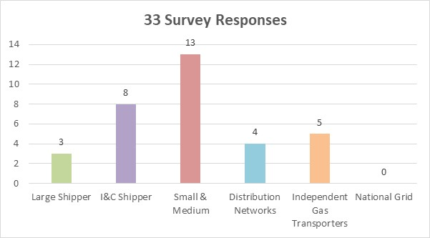
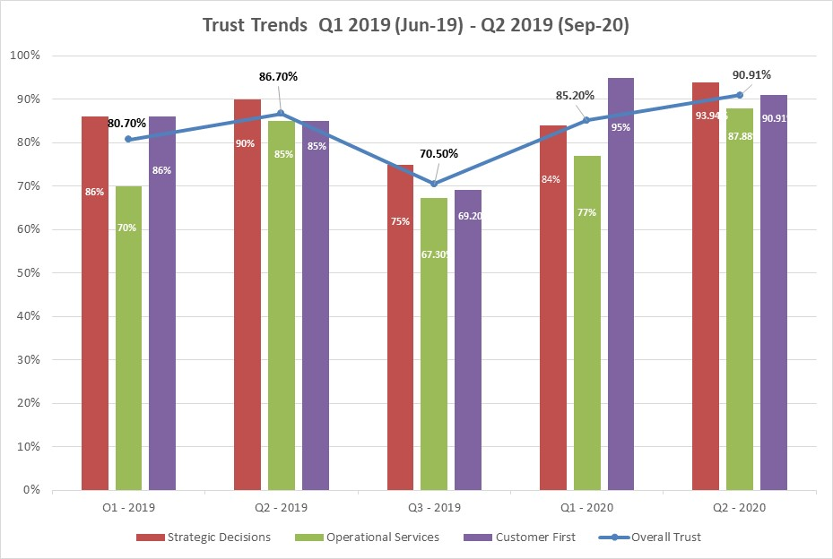
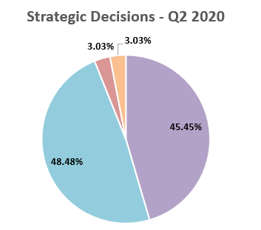
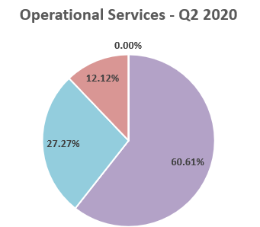
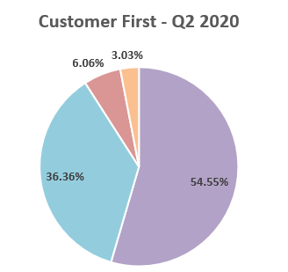
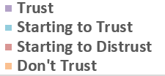
KVI Relationship Management - September 2020
Relationship Management Trust
90.91
Target Score 95%
Up from:
85.2% Jun 20
86.7% Sep 19
93.94%
87.88%
90.91%
Previously scored:
86.6% Jun 20
90% Sep 19
Previously scored:
77% Jun 20
85% Sep 19
Previously scored:
95.1% Jun 20
85% Sep 19

Slide 3
What is driving the increased score?
Improvement themes seen by customers | Further improvement opportunities
Must Read process improvements Proactive approach to customer workshops Understanding pain points from all customer perspectives Cost avoidance transparency Improvements to customer contact Quicker query and ticket resolutions Proactive customer engagement Business planning approach and early customer engagement SME engagement through Expert Days and customer workshops Customer Advocate relationship DDP training events and monthly customer sessions Customer Understanding Improved understanding of IGT needs and their requirements | Gemini issues Improvements to customer communications during and post issue resolution Visibility of how the root cause of the issue is being addressed CMS Review of CMS response timescales and understand causes of delays Customer Understanding Continue to educate Xoserve people on unique customer needs and requirements Understand the impacts that CDSP processes have on all customer types

