Slide 1
DSC Governance Sub-Committee 1st September 2020

Slide 2
Agenda / Approximate Timings
Introductions & Background (10 mins)
Capture Prioritisation (45 mins)
Xoserve Change Fund (30 mins)
Break (10 mins)
4. Development of changes that benefit non-DSC parties (20 mins)
5. Summary & Next Steps (20 mins)
6. AOB (10 mins)

Slide 3
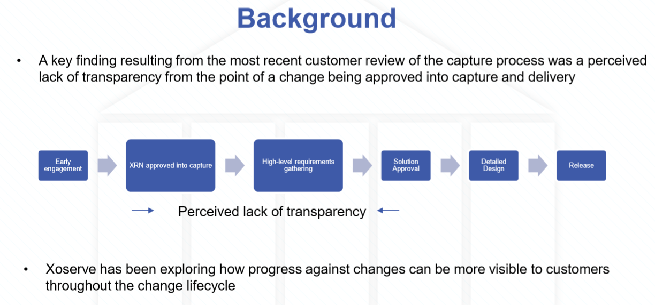
1.

Slide 4
2. Capture prioritisation
The Change Management Procedures document sets out how changes should be prioritised https://gasgov-mst-files.s3.eu-west-1.amazonaws.com/s3fs-public/ggf/page/2018-12/Change%20Management%20Procedures%20v2%20%209.11.18.pdf (section 4.5 Priority Principles)
The procedures describe the following types of changes and their related priority definitions:
4.5.1(a) a Priority Service Change is:
  (i) a Modification Service Change; or
  (ii) a Service Change in respect of a Service which allows or facilitates compliance by a Customer or Customers with Law or with any document designated for the purposes of Section 173 of the Energy Act 2004 (including any such Law or document or change thereto which has been announced but not yet made); and
(b) a Service Change which is not a Priority Service Change is a Non-Priority Service Change.
The document goes on to say:
4.5.3 (a) a Priority Service Change shall take priority over a Non-Priority Service Change and 4.4.3 (c) (ii) an Urgent Modification shall take priority over a Modification which is not an Urgent Modification;
The document doesn’t dictate how value add changes should be prioritised other than when the change was raised.

Slide 5
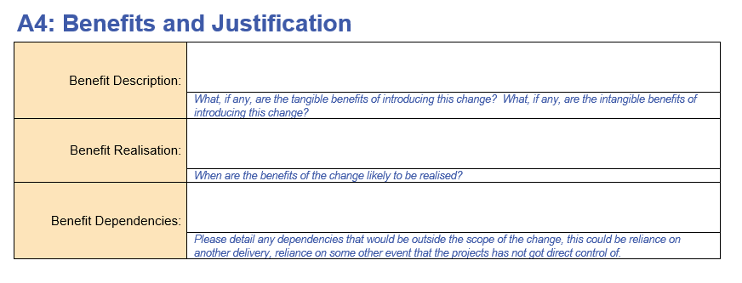
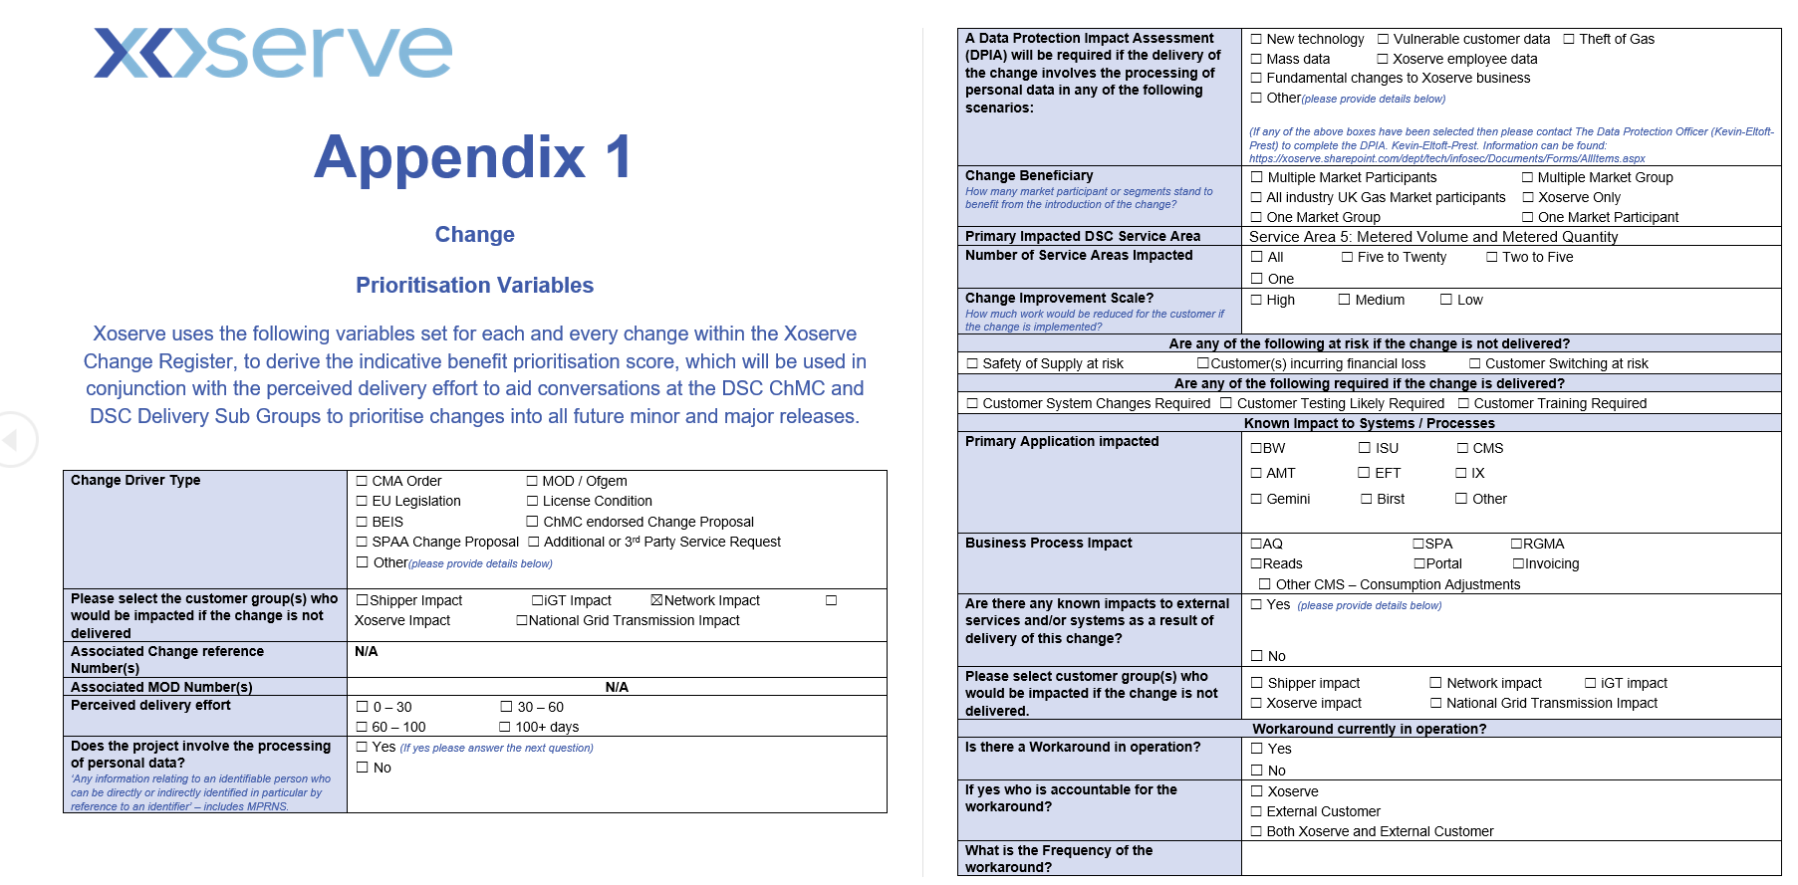
Current translation
Urgent and non-urgent regulatory changes are currently classed as Priority Service Changes and capture is performed at the appropriate pace and intensity in comparison with non-priority changes. Perceived benefits are captured in section A4: Benefits and Justification in the Change Proposal form
In an attempt to further prioritise, once assigned an Xoserve Reference Number (XRN), all changes are given a priority % score based on a of factors (e.g. is the change driven by a UNC code amendment, how many parties / business processes does the change impact etc), with outputs made visible in ‘Appendix 1’ of the Change Proposal document
All changes in capture are progressed through the pipeline in readiness for discussion in Delivery Sub-Group (DSG, where the prioritisation score is currently presented), distribution in change packs and approval for implementation in ChMC
Change Proposal (As is)
Appendix 1 (As is)

Slide 6
Limitations
All newly-raised customer changes are currently approved into Capture, sometimes with limited discussion over change benefits taking place in ChMC (perceived, trackable benefits should drive the priority order of ‘Non-Priority Changes’)
Sometimes change benefits aren’t obvious from the documentation (section A4: Benefits and Justification)
The criteria captured in Appendix 1 is such that large proportions won’t be known until capture has taken place and so prioritisation is focussed more at delivery decisions
The prioritisation ‘result’ is played back to DSG and not ChMC (which is the decision making forum in the governance model)

Slide 7
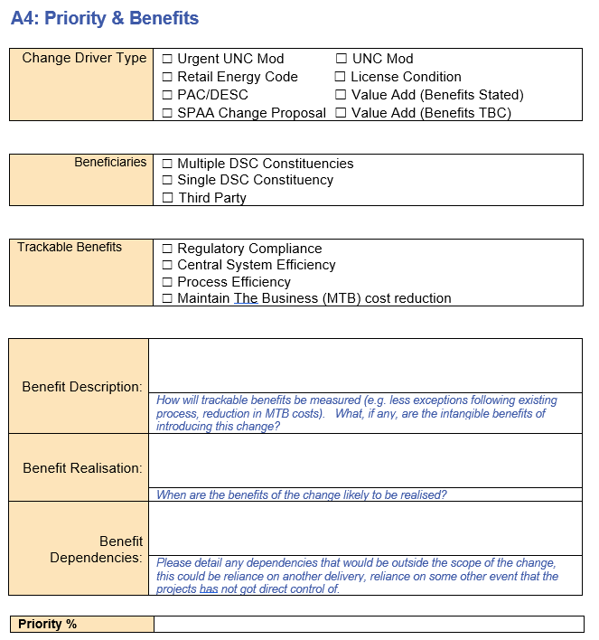
Proposal for Refinement (Capture Prioritisation)
Upon raising a new change proposal, along with completing some of the existing criteria in ‘A4’, the sponsor would be encouraged to complete additional criteria in what would be renamed ‘Priority & Benefits
The selections chosen will determine a priority % score (which will then correlate to an appropriate Priority Ranking
New
The weightings are designed to ensure that urgent regs changes are defaulted to ‘U’ priority status but also are dynamic enough to ensure that value add changes can also be ‘stack ranked’ – the results align with recent constituency prioritisation
ChMC would approve the change into capture along with the priority score, with the Customer Change team using the score to determine ordering of capture work

Slide 8
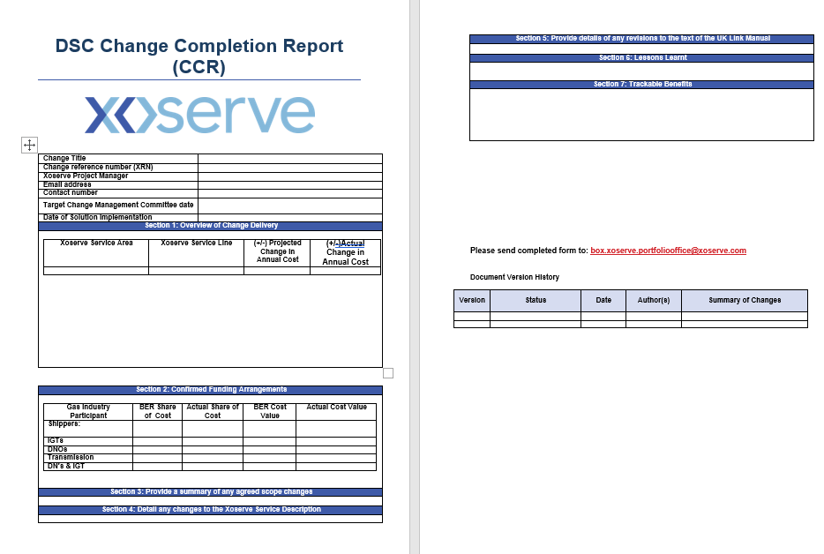
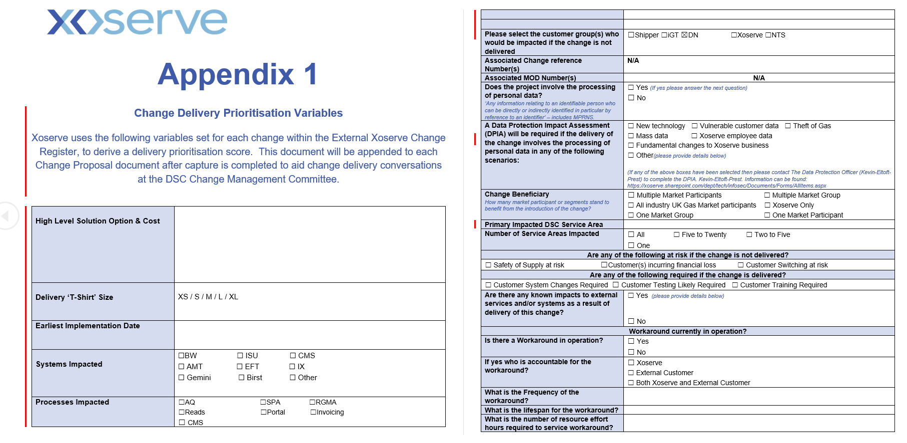
Delivery Prioritisation & Benefits Tracking
It is proposed that ‘Appendix 1’ is amended to become a ‘post-capture’ document that would enable ChMC to discuss benefits v cost ahead of moving changes from ‘capture’ to detailed requirements (see next slide)
The CCR form could also be amended to track benefits in the Post Implementation Support stage of implementation
Appendix 1 (to be)
CCR (to be)

Slide 9
ChMC Decision Points & Related Documents
Key
Amended Doc
Existing Doc
Stage
ChMC Decision
High-Level Capture
Initial Scope, Detailed Requirements & Design
Final Scope / £ Approval & Build/Test
Implementation, PIS & Benefits Tracking
Change Proposal + New Appendix 1
Project Updates
Change Proposal
EQR
BER
CCR
12 weeks
22 weeks
27 weeks
16 weeks
Has the CP been correctly prioritised / how quickly should capture progress?
Do perceived Benefits warrant estimated cost?
Can the change be delivered during the current FY (considering available scope bandwidth and remaining DSC Change Budget)?
Should the change proceed to a releases detailed requirements & design?
Do perceived Benefits still warrant refined estimated cost?
Can the change be delivered during the current FY (considering available scope bandwidth and remaining DSC Change Budget)?
Should the change proceed to a later release
Have all requirements been met?
Have perceived benefits been successfully proven / tracked?

Slide 10
Q. Do you support the proposals for improvements captured in this presentation? Do you have any further refinements that you think would improve the facilitation of priority decisions for capture and delivery?

Slide 11
3. Xoserve Change Fund
Constituency discussions and a subsequent ChMC recommendation have provided Xoserve with a steer as to what is required / desired for delivery using BP21 funds. This has driven out a requirement for a total budget of £4m broken down as shown in the pie chart below:

Slide 12
Constituency View

Slide 13
Unknown / ‘Indirect’ Costs
Along with known costs being estimated, it is proposed that ChMC has money set aside for ‘as-yet-unknown’ and indirect change. These costs (derived from historic trends and discussions with PAC) are shared out between constituencies based on relative % split of wider budget
Contingency
Yet-to-be-raised modifications / urgent unforeseen changes
Indirect
Required major release Market Trials
Performance Assurance Committee reporting
Xoserve Change Funding
The ChMC-recommended ‘Xoserve Change Fund’ will be (subject to wider Business Plan approval) made available to enable Xoserve to drive UK Link improvements with greater fluidity and transparency

Slide 14
Xoserve Change Fund Proposal
A parent XRN would be created at the start of the FY, from which to list and track candidates for delivery from this fund
An agenda item would be introduced into ChMC for progress update on this XRN
The parent XRN would include elements of a CP, BER, CCR all rolled up in one document which would be approved once in ChMC (at the start of each financial year) and would be for discussion / update thereafter
The same approach is also being proposed for spending the PAC ring-fenced budget (parent XRN 4876 containing an ever-changing list of requirements or ‘user stories’)
Before moving any change from ‘capture’ to ‘delivery’ Xoserve will demonstrate benefits (and how they would be tracked) and provide assurance / rationale as to why the change does not impact customer systems
This approach would:
  Negate the need to have multiple CRs transferred into CPs (any CRs where customer system impacts were identified during capture would be transferred to CPs and follow the usual governance)
  Reduce the need to create separate / multiple XRNs thereby reducing the time it would take to move from capture to delivery
  Create distance between the external change register and the list of internal (to Xoserve) change request list

Slide 15
Parent XRN Trajectory Through Financial Year
Changes Delivered
Changes Added
XRN1234 Approved into delivery with known changes listed (with associated new Appendix 1 forms)
XRN1234 Closed down with associated Parent (not for approval) CCR
XRN4321 Approved into delivery with known changes listed (with associated new Appendix 1 form)
Updates provided monthly to ChMC to report:
Spend to date (per change / month)
Change marked XRN to show changes completed / added (with related Appendix 1 Document)
April-21
March-22
April-22
Q. What else would ChMC need to see to have required transparency of changes being delivered throughout the financial year?

Slide 16
4. Delivery of changes that benefit non-DSC parties
Parties that aren’t acceded into the DSC are referred to as ‘Third Parties’ and change delivery in this space is described and governed via the related document https://www.gasgovernance.co.uk/sites/default/files/ggf/page/2017-07/CDSP%20SERVICE%20DOCUMENT%20THIRD%20PARTY%20AND%20ADDITIONAL%20SERVICES%20POLICY.pdf
The Third Party services policy is there so that non-DSC parties (e.g. MAP,MAM, PCWs) can purchase products and services delivered by Xoserve – they are charged individually for each service that they purchases
ChMC provides the check and balance to ensure the DSC Change Budget is used to deliver changes that benefit DSC Parties (if ChMC doesn’t approve, we don’t access the DSC Change Budget)
Q. As per the capture prioritisation material in this pack, when new changes are being proposed for entry into capture we are proposing that beneficiaries are stated and discussed in the form. Is there anything else Xoserve can do to aide ChMC in making an informed decision on change beneficiaries?

Slide 17
5. Summary & Next Steps

Slide 18
6. AOB

