Slide 1
CSSC Programme Dashboard
September 2020

Slide 2
Programme Update
Programme Health – RAG |  |  | Return to Green Plan
Overall Programme Status | Previous | Current | The programme is Amber due to the programme re-plan, the outstanding defects from SIT Integration sequence which is preventing progression of SIT scenarios and the number of CR’s that are currently working through Programme governance. Xoserve will continue to assess all of the above against our programme plan, resource and costs to understand impacts as further detail is provided by the central programme RTG actions include continued analysis of the CSSIP and the underpinning assumptions. The understanding of the CR analysis and when these will be released into the appropriate testing phases alongside release plans of defects to be included into SIT.
Programme Plan | Previous | Current
Risk Profile | Previous | Current
Resources | Previous | Current
Executive Summary |  |  |  | Key Progress & Milestones (Last Month)
Key Programme Updates: All key external milestones to date have been met for this reporting period, however the programme continues to trend to Amber Programme Planning: The SI have issued a revised MAD log (v1.1), and the CSSC team have challenged the log from a number of areas, including planned milestone dates, environments and resource impacts all of which have the potential of increased costs associated with them. Xoserve continue to challenge, raise alternatives with the programme in order to minimise cost impacts and where we can influence assumptions and planned phases. CR’s: There are a number of programme CR’s that are currently in flight. Some of these CR’s are significant and will potentiallty impact costs and current design. Xoserve are concerned at the number of CR’s that are being raised by the programme specifically from a cost perspective and the inclusion of these CR’s within the testing timelines. Programme risks have been raised. Costs: Cost analysis continues due to the Programme re-planning, new requirements and a back log of CR’s that currently sit within Programme governance. At this point as confirmed to CoMC we are still within our estimates for this year budget however we will continue to review this in line with the number of CR’s and programme requirements that are emerging. Future costs will also continue to be reviewed in line with the programme delays that are currently being replanned. External Testing: SIT Integration sequence completed, however delays are continuing to be seen for SIT functional testing. The SI are closely monitoring the test phase to understand impacts to the current plan should this phase be delayed as defects from SIT integration sequence are preventing progression of SIT functional scenarios. External NFR: SIT NFR testing execution has commenced with the CSSP, other programme participants will start testing early September based on current plans. We continue to be concerned that commencing NFR SIT in July, without having undertaken an adequate level of SIT Functional testing with the high level of defects poses a wider programme risk. We have strongly recommended that this risk is re-assessed along side the overall Switching Programme Re-plan. External Data DMT: Cycle 1 completed and Cycle 2 of DM testing in progress and reporting ahead if schedule. Xoserve team continue to be ahead of plan. Delta testing is planned to be included in this cycle. A high volume of confidence is being seen throughout these later DMT cycles. |  |  |  | DMT: Cycle 1 complete, Cycle 2 started External NFR: Smoke test complete, CSSP internal tests started External SIT: Integration Sequence testing finished with 0 Xoserve defects Internal SIT: Phase 3 completed Programme: 1st review of MAD log complete. Gemini & Batch: UAT Completed CRs: Delivery and IA’s continue Performance Testing: Significant progress achieved around gate closure Internal NFT: Completed Performance Testing Phase 2A
 |  |  |  | Upcoming Activities & Milestones (Next Month)
 |  |  |  | DMT: Complete Cycle 2 External SIT: Continue External SIT Internal Test: Continue UAT Phase 1 Internal NFT: Commence Performance Testing Phase 2B Service Mgmt: Obtain approval on Xoserve integration and continue internal SM activities DES: Continue DES Re-write activities External Audit: Expleo Test audit completed.

Slide 3
Workstream Updates
Previous Month | Current Month | Work Stream | Summary
 |  | UK Link | This has moved to amber due to review of the TS documents which has been delayed due to conflict in priorities for SME’s. June20 Retrofit FS approval is ongoing, internal workshops to understand impacts have completed. Review comments and SME reviews are underway for updated documentation approval. SME conflicts are being actively managed by the Programme alongside the operational management team.
 |  | DES & API | DES Full Re-platform (DES4) Build in progress. Queries, data transformations and replication tasks underway. Scope is showing amber as original DES requirements are still being confirmed and reviewed, this is a comprehensive review which is taking time. Assessment against delivery plan continues. REL & MAP ID Enquiry API builds in progress. Customer Portal MVP build commenced and remains on track. 2nd draft of internal BRD issued and updates in progress, final approval version will be shared.
 |  | Data Provision | Schedule and scope are Amber due to the timing of the data cut for UEPT and Cycle 3 Analysis reports. Discussions on going with SI regarding delivery of Cycle 3 Analysis reports in September and the underpinning requirement. The SI have reverted to the original plan of using a 31st October data copy for UEPT but this is likely to be moved following a Programme communication received last week. Work continues to prepare for the production copy whilst waiting for confirmed data cut date. The SI have confirmed delivery dates from the CSSP for the REL and Reg Id data as the 19/01/2021, internal plans are being updated.
 |  | Data Migration | Xoserve team are ahead of schedule for DMT test cycle 3 with one defect being raised and fixed during cycle 3. Programme CR-D024 change has been released into DMT for testing. Planning for DMT non functional continues. Data requirements have been reviewed, significant synthetic data is required and discussions are underway internally and with the programme to determine how this can be achieved. A CR has been received for a dedicated environment for DM non-functional and DM Live rehearsal test phases. The programme team continue to work through impact and options. Amber status due to the unknown in the data workstream presently due to programme replanning and data requirements.

Slide 4
Workstream Updates
RAG Previous MONTH | RAG Current MONTH | WORK STREAM | SUMMARY
 |  | Market Trials | Overall the workstream is amber, decisions regarding the environment are still outstanding with the CR(0078) being fully assessed due to ongoing programme requirements in relation to environments.. Until this has been assessed and approved, resources and schedule will remain at amber. The revised timelines have now been proposed to both the programme and internal programme board. Timelines may need to move again in line with Supplier programme considerations that have been received by the central programme team.
 |  | Performance Test & OAT | Overall status amber trending green due to progress made in secured active performance. Testing continues and we expect this workstream to be green next month.
 |  | Testing - SIT | External SIT initial integration sequence execution phase has seen a number of challenges and a number of defects that are impacting SIT functional tests from progressing. Weekly meetings are being held between Xoserve and the SI, these meetings are to discuss progress of the test phase and to walk through programme defects. This phase continues to be assessed in order to identify issues and continually monitor against the phase timelines. This phase is also being assessed as part of the programme re-plan. UAT testing is in progress and on track.Test Evidence Assurance meetings are in progress and we continue to work closely with internal operational teams and SME’s for these assurance activities.
 |  | Service Management | Integration recommended option has been approved. On track to provide feedback to the DCC for our review of all the core processes by 21st August. We have also started to review the non-core processes. Sessions have been held with the majority of the internal workstream to discuss requirements however, due to annual leave, there are a couple more to do.Latest MAD log has been reviewed by the workstream leads and our feedback and analysis provided
 |  | Batch | The overall status is green however schedule is amber until details of the Ofgem Programme re-plan are confirmed. The UK Link full schedule has been tested and evidence is being produced. UAT for both Control-M and EFT is progressing with minimal issues being raised. The resolution for the Control-M Gateway issue has been identified and the team are working on getting this resolved.

Slide 5
Workstream Updates
RAG Previous MONTH | RAG Current MONTH | WORK STREAM | SUMMARY
 |  | Gemini | The schedule is amber until details of the Ofgem Programme re-plan are confirmed. The testing of the Gemini triggers is in progress. The monthly files failed due to unforeseen issues occurring with Control-M /AMT. The legacy Gemini environment is only available until 21/08. Apps Support have confirmed that these need to be tested so this needs to take place following the transition to the ECP environments on 1/10, the completion date of UAT has been extended to include this re-test. The test stream have confirmed this can be accommodated. Planning of a data refresh on the ECP environment is ongoing.
 |  | Reporting | There are 2 newly identified reports that are potentially impacted by CSS, these are currently being reviewed to understand impacts. If impact is found internal CR’s will be raised.
 |  | Environments | RAG is green. Environment requirements have been re-aligned with latest plans from SI.

Slide 6
Key Programme Risks (1/5)
REF | RAG | WORKSTREAM | DESCRIPTION | MITIGATING ACTIONS | LATEST UPDATE | TARGET RESOLUTION DATE
62741 |  | Programme | There is a risk that SIT NFR testing will be deemed invalid if carried out as currently planned because SIT Functional would not have reached the necessary level of code stability for Non functional testing to be carried out leading to additional costs related to resources and environments required to support further cycles of NFR testing once a stable code level has been achieved. High volumes of defects are currently being found in SIT which in turn is impacting progression and therefore delays in completing the SIT cycles required to establish a suitable level of code stability. The current timelines still plan for NFR testing to be carried out prior to the completion of sufficient functional SIT required to establish a stable code set. | Escalate to the SI via all established forums to instigate a near term plan review to ensure these phases are re-planned appropriately. | External SIT NFT continues to be halted. SI awaiting approval to recommence activities before re-plan can be shared with parties | 30/09/20
63411 |  | Transition and Cutover | Lack of adequate Transition Test cycles within the Switching Programme Plan | Raise with the SI & Ofgem via the established forums Ensure that Xoserve internally tests our Transition plan adequately even if this is without involvement from external stakeholders (with as robust assumptions as possible) | This has been raised at various Switching Programme forums. The SI have taken away an action to table this concern and assess it | 30/10/20
62448 |  | Data Migration | There is a risk that Xoserve's solution delivery is incompatible with the CSS being delivered by Landmark because of poor version control and ambiguity as to which is the live version of the CSS Interface Design Specification that the CSSP have built to, leading to avoidable defects arising in SIT and the subsequent rework required by one or both parties. | Confirm with SI the correct version of this document and support them in improving the version control in future | Release notes provided. These are now being reviewed with a view to closing this risk off next week. | 31/08/20

Slide 7
Key Programme Risks (2/5)
REF | RAG | WORKSTREAM | DESCRIPTION | MITIGATING ACTIONS | LATEST UPDATE | TARGET RESOLUTION DATE
62748 |  | Programme | There is a risk that the later test phases such as DMT Live Rehearsals, Transition Testing and Operational Testing are not sufficiently defined or planned with clear understanding of the scope or the associated roles & responsibilities of participating industry parties because the SI have been working predominantly on the near term plan without taking into consideration the scope and objectives or the later phases | Escalate to the SI for addressing as part of the re-planning exercise | Xoserve have now fed back comments in line with the MAD log and replan review process. Baselining of new plan is expected at the end of September. Xoserve still have concerns over the quality of the planning for later phases, in particular live rehearsal and transition. | 28/09/20
62897 |  | Data Migration | There is a risk that Xoserve may not be able to provide Landmark with data for UEPT on time leading to late delivery of data and potential delay to the start of UEPT | Review plans, discuss with programme | Approach reverting back to 31st Oct data copy. Plan in place to deliver. Progress to be monitored | 31/10/20
63285 |  | Data Migration | Xoserve may not have data prepared in time for UEPT due to change in prod data approach | Review with SI | Discussions now refocussed on 31st Oct - awaiting final confirmation | 28/08/20
63431 |  | Data Migration | Risk of additional cost of generating and loading high volumes of synthetic data into UK Link for DM NF | Review with SI | Following discussion at SI-TDG, waiting for meeting to be scheduled with SI and other parties to discuss. The data team are to investigate whether data could be loaded into and extracted from staging which would require less additional effort. | 04/09/20

Slide 8
Key Programme Risks (3/5)
REF | RAG | WORKSTREAM | DESCRIPTION | MITIGATING ACTIONS | LATEST UPDATE | TARGET RESOLUTION DATE
62682 |  | Data Migration | There is a risk that DMT will not complete on time because of extremely tight schedule | Risk raised with the SI prior to the start of DMT. The SI reported at SI-TDG that the schedule would be reviewed, but this has not happened, or the outcome has not been implemented. DMT is currently on day 2 and is significantly behind schedule | Cycle 3 testing is ahead of schedule, risk downgraded but will remain open for monitoring | 04/09/20
62830 |  | Data Migration | There is a risk that we may not be able to access the datacentre in order to connect the databox, to move the 31st prod cut to the azure environment eading to Xoserve being unable to load the data copy onto the environment to begin extract work, and test preparation | Escalate with TechOps to explore options for gaining access to the data centre. | Data centre now open. Risk score reduced but remains open in case of further lockdowns | 31/10/20
63061 |  | Data Migration | There is a risk of delays in transferring the production data copy from the databox to Azure by Microsoft leading to delays in provision of data extracts for Landmark for UEPT | Discuss MS service levels and agreements with Steve Concannon | Work ongoing to prepare plan for UEPT data extracts from 31st Oct data copy | 30/10/20
62747 |  | Programme | There is a risk that SI working groups such SI Transition Group & Technical Data working group are working in silo because of the way working groups are set up and co-ordinated leading to conflicting assumptions and decisions being made by different working groups. | Escalate to the SI & Ofgem via working group discussion to bring together related workgroups or ensure there are feed-ins between workrgoups | Xoserve have raised this at various forums. This risk will be kept open and monitored until evidence is available that more holistic thinking and planning is in place. | 30/09/20

Slide 9
Key Programme Risks (4/5)
REF | RAG | WORKSTREAM | DESCRIPTION | MITIGATING ACTIONS | LATEST UPDATE | TARGET RESOLUTION DATE
50199 |  | Programme | There is a risk that CSS Consequential may be unable to meet switching Programme timelines and end up delaying the overall Ofgem Switching Programme because of the fact that Xoserve consequential changes are complex and significant in scale, leading to potential delays to the Industry plan & reputation impact to Xoserve | Continued engagement with SI and other Switching Programme stakeholders to ensure that all inbound dependencies are met within expected timelines. | Xoserve's activities all continue to be on track to the delivery plan and future dates are being aligned to the replan | 30/09/20
54378 |  | Programme | There is a risk that the logical model contained in Abacus may not fully reflect the CSS processes and interactions with existing service providers because of limited engagement of all Programme stakeholders during the industry wide design phase. Leading to rework of the consequential design activities that have already been completed. | Engage with SI to ensure that Abacus update to fully reflect CSS processes | This RAID item will be kept open for monitoring during SIT. | 31/08/20
55549 |  | Programme | There is a risk that that the approval of the CSS Physical Design does not take into consideration the complete E2E impacts of the Switching Programme because the CSS design is solely focused on the core CSS and primary interactions with CSS. Leading to an inaccurate critical path being followed for the Programme and subsequent downstream delays to the delivery timeline. | 1. Raise with Ofgem to identify owner/RACI 2. E2E CSS design needs to be in place involving all components/systems/interactions which needs to be form the architectural baseline that the Programme is governed against. | This RAID item will be kept open for monitoring until the end of SIT phase 1. | 31/08/20
62695 |  | Service Management | There is a risk that Xoserve is not aware of changes made to the core Service Management processes because of DCC not providing updated process maps leading to re-work to review the revised DCC process maps and update ours accordingly. | Requested copies of the revised process maps to review | Agreement with DCC that XOS will review the core processes by 21st August and will then focus on the non core processes. Within the forum today, DCC confirmed that they had now issued all ITIL related documents. | 18/09/20

Slide 10
Key Programme Risks (5/5)
REF | RAG | WORKSTREAM | DESCRIPTION | MITIGATING ACTIONS | LATEST UPDATE | TARGET RESOLUTION DATE
63062 |  | Data Migration | There is a risk that REL and RegId data may be provided late in February / March because of 2 weeks programme shutdown at Landmark / SI over Christmas leading to shortened timeline for loading the data or a delayed load | Review with SI | Delivery date now confirmed as 29/01/2021 - plan to be prepared | 11/12/20
55513 |  | Programme | There is a risk that in the Programme participants might interpret business rules differently because business rules underpinning the CSS Interfaces have not been published alongside the interface document as well as discrepancies between business rules defined within REC and captured in ABACUS. Leading to significant process mismatches at a later stage (i.e. SIT, UEPT) and potential rework and timeline slippages. | Xoserve to publish design assumptions as part of the RAID reporting to the SI to ensure visibility of Xoserve design assumptions around business rules and processes. | This RAID item will be kept open for monitoring during SIT | 31/08/20
61894 |  | Service Management | There is a risk that the CSS proposed SLA's do not align to current service model/SLA's because DCC/Ofgem are proposing a new set of SLA's for all parties regardless of existing arrangements, leading to target operating model changes and potential contractual changes with 3rd party suppliers (considerable increase in operational cost) | Our working assumption is that existing SLAs will prevail however, there are ongoing discussions taking place with DCC to understand their expectation. REC review - no such SLA's imposed on us currently. | Requested if there had been any progress on this at August Forum. Advised no but there were ongoing discussions taking place between DCC & Ofgem to discuss and would provide an update as soon as possible. | 04/09/20

Slide 11
Key Programme Issues
REF | RAG | WORKSTREAM | DESCRIPTION | MITIGATING ACTIONS | LATEST UPDATE | TARGET RESOLUTION DATE
63420 |  | Data | The Interim CSSIP milestone DA070 is now set at 16/09. Xoserve have been asking the SI to confirm the expected deliverable for a number of weeks without success. The SI finally have confirmed with one months notice that a set of Analysis reports is required. Previous plans were to use the UEPT data (31st May) for the next cycle of reports, but the data copy has now been moved to 31st Oct which is too late. The last set used the 18th Jan data and there is no other data set available. Data team are investigating the possibility of adjusting the reports to run against BW instead, but at present can't confirm that the reports will be ready on time. | Mike D provided an update that the formal request would be issued imminently, but seemed to suggest that the gas reports weren't required. Xoserve to seek confirmation from SI. | Mike Dougan has confirmed that Xoserve do not need to submit reports for cycle 3. Issue downgraded while investigation into repointing reports to BW carried out. | 28/08/20

Slide 12
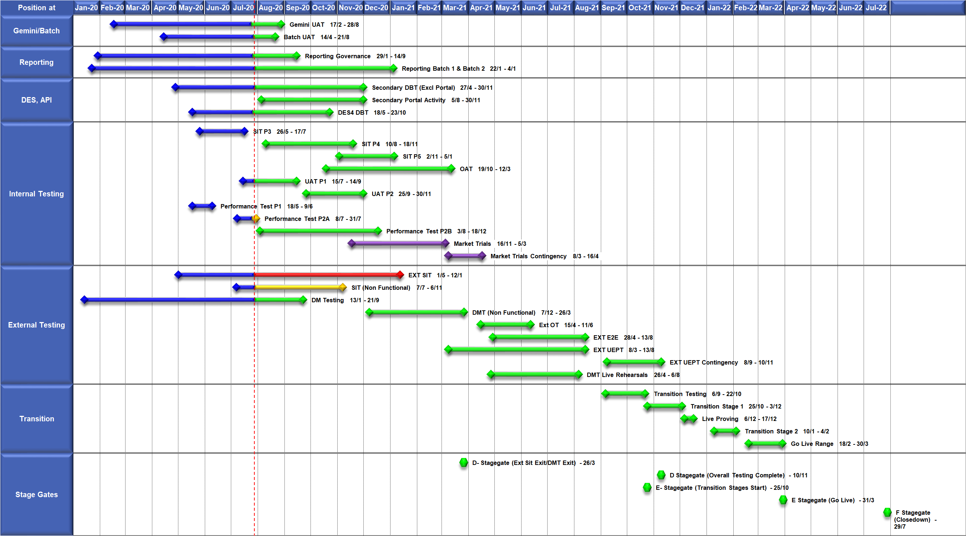
High Level Plan

Slide 13
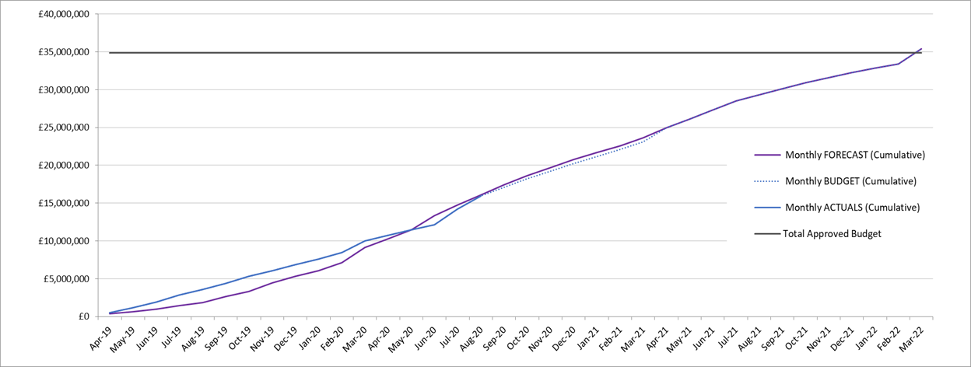

Slide 14
Change Requests raised by the Programme to date

Slide 15
Switching Programme CR Position – CRs not impacting Xoserve
CR Name | CR Ref | High Level Cost IA Cost | Date Raised | Status
Non_Mandatory_MPAS_Metered_Indicator_v0.4 | CR-D001 | £0.00 | 27/01/2020 | Complete - No Xoserve Impact
REC Manager Procurement Timelines | CR-D003 | £0.00 | 02/12/2019 | Complete - No Xoserve Impact
MPAS Related MPAN Disconnection | CR-D004 |  |  | On Hold
Modification of Related MPAN Cleanse Checkpoint Milestones | CR-D006 | £0.00 | 27/11/2019 | Complete - No Xoserve Impact
ABACUS Corrections and Re-alignments | CR-D007 | £0.00 | 04/12/2019 | Complete - No Xoserve Impact
ECOES REL API Webmethod | CR-D009 | £0.00 | 17/12/2019 | Complete - No Xoserve Impact
CSSIA Uplift to Implement IG Recommendations | CR-D010 | £0.00 | 17/12/2019 | Complete - No Xoserve Impact
Update 3 E2Es to align to CSSIA | CR-D011 | £0.00 | 10/06/2020 | Complete - No Xoserve Impact
Messaging_Requirements_Revisions_REC_Code_Manager_and_CSS_v0.1 Clean | CR-D013 | £0.00 | 28/01/2020 | Complete - No Xoserve Impact
DSP_Specific_ SIT_ Functional_Exit_Criteria | CR-D023 | £0.00 | 29/05/2020 | Complete - No Xoserve Impact
Changes to support enhanced Solar arrangements | CR-D025 |  |  | Not Received
MPAS Related MPAN Disconnection | CR-D004 |  |  | On Hold
Total |  | £0.00

Slide 16
Switching Programme CR Position – CRs impacting Xoserve
CR Name | CR Ref | High Level Cost IA Cost | Date Raised | Status
Programme Plan Re-Baseline | CR-D002 | £0.00 | 07/11/2019 | Approved for Implementation by Ofgem
Introduction of Validation Message to Logical Mode | CR-D005 | £61,000.00 | 25/11/2019 | Withdrawn – but expected to be reinstated
Updates to the CSS Physical Interface Design (PhID). | CR-D008 | £17,250.00 | 22/01/2020 | Approved for Implementation by Ofgem
CSS_Physical_Interface_Design_Updates_mpxn_v0.2 | CR-D012 | £5,534.38 | 30/01/2020 | Approved for Implementation by Ofgem
CSS_Exception_Handling_Strategy_v0.2 | CR-D014 | £0.00 | 26/02/2020 | Approved for Implementation by Ofgem
Amendment_of_Xoserve_Consequential_Change_Milestone_Delivery_Dates_v0.2[DRAFT] | CR-D015 | £0.00 | 26/02/2020 | Withdrawn
Provide_CSS_RegistrationID_to_PUI_and_LPs | CR-D016 | £12,643.00 | 07/08/2020 | Awaiting Decision
CSS_Handling_of_MPAS_Business_Dates_v0.2[DRAFT] | CR-D017 | £3,500.00 | 20/07/2020 | Awaiting Decision
Confirmation_Responses_to_Outbound_Synchronisations_v0.2[DRAFT] | CR-D018 | £85,000.00 | 02/03/2020 | Withdrawn – Exp;ected to be reinstated
Licence Exempt Network Customer Identifier – ABACUS Data Model update | CR-E51 | £0.00 | 29/10/2019 | Approved for Implementation by Ofgem

Slide 17
Switching Programme CR Position – CRs impacting Xoserve ctd
CR Name | CR Ref | High Level Cost IA Cost | Date Raised | Status
Amendments to the DMS artefact suite | CR-D019 | £6,500.00 | 16/03/2020 | Approved for Implementation by Ofgem
Regulatory Workstream – Programme Milestones Refresh | CR-D020 | £0.00 | 16/03/2020 | Withdrawn
Remove MPAS Interface | CR-D021 | £0.00 | 29/04/2020 | Withdrawn
Migration of Terminated Gas RMPS | CR-D022 | £0.00 | 10/06/2020 | Awaiting Decision
Amendments to the NC-0079 for REL (Retail Energy Location) Data Migration and Reconciliation | CR-D024 | £20,000.00 | 06/07/2020 | Approved for Implementation by Ofgem
DMS - PHID Alignment Parties | CR-D026 | £0.00 | 06/07/2020 | Approved for Implementation by Ofgem
Request For a New or Upgraded DMT Environment | CR-D027 | £250,000.00 | 07/08/2020 | Approved for Implementation by Ofgem
Enable TLS connection pooling for all directly connected parties to CSS] | CR-D028 | £2,500.00 | 13/07/2020 | Awaiting Decision
Message Header Format for PKI Certificate Identification] | CR-D029 | £2,500.00 | 13/07/2020 | Awaiting Decision
Total |  | £466,427.38

