Slide 1
DSC Change Budget BP20 (Financial Year To Date)

Slide 2
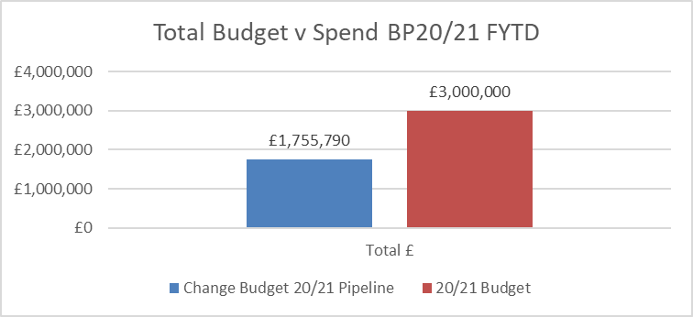
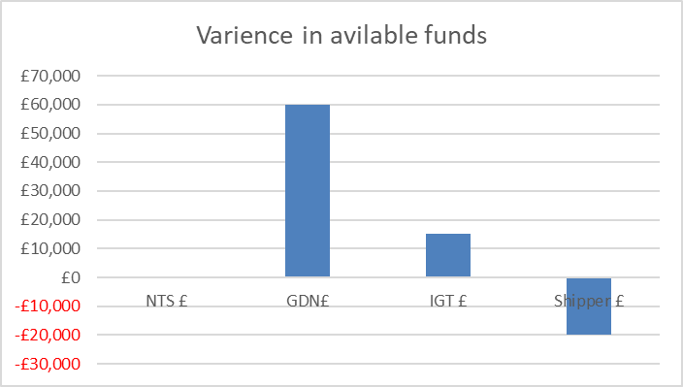
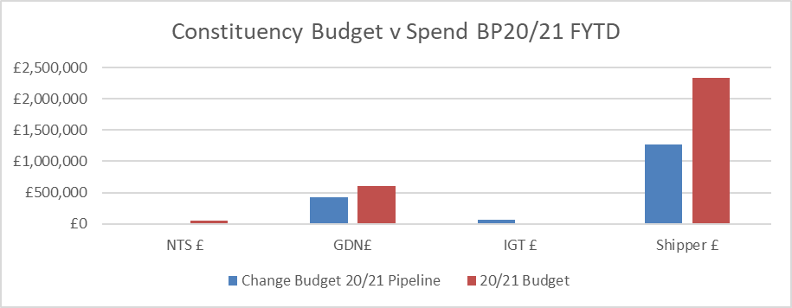
Budget v Spend BP20/21 Financial Year To Date (FYTD)
Overall increase in available funds of £55k for FY 20/21
DNs (overall movement +£60k available funds)
Added £75k (100%) HLSO costs associated with XRN5135 DNO and NTS Invoices to Shippers and DNs VAT compliance
Removed £135k for 75% of HLSO costs associated with XRN5142 New Allowable Values for DCC Service Flag in DXI File From DCC which was de-scoped from June-21 release in September ChMC
Shippers (overall -£20k available funds)
£20k HLSO cost (* 10% to account for potential EQR Design costs required in FY 20/21) for XRN XRN5091 - Deferral of creation of class change reads at transfer of ownership which is a potential delivery in the Nov-21 Major Release.
IGT (overall +£15k available funds / reduction in overspend)
£15k HSLO costs associated with XRN5142 New Allowable Values for DCC Service Flag in DXI File From DCC which was de-scoped from June-21 release in September ChMC
NTS
No Movement

Slide 3
Working Principles for Budget Reporting Financial Year (FY 21/22)
Non-direct costs tracking
Contingency – £550k budget allotted for contingency (for as-yet-unknown changes that will require delivery during FY) line will be transferred to individual change lines from point at which any new change is introduced and pre-HLSO £ provided
Xoserve Change Fund (XCF) - £200k budget allotted to parent XRN at start of financial year to draw down upon ring-fenced XCF budget will be tracked on a monthly basis throughout year, with a dedicated ChMC agenda item to report delivery and budget v spend
Performance Assurance Committee (PAC) – £100k budget allotted to parent XRN (this year = XRN 4876) at start of financial year to draw down upon ring-fenced PAC budget will be tracked throughout year to show (ChMC / PAC) delivery of PAC user stories captured in parent XRN. Additional changes that have been identified during the FY will be added to the parent XRN
Market Trials (MT) – £250k budget allotted to MTs at start of year will be removed from pot and added to individual changes where appropriate
DSC Change Budget for FY21/22 subject to final Business Plan approval
Tracking of cost movement from ROM to CCR
Reporting will be introduced to show movement from the earliest estimated cost through to change completion to assist in future budget setting accuracy and planning
Quarterly Budget Review
Alongside the monthly budget update in ChMC, a Quarterly Budget Review will be introduced into the ChMC agenda to discuss / approve rebates on the remaining budget. Rebate decisions will be at the discretion of ChMC (with CDSP advice) and will be based on likelihood of remaining pipeline of change during that FY

