Slide 1
KVI Relationship Management Q1 CoMC Update July 2020
Dionne Thompson

Slide 2
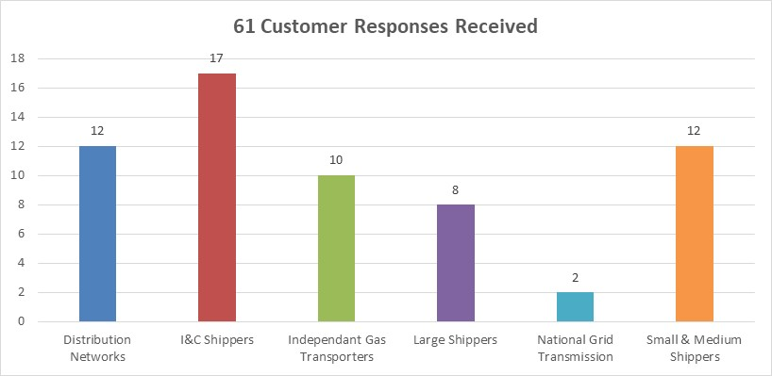
KVI Relationship Management Scores - June 2020
Relationship Management Trust
85.2%
Segment | Overall Trust | Strategic Decisions | Operational Services | Customer First | Response Vol
All Segments | 85.2% | 84% | 77% | 95% | 61
Large Shippers | 100% | 100% | 100% | 100% | 8
I&C Shippers | 90.2% | 94.1% | 82.4% | 94.1% | 17
S&M Shippers | 94.4% | 91.7% | 91.7% | 100% | 12
DN’s | 58.3% | 50% | 41.7% | 83.3% | 12
IGT’s | 83.3% | 80% | 70% | 100% | 10
NGT | 100% | 100% | 100% | 100% | 2
Target Score 95%
Up from:
70.5% Dec 19
84.8% Jun 19
83.6%
77%
95.1%
Up from:
75.0% Dec 19
81.9% Jun 19
Up from:
67.3% Dec 19
Down from:
84.9% Jun 19
Up from:
69.2% Dec19
87.9% Jun 19

Slide 3
Customer Feedback Summary
Improvements seen by customers:
Improvements to Customer Contact backlogs and turnaround timescales
Xoserve’s approach to COVID19
Easy access to data via DDP platform
Improvements to customer engagement including increased frequency and development of partnering based relationships
Dedicated focus on understanding customer needs and their pain points.
Required / in progress improvements:
Operational issues
Proactive communications
Timely resolution
Understanding of customer impacts
DDP developments and access to self-serve data for all customer segments
Customer Experience Contact Transformation
Customer Journey/Process Improvements
Change Management
New Entrants (Join)
Invoicing
CMS processes

