Slide 1
AQ Taskforce Update CoMC
17th June 2020
Version 0.1

Slide 2
Summary
A number of taskforce resources continue to focus on supporting our business continuity efforts, as well as continued support and assessment of COVID-19 related MODs. This work, whilst an understood priority has impacted the pace of the taskforce.
However our focus remains on ensuring that the right level of quality is being applied to the known AQ defects. Positively we see numbers of new defects falling whilst our resolution rate increases month on month (see AQ Defect Status slide).
A concerted body of work is currently in progress to undertake high value capacity adjustments for defect 61866 (Incorrect FYAQ values applied). Re-assessment of the internal process used to ensure that all necessary financial adjustments post defect fix/AQ correction are completed is now underway.
A formal root cause activity (slide 6) has now been instigated with our technical service provider to analyse all AQ defects to provide clear recommendation on what is causing defects to be identified. This work will last 6 weeks and will result in a root cause analysis report highlighting areas for fix, process improvements, reporting enhancements and other necessary changes as required.
The first phase of additional MI reports to further strengthen our operational management/procedures as well as aid root cause is due to deliver in mid-June. These reports will not only provide greater control but will also in the short term (until root cause is permanently addressed) identify additional areas for investigation and resolution.
A separate body of work has also been instigated within Technology Operations and Business Operations to review and implement improvements to the overall defect process. The AQ taskforce are working closely with this group to ensure the right level of root cause, fix and test assurance are being applied which will result in quicker resolution times.

Slide 3
AQ Defect Status (breakdown as at June 20)
56
Defects impacting AQ since August 2019
(+1 raised since last month)
12
Open Defects
(-5 on previous month)
3
Analysis
(same as previous month)
44
Resolved defects
(+6 on previous month)
7
UAT
(+2 on previous month)
2
Fixed, Deployed Awaiting Data Correction
(-1 on previous month)
0
Awaiting Deployment
(-2 on previous month)
Open defect details can be found in the Appendix

Slide 4
Improvements being made to the generic defect process (fix/test) and within the AQ taskforce are starting to increase the rate of resolution
We positively are seeing a reducing trend on new defects being identified

Slide 5
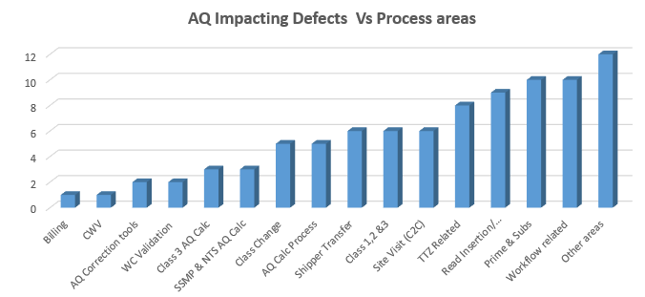
Formal Root Cause Analysis (RCA) Activity
Week 1 wc. 8th June
Week 2
Week 3
Week 4
Week 5-6
Defects Analysis
Final RCA recommendations
AQ Process Stabilisation packages
New operational reporting
Process Improvements
AQ Calc process
SSMP& NTS AQ Calc
Class 3 AQ Calc
Read Insertion
Read replacement
Shipper Transfer
Class 1,2 & 3 related
TTZ related
Workflow related
WC Validation
AQ Correction tool
Class Change
Site Visit
Other areas (isolated defects)
Prime & Subs
Billing
CWV
RCA Outputs

Slide 6
Appendix

Slide 7
Open AQ defects
Defect No. | Issue Description | Lifecycle Status
60230 | Volume and energy calculated incorrectly for Prime and Sub meter points | Fixed, Deployed Awaiting Data Correction
60917 | Following an update to a meter (non-physical) the volume which is calculated is based on the opening exchange read (OPNX) as opposed to calculating from the final exchange read (FINX) | Fixed, Deployed Awaiting Data Correction
60942 | For meter points that have had a class change from 4 to 3, following receipt of reads (via the UBR file) the system is unable to identify the last read date for volume calculation when there is no actual read present during the class 4 period. Therefore AQ calculation is not using the latest read. | UAT
62028 | Following acceptance of a replacement read for an ‘inactive’ read, the system is incorrectly accepting the read, when it should reject. | UAT
62164 | The net-off volume / energy is being incorrectly calculated as zero for class 4 prime sites | UAT
61019 | When receiving a Site Visit read and an RGMA read on the same day the system is incorrectly processing the reads in the wrong order causing energy and volume to be incorrectly calculated. | UAT
62178 | Where volume and energy is incorrectly loaded, the system is not creating an exception | UAT
61866 | While deriving the FYAQ/SOQ values for 01/04/2020 during class change effective on 1st, 2nd and 3rd of Jan 2020, instead of using the rolling AQ/ SOQ of 01/12/2019 values, the previous year values (01/12/2018) have been used which is incorrect. | UAT
61452 | Reconciliation process is being excluded for prime and sub sites where there has been a class change or a meter exchange or the generation of an estimated shipper transfer read, therefore AQ is not being calculated | UAT
61453 | Where there has been a read replacement, or a manual read has been inserted, the total deemed volume and total deemed energy is being incorrectly populated for reconciliation charges of prime and sub sites | Analysis
61647 | Energy is not updated correctly following read replacement | Analysis
62513 | When the Cyclic read is received in the Class 3 period before RGMA asset update activity date (D-1), the incorrect energy values are being calculated | Analysis

Slide 8
New AQ Defect Life Cycle – Process being followed
Defect Cycle - Stages
Stage 1 – Assessment
Stage 2 – Fix, Test & Deploy
Stage 3 – Data Correction & AQ Re-Calc
Incident Reported & assessed
AQ Impacted?
Yes
Raise Defect & Assign Priority
Follow Defect Life Cycle
Defect Fix Deployed into Production
Data Correction
Needed?
Yes
Complete Profiling & Assess Customer Impacts
No
Fix, Test & Assurance
No
Invoke Data Correction Process
Follow
Non-AQ Defect Process
First Usage Checks & Monitor AQ Calc
Raise
New Incident
Customer impacts?
Complete Data Correction (and AQ Calc where needed)
No
Checks Passed?
Close Defect
Yes
Yes
Yes
No
Business Assurance on Correction
Complete Profiling & Assess Customer Portfolio
Checks Passed?
No
Assess Financial Impacts
Issue/Update Customer Comms
Raise
New Incident
Yes
Issue Financial Adjustments & Comms
Customer Interaction

Slide 9
AQ Taskforce Workstreams
Workstreams
Defects
Ongoing Resolution
Underlying
Root Cause
MI/Reporting
Operational MI
AQ Change Requests
AQ Defect Process Improvements
Process Improvements
System
Business process
Solution
options
Assessment
Test Quality
Correction Tools
Customer data
Analytics
Customer Engagement
Prioritisation
Deriving root cause; prioritising AQ CRs; streamlining our defect, system and business processes and underpinned by meaningful data and MI will support resolution

