Slide 1
AQ Taskforce Update CoMC
15th^{th} April 2020
Version 0.1

Slide 2
Summary
Given the recent exceptional circumstances a number of our key resources have been focused on supporting our business continuity efforts to maintain our critical processes. Understandably this has slowed the progression of AQ taskforce activities but as adoption to new ways of working are stabilising these resources are being utilized again.
Additionally, Xoserve have been supporting the industry to understand the COVID-19 impacts on NDM Allocation, UIG, Reconciliation, AQ and Transportation Charging​ resulting in a recent conversation at Distribution workgroup with more discussions to follow.
Our focus remains on ensuring that the right level of quality is being applied to the known AQ defects (19 open defects as at 2nd April) . A ‘drains up’ review of our defect process has been instigated to ensure appropriate levels of control exist supported by daily ‘drumbeat’ sessions to ensure all parties are working to agreed targets/outcomes.
The underlying root cause of these issues remains a significant body of work, and work has started to ‘package’ these into focused areas for investigation (see later slide) by our technical suppliers and business SME’s. An initiative to bring some technical off-shore resources to the UK to further support root cause was quashed due to travel restrictions and so alternative adjustments have been made to this process to accommodate.
We have assessed the current change portfolio to understand what CRs have an impact on AQ functionality and we are now doing internal assessment to understand the delivery implementation for these and may seek to reprioritise with ChMC if needed.
To aide root cause and visibility of issues we are seeking to develop a suite of data/MI to aide the day to day process as well as further assure the AQ data correction output.
Continued efforts have been applied to review the overall AQ defect process to identify areas for quick improvement as well as process efficiencies. A number of these improvements have already been implemented.

Slide 3
AQ Taskforce Workstreams
Workstreams
Defects
Ongoing Resolution
Underlying
Root Cause
MI/Reporting
Operational MI
AQ Change Requests
AQ Defect Process Improvements
Process Improvements
System
Business process
Solution
options
Assessment
Test Quality
Correction Tools
Customer data
Analytics
Customer Engagement
Prioritisation
Deriving root cause; prioritising AQ CRs; streamlining our defect, system and business processes and underpinned by meaningful data and MI will support resolution

Slide 4
AQ Defect Status (2nd April)
54
Defects impacting AQ since August 2019. Circa 800,000 MPRNs affected
19
Open Defects
8
Analysis
35
Resolved defects
(c.798k MPRNs)
5
UAT
4
Fixed, Deployed Awaiting Data Correction
2
Awaiting Deployment

Slide 5
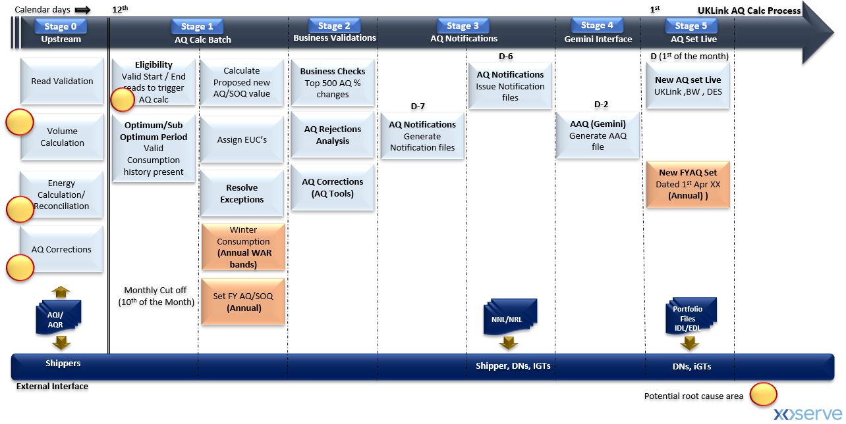
Monthly AQ Process – Defect Heat-Map
Potential Root Cause Areas…
Multiple process/system events occurring on the same day
Business/Technical Exceptions resulting in incorrect AQ
BAU change delivery – Robust regression test of all scenarios/variants
AQ defect process – robustness of process
Others…

Slide 6
Next Steps…
Continue to drive pace of defect resolution
Specific insight on the root cause and what remediation can be put in place (short, medium and long term)
Providing greater confidence on what additional checks and balances are being applied to BAU processing

