Slide 1
Key Value Indicators (KVIs) For Approval at CoMC
15th April 2020

Slide 2
Background
KVIs effective 1st April were agreed in principal at March CoMC.
Request for formal approval today (April CoMC) but recognising that these will be continually reviewed and updated where required
The new KVIs will be reported at May CoMC.
The KVIs will be an interim performance measure until the new operational performance measures and implemented.
To confirm, we shall continue to report on our performance with the (old) ‘Customer Service’ KVIs

Slide 3
KVI Summary
KVI | Measure | How Data is Captured | New or Existing | Reporting Frequency | Reporting Month
Customer Issue Resolution | Meeting commitments | Self assessment | Revised | Monthly | Monthly
Communication | Meeting commitments | Self assessment | New | Monthly | Monthly
Relationship Management | 95% stated they ‘Trust’ or ‘Starting to Trust’ Xoserve | Customer feedback requested via Contract Managers & Constituent Meetings | Existing | Quarterly | June 20, Sep 20, Dec 20, Mar 21
Change Management | 90% rated as ‘Always’ or Usually | Customer feedback requested from Change Managers | Revised | Quarterly | May 20, Aug 20, Nov 20, Feb 21
Customer Data Security | Number of data breaches | Self assessment | Existing | Monthly | Monthly
Financial Information | Meeting commitments | Self assessment | Revised | Minimum of 4 per year | TBC

Slide 4
Strawman KVI – Issue Resolution
Problem Statement:
Resolution of issues can be slow, the updates provided do not give sufficient information to enable customers to understand the materiality of the issue and the actions that organisations needs to take as a result of the issue.
Commitment:
Use MI to drive greater insight
Score each issue based on customer impact (see following 3 slides) and manage each issue accordingly
Notify customer as soon as issue is realised [depending on issue score]
Follow up with a plan for rectification (to include tasks, timescales, ownership)
Provide sufficient information in a timely manner, to enable customers to make an informed decision regarding actions they need to take.
Measure:
Self assessment based on whether or not the commitments set out above have been achieved
report monthly at CoMC

Slide 5
Strawman KVI - Communication
Problem Statement
Communication from Xoserve lacks clarity. It is not always clear who a message has been sent to; why it has been sent; or what actions are required by the customer.
Commitment
Maintaining distribution lists & notifying customers who the communication has been sent to in the comms
Standard template used (where appropriate) which clearly states what the comms is about, what action is being taken and if the customer is required to do anything and the material/financial impact on customers & who impacted
Comms to specify what we know & what we don’t know and when we will provide further information
Contact name will be provided if further is required from the customer
Measure
Self assessment. Xoserve to introduce internal peer review for communications issued externally based on the above commitments.

Slide 6
Customer Relationship
Statement
Xoserve to demonstrate improvement in customer relationships.
Commitment
Improve the quality and efficiency of Xoserve’s engagement with customers
Improve Xoserve’s relationship with its customers
Add value to customers
Feedback provided is evaluated and action plans developed to improve pain points for customers
Measure
Based on feedback received for the previous 3 months
95% or more of customers who provided feedback stated that they ‘Trust’ or ‘Starting to Trust’ Xoserve when requested to rate as ‘Trust’, ‘Starting to Trust’ ‘Starting to Distrust’ or ‘Don’t Trust’ with
strategic decisions
with delivery of operational services
putting our customers first

Slide 7
Change Management
Statement
Xoserve to demonstrate that it engages with customers during the change process and provides relevant level of support and information prior to delivery of change.
Commitment
Involve and consult customers regarding solution development
Provide customers with information and support to ensure they are prepared and ready for the changes being implemented
Changes delivered as per the agreed plan (at the relevant governance committee)
Delivering the customer benefit
Measure
Based on feedback received over a 3 month period
90% or more of customers who provided feedback responded ‘Always’ or ‘Usually’ when requested to rate the service as: ‘Always’, ‘Usually’, ‘Rarely’ or ‘Never’.
Feedback provided by customers is followed up to understand context, evaluated and continuous improvement plans developed and monitored until resolved.

Slide 8
Customer Data Security
Statement
Customers want regular updates on how Xoserve is managing Data Security on their behalf.
Commitment
To protect the integrity and security of customers data at all times
Zero data breaches
Notify customers immediately in the event of a data breach that is categorised as [Critical or High].
Report monthly to customers in the event of a data breach that is categorised as [Medium or Low].
Measure
Self assessment based on whether or not the commitments set out above have been achieved

Slide 9
Financial Information
Statement
Customers want clear financial updates from Xoserve.
Commitment
Minimum of four updates per financial year including:-
preliminary results from the previous financial year
quarterly forecasts which include actual results, key themes, investment progress and (where relevant) impacts on charges position
Offer sessions to review finances at an individual customer charging level.
Measure
Self assessment based on meeting the commitments set out above

Slide 10
Agree Next Steps
Formal approval and todays meeting (April CoMC)
KVIs will be effective from 1st April
First reporting month will be at May CoMC
Continuous review of the new KVIs

Slide 11
Appendix 1
Issue Resolution Framework

Slide 12
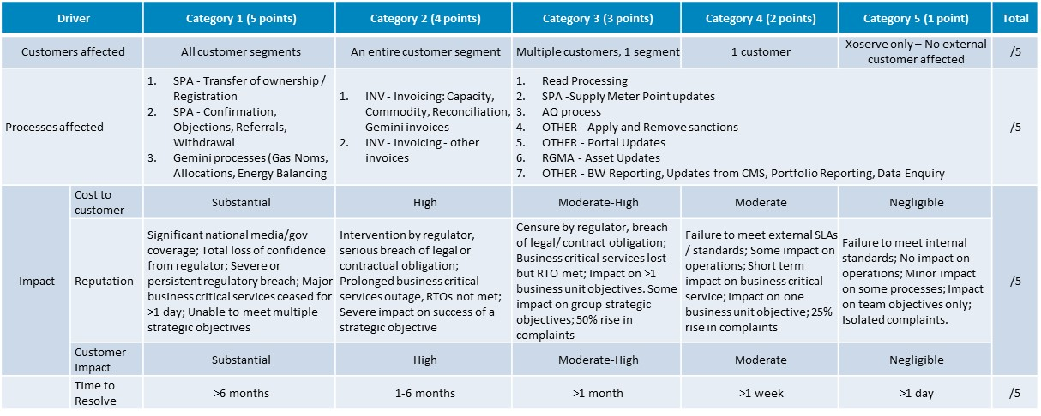
Customer Issue Prioritisation Framework

Slide 13
Defining Priority of each Customer Issue
Providing a tiered level of service both in terms of customer communications and sets a default standard for customers.
In the first instance, this categorisation will be applied to new customer issues in order to determine how effort is spent to resolve them. Incidents and defects should be reassessed using the same framework in order to;
Identify any customer issues that require a change in priority; and
Gain a better understanding of the current cost (financial or otherwise) of outstanding customer issues
Customer Issue Response Level
< 8 points
8-12 points
13-16 points
> 16 points
P1 & P2
BAU Process
Bronze Service
Silver Service
Gold Service
Platinum Service

Slide 14
Customer Issue Communication
Each level of Customer Issue will be attributed with specific targets around issue resolution and further communication/support.
The following details the expectations around tiered Customer Issue communications.
Service Levels | Associated Defect / Incident Priority Level | Communication Method | Communication Timings | Resolution Plan
BAU |  | Website & Email where required | Updated Monthly | Share
Bronze | D4 | Website | Updated Monthly | Share
Silver | D3 | Email & Website | Monthly | Share
Gold | D1 – D2 | Email & Website | Weekly | Agree
Platinum | P1 – P2 | Email & Website | Daily | Share/Agree

Slide 15
Appendix 2
Process for Measuring Communication

Slide 16
Key Value Indicators (KVIs) 2020/2021
Process for measuring Communications
April 2020, V1.0

Slide 17
KVI process
Submission
Review
Feedback
Training
1
2
3
4
Direct reports of XEC provide a random selection of customer emails sent out the previous month.
A selection of the submissions will be reviewed against the eight KVI criteria, by a panel made up from representatives across the business.
The KVI criteria will be used to formulate a set of improvement opportunities for each communication reviewed. Examples of best practice from the reviews, will be shared with the business.
Where needed the Communications Team will provide teams and individuals with training.
* CoMC members will validate scores and feedback
* The KVI review will not include communication campaigns led by the Communications Team.

Slide 18
KVI criteria
:
· Do you need to provide updates? Always respond to customers within the timeframe you have committed to or
The KVI criteria are based on our best practice guidelines for creating customer emails that are clear, consistent and reliable. Each communication reviewed can score a maximum of ten points.
Has any impact to the customer been included?
Is the communication templated?
1 mark
1 mark
Does the communication have a suitable email title?
Are actions clearly identified with deadlines?
1 mark
1 mark
Is the communication addressed to Dear Customer or personlised?
Have further contact details been provided?
1 mark
1 mark
Is it clear who the communication has been sent to?
Is the communication written in plain English, with minimum jargon?
1 mark
1 to 3 marks

Slide 19
KVI results
0 to 4
5 to 7
8 to 9
10
score
Score
Score
Score
Did Not Meet Expectations
Met Some Expectations
Met
Expectations
Exceeded Expectations

Slide 20
Schedule
Submissions | Review | CoMC material submission | CoMC
30th April | 5th May | 7th May | 20th May
29th May | 3rd June | 5th June | 17th June
30th June | 1st July | 3rd July | 15th July
31st July | 5th August | 7th August | 19th August
28th August | 2nd September | 4th September | 16th September
28th September | 30th September | 2nd October | 14th October
30th October | 4th November | 6th November | 18th November
30th November | 2nd December | 4th December | 16th December

