Slide 1
Change Management Committee
11th March 2020

Slide 2
2. New Change Proposals – Initial Review

Slide 3
2. New Change Proposals – Initial Review
Agenda Item | XRN / Title | Voting |  |  |  | Funding | DSC Service Area
 |  | Shipper Y/N | DNO Y/N | IGT Y/N | NTS Y/N
2.1 | XRN5116 Domestic Report - Must Read Prenotification | Y |  |  |  | 100% Shipper | Service Area 18: Provision of user reports and information
2.2 | XRN5120 MAP to UKL Monthly Comparison Service | Y | Y | Y | Y | Shipper – 34% DNO – 53% NTS – 7% IGT – 6% | Service Area 18: Provision of user reports and information
2.3 | XRN5110 November 2020 Release | Y | Y | Y |  | See Individual CP’s
2.4 | XRN5121 Supplier Portfolio Service | Y |  |  |  | 100% Shipper | None expected to be impacted. New service to Suppliers, suppliers do not form part of DSC customer base and data transfers to non-DSC customers are covered under existing service lines.
2.5 | XRN5122 Gemini System Enhancements - Delivery |  |  |  | Y | 100% NTS | Service Area 20: Gemini system services
2.6 | XRN5123 DSC Service Description Table cosmetic change to Service Line Table v10 | Y | Y | Y | Y | N/A | The introduction of 3 new service lines to cover BAU activities

Slide 4
2.1 XRN5116 Domestic Report - Must Read Prenotification
Voting Parties and Funding Split
Change Details
Customer Class | Voting Party? | Funding Split (%)
Shipper | Y | 100%
Distribution Network Operators (DNOs)
National Grid Transmission
IGT’s
Impacted Parties:- Shippers
Problem Statement
Current Must Read processes impact IGT SSPs, however the current Domestic pre-notification report is only issued on a quarterly basis. Changing the frequency of this report to Monthly would support proactive activity around submitting reads for IGTs, in line with UNC Must Read obligations, in addition to reducing MRA activity for IGTs.
Change Description
Change the frequency of the Domestic pre-notification report to Monthly.
DSC Service Area: | Service Area 18: Provision of user reports and information
Service Line Impacts (new, amended, existing, deleted), etc.
Link to Change Proposal | Link to CP
Sponsor Representative | British Gas

Slide 5
2.2 XRN5120 MAP to UKL Monthly Comparison Service
Voting Parties and Funding Split
Change Details
Customer Class | Voting Party? | Funding Split (%)
Shipper | Y | 34%
Distribution Network Operator (DNO) | Y | 53%
National Grid Transmission | Y | 7%
IGT | Y | 6%
Impacted Parties:- Meter Asset Providers (MAP)
Problem Statement
Meter Asset Providers have access to a best endeavors data reconciliation service of which a request has been received to make this an ongoing regular reconciliation.
Change Description
Over the last year or so, the CDSP have been providing a service to Meter Asset Providers (MAPs) to compare their meter asset portfolio against UK Link systems and play back the submitted data (MAP ID, MRPN, SUPPLIER_ID, METER_SERIAL_NUMBER, METER_INSTALL_DATE) into specific ‘pots’ to outline where mismatches occur and reporting back were there mismatches are found. See the CP for the Outlined ‘pots’ which are to become an enduring set of reporting for participating MAPs: This Change Proposal is looking to enhance this reconciliation process making it a more formal ongoing Monthly service as a maximum frequency (but would also accommodate requests where customers wanted to participate quarterly or six monthly for example).
DSC Service Area: | Service Area 18: Provision of user reports and information
Service Line Impacts (new, amended, existing, deleted), etc. | TBA
Link to Change Proposal | Link to CP
Sponsor Representative | E.ON

Slide 6
2.3 XRN5110 November 2020
Voting Parties and Funding Split
Change Details
Customer Class | Voting Party? | Funding Split (%)
Shipper | X
Distribution Network Operators (DNOs) | X
National Grid Transmission
IGT’s | X
Impacted Parties:- See Individual Change Proposals
Change Description
There are 10 changes for inclusion as scope of delivery for the November 20 release as approved by ChMC on the 12th February 2020 For information these changes are… • 4780c - MAP ID: CSSC • 4801 - Additional Info in DES • 4871b - Ratchet regime changes • 4897 - Contact Details • 4899 - Contact Details • 4931 - Space in SPA Files • 4941 - MOD 692 - Auto Updates to Meter Read Frequency • 4992 - Supplier of last resort charge type • 5014 - Hydeploy trial • 5036 - Updates to must read process
DSC Service Area: | See Individual Changes
Service Line Impacts (new, amended, existing, deleted), etc.
Link to Change Proposal | Link to CP
Sponsor Representative | Xoserve

Slide 7
2.4 XRN5121 Supplier Portfolio Service
Voting Parties and Funding Split
Change Details
Customer Class | Voting Party? | Funding Split (%)
Shipper | Y | 100%
Distribution Network Operators (DNOs)
National Grid Transmission
IGT’s
Impacted Parties:- Suppliers
Problem Statement
As part of the Data Permissions Matrix (DPM) Suppliers are able to receive a portfolio report however it has not yet been created. This Change Proposal is to create the portfolio report.
Change Description
As part of the Data Permissions Matrix (DPM) Suppliers can access a variety of data items if the Supply Meter Point is within their portfolio. As a result, several requests have been received by Suppliers to access this information. This Change Proposal is looking to develop a portfolio service to be provided to Suppliers via a Commercial Contract. This is an opportunity for cost of the development of the Supplier Portfolio Report to be socialized across the Shipper community.
DSC Service Area: | None expected to be impacted. New service to Suppliers, suppliers do not form part of DSC customer base and data transfers to non-DSC customers are covered under existing service lines.
Service Line Impacts (new, amended, existing, deleted), etc. | n/a
Link to Change Proposal | Link to CP
Sponsor Representative | Xoserve

Slide 8
2.5 XRN5122 Gemini System Enhancements - Delivery
Voting Parties and Funding Split
Change Details
Customer Class | Voting Party? | Funding Split (%)
Shipper
Distribution Network Operators (DNOs)
National Grid Transmission | Y | 100%
IGT’s
Impacted Parties:- NTS, Shippers & DNO
Problem Statement
NG have a commitment to our customers and Ofgem to maintain compliance with the UNC and ensure that Gemini meets the needs of its users. Gemini Re-Platforming addresses the ageing hardware and brings the software versions back in support. Enhancements along with the longer-term roadmap is about adapting/improving Gemini based on the needs of a changing industry to meet customer expectations.
Change Description
The purpose of this Change Proposal is to request Xoserve to deliver a set of the requirements captured in the CBRS; key activities to include the following: • Detailed analysis of the selected enhancements • Engage with shippers and other Gemini users to clarify those enhancements where assumptions were made under the F&A • Define solutions for the in-scope enhancements • Provide delivery options, including costs, complexity and timescales, taking into consideration the wider Gemini change programme • Deliver the chosen delivery option SEE CP FOR FULL DESCRIPTION
DSC Service Area: | Service Area 20: Gemini system services
Service Line Impacts (new, amended, existing, deleted), etc. | Existing
Link to Change Proposal | Link to CP
Sponsor Representative | National Grid

Slide 9
2.5 XRN5123 DSC Service Description Table cosmetic change to Service Line Table v10
Voting Parties and Funding Split
Change Details
Customer Class | Voting Party? | Funding Split (%)
Shipper | Y | N/A
Distribution Network Operators (DNOs) | Y | N/A
National Grid Transmission | Y | N/A
IGT’s | Y | N/A
Impacted Parties:- All
Problem Statement
The Service Description table needs to be updated with the following new Service Lines: ASGT NC SA9 02 which details how Xoserve as the CDSP will invoke the Supplier Deed of Undertaking as an Agent of National Grid Gas Transmission ASiGT CS SA9 02 which details how Xoserve as the CDSP will invoke the Supplier Deed of Undertaking on behalf of IGTs DS-CS SA3 -18 which details how Xoserve as the CDSP manage the administration of MDD as set out within the UNC
DSC Service Area: | The introduction of 3 new service lines to cover BAU activities
Service Line Impacts (new, amended, existing, deleted), etc. | New
Link to Change Proposal | Link to CP
Change Description
The amended Service Description table will be issued to each DSC contract manager for consultation. The CDSP will collate any consultation responses and provide these to the DSC Contract Management committee with recommendations for treatment. Unless there are consultation responses that are considered material, the Contract Management committee can approve the proposed Service Description table at the relevant meeting
Sponsor Representative | Xoserve

Slide 10
3. New Change Proposals – Post Initial Review
None for this meeting

Slide 11
4. New Change Proposals – Post Solution Review

Slide 12
4.1 New Change Proposals – Post Solution Review
XRN / Title Proposed Release Link to Change Proposal Comm Ref | DSG Preferred Option and date | Solution Summary Outcome and implementation date outcome |  |  |  | Comments | Xoserve response (where applicable)
 |  | Organisation | Approve | Defer | Reject
XRN5036 Updates to must read process Proposed for November Release Link to CP Link to Change Pack ref: 2532.1 - MT - JR Voting: DNs High Level Solution Option 1 £25,000 – 30,000 GBP Sponsor: Cadent Gas | Option 1 has been classified to be a Minor Release candidate, however if ChMC agree that this option should be delivered within a Major Release, the delivery cost will increase due to additional efforts involved with standing up a Major Release Project team. These additional efforts will not be reflective in the HLSO cost for Option 1. | NGN | X |  |  | NGN’s preference is for Option 1 to be delivered within a Minor Release either before or in line with XRN4941. If it is implemented prior to XRN4941, we would prefer a minor release in Oct 2020. | Thank you for your representation, we will feed this into ChMC for a final decision.
 |  | Cadent | X |  |  | Option 1 as this is the least cost option which meets all requirements and can be implemented ahead of or in conjunction with XRN 4941 | Thank you for your representation, we will feed this into ChMC for a final decision.
 |  | EDF | X |  |  | Preferred Solution Option 1. Albeit the data will be one day out of date, it is a much more sensible approach at a reduced cost. | Thank you for your representation, we will feed this into ChMC for a final decision.

Slide 13
4.1 New Change Proposals – Post Solution Review
XRN / Title Proposed Release Link to Change Proposal Comm Ref | DSG Preferred Option and date | Solution Summary Outcome and implementation date outcome |  |  |  | Comments | Xoserve response (where applicable)
 |  | Organisation | Approve | Defer | Reject
XRN5036 Updates to must read process Proposed for November Release Link to CP Link to Change Pack ref: 2532.1 - MT - JR Voting: DNs High level Solution Option 1 £25,000 – 30,000 GBP Sponsor: Cadent Gas | Option 1 has been classified to be a Minor Release candidate, however if ChMC agree that this option should be delivered within a Major Release, the delivery cost will increase due to additional efforts involved with standing up a Major Release Project team. These additional efforts will not be reflective in the HLSO cost for Option 1. | Wales and West | X |  |  | WWU supports option 1 as this can be delivered as a minor change ahead of XRN4941 that implements UNC 0692 (subject to appeal). We would like the addresses to be validated and MPRNs with invalid or poor quality addresses rejected and not issued as requests for must reads. The Meter Read Agent will not be able to obtain a read for MPRNs with a poor quality address so it would be more sensible to remove these at source. We realise that it is not possible to change the scope of this change this late and we do not want to delay this change. Please would Xoserve, in their response, identify what if any address validation is applied in this process. We have ticked approve Xoserve preferred solution and approve implementation date although Xoserve had no preferred solution and the implementation date depends on the solution. We prefer option 1 delivered in a minor release ahead of the November 2020 major release. For information, WWU intends to recover its share of the cost of this change in an amendment to our charges for the must read service. Although the must read service is a transportation service, the revenue is not part of WWU's allowed revenue and therefore it is appropriate that the cost of the service is fully recovered from the parties receiving it. | Thanks for your response. We have spoken to the relevant team and have been told that currently there is no address validation carried out within the must read process. We will feed your response into ChMC for a final decision.
 |  | Robin Hood Energy |  |  | X | We are of the view that an agreed industry position does not quite qualify as the Transporter's discretion, and therefore feel that TPD 5.10 (specifically 5.10.1 and 5.10.2) ought to be amended in order to permit this change. We feel that where this 'agreement' is permitted outside of the relevant code changes we will likely experience issues going forward e.g. potentially material impacts where Xoserve incorrectly hold a smart identifier for a traditional/classic meter; differential treatment of must reads for smart meters between iGTs and GT, differential treatment of smart meters between GTs where GTs utilise their discretion to move away from said 'agreement' at any future point (without any requirement/process to notify such a change in discretion) etcetera. Consequently, we feel that this is not a future-proofed solution and would request that the Change Committee consider unintended consequences when deliberating on this change request. | Thank you for your representation, we will feed this into ChMC for a final decision.

Slide 14
5. Implementation Plan
Please see the following slides for an overview of:
Detail Design Changes for approval
Outages
  No new outages.
  Changes to dates and descriptions (highlighted on slide)
Attached is the full Implementation Plan document.

Slide 15
CSSC Detail Design Reps
Release

Slide 16
Functional Changes
XRN / Title | Solution & Implementation Summary outcome |  |  |  | Comments | Xoserve response
 | Organisation | Approve | Deferred | Reject
DES CSS Consequential Change – Detailed Design Change Pack ref: 2533.2 - MT - JR June 2021 Release Voting: Shipper, Supplier, DNs and iGTs | EDF |  |  | X | 4.1.1 – what if they were provided by the portfolio shipper after the switch? These should also be displayed - How often will DES be updated, will it be live updates? Can't see this called out. - I think REL address should be displayed as a tab in the main ‘Search Details’ screen of DES not just in a totally separate screen area to make it easier to reference - Main reason for rejecting is that we believe DES APIs should be updated with new data items in line with DES screen updates inc REL data. This should be the default in a future where our thinking regarding change should be joined up rather than isolated and this BRD should set this precedent. | 4.1.1 – what if they were provided by the portfolio shipper after the switch? These should also be displayed Additional clarity to be added to the BRD to confirm that where emergency contact details have been provided by the incoming or registered shipper that the relevant details will still be visible via DES. - How often will DES be updated, will it be live updates? Can't see this called out. The BRD will be updated to include the planned near “real-time” refresh frequency that will be introduced as part of the CSS changes. - I think REL address should be displayed as a tab in the main ‘Search Details’ screen of DES not just in a totally separate screen area to make it easier to reference The REL has been added to a different set of screens to enable DES to capture that users are confirming that the data is being used for the purposes of switching, as per the usage constraints that are applied to REL data by the Switching Programme. - Main reason for rejecting is that we believe DES APIs should be updated with new data items in line with DES screen updates inc REL data. This should be the default in a future where our thinking regarding change should be joined up rather than isolated and this BRD should set this precedent. The DES BRD is only covering the screen changes that are being made to DES, a separate set of documentation is being produced to cover the API changes that are being introduced. The DES BRD scope section will be updated to included APIs as an out of scope item for this document.

Slide 17
Outages
Change Request Number | Impacted System | Outage Duration |  |  |  |  | Committee Notified Date
 |  | Start Date | Start Time | End Date | End Time | Brief Description
4970 | DCC | 11/04/2020 | TBC | 12/04/2020 | TBC | This is the cutover of the production environment for DCC the outage will be on the weekend, the impact to the industry will be minor and that any nominations/ confirmations that utilises the Data Communications Company (DCC) as a background application will be unable to send or receive files during the maintenance window as the application is switched from our Legacy DC to TCS ECP. Subject to change due to multiple inflight changes and dependencies on suppliers. | Updated 11th March
4970 | AD & BoKs | 28/03/2020 | TBC | 29/03/2020 | TBC | This will be cutover of the AD & BoKs application, the which includes the Actives Directory (AD), BoKs and Squid proxy the outage will be on the weekend and the impact will be little to none and will unable to be utilised during the maintenance window as the application is switched from our Legacy DC to TCS ECP.. | Updated 11th March
4970 | CMS | 11/04/2020 | TBC | 12/04/2020 | TBC | This is the cutover of the production environment for CMS, the outage will be on the weekend, the impact to the industry should be minor and that the Contact Management System will be unable to send or receive files, raise contacts and will not allow users to log on during the maintenance window as the application is switched from PET/KET to Chess/Cress. Subject to change due to multiple inflight changes at the time, but only by a week. | 13/11/2019
4970 | CMS | 25/04/2020 | 00:00:00 | 26/04/2020 | 07:00:00 | This is the outage for CMS DR testing this will be on the weekend, the impact to the industry will be minor as this will be conducted through the scheduled maintenance window. During this window CMS will be unavailable as such users will be unable to log into the system and files that would normally be processed daily are unaffected as they are planned/scheduled for outside this window. Subject to change due to multiple inflight changes at the time, but only by a week. | Updated 11th March
4970 | Birst Connector | 11/04/2020 | TBC | 12/04/2020 | TBC | This is the cutover of the entire Birst connector application, the outage will be on the weekend and the impact will be little to none and will unable to be utilised during the maintenance window as the application is switched from our Legacy DC to TCS ECP. | Updated 11th March
4970 | DCC | 02/05/2020 | TBC | 03/05/2020 | TBC | This is the outage for DCC DR testing this will be on the weekend, the impact to the industry will be minor and that any application that utilises DCC as a background application will be unable to send or receive files during the maintenance window will DR testing is conduct. Subject to change due to multiple inflight changes at the time, but only by a week. | Updated 11th March
4550 | Control M | 16/05/2020 | TBC | 17/05/2020 | TBC | This is the cutover of the entire Control M application, the outage will be on the weekend and the impact will be minimal, batch jobs that will utilise the application will be delayed during the maintenance window as the application is switched from our Legacy DC to TCS ECP. Subject to change due to multiple inflight changes at the time, but only by a week. | Updated 11th March
 | Internet routing for UKLink | 23/05/2020 | TBC | 24/05/2020 | TBC | This is the cutover of the Internet routing for UKLink, the outage will be on the weekend and the impact will be minor, UKLink will be unable to be accessed and unable to send or receive files to corresponding systems during the maintenance window as the application is switched from our Legacy DC to TCS ECP. | Updated 11th March
 | Gemini | 05/07/2020 | 03:00 | 05/07/2020 | 17:00 | In order to complete the Gemini Re-Platforming (GRP) project implementation, an extended outage will be required on the Gemini system on 5th July 2020. Provisional timescales for the GRP implementation are as follows: Gemini Maintenance Window: 03.00 to 5.00 Extended outage: 05.00 to 13.00 In the event of a rollback an additional outage will be required from 13.00 to 17.00 If a change is identified to the above timings, a further notification will be issued. The GRP team will work with the National Grid and Xoserve business to ensure appropriate measures are in place to manage all impacts due to the extended outage. If you have any concerns or any questions, please contact the project team on box.xoserve.geminire-platform@xoserve.com | 11/12/2019

Slide 18
6. Approval of Change documents
6.1 CCR for XRN4665 End User Categories (EUC) Update
  Voting: Shippers
6.2 CCR for XRN4828 November 2019 Release Update
  Voting: Shippers
6.3 CCR for XRN4851 Moving Market Participant Ownership from SPAA to UNC/DSC
  Voting: Shippers
6.4 CCR for XRN4853 Interim process to monitor & manually load rejected reads into UK Link where the read was rejected for reason code MRE00458 only (UIG Recommendation 3.1 option 5)
  Voting: Shippers
6.5 Updated BER for XRN4653 iConversion Phase 1
  Voting: NTS
6.6 CCR for XRN4653 iConversion Phase 1
  Voting: NTS

Slide 19
6. Approval of Change documents
6.7 EQR for XRN5110 UKLink November 2020 Major Release
  Voting: All parties (except NTS)
6.8 CCR for XRN5013 Performance Assurance Framework Administrator Access to Data Discovery Platform

Slide 20
XRN4996 - June 20 Release - Status Update
11th March 2020 | Overall Project RAG Status:
 | Schedule | Risks and Issues | Cost | Resources
RAG Status
Status Justification
Schedule | Plan: Replan completed following descope of 4 changes, Market Trials inclusion pending confirmation at eChMC on 5th March. Delivery: Build has completed for all changes. System Testing (ST) has been completed for 3 changes and (User Acceptance Testing (UAT) has commenced. ST is in progress for 3 changes. Scope: Scope is unchanged from meeting in February, please refer to slide 4 for confirmed scope of release. Implementation: Implementation date of Saturday 27th June confirmed.
Risks and Issues | Risk – The remaining risk margin for this change will be used up due to additional, as yet unidentified, costs being incurred for the Integration of the SMS Service with Xoserve systems.
Cost | Costs for the SMS set up and configuration for xrn4850 - Notification of Customer Contact Details to Transporters have increased following design approval due to the fact that third parties are required to build, test and implement the solution/integration with Xoserve systems and to carry out penetration testing, see following slide for detail.
Resources | Weekly monitoring of Xoserve SME resources supporting multiple demands (e.g. BAU defects, Future Releases etc.) is ongoing

Slide 21
June 20 Release – XRN4850 Costings
UK Link SAP Delivery (BER Extract for xrn4850 – ChMC on 12/02))
Delivery costs remain unchanged at £162,456
MT Set Up Cost attributed to 1 change not split between 3
SMS Functionality Integration
Delivery Costs unchanged
Cost of Integration is £75,292
  SMS/Email Integration - Build, Test and Implement confirmed at £70,292
  Penetration Testing is required at £5,000
SMS Set Up risk (see previous slide) materialised so risk margin funds used for this change.
Risk Margin was £78,944 now stands at £3,652
Total remaining risk margin for June 20 is £86,457

Slide 22
XRN4996 - June 20 Release Timelines
Key Milestone Dates:
Capture completion – 19/09/19
Design Completion – 13/12/19
Build & Unit Test Completion – 31/01/20
System & UAT Completion – 24/04/20
Regression Test Completion – 29/05/20
Implementation – 27/06/20
PIS Completion – 25/09/20 (provisional)

Slide 23
June 20 Release Summary
June 20 Release consists of 7 changes, Implementation is planned for June 2020:
In Scope
XRN4772 - Composite Weather Variable (CWV) Improvements
XRN4888 - Removing Duplicate Address Update Validation for IGT Supply Meter Points via Contact Management Service (CMS)
XRN4930 – Requirement to Inform Shipper of Meter Link Code Change
XRN4850 - Notification of Customer Contact Details to Transporters
XRN4865 - Amendment to Treatment and Reporting of CYCL Reads
XRN4932 - Improvements to the quality of the Conversion Factor values held on the Supply Point Register (MOD0681S)
XRN4780 (B)*** – Inclusion of Meter Asset Provider Identity (MAP Id) in the UK Link system (CSS Consequential Change)
Descoped
XRN4691** - CSEPs: IGT and GT File Formats (CGI Files)
XRN4692** - CSEPs: IGT and GT File Formats (CIN Files)
XRN4780 (B) - Inclusion of Meter Asset Provider Identity (MAP Id) in the UK Link system (CSS Consequential Change)
XRN4871 (B)** - Changes to Ratchet Regime (MOD0665)
XRN4941* - Auto updates to meter read frequency (MOD0692)
* Pending Solution/MOD approval by ChMC/DSG for remaining CRs. Descoped at ChMC on 08/01/20
** Descoped at eChMC on 22/11/19
*** Added to scope (revised scope from original)

Slide 24
Retro Proof of Concept
Step 1 ‘Data Comparison and Aggregation’
Market Level – Results Deck

Slide 25
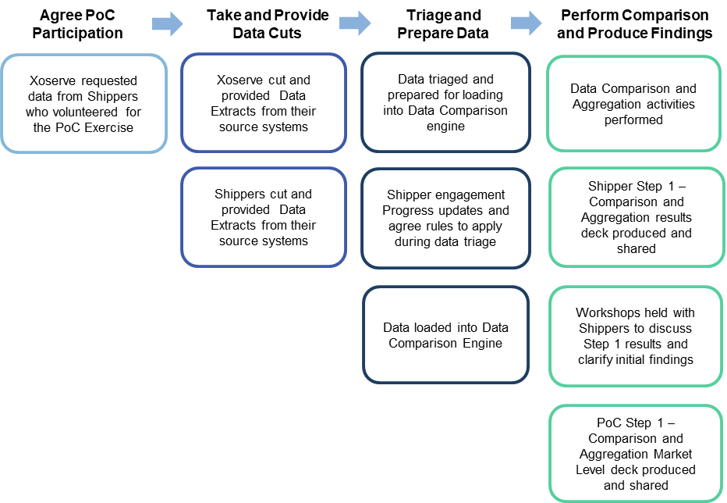
Retro Proof of Concept - the Story So Far

Slide 26
Key Points
Data Cut Timings – UK Link as of 8th December 2019
9 Shipper participating in the Proof of Concept
9.7m MPRNs received
133m data items provided across 31 data fields
This pack details the results from Step 1 ‘Comparison and Aggregation’ of the levels and types of data mismatches identified
Step 2 ‘Deep Dive’ analysis will investigate the impact & root cause of the Retro Assessable mismatches
Retro
Proof of Concept

Slide 27
Step 1 - Market Level Data Categories
Retro Proof of Concept
Step1
General Details
Asset Details
Measurement Details
AMR & Convertor Details
Reading Details
To support presenting our Step 1 findings data items have been grouped into 5 categories
Categories were defined based on the type of data items received from Shippers taking part in the PoC
This data has been compared against equivalent records held in UK Link systems
Any mismatches that have been identified will be fed into the Proof of Concept Step 2 Deep Dive analysis

Slide 28
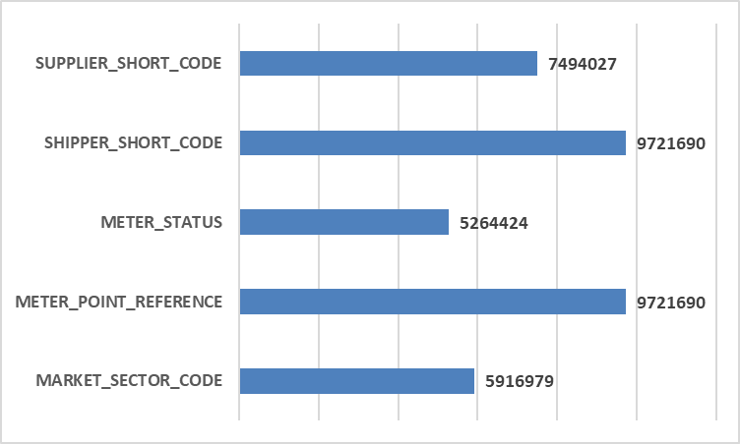
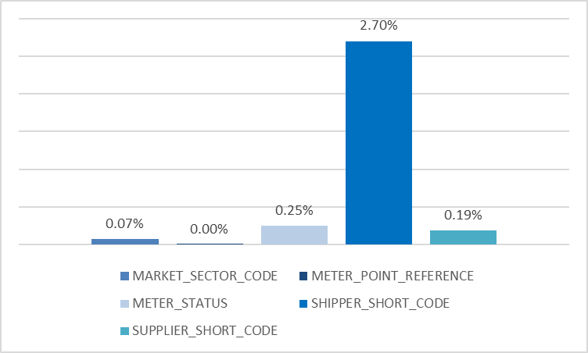
General Details – Step 1 Findings
Frequency of Data Item Provided
Average Percentage of Mismatch Identified
Key Points / Considerations
2.70% Mismatches for the Shipper Short Codes data item due to variation in data cut dates = the natural churn in MPRNs between Shippers
0.25% Mismatch between Meter Status details data item – To be investigated as part of Step 2 Deep Dive analysis
0.07% difference between Market Sector Code details provided by Shippers against equivalent record held in UK Link

Slide 29
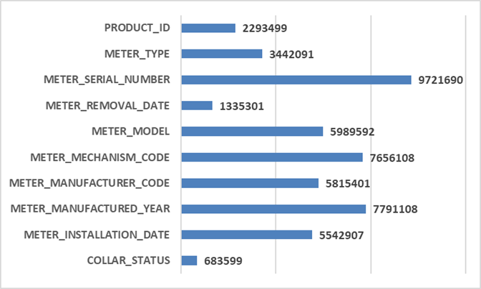
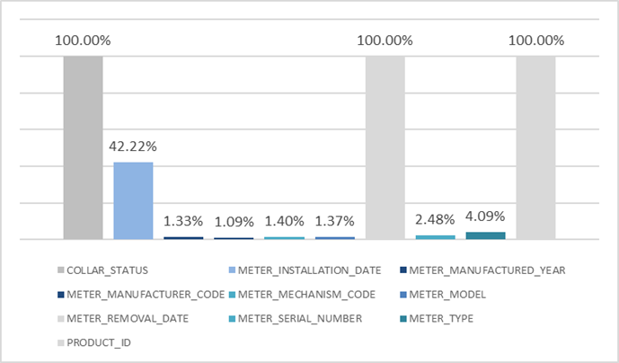
Asset Details – Step 1 Findings
Frequency of Data Item Provided
Average Percentage of Mismatch Identified
Key Points / Considerations
100% mismatches relate to data items where no equivalent UK Link values are held
Meter Installation Date data item (42.22%) and Meter Removal Date data item (4.09%) identified differences in system treatment – e.g. Future Effective Meter Removal Dates provided in Shipper datasets
2.48% mismatch between Meter Serial Number data item held in respective systems – root cause and impact of this to be assessed in Step 2 Deep Dive analysis

Slide 30
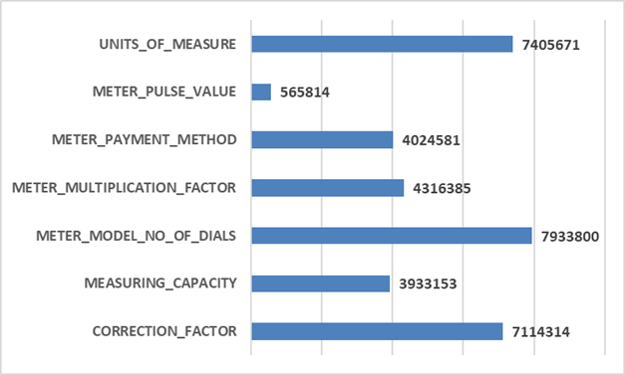
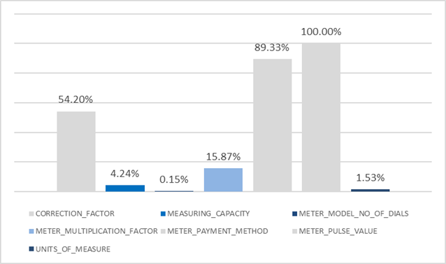
Measuring Details – Step 1 Findings
Frequency of Data Item Provided
Average Percentage of Mismatch Identified
Key Points / Considerations
Mismatches identified on Meter Payment Method data item (89.33%) and Meter Pulse Value data item (100%) due to minimal population of these data items being held in UK Link
Correction Factor mismatches data item (54.20%) due to combination of rounding and truncation anomalies within Shipper datasets
All data Items to be assessed further for root cause and impact as part of Step 2 Deep Dive analysis

Slide 31
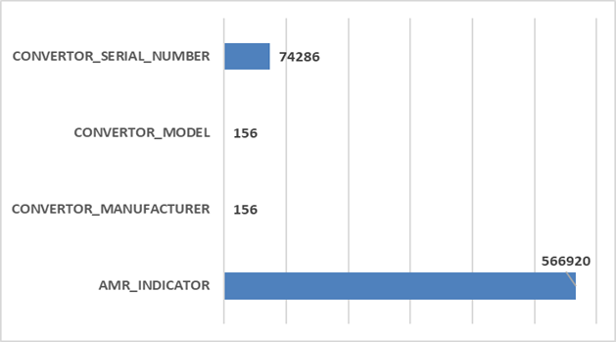
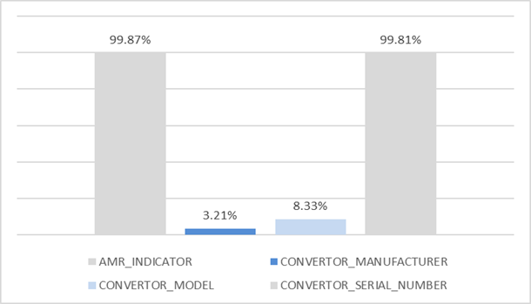
AMR & Convertor Details – Step 1 Findings
Frequency of Data Item Provided
Average Percentage of Mismatch Identified
Key Points / Considerations
AMR Indicator data item (99.87%) and Convertor Serial Number data item (99.81%) mismatches due to default values being provided in Shipper datasets
Convertor Model data item (8.33%) and Convertor Manufacturer data item (3.21%) mismatches to be investigated further during Step 2 Deep Dive analysis
All data Items to be assessed further for root cause and impact as part of Step 2 Deep Dive analysis

Slide 32
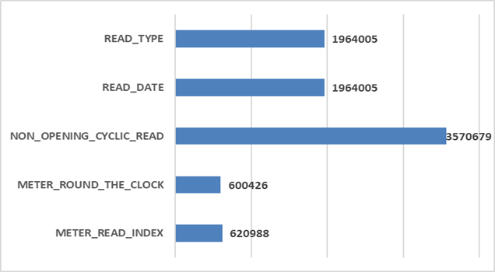
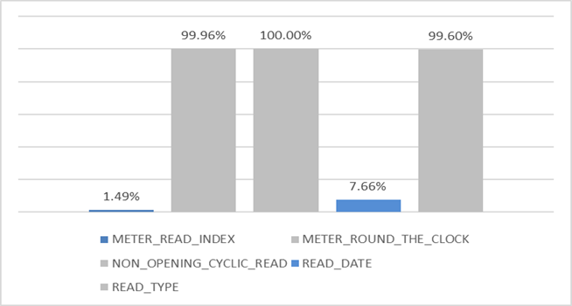
Reading Details – Step 1 Findings
Frequency of Data Item Provided
Average Percentage of Mismatch Identified
Key Points / Considerations
Meter Round the Clock data item (99.96%) due to difference in the way data is stored in respective systems (e.g. 01 provided vs 1 held in UK Link)
Mismatches against Non Opening Cyclic Read data item (100%) and Read Type data item (99.6%) expected as these items were requested to support further analysis during Step 2 Deep Dive
Differences in Meter Read Index data item (1.49%) and Read Date data item (7.66%) appear genuine and will also be assessed further during Step 2 Deep Dive analysis

Slide 33
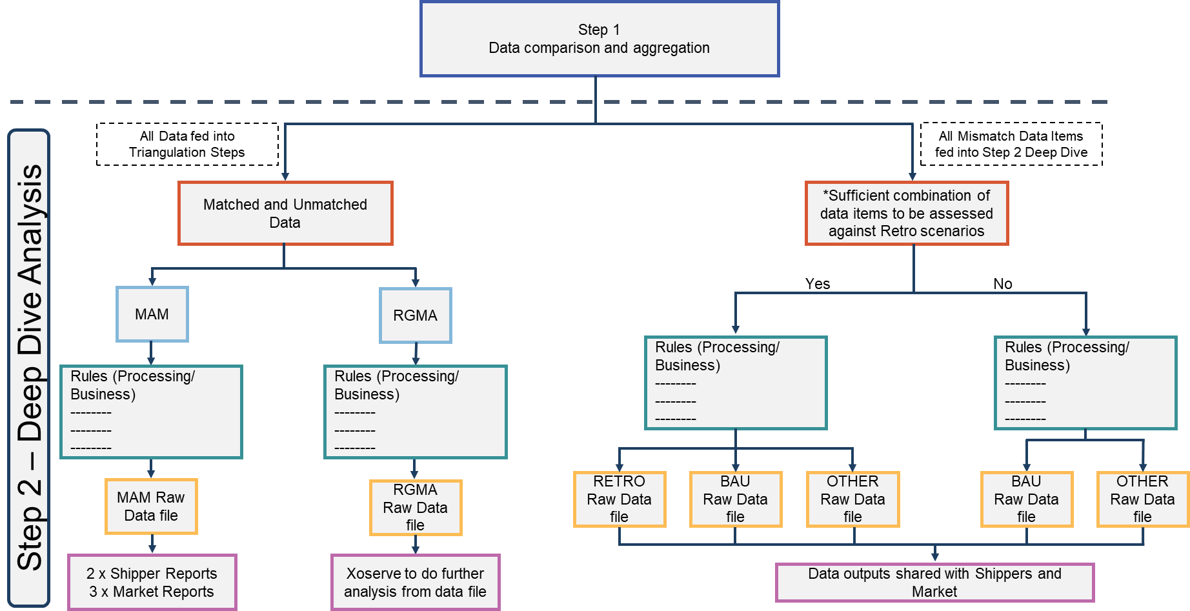
What’s Happening Next?

Slide 34
XRN4914 MOD 0651- Retrospective Data Update Provision –
Proof of Concept Progress update
11th March 2020 | Overall Project RAG Status:
 | Schedule | Risks and Issues | Cost | Resources
RAG Status
Status Justification
Schedule | Delivery: All participating shippers have been issued a Data Comparison and Aggregation deck for Step 1 of the POC detailing key findings, breakdown of results (volume of anomalies) as well as a comparison as to how their portfolio performed against overall market level view (8 participating shippers) A Market Level view of the findings from Step 1 has been published and will be presented at Change Management Committee (ChMC) on 11th March Step 1 Market Level view to be published following walkthrough at ChMC Development and Testing of the comparison tool for Step 2 to be completed in early March Detailed planning of analysis activities for Step 2 and External Communication approach being finalised. Step 2 execution forecast to be completed by end of April with final outputs shared in May Customer Engagement and Communications: Ongoing communication with POC participating members to walkthrough outputs for Step 1 and next steps for POC External Communication approach for Step 2 being finalised
Risks and Issues | Deep Dive Analysis (Step 2 of POC) may require more time/ effort to complete than is currently thought Update: Initial assessment of Step 2 and efforts involved indicates execution and analysis will be completed by end of April. Timeline to be validated once Step 2 results generated and scope of analysis work required, based on volume of anomalies, is defined.
Cost | Approval received from DN’s for BER of £270k for proof of concept
Resources | Security resource allocated to proof of concept Working with SME team to agree resource allocation. There is a risk that SME resources required for Step 2 are not wholly available due to commitment to other in flight projects.
XRN4914 MOD 0651 - Retrospective Data Update Provision - CHMC Update 11th March

Slide 35
XRN4914 – Retro proof of concept - timeline
2019 / 2020
November | December | January | February | March | April
Date for slicing data
8th Dec
Checkpoint 1
29th Nov
Checkpoint 2
7th Feb
Checkpoint 3
12th Mar
Customer Engagement
Initial Customer engagement
kick-off 4th Nov
Initial Customer engagement of File receipt
Still ongoing
Recommendations
Customer / Advocates encouraging participation
Kick-off prep
Test files can be accepted
Actual data files can be accepted
Weekly project update via external communication methods
Support
Design (Step 1)
Develop (Step 1)
Design (Step 2)
Business Rules for Shipper Fixed Anomalies awaiting SME Review and Input, Design Step 2 then complete
Testing (Step 1)
Develop (Step 2)
Testing (Step 2)
Support
Analysis
Test data
files in
Actual data
files in
Step 1 Compare / Outcome / Aggregate
Step 2a Categories & 2b MAM
Step 2c RGMA & 2d Deep Dive
Output from Step 1
Output from Step 2a & 2b
Output from Step 2c & 2d
today
Dates need to be confirmed post Step 1
results as volumes will inform task size
XRN4914 MOD 0651 - Retrospective Data Update Provision
11th March
Completed
On-target
Medium risk
Planning
Key:
Slipped / High risk

Slide 36
7.3 XRN5057 – Minor Release Drop 6 - Status Update
11th March 2020 | Overall Project RAG Status:
 | Schedule | Risks and Issues | Cost | Resources
RAG Status
Status Justification
Schedule | Plan: MiRD6 consists of 2 changes and to be delivered on 29/02/20. Delivery: Build and all Testing is completed and implementation will be on 29/02/20. PIS preparation complete and First Usage plan has been approved. Scope: The agreed scope of XRN5057 is for 2 changes XRN 4955 - Amendment of MDD PSR Needs Codes and Needs Codes Descriptions and XRN4997 - Introduction of New Charge Codes for Pro-Active Payment of GSOP 3 and GSOP 13 and GT Voluntary Consumer Payments Implementation: Implementation date of Saturday 29th February has been agreed.
Risks and Issues | Risk – A risk has been raised against the availability of environments during PIS. The project team are working with other project teams and Tech Ops to ensure there is no disruption if any defects are identified.
Cost | Changes are being delivered as part of the Minor Release budget.
Resources | All required resources for PIS and First Usage have been confirmed and approved

Slide 37
XRN5057 – MiRD6 Release Timelines
Key Milestone Dates:
Design Completed – 13/12/19
Build & Functional Unit Test Completion – 03/01/20
System Test & Assurance Completion – 24/01/20
Regression Test & Assurance Completion – 14/02/20
Implementation Date – 29/02/20
PIS Completion – 13/03/20
CR ID | 11-Nov-19 | 18-Nov-19 | 25-Nov-19 | 02-Dec-19 | 09-Dec-19 | 16-Dec-19 | 23-Dec-19 | 30-Dec-19 | 06-Jan-20 | 13-Jan-20 | 20-Jan-20 | 27-Jan-20 | 03-Feb-20 | 10-Feb-20 | 17-Feb-20 | 24-Feb-20 | 02-Mar-20 | 09-Mar-20
 | Pre-Work |  | Wk 1 | Wk 2 | Wk 4 | Wk 5 | Wk 6 | Wk 7 | Wk 8 | Wk 9 | Wk 10 | Wk 11 | Wk 12 | Wk 13 | Wk 14 | Wk 15 | Wk 16 | Wk 17
XRN 5057 | IA & Approval
 |  |  |  | Design & Approval |  | Build + FUT
 |  |  |  |  |  |  |  |  | ST + Assurance |  |  | Code Merge
 |  |  |  |  |  |  |  |  |  |  |  |  | RT + Assurance |  | Contingency | Imp 29/02 | PIS

Slide 38
UK Link Releases Update – For Information
March 2020 CHMC

Slide 39
2020/2021 UK Link Governance Timeline
2020 | 2021
Jan | Feb | Mar | Apr | May | Jun | Jul | Aug | Sep | Oct | Nov | Dec | Jan | Feb | Mar | Apr | May | Jun | Jul | Aug | Sep | Oct | Nov | Dec
4779
Key:
BER Approval
10/04/18
On track
Feb-20
Complete
MiR 6
At risk
Jun - 20
Scope approval – Feb ChMC
Nov 20
BER Approval
May-20
EQR Approval – March ChMC
RETRO
Potential Activity
Governance Approval dates tbc…
CSSC
CSSC activity
Assumes that there will be a Major Release in Nov 2020
Please note that this includes potential activity within UK Link over the next 24 months

Slide 40
Change Index – UK Link Allocated Change
Proposed Release | XRN | Change Title | Current Status | UK Link Release | Complexity | Finance
Feb 20 | 4896 | Rejection code reword – defect 1492 / End User Categories (EUC file format descriptions | In Delivery | Documentation | N/A | N/A
MiR D6 Feb-20 | 4955 | Amendments of MDD PSR needs code descriptions | In PiS | MiR D6 | Medium | N/A
 | 4997 | Introducing new charge codes for pro-active payment of GSOP 3 and GSOP 13 | In PiS | MiR D6 | Small | N/A
Jun-20 | 4865 | Amendment to Treatment and Reporting of CYCL Reads | In Delivery | June-2020 | Small | Shippers / DNO
 | 4772 | Composite Weather Variable (CWV) Improvements | In Delivery | June-2020 | X-Large | Shippers / DNO
 | 4930 | Requirement to Inform Shipper of Meter Link Code Change | In Delivery | June-2020 | Small | Shippers
 | 4932 | Improvements to the quality of the Conversion Factor values held on the Supply Point Register (MOD0681S) | In Delivery | June-2020 | Medium | Shippers / DNO
 | 4850 | Notification of Customer Contact Details to Transporters | In Delivery | June-2020 | X-Large | IGTs / DNO
 | 4888 | Removing Duplicate Address Update Validation for IGT Supply Meter Points via Contact Management Service (CMS) | In Delivery | June-2020 | Medium | IGTs
 | 4780b | MAP ID Part B | In Delivery | June 2020 | Large | Shippers
CSSC | 4627 | Consequential Central Switching Services | In Delivery | June 2021 | N/A | Shippers
Retro | 4914 | Retro Proof of Concept | In Delivery | Standalone | N/A | DNO
Nov 2020 | 5014 | Hydeploy Live Trial | In Delivery | Nov 2020 | Large | Northern/DNO
 | 5036 | Updates to must read process | In Delivery | Nov 2020 | Small | DNO
 | 4897/ 4899 | Contact details – resolution of deleted contact details and PSR data at change of shipper event | In Delivery | Nov 2020 | Large | Shippers
 | 4992 | Supplier of last resort charge type | In Delivery | Nov 2020 | Medium | Shippers
 | 4931 | Submission of space in mandatory data on multiple SPA files | In Delivery | Nov 2020 | Medium | Shippers
 | 4801 | Additional info into DES | In Delivery | Nov 2020 | Medium | Shippers
 | 4780c | MAP ID part C (CSSC) | In Delivery | Nov 2020 | Large | CSS
 | 4941 | Auto updates to meter read frequency | In Delivery | Nov 2020 | Large | Shippers
 | 4871b | Ratchet regime changes part B | In Delivery | Nov 2020 | Large | DNO

Slide 41
UK Link – Unallocated Changes
XRN# | Description | Capture Status | Release Type | Indicative Release | Complexity | Points
4645 | The rejection of incrementing reads submitted for an Isolated Supply Meter Point (RGMA flows) | In capture | Major | tbc | Tbc | tbc
4691 | CSEPs – to be consolidated | On hold | Major | Tbc | Medium | 8
4692 | CSEPs – to be consolidated | On hold | Major | Tbc | Medium | 8
4693 | CSEPs – to be consolidated | On hold | Major | Tbc | Tbc | Tbc
4694 | CSEPs – to be consolidated | On hold | Major | tbc | Tbc | Tbc
4854 | Transfer of NDM sampling obligations from Distribution Network Operators to the CDSP | On hold | tbc | tbc | tbc | Tbc
4896 | Failure to Supply Gas System and Template Amendment | Requirements in review | Minor | tbc | Small | 5
4914 | Retro (MOD 651) | On hold for POC | Standalone | tbc | tbc | Tbc
4923 | AQ Calculation for RGMA (ONUPD) Estimate Reads | Requirements in review | Minor | Tbc | tbc | Tbc
4978 | Notification of Rolling AQ value (following transfer of ownership between M5 and M) | In capture | tbc | tbc | tbc | Tbc
4990 | Transfer of sites with Low Read Submission Performance from Class 2 and 3 into Class 4 (Mod 664) | Ready for assignment | Major | tbc | tbc | Tbc
5000 | CZI +COI supporting information files | Ready for assignment | tbc | tbc | tbc | Tbc
5027 | UK Link data cleanse of conversion factor in line with MOD681s | In capture | tbc | tbc | tbc | Tbc
5038 | Convert class 2, 3, 4 to class 1 (MOD691) | In Capture | Tbc | Tbc | Tbc | Tbc
5070 | Amendment to isolation flag | In Capture | Tbc | Tbc | Tbc | Tbc
5072 | Class 4 with AMR/D4 installed. RGMA flow received with no RTC count | In Capture | Tbc | Tbc | Tbc | Tbc
5091 | Deferral of creation of class change reads at transfer of ownership | In Capture | tbc | Tbc |  | tbc
5093 | Update of AUG table to reflect new EUC bands | In Capture | Tbc | tbc | tbc | Tbc
5116 | Domestic report – must read pre-notification | In Capture | Tbc | Tbc | Tbc | tbc
5117 | Correct to failure to supply gas invoicing | In Capture | Tbc | Tbc | Tbc | tbc

Slide 42
November 2020 Major Release Confirmed Scope
XRN | Description | Relative Size | T-Shirt | Finance | Comments
5014 | Hydeploy Live Trial | 13 | Large | DNO | Xoserve have been asked to investigate feasibility of bringing the trial forward to Sep 2020.
5036 | Updates to must read process | 5 | Small | DNO | Option 1 is preferred solution. Change Pack issued on 15/02. Xoserve exploring delivering via Minor Release.
4897 / 4899 | Contact details | 13 | Large | Shippers | Requirements clarification in progress.
4992 | Supplier of last resort charge type | 5 | Medium | Shippers | Ofgem decision pending for Option 1. ChMC approved to continue until Ofgem decision made.
4931 | Space in SPA files | 8 | Medium | Shippers
4801 | Additional info in DES | 8 | Medium | Shippers
4780c | MAP ID (Part C) | 13 | Large | Shippers (CSS) | Solution agreed ChMC. Question re party undertaking updates (MAPs or MAMs).
4941 | Auto Updates to Meter Read Frequency | 13 | Large | Shippers | Under appeal with Ofgem. Xoserve proceeding with change as agreed at Feb ChMC.
4871b | Ratchet Regime changes (Part B) | 13 | Large | DNO
 | Total Estimates | 91

Slide 43
Glossary / RAG
RAG Status | Description
RED | Change at high risk for Nov 20 inclusion as not sufficiently developed
AMBER | Change may be ready for Nov 20 release if governance completed in time
GREEN | Change ready for inclusion in Nov 20
GREY | Change not being considered for Nov 20
Project Phase Abbrev. | Project Phase
FUT | Factory Unit Testing
IDR | Implementation Dress Rehearsal
PIS | Post Implementation Support
PT | Performance Testing
RT | Regression Testing
SIT | System Integration Testing
ST | System Testing
Capture Artefact Abbrev. | Capture Artefact
CP | Change Proposal
HLSO(s) | High Level Solution Option(s)

Slide 44
7.5 UK Link POAP

Slide 45

7.6 Customer Impacting Data Changes: XRNs
Capture
**Estimated delivery dates will be confirmed on completion of Capture and align to the chosen solution.
**Estimated Delivery
Delivery
Change Proposals | Dec 19 | Jan 20 | Feb 20 | Mar 20 | Comments
4738: Shipper portfolio update of proposed Formula Year AQ/SOQ |  |  |  |  | On target for delivery
4860: National ‘Temporary’ UIG Monitoring |  |  |  |  | Data Strategy start date 16th March if Capture complete.
4713: Actual read following estimated transfer read calculating AQ of 1 |  |  |  |  | Further DSG discussion required
5004 – Golden Bullet Report |  |  |  |  | Part B no longer required. Pricing Managers to approve solution w/c 10th Feb
4874 – Must Read Invoicing Validation |  |  |  |  | Due for delivery end February
4929: BG Request for IGT Elected Sites |  |  |  |  | Report ready for February run

Slide 46
8. UIG Task Force Update

Slide 47
9.1 Bubbling Under Report

Slide 48
9.2 Gemini Horizon Planning

Slide 49
10 Finance and General Change Budget Update

Slide 50
11. AOB

Slide 51
11.1 Xoserve IX Refresh
Customer Update
11/03/2020

Slide 52
IX Refresh Customer Update
The new project approach and plan has been baselined and work has commenced on all workstreams
  Network Lines (Workstream 1)
  Router Installations (Workstream 2)
  Server Installations (Workstream 3)
  Final Migration (Workstream 4)
Overall project RAG status remains green
  Network Lines and Router installations are ahead of schedule
  Server rollout saw a 1 week delay. This has now commenced and project has increased resources to mitigate delay
  Some migrations have seen a slight delay due to Server rollout
We take this opportunity to thank you for your valued support and patience. Please be assured of our continued commitment to have the IX migration delivered as efficiently and cost- effectively as possible
If you have any questions or concerns, please reach out to box.xoserve.IXEnquiries@xoserve.com

Slide 53
All workstreams remain within tolerance

