Slide 1
AQ Taskforce Update CoMC
18th March 2020
Version 0.2

Slide 2
Summary
We have focused our immediate attention on ensuring that the right level of quality is being applied to the known AQ defects (17 open defects as at 6th March). A ‘drains up’ review of our defect process has been instigated to ensure appropriate levels of control exist supported by daily ‘drumbeat’ sessions to ensure all parties are working to agreed targets/outcomes.
We continue to see defects being raised but these are slowing, whilst positively we are starting to clear the backlog.
The underlying root cause of these issues remains a significant body of work, and work has started to ‘package’ these into focused areas for investigation (see later slide) by our technical suppliers and business SME’s.
To aide root cause and visibility of issues we are seeking to develop a suite of data/MI to aide the day to day process as well as further assure the AQ data correction output.
Workstreams have been established and resources are being assigned accountability and responsibility within each. Presently this is being done through a virtual team model, and as further insight on root cause is identified we will look to secure dedicated resources.

Slide 3
AQ Taskforce Workstreams
Workstreams
Defects
Ongoing Resolution
Underlying
Root Cause
MI/Reporting
Operational MI
AQ Change Requests
AQ Defect Process Improvements
Process Improvements
System
Business process
Solution
options
Assessment
Test Quality
Correction Tools
Customer data
Analytics
Customer Engagement
Prioritisation

Slide 4
AQ Defect Status (6th March)
52
Defects impacting AQ since August 2019. Circa 800,000 MPRNs affected
17
Open Defects
4
Analysis
1
Technical Fix
35
Resolved defects
(c.798k MPRNs)
5
UAT
7
Fixed, Deployed Awaiting Data Correction

Slide 5
Raised and Resolved AQ Defects by Month
Defects with a high volume of impacted MPRNs or were known to have a significant impact on the AQ were prioritised and resolved prior to 1st December 2019.
Defects continue to be raised however these are slowing, and our ability to clear the backlog is improving.

Slide 6
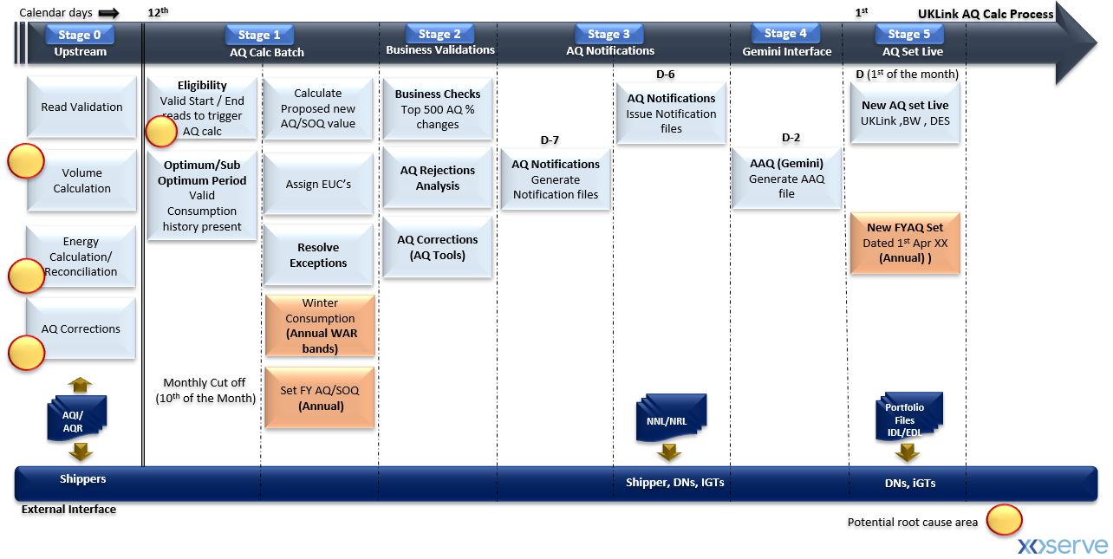
Monthly AQ Process – Defect Heat-Map
Potential Root Cause Areas…
Multiple process/system events occurring on the same day
Business/Technical Exceptions resulting in incorrect AQ
BAU change delivery – Robust regression test of all scenarios/variants
AQ defect process – robustness of process
Others…

Slide 7
Next Steps…
Greater detail on the defect glide path
Highlighting the quick wins achieved and the outcome they have delivered
Specific insight on the root cause and what remediation can be put in place (short, medium and long term)
Providing greater confidence on what additional checks and balances are being applied to BAU processing

