Slide 1
UNC / REC Development
CoMC – March 2020

Slide 2
Background
Ofgem has asked the Transporters to update the UNC, to follow up on the version of the UNC issued in June 2019
  Some changes through design as described to Panel to UNC G and M
    Paper presented at December 2019 Panel – we don’t propose to discuss here
  Changes to GT-D for provision of services in the REC
  Data permissions in V – relationship between Data Permissions Matrix and REC Data Access Matrix
    Update on our understanding from Ofgem re: proposal re: Data Access Administrator

Slide 3
Changes to GT-D
CDSP will undertake a number of roles under the REC
  GRDA
  GES Service Provider
  CDSP Further Services
GRDA provides the file interface between CDSP and CSS, and is a role in the REC
  Expected to be a DSC Service –rather than contracted to RECCo
  As this is predominantly Registration activities – we are anticipating that this will be assigned to Service Area 1 – Views?

Slide 4
Changes to GT-D
GES SP and CDSP FS will be provided by CDSP under contract to RECCo
    GES is DES + some APIs* - highlighted that this cannot be provided at a lower priority than current service is provided
    CDSP FS is currently provided to SPAA Ltd at lower priority – this is only reporting at the moment, but is likely to be enhanced in future so probably should be considered now similarly
  Solution proposal - development of a ‘fourth service’ to allow services to non DSC Customers at the same priority as Direct Services where there is a requirement to do so on the CDSP in any Code
  Third Party and Additional Services Policy will need to be updated to reflect the additional services – consideration will need to be given to the terms of these arrangements.
  What are the views of CoMC?
  * - working assumption is that these are those developed under MIS only

Slide 5
Data Permissions
The Data Access Schedule in REC describes a Data Access Matrix which will record the parties that will have access to each data item as approved by the REC processes
  CoMC are currently responsible for release of Protected Information under UNC
  What view does CoMC have regarding the future release of data currently classed as UNC data?
    Is this expected to be solely determined by the REC? We understand it is assumed by Ofgem that this is a consultation only process – but it is unclear how this will work.
    We note that this should be assessed against the Open Data Framework – i.e. assumed open – but guidance is sought from CoMC on what process they are expecting.

Slide 6
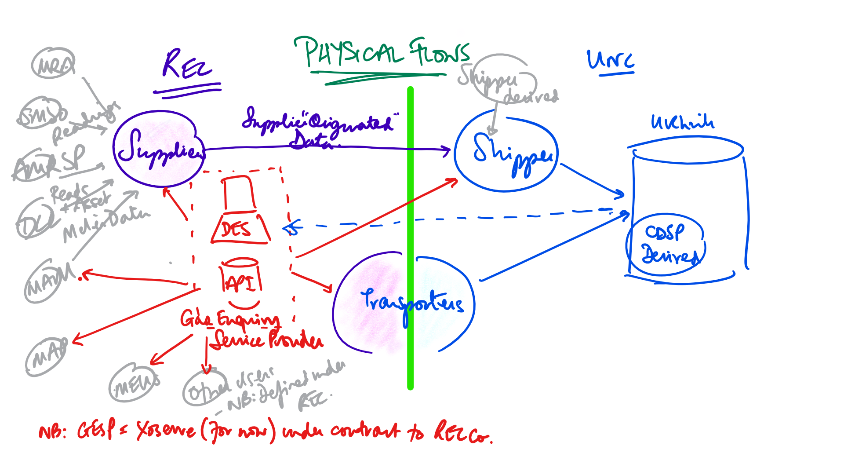
Physical Data Flows between REC / UNC

Slide 7
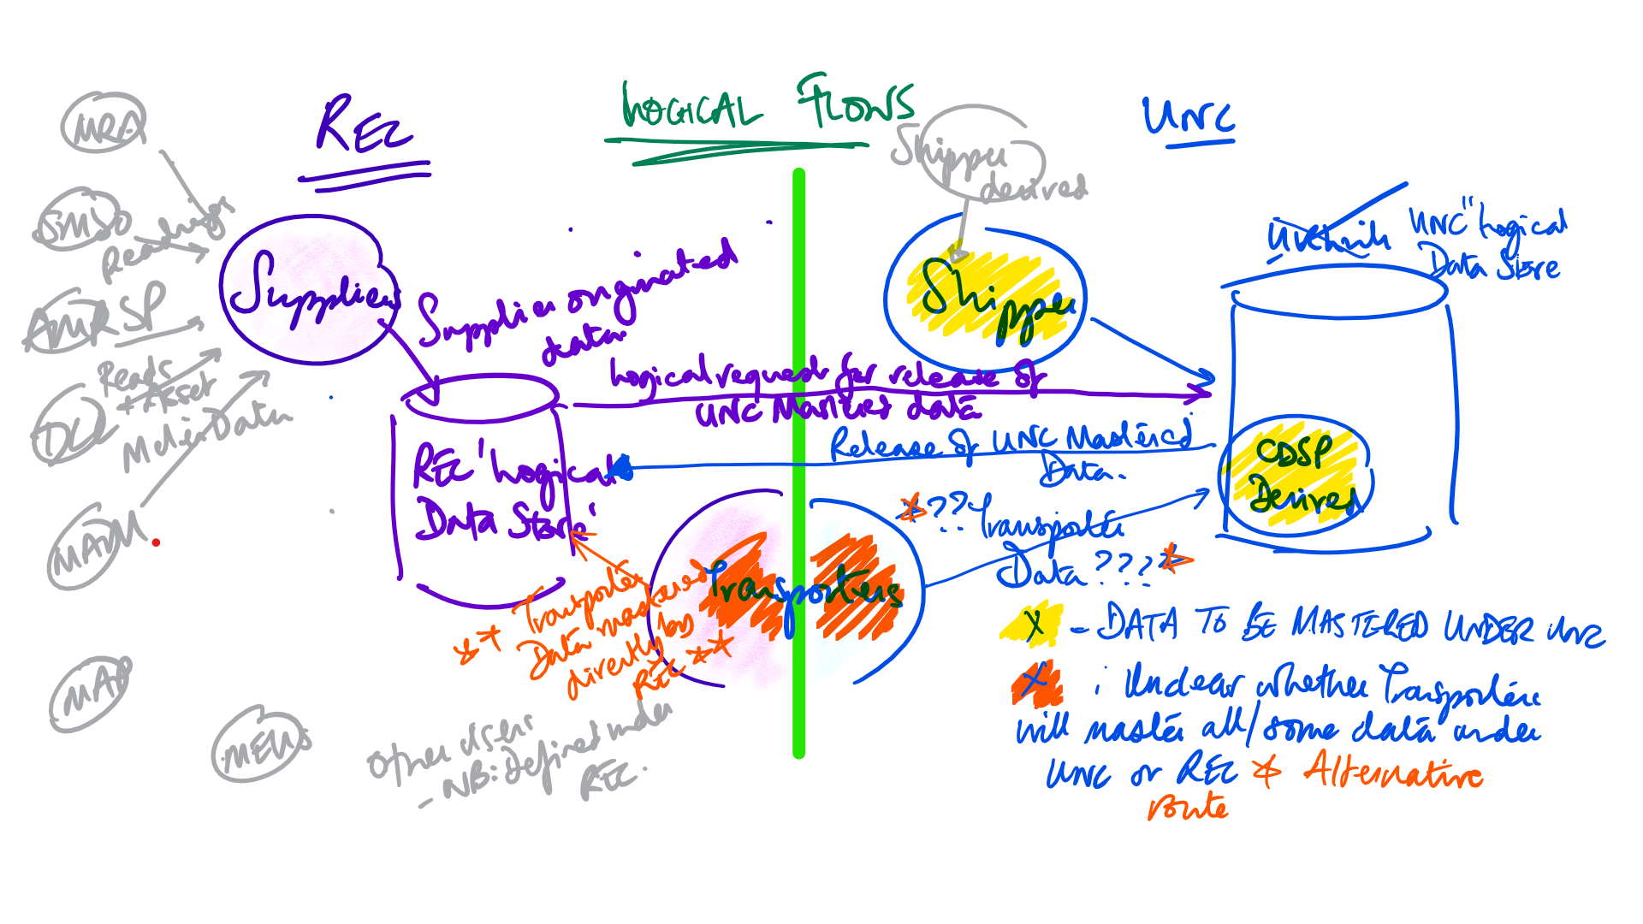
Logical Data Flows between REC / UNC

Slide 8
Questions
Are the data sources correct / exhaustive?
  Noting that post CSS a source of Registration data will be CSS
Is the Logical treatment correct?
  Suppliers will logically provide direct to the REC (regardless of the physical route)
    Do Shippers expect to apply confidentiality based on physical or logical flows of data?
  Shipper derived data will be mastered under UNC
    Assumed as Shippers will not want data to be released without their ability to influence this
  CDSP derived data is mastered under UNC
    Assumed as this is derived under UNC, it should be controlled by the UNC
  Transporters as party to both can decide WHICH code to master under

Slide 9
Data Access Agreement
In our response to the June 2019 Consultation we suggested that the CDSP should continue to execute the Data Access Agreement for the following reasons:-
  We believe that this is the right thing to do as the CDSP is the party that is providing the service
  The alternative approach is that the Code Manager assesses a party’s eligibility to access data and instructs CDSP to release data to a party the Code Manager determines has met the relevant criteria, thereby granting control to the Code Manager
We understand that Ofgem prefer the model that non REC parties will sign a Short Form Agreement that will bind parties to certain clauses in the REC and the relevant REC schedule for the service requested e.g.:
  MAPS being CSS Users (to receive Registration Updates) and GES Users (to access the Gas Enquiry Service)
  Shippers would also follow this approach
Can CoMC provide guidance on the points above?

