Slide 1
7.1 XRN4665 – EUC Release
08/01/20 | Overall Project RAG Status:
 | Schedule | Risks and Issues | Cost | Resources
RAG Status
Status Justification
Schedule | Post Implementation Support (PIS) All PIS activities successfully completed as planned with all EUC changes handed over to Tech Ops Closedown Closedown milestone moved out to incorporate required project fix timescales on the identified issue on the BW ‘Network Throughput Data’ weekly report Work commenced on a six week delivery plan to resolve identified aggregation of CWV & Shrinkage values within the BW report ‘Network Throughput Data’ – Build activities commenced and tracking to plan
Risks and Issues | No key open Risks or Issues
Cost | Project delivery costs are tracking to approved internal budgets (Revised BER to include Financial Risk margin approved at ChMC on 10/07/19)
Resources | No Issues

Slide 2
XRN 4665 - EUC Release Timelines
Key Milestone Dates:
PIS & First Usage completed as planned
Application Handover internally approved by Tech Ops
Project now in Closedown
6 week delivery plan commenced to resolve identified aggregation of CWV & Shrinkage values error within the BW Report ‘Network Throughput Data’
T67 Issued
NRL Issued

Slide 3
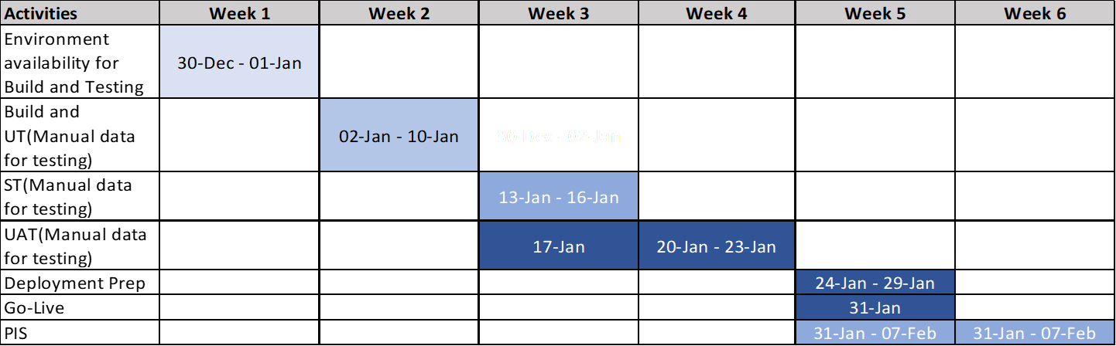
BW Report Fix ‘Network Throughput Data’ High Level Timeline

Slide 4
7.2 XRN4828 - Nov 19 Release - Status Update
08/01/20 | Overall Project RAG Status:
 | Schedule | Risks and Issues | Cost | Resources
RAG Status
Status Justification
Schedule | PIS and First Usage monitoring completed Handover of associated changes to Tech Ops approved and completed Closedown activities to commence
Risks and Issues | No key Risks or Issues associated
Cost | The BER with full delivery costs were approved at ChMC in April 2019, BER for XRN4866 UIG Recommendation approved by ChMC on 12th June
Resources | Weekly monitoring of Xoserve SME resources supporting multiple demands (e.g. BAU defects, Future Releases etc.) is ongoing. No current concerns

Slide 5
XRN4828 - Nov 19 Release Timelines
Key Milestone Dates:
Successful Implementation – 09/11/19
FU & PIS successfully completed with all Nov 19 changes handed over to Tech Ops
Closedown activities to commence

Slide 6
7.3.1 XRN4996 - June 20 Release - Status Update
8th January 2020 | Overall Project RAG Status:
 | Schedule | Risks and Issues | Cost | Resources
RAG Status
Status Justification
Schedule | Plan: Replan completed following descope of 3 changes, Market Trials inclusion pending confirmation. Delivery: Build is in progress, ST due to commence next week for changes that have completed build. Scope: Change Request for XRN4870B has been approved and is currently in Design phase – no cost implications to the project. Revised BER to be shared for information in February. Implementation: Implementation date of Saturday 27th June proposed.
Risks and Issues | Risk – There is a risk that costs detailed in the BER will change because these are based on estimates following approved scope changes leading to a higher than expected contingency figure. There is a risk that build and unit testing may not complete on time, because of environment set up issues, leading to a delay in the start of system testing. Work is ongoing with the ECMS and Basis teams to mitigate this risk.
Cost | Revised BER will be shared in February detailing firm costs and including xrn4870B.
Resources | Weekly monitoring of Xoserve SME resources supporting multiple demands (e.g. BAU defects, Future Releases etc.) is ongoing

Slide 7
XRN4996 - June 20 Release Timelines
Key Milestone Dates:
Capture completion – 19/09/19
Design Completion – 13/12/19
Build & Unit Test Completion – 20/02/20
System & UAT Completion – 24/04/20 (provisional)
Regression Test Completion – 29/05/20
Implementation – 27/06/20
PIS Completion – 25/09/20 (provisional)

Slide 8
June 20 Release Summary
June 20 Release consists of 8 changes, Implementation is planned for June 2020:
XRN4691** - CSEPs: IGT and GT File Formats (CGI Files)
XRN4692** - CSEPs: IGT and GT File Formats (CIN Files)
XRN4772 - Composite Weather Variable (CWV) Improvements
XRN4780 (B) - Inclusion of Meter Asset Provider Identity (MAP Id) in the UK Link system (CSS Consequential Change)
XRN4850 - Notification of Customer Contact Details to Transporters
XRN4865 - Amendment to Treatment and Reporting of CYCL Reads
XRN4871 (B)** - Changes to Ratchet Regime (MOD0665)
XRN4888 - Removing Duplicate Address Update Validation for IGT Supply Meter Points via Contact Management Service (CMS)
XRN4930 – Requirement to Inform Shipper of Meter Link Code Change
XRN4941* - Auto updates to meter read frequency (MOD0692)
XRN4932 - Improvements to the quality of the Conversion Factor values held on the Supply Point Register (MOD0681S)
XRN4780 (B)*** – Inclusion of Meter Asset Provider Identity (MAP Id) in the UK Link system (CSS Consequential Change)
* Pending Solution/MOD approval by ChMC/DSG for remaining CRs.
** Descoped at eChMC on 22/11/19
*** Added to scope (revised scope from original)

Slide 9
7.3.2 Change Assurance XEC Report
UK Link Release – June 20
December 2019

Slide 10
Project | Date | Change Assurance Type | Overall RAYG
UK Link Release – June 20 | 16/12/2019 | General Health Check
CA1 | 1 | CA2 | 15 | CA3 | 12 | CA4 | 8
Topic | RAYG | Summary
Business Case |  | The Change Assurance was performed when the project was mid way through the Design phase when the scope was undergoing changes as the firm costs were delivered to ChMC in the BER June 20 project started off with 11 changes in scope which was later amended to 7 changes in scope with a possible addition of one more CSS specific change to the scope which is under discussion with the Project Board. The project has been through various challenges which has resulted in an amber report which indicates issues that could entail significant risk to the success: The plan is incomplete and not baselined It took longer than expected to firm up the scope due to the various complex changes involved in the Release There was a significant difference in costing of the changes between HLSO and Design which led to removal of 3 changes from scope in November 2019, by Networks SME availability was constrained due to the other priorities The project engaged a 3rd party supplier for UAT, which resulted in significant changes to the cost There is a change within the scope that requires an integration with a SMS vendor which is yet to be finalised when the Design is approaching an end A concern on version control of FS/TS documentation needs to be addressed These challenges have resulted in the project having to work through unforeseen changes. The project will need to tighten up the planning, control and risk management to achieve a successful outcome
Sponsorship
Governance
Scope & Solution
Team & Skills
Plan
Customer
Other - Information Security
Other - Supplier
Other – Service Transition
Other - Testing
Other – Previous Findings

Slide 11
Change Assurance reporting RAYG definitions
Categorisation of delivery risk is as follows:
Red : indicates issues that could entail significant risk to the success of the Programme. Remedial action fundamental to successful outcome of programme, should be implemented as soon as possible;
Amber : indicates issues that could entail significant risk to the success of the Programme. Remedial action important to programme outcomes, should be implemented as soon as practical;
Yellow : indicates issues within could entail risk to the success of the Programme, but this risk is low Remedial action a good to have for the programme, implementation advised;
Green : indicates very minor to no issues, entailing minimal risk to the success of the Programme. Improvement would reduce risk, but the weakness is unlikely to undermine the success of the programme

Slide 12
Change Assurance Findings Severity
Category | Description
CA1 | High risk of impacting successful delivery and achieving outcomes – finding needs to be addressed in order for project to succeed
CA2 | Moderate risk of impacting successful delivery and achieving of outcomes – finding needs to be addressed in order to protect time, cost and quality
CA3 | Low risk of impacting successful delivery and outcomes – consider fixing in project and apply to future projects
CA4 | Minor impact to achieving delivery or outcomes – build in as a lessons learnt for efficient and effective delivery for future projects

Slide 13
7.3.3 XRN4996 - June 20 Implementation Date Approval
The proposed implementation date for June 20 is the weekend of 26th – 27th June 2020 with the changes going live on 27th June.
A contingency date of 10th – 11th July is also proposed.
Approval of these dates is requested.
Please note: A high level implementation timeline and the file format transition plan will be shared for your information closer to the implementation date.

Slide 14
7.4 XRN4914 MOD 0651- Retrospective Data Update Provision

Slide 15
XRN4914 MOD 0651- Retrospective Data Update Provision –
Proof of Concept Progress update
8th January 2019 | Overall Project RAG Status:
 | Schedule | Risks and Issues | Cost | Resources
RAG Status
Status Justification
Schedule | Delivery: Design, Build and Test of comparison tool for step 1 execution has been completed Data Cut from UK Link has been completed and shared with Innova 7 of 8 Shippers participating have provided files for Step 1 and validation has commenced. Remaining shipper looking to provide file in early Jan, impact to plan being assessed Plan to issue all shipper and market level information in January 2020 for Step 1 Step 2 Business and Validation Rules broadly defined and shared with Innova. Remaining elements being finalised w/c/ 06/01 Customer Engagement and Communications: Web page now live and we will be providing fortnightly updates 8 Shippers taking part in PoC exercise. Regular direct engagement ongoing.
Risks and Issues | There is a risk that there will not be sufficient volume received from Shippers in the proof of concept to be able to quantify the size of the data mis-match activity. This risk is to be closed. We now have 8 shippers signed up to take part in PoC with data volume approx. 6.5m
Cost | Approval received from DN’s for BER of £270k for proof of concept
Resources | Security resource allocated to proof of concept Working with SME team to agree resource allocation as required Concerns raised about availability of Customer Change Team resource to support delivery and specifically Customer Engagement activities
XRN4914 MOD 0651 - Retrospective Data Update Provision - ChMC Update 8th January

Slide 16
XRN4914 – Retro proof of concept - timeline
2019/2020
November | December | January | February
Date for slicing data
8th Dec
Checkpoint 1
29th Nov
Checkpoint 2
24th Jan
Checkpoint 3
3rd Feb
Customer Engagement
Initial Customer engagement
kick-off 4th Nov
Initial Customer engagement of File receipt
ends 3rd Jan
Recommendations
Customer / Advocates encouraging participation
Kick-off prep
Test files can be accepted
Actual data files can be accepted
Weekly project update via external communication methods
Support
Design
Develop
Testing
Support
Analysis
Test data
files in
Actual data
files in
Step 1 Compare / Outcome / Aggregate
Step 2 – deep dive / Outcome / Aggregate
Output from Step 1
Output from Step 2
today
Key:
Completed
On-target
Medium risk
Slipped / High risk
Planning
XRN4914 MOD 0651 - Retrospective Data Update Provision – 16th December 2019

Slide 17
7.5 & 7.6 UK Link Releases Update
January 2020 CHMC

Slide 18
2020/2021 UK Link Governance Timeline
2020 | 2021
Jan | Feb | Mar | Apr | May | Jun | Jul | Aug | Sep | Oct | Nov | Dec | Jan | Feb | Mar | Apr | May | Jun | Jul | Aug | Sep | Oct | Nov | Dec
4779
Key:
BER Approval
10/04/18
On track
Feb-20
Complete
MiR 6
At risk
Jun - 20
Scope approval – Feb ChMC
Nov 20
BER Approval
May-20
EQR Approval – March ChMC
RETRO
Potential Activity
Governance Approval dates tbc…
CSSC
CSSC activity
Assumes that there will be a Major Release in Nov 2020
Please note that this includes potential activity within UK Link over the next 24 months

Slide 19
Change Index – UK Link Allocated Change
Proposed Release | XRN | Change Title | Current Status | UK Link Release | Complexity | Finance
Nov-19 | 4679 | Requiring a Meter Reading following a change of Local Distribution Zone or Exit Zone | In Delivery | November 2019 | Medium | Xoserve
 | 4725 | New read reason type for LIS estimate readings | In Delivery | November 2019 | Medium | Xoserve
 | 4621 | Suspension of the validation between meter index and unconverted index | In Delivery | November 2019 | High | Shipper
 | 4866 | UIG Recommendation – removal of validation on uncorrected read | In Delivery | November 2019 | Low | Shipper
4779 | 4779 | AQ into PARR reports | In Delivery | Standalone BW | Medium | PAC
MiR D6 Feb-20 | 4955 | Amendments of MDD PSR needs code descriptions | In Delivery | February - 2020 | Medium | Shippers / GT/IGTs
 | 4997 | Introducing new charge codes for pro-active payment of GSOP 3 and GSOP 13 | Awaiting ChMC approval | MiR D6 | Small | DNO
Jun-20 | 4865 | Amendment to Treatment and Reporting of CYCL Reads | In Delivery | June-2020 | Small | Shippers / DNO
 | 4772 | Composite Weather Variable (CWV) Improvements | In Delivery | June-2020 | X-Large | Shippers / DNO
 | 4930 | Requirement to Inform Shipper of Meter Link Code Change | In Delivery | June-2020 | Small | Shippers
 | 4932 | Improvements to the quality of the Conversion Factor values held on the Supply Point Register (MOD0681S) | In Delivery | June-2020 | Medium | Shippers / DNO
 | 4850 | Notification of Customer Contact Details to Transporters | In Delivery | June-2020 | X-Large | IGTs / DNO
 | 4888 | Removing Duplicate Address Update Validation for IGT Supply Meter Points via Contact Management Service (CMS) | In Delivery | June-2020 | Medium | IGTs
 | 4941 | Auto updates to meter read frequency (MOD0692) | In Delivery | June-2020 | Large | Shippers
 | 4780b | MAP ID Part B | Awaiting Solution Approval | June 2021 | Large | Shippers
CSSC | 4627 | Consequential Central Switching Services | In Delivery | June 2021 | N/A | Shippers
Retro | 4914 | Retro Proof of Concept | In Delivery | November 2020 | N/A | DNO

Slide 20
November 20 Major Release
Year | 2019 |  | 2020
Month | Nov | Dec | Jan | Feb | Mar | Apr | May | Jun | Jul | Aug | Sep | Oct | Nov
Phase | Start-Up |  | Init | Design |  |  | Build / Test / Implement
Points Available | 120
 |  | 100
 |  |  | 75
 |  |  |  | 34
 |  |  |  |  | 21
 |  |  |  |  |  | 5
Scope Approval
Change Packs issued for review
Change Packs issued
Implementation

Slide 21
UK Link – Unallocated Changes
XRN# | Description | Capture Status | Release Type | Indicative Release | Complexity | Points
4645 | The rejection of incrementing reads submitted for an Isolated Supply Meter Point (RGMA flows) | In capture | Major | tbc | Tbc | tbc
4691 | CSEPs: IGT and GT File Formats (CGI Files) | Ready | Major | Nov 20 | Medium | 8
4692 | CSEPs: IGT and GT File Formats (CIN Files) | Ready | Major | Nov 20 | Medium | 8
4716 | Increased Field Length – ‘Updated by’ data item | Closed | N/A | N/A | N/A | N/A
4780c | MAP ID (Part C) Inclusion of Meter Asset Provider Identity in the UK Link system (CSSC) | Requirements gathering | Major | Nov 20 | Large | 13
4801 | Additional information to be made viewable on DES | HLSOs in review | Major | Nov 20 | Large | 13
4851 | Moving Market Participant Ownership from SPAA to UNC/DSC | Requirements in review | tbc | tbc | tbc | tbc
4854 | Transfer of NDM sampling obligations from Distribution Network Operators to the CDSP | In capture | tbc | tbc | tbc | tbc
4871b | Modification 0665 – Changes to Ratchet Regime (Part B) | Ready | Major | Nov 20 | X-Large | 21
4896 | Failure to Supply Gas System and Template Amendment | Requirements in review | Minor | tbc | Small | 5
4897 | Resolution of deleted Contact Details at a Change of Supplier event | HLSOs in review | Major | Nov 20 | Small | 5
4899 | Treatment of PSR data and contact details on a change of supplier event | HLSOs in review | Major | Nov 20 | Small | 5
4914 | Retro (MOD 651) | On hold for POC | Standalone | tbc | tbc | tbc
4923 | AQ Calculation for RGMA (ONUPD) Estimate Reads | Requirements in review | Minor | Tbc | tbc | tbc
4931 | Submission of Space in Mandatory Data on Multiple SPA Files | DSG review | Minor | Nov 20 / Minor | Small | 5
4978 | Notification of Rolling AQ value (following transfer of ownership between M5 and M) | In capture | tbc | tbc | tbc | tbc
4990 | Transfer of sites with Low Read Submission Performance from Class 2 and 3 into Class 4 (Mod 664) | Ready for assignment | Major | tbc | tbc | tbc
4992 | Creation of new change type to recover last resort supply payment (Mod 0687) | DSG review | Major | Nov 20 | Medium | 8
5027 | UK Link data cleanse of conversion factor in line with MOD681s | In capture | tbc | tbc | tbc | tbc

Slide 22
7.7 UK Link POAP

Slide 23
7.8 Change Assurance

Slide 24
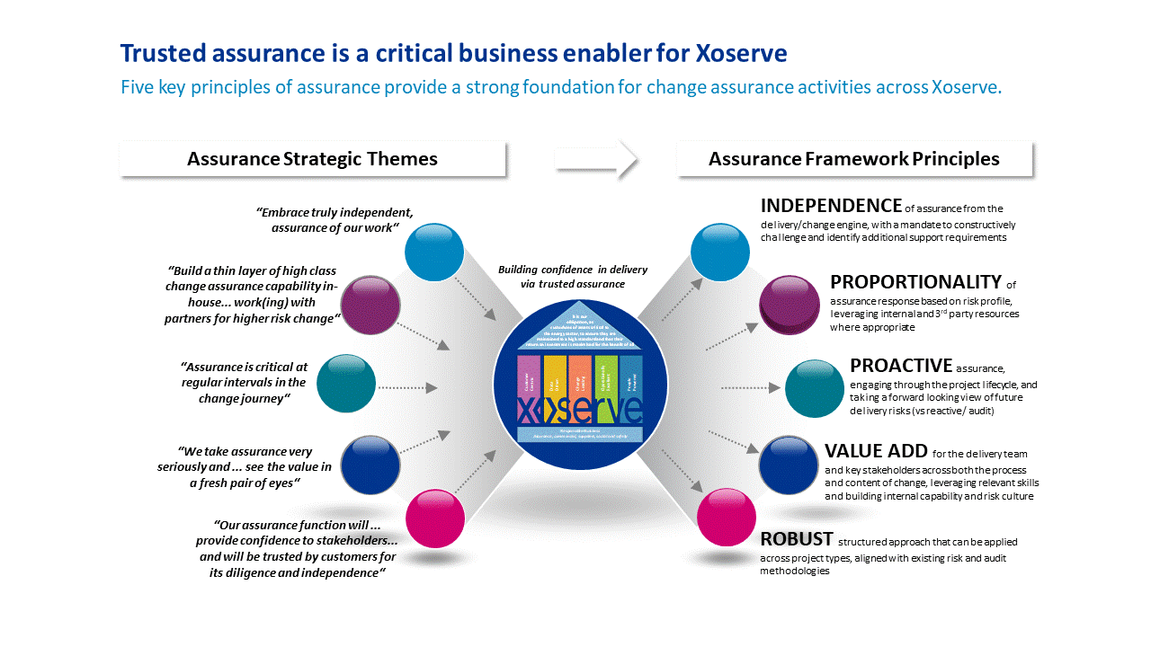
Xoserve Change Assurance: Principles
Established in 2018 under Jane Rocky as an independent function, aligned with Xoserve’s Internal Audit, to address delivery concern
Thin layer assurance capability was extended to Trevor Howfield plus 2 C.A. Specialists in July, 2019. All experienced in change delivery and assurance in the energy industry and more widely
We adhere to a bench-marked Assurance Framework built on business-enabling principles
Change Assurance informs specific project & programme outcome delivery health, as well as capability development at Xoserve.
To continue to support our Strategy, Xoserve’s Change Assurance needs to address our customers’ key concerns

Slide 25
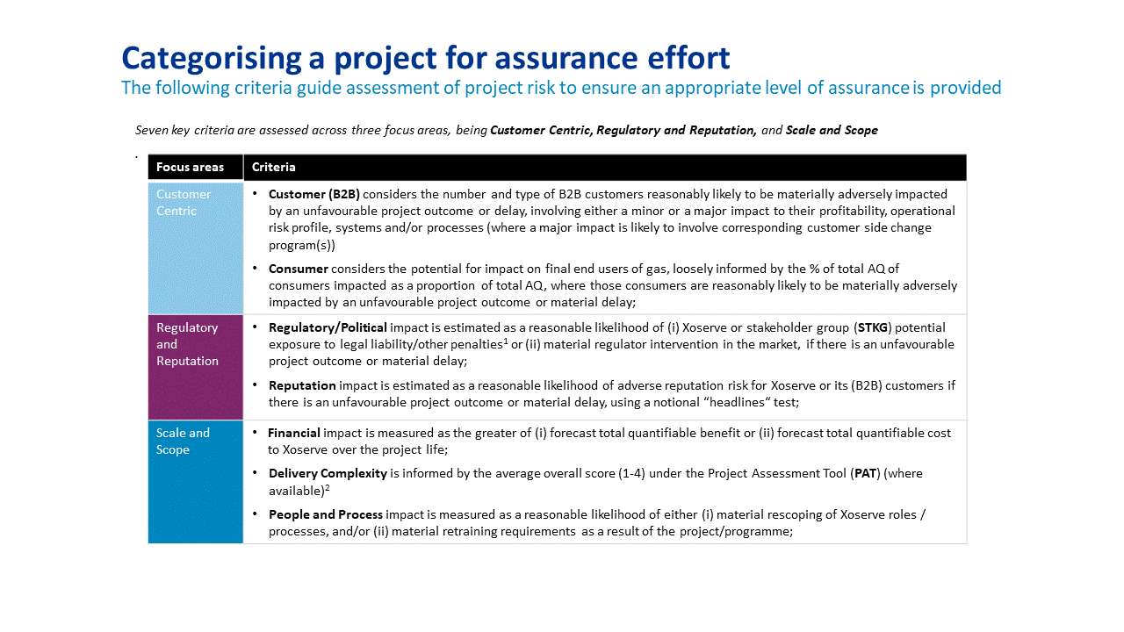
Change Categorisation for Assurance
Change Assurance has focused to date on selected projects chosen against qualifying criteria
Assurance services range from quick Pulse Checks to advise on set up for success, to embedded assurance for long-term, complex Programmes
Assurance scope typically looks at full project outcome delivery health, but may be tailored to a specific topic or deep dive
To enable consistency across delivery teams, Change Assurance includes internal teams, partners and Xoserve customer representatives
Assurance is point in time in a project lifecycle – we may revisit a project if we find significant outcome delivery health risk

Slide 26
What can we offer the Committee?
Current Offering | Additional Options
Projects receiving an overall Assurance outcome delivery medium to high risk rating bring their back to green approach to the Committee. Change Assurance can attend to provide an independent view of the suitability of the approach. | Understand Committee priorities and key change delivery concerns and: 1. Ensure all Change Assurance activity focuses on these as part of our wide view 2. Undertake deep dive Assurance activity on specific focus topics commissioned by the Committee and report our finding
 | Provide change delivery trend analysis, tailored to Committee requirements to identify improvement performance
 | Engage with customers’ own change governance or assurance teams to align our service to find synergies.

Slide 27
7.9 Data Office Changes

Slide 28

Customer Impacting Data Changes: XRNs
Capture
**Estimated delivery dates will be confirmed on completion of Capture and align to the chosen solution.
**Estimated Delivery
Delivery
Change Proposals | Sept 19 | Oct 19 | Nov 19 | Dec 19 | Jan 19 | Comments
4738: Shipper portfolio update of proposed Formula Year AQ/SOQ
4859: Increasing MAM Access to CDSP Data to Mitigate Reduced MAM Appointment Timescales
4860: National ‘Temporary’ UIG Monitoring |  |  |  |  |  | Data Strategy to confirm start up for product user case
XRN4928: BG Request for iGT Elected sites
4779: UNC Modification 0657S - Adding AQ reporting to the PARR |  |  |  |  |  | Change due for delivery for January PARR Report run
4980: Change Supply Point Enquiry API to add in extra field and make certain other fields visible.
4713: Actual read following estimated transfer read calculating AQ of 1
5004 – Golden Bullet Report
PART A
PART B

Slide 29
8 UIG Task Force Progress Report
Change Management Committee 08/01/2020

Slide 30
Background
Modification 0658: ‘CDSP to identify and develop improvements to LDZ settlement processes’ approved by Ofgem on 6th July 2018
  Modification raised to authorise the CDSP to assign resources and incur costs related to a Task Force to investigate the causes and influencers of Unidentified Gas (UIG), with a target of reducing the volatility and scale of UIG and developing a robust predictive model for daily UIG for use by all parties.
BER for Change Reference Number XRN4695: ‘Investigating causes and contributors to levels and volatility of Unidentified Gas’ approved at ChMC on 11th July 2018
  This Change Proposal added an additional service line into the DSC to enable Xoserve access to investigate, using resources and technology, causes and contributors to levels and volatility of Unidentified Gas. Xoserve is to provide monthly update reports and recommend proposals and subsequent changes or modifications for the industry.
The following slides provide:
  Task Force dashboard
  POAP
  Recommendation stats
  Reporting on budget
  UIG Task Force Activities migration post October 19

Slide 31
UIG Task Force: Dashboard
RAG
Time | G
Cost | G
Benefit | N/A
Overall RAG status:*
G
Progress since last month - key milestones | Date | Status
Attend December UIG Work Group | 12/12/19 | Complete
Attend December Change Management Committee | 11/12/19 | Complete
Attend December Contract Management Committee | 18/12/19 | Complete
Executive Summary Update | 20/12/19 | Complete
Attend Work Group 674 | 11/12/19 | Complete
Approval of UNC Mod 0692S | 19/12/19 | Complete (UKLink June 2020 Release)
Priorities for next month – key milestones | Date | Status
Support Mod development (All) | 01/03/19 | G
Development of automated UIG reporting | End of June | R
Commence UIG Task Force close down/extension options | 01/07/19 | G
Attend January Change Management Committee | 08/01/20 | G
Attend January Contract Management Committee | 15/01/20 | G
Executive Summary Update | w/c 27/01/20 | G
Attend January UIG Work Group | 21/01/20 | G

Slide 32
Plan on Page Updated
Completed activity
Delivery team milestone
Advanced Analytics
Governance
C
I
Rescheduled
 | September |  |  |  |  | October |  |  |  | November |  |  |  | December |  |  |  | January 2020 |  |  |  | February 2020
 | 02/09 | 09/09 | 16/09 | 23/09 | 30/09 | 07/10 | 14/10 | 21/10 | 28/10 | 04/11 | 11/11 | 18/11 | 25/11 | 2/12 | 09/12 | 16/12 | 20/12 | 06/01 | 13/01 | 20/01 | 27/01 | 03/02 | 10/02 | 17/02 | 24/02
I
I
I
I
I
I
11/09 DSC ChMC
09/10 DSC ChMC
13/11 DSC ChMC
11/12 DSC ChMC
08/01 DSC ChMC
12/02 DSC ChMC
BAU Publish UIG Investigation guide V.2
w/c 09/09 Exec Summary
w/c 11/11 Exec Summary
w/c 16/12 Exec Summary
C
C
C
w/c 27/01 Exec Summary
Develop Xoserve owned Recommendation options – update and publish recommendation tracker in line with UIG working group meetings
Develop Findings template and Recommendation Packs
Investigation Analysis
Final phase of Machine Learning complete
Support Mod development
Issue analysis and tracking
I
I
I
I
I
I
18/09 CoMC
16/10 CoMC
20/11 CoMC
18/12 CoMC
15/01 CoMC
19/02 CoMC
w/c 01/07 create close out activity plan
I
I
I
I
I
I
23/09 UIG WG
22/10 UIG WG
26/11 UIG WG
12/12 UIG WG
21/01 UIG WG
18/021UIG WG
Review/draft updates to UIG user guide ongoing

Slide 33
Recommendations - where we are
14 finding & recommendations = 95 recommendation lines
70 CLOSED
4 lines MOD 0681 – EON
9 lines MOD – Scottish Power (12.2) = 1 MOD – sponsored 0693R
4 lines MOD – (3.2.1) = 3 MODS – 1 sponsored Total 0692*), 2 sponsored British Gas 0690 & 0691
2 lines Xoserve drafted MODs 3.2.5
1 line MOD 0699 Scottish Power
11 do nothing
3 BAU
19 completed
37 - other options progressed
5 Future review
3 review January
1 review February
1 review March
* UNC Mod 0692 now approved, awaiting UKLink Release
As at 18/12/19

Slide 34
Overview Of Task Force Funding
Note that compared with last month, spend is reprofiled in line with actual invoice dates. Total value is unchanged.

Slide 35
Reminder – UIG Task Force Activities migration post October 19
Pre November Task Force | Post October Customer Support Services Team | Post Oct Customer Change Team
Existing activities which will migrate Daily UIG Box account management Monthly UIG Executive Summary Creation of UIG monthly dashboard stats Web page ownership updates & maintenance UIG Work Group attendance UIG Work Group Task Force recommendation tracking UIG data sources creation UIG modification alignment creation & publication Machine Learning new analysis Budget mapping and forecast . Support development of new online UIG interactive reporting Activities which will cease Representation at ChMC & CoMC | Existing activities which will be migrated Daily UIG Box account management Monthly UIG Executive Summary Creation of UIG monthly dashboard stats Web page ownership updates & maintenance UIG Work Group attendance UIG Work Group Task Force recommendation tracking UIG data sources maintenance UIG modification alignment pack maintenance Machine Learning outstanding analysis Budget monitoring for UIG activities Outstanding CP 4853 Interim process to monitor and manually load rejected reads into UK Link where the read was rejected for reason MRE00458 only. Manual work around to be closed out end of October 19. UIG brochure version 2 creation & publication Re-purpose the existing "Lines of investigation tracker" Work with Customer Change team to develop formal project close down New activities which will commence Support maintenance of new online UIG interactive reporting Adhoc new UIG related requests One off activities e.g. simulations/adhoc UIG reporting requests – considered by Customer Support Services and/or directed to raise CP | Live CP4866 Removal of validation on uncorrected read due November release Work with Customer Team complete outstanding UIG related CR's. Newly identified Modifications & CRs

Slide 36
9.1 Bubbling Under Report

Slide 37
9.2.1 Gemini Horizon Planning

Slide 38


9.2.2 Gemini Re-Platform Project
Update

Slide 39
Gemini Re-Platform Project Overview
Gemini system is going through an Infrastructure Upgrade as part of this change and also moving to new virtualised infrastructure
Software upgrades due to
  End of life support
  Meet industry best practices
No changes are being made to the application or the functional capabilities of the system

Slide 40
In Summary - Impacts to the Industry
Extended Outage
  Extended system outage on Sunday 5th July. Estimated outage window is currently anticipated to be between 8 to 12 hours.
In order to complete the Gemini Re-Platforming (GRP) project implementation, an extended outage will be required on the Gemini system on 5th July 2020. Provisional timescales for the GRP implementation are as follows:
Gemini Maintenance Window: 03.00 to 5.00
Extended outage: 05.00 to 13.00
In the event of a rollback an additional outage will be required from 13.00 to 17.00

Slide 41
In Summary - Impacts to the Industry
Access to Gemini
  Extended option to access Citrix via your web browser and/or update of your current Citrix receiver client, due to current version being out of support.
Functionality
  The Gemini functionality will remain exactly the same and how Industry participants interact with the system.
External Connectivity Testing
  All Industry participants are invited to test connectivity to the new data centre during the period 13th April to 8th May 2020, please confirm intended participation
  Please contact box.xoserve.geminire-platform@xoserve.com if you wish to participate in external connectivity test phase.

Slide 42

Any queries please email: box.gasops.businessc@nationalgrid.com
box.xoserve.geminire-platform@xoserve.com

Slide 43
10 Finance and General Change Budget Update
Key Dates for Finance Updates
In Feb there will be additional sheet in the file “20-21 Year End Forecast”
  This sheet will show all changes that have at least initial approval
  that may result in spend in 20-21
In May there be a new sheet added “20-21 Spend to date”
  This sheet will show all changes that have BERs approved by CHMC
Also in May final actuals view for 19-20 will be presented

Slide 44
10 Finance and General Change Budget Update

Slide 45
11. AOB

Slide 46
11.1 IX Refresh Customer Update
The Vodafone support of the legacy IX service ends in February 2020. Gamma are finalising the migration dates for all customers.
To ensure the project completes on time we need your support in committing to the migrations dates. We have observed a number of last minute cancellations which adds additional cost and puts the completion date at risk.
As a mitigation, Xoserve are exploring extended support with Vodafone for any migrations that move past February 2020, if required.
If you have any questions or concerns, please reach out to box.xoserve.IXEnquiries@xoserve.com

Slide 47
11.2 CDSP Prioritisation and Release Scoping Approach Review

Slide 48
11.3 DDP Update

