Slide 1

Customer Journey - Change
“I want something different or new”
Findings Review
12th December 2019

Slide 2
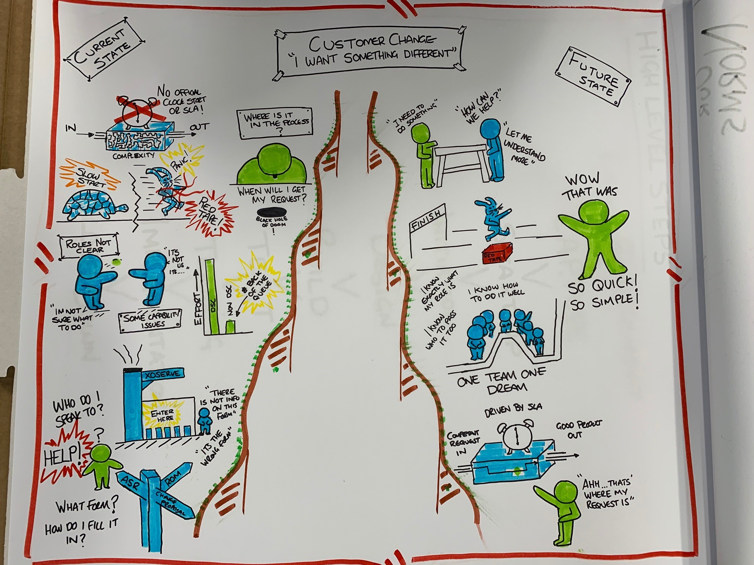
Understanding the need using Task Appraisal
The Task appraisal was completed with internal stakeholders so that we could understand the size, shape and scope of the task ahead.
All interviewees were asked the following questions:
What are we trying to achieve?
What's stopping us?
What would good look like?
Notes:
Ranjit

Slide 3






Using Personas to help us understand how the customer feels
EXPERIENCED
Persona | Description
DSC Participant | I am an active participant who understands the change process and can raise change proposals. I regularly attend industry meetings and engage actively with Xoserve.
New DSC Participant | I am an new DSC signatory with limited knowledge of the change process and may/may not be attending industry meetings
Non DSC Signatory | I am not a DSC signatory but request services from the CDSP
DSC
PARTICIPANT
Less Active
More Active
Non DSC Signatory
New DSC Participant
NOT EXPERIENCED

Slide 4
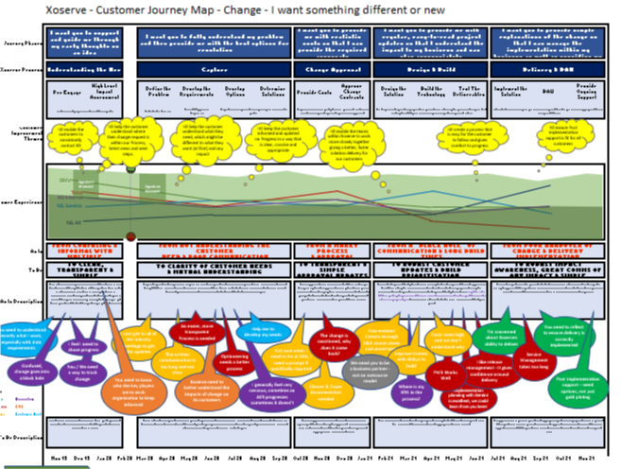
Understanding how we make the customer feel using Customer Journey Mapping
Define the high level journey steps
Understand and define the Journey Personas
Internally review and define the perceived customer experience
Interview Customers to gain actual insights into how we make them FEEL through their interactions with us
Gather verbatim feedback
Group feedback into key themes for problem solving

Slide 5




Customer Journey – Improvement Themes Identified
Visibility & Communication
Understanding
the real need
Working better
together
Customer
Contact
Better after
care
How to help the customer understand where their change is within the process, whilst keeping them informed of progress and next steps?
In what ways might we be able to robustly understand the real customer need and potential impact of change?
How might we be able to deliver a better, faster solution for our customers?
How could we make it easy for our customer to contact us and provide them information?
How can we achieve a more reliable service post implementation?
Improvement Theme
Improved Website “live” Tracking
Single point of contact
CRM system to workflow, manage, track and record customer interaction
Improved relationship management
Change of focus from Solution to Goal
Better defined scope of Capture
Better RACI across the E2E (not all falling back on capture)
Change Specialists capability uplift to understand NEED
Improve SME knowledge for downstream impact of change
Consider a sprint type approach for changes as they come through
Consider a trial where team members from Capture to Design and Build sit together and process applications as one piece flow
CRM system to workflow, manage, track and record customer interaction
Improved website functionality
Improved website document search
Improved website “live” tracking
Single expert point of contact
CRM system to workflow, manage, track and record customer interaction
Better training & documentation (UK LINK documentation is a particular frustration)
Improved Standard Procedures detailing What, How and Why (SOP’s)
Improved Impact awareness within capture
Single expert point of contact
Improved relationship management
Consider online training modules
Recommended Options

Slide 6
Xoserve Key Value Indicator (KVI) Change Management Survey

Slide 7
Xoserve Key Value Indicator (KVI) Change Management Survey Questions
Xoserve Key Value Indicator (KVI) Questions (Current)
I receive timely and fit for purpose information to enable me to manage new changes that impact my organization.
Xoserve presents a range of solution options for each change to enable choice
I trust Xoserve to identify solutions that benefit the whole Industry where possible
Xoserve supports the ability for me to fully engage me in the change process, should I choose to
I trust Xoserve to deliver changes to agreed costs, timescales and quality
Please provide any further comments in support of your rating (optional)

Slide 8
Xoserve Key Value Indicator (KVI) Change Management Survey Questions
Xoserve Key Value Indicator (KVI) Questions (New/Proposed)
Xoserve delivers change that benefits my organisation
Xoserve reacts quickly and effectively to gas industry changes that affect my organisation
Xoserve is neutral and transparent during industry discourse
Xoserve presents its customers with options for delivery of industry changes
Xoserve always consults its customers and presents effective options for change solutions (we already have something similar which we will probably keep)
Costs associated with the changes that Xoserve deliver are clear and accurate
Xoserve appropriately prioritises change

