Slide 1
Default System Marginal Price
Malcolm Montgomery

Slide 2
The issue
The current cash out arrangements are based upon an annually calculated default system marginal price. The principle of which was intended as a proxy of the cost associated with managing a imbalance on the network.
We are proposing a update of the formula used to calculate the default system marginal price (SMP) as it is no longer deemed to be an accurate reflection of the way the network is operated due to market evolution since 2011.

Slide 3
The NTS is changing
Over the past ten years, the way the NTS is used has changed dramatically in terms of supply/demand patterns, in day linepack change and day on day linepack variability.
We need a formula that is reflective of the current system and adaptive enough to evolve with future changes, within the scope permitted by EU Bal code.

Slide 4
Current Methodology
The current formula was derived in 2011 and is closely linked to compressor usage, previous years demand and capacity charges.
As supply and demand patterns have changed, alongside how we operate the network, the current SMP small adjustment formula may not be as reflective as it once was.

Slide 5
Further Considerations
Realistically it is very difficult to isolate incremental costs caused by market imbalance from general operational costs in order to derive a reflective formula.
Changes to the default SMP may have the consequence of altering the commercial drivers of Shippers to balance.
Any review should therefore balance the desire for cost reflectivity both with practical considerations and with providing sufficient incentives on the market to balance.

Slide 6
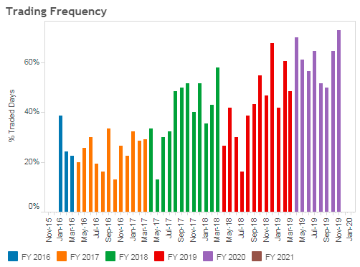
External Views
The Industry view is mixed, however concerns raised via Ops Forum and bilaterals include:
Increased frequency of National Grid trading as residual balancer;
Shippers whose inputs and outputs are out of balance are not being held accountable;
Default cash-out price isn’t sufficient enough to drive commercial decisions;
Small cash out prices are giving the perception that imbalances do not cause issues on the NTS.

Slide 7
Summary
National Grid (NG) believe it is appropriate to raise a UNC modification to amend the default SMP formula. NG believe the main considerations are:
How should the formula evolve to reflect the operation of the network in 2019 and be adaptive to future needs.
Opportunity to address concerns raised by shippers regarding NG’s increased trading frequency.
What is a proportional incentive on Shippers to balance their portfolios and how does that relate to other EU markets?

Slide 8
Next Steps
UNC modification proposal to be raised to Dec or Jan panel.
Further engagement with industry to understand range of views.
Establishing understanding of arrangements in other EU countries.
Target date of 1st Oct 2020 for any new UNC methodology.

