Slide 1
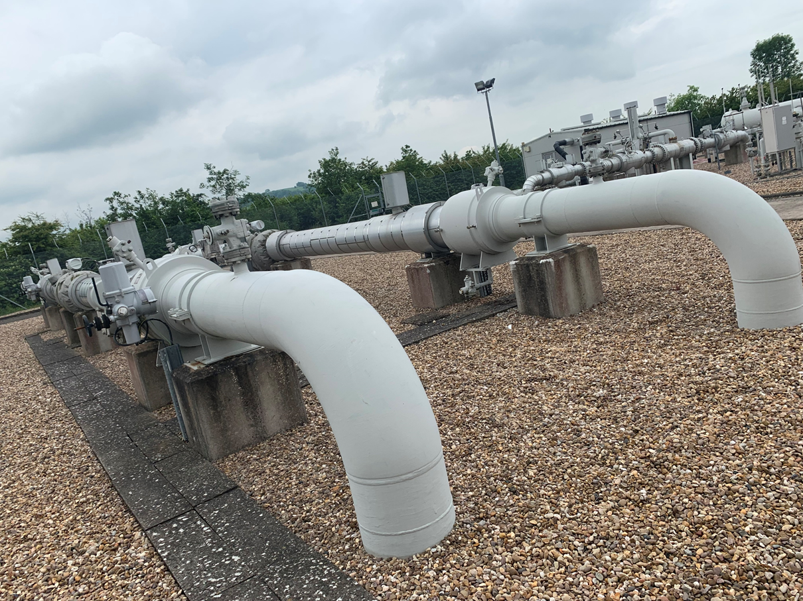
Meters: Pro-active investment to avoid long term outage £17m over 5 years

Slide 2
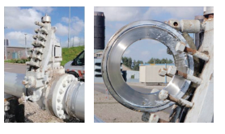
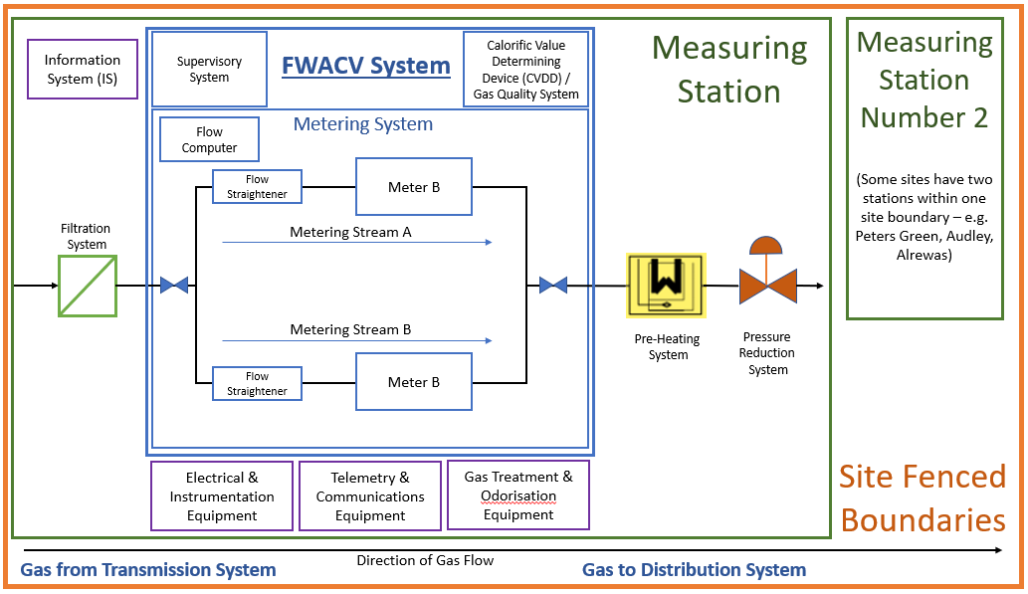
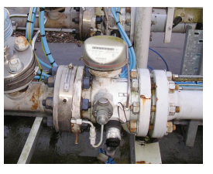
Introduction to asset
Ideal layout for a measuring station

Slide 3
DEEP DIVES INTO BUSINESS PLAN PROPOSALS
Strictly Confidential
Engagement
Working with Gas Transmission Control Room to understand consequences
Shippers have expressed preference for improving accuracy and confidence in the past
Funding mechanism/ Output measures
Base plan deliverable, tracked via NARMs.
Alternative of PCD rejected, as NARMs covers output
Delivery
This will be an expansion of current activity, outage will need to be carefully planed but a relatively small number of sites will be impacted
Cost
External conceptual design work supported by site visits currently underway and will inform December.
Key driver is any requirement to reconfigure pipework
Optionering and evidence base
Continue with reactive maintenance
v’s pro-active replacement
Rate of pro-active programme to be confirmed
CBA used to help understand different options

Slide 4
Failure Modes and Repairs
Likelihood:
Our metering equipment is low tech mechanical kit.
It is protected upstream by filtering systems designed to remove damaging particulates
We have recorded only 2 meter failures during GD2
However, the mechanical kit is generally over 50 years old and is beginning to show condition deterioration, including joint leakage. In addition many of our sites do not have standby meters.
Commercial Obsolescence
The equipment produced in the 60/70s and as such suppliers no longer hold spares for these models as standard items.
Bespoke are high cost and long lead time.
Most significantly we have not identified suppliers which will provide spares for old units to the required British Standard -needed to ensure the low meter uncertinty that shipper expect.
The criticality of spares to system operation is understood

Slide 5
Consequence - £28m of gas metered per day
Odour
The metered volume of gas determines the rate of odorant addition at the Offtake.
Poor/absent meter data will impact odorant system
Un-odorised gas a significant risk
Mitigation – turn it up to 11
This can result in escalated concern/reporting from customers
2. Interruption to supply
Poor volumetric control could lead to interruptions to supply.
Mitigation – ‘site set points’ would allow gas to continue to flow at approximately the correct volume
Impact of extended outage on GT system being evaluated- would they really cut us off?
3. Impact on GT & Shippers
In the case of a short term outage an independent specialist is recruited to make flow calculations to provide assurance to GT around flows.
For long term outage the knock on impact onto management of the GT network and compliance with transportation codes is uncertain.
£28m of gas per day goes through the meters
Opportunities
Modern Ultrasonic Meters are more accurate over a wider flow range – move from 3% to 1% performance
They can be more closely monitored from a condition perspective – self reporting drift or anomalies
Reconfiguring sites to provide duty and standby metering streams will increase reliance.
A number of our sites have a single meter stream, if it fails there is no standby system
A number of our sites do not have readily available spares, extending the time to achieve a repair
4. The Law
Statute Gas (Calculation of Thermal Energy) Regulations (Sec 12), License Conditions and Uniform Network Code (UNC) require Cadent to provide a fit-for-purpose Flow Weighted Average Calorific Value (FWACV) system that is reliable, accurate, safe and efficient way to measure gas-volumes and energy at our offtakes.

Slide 6
Options
Continue as is:
We have not yet experienced a prolonged outage of our metering equipment
We can continue to examine opportunities to extend asset life
Likelihood that maintenance costs will increase and that outage will occur
Begin pro-active programme of replacement
The asset base is aged and does not meet the accuracy expectations of todays network users. Repairs are more difficult to achieve The risk of a prolonged outage is a realistic possibility
A prudent programme phased over 10 to 15 years to replace meters – highest risk sites in GD1. Removes risk, improves accuracy of reporting.
UMs can cope with greater flow ranges – future proof. Would be one of the last assets to be decommissioned
CBA & NARMS models
The NARMS model can be used to identify minimum investment levels to hold risk flat. However, it does not properly represent the impacts on GT of prolonged outage nor does it capture asset specific obsolescence issues.
CBA analysis can be used to examine different scenarios. Using the value of gas flowed through the sites gives very short payback periods. The costs of reactive and pro-active intervention following failure can also be compared.

