Slide 1
PAC Reporting In DDP

Slide 2
Contents
UNC Mod & PAFA DDP Drop Update
Future Process
Prioritisation
Influencing DDP Roll Out

Slide 3
Mod and PAFA Drop Update
Verbal update to be provided to present very latest view ahead of PAC meeting 12th November 2019

Slide 4
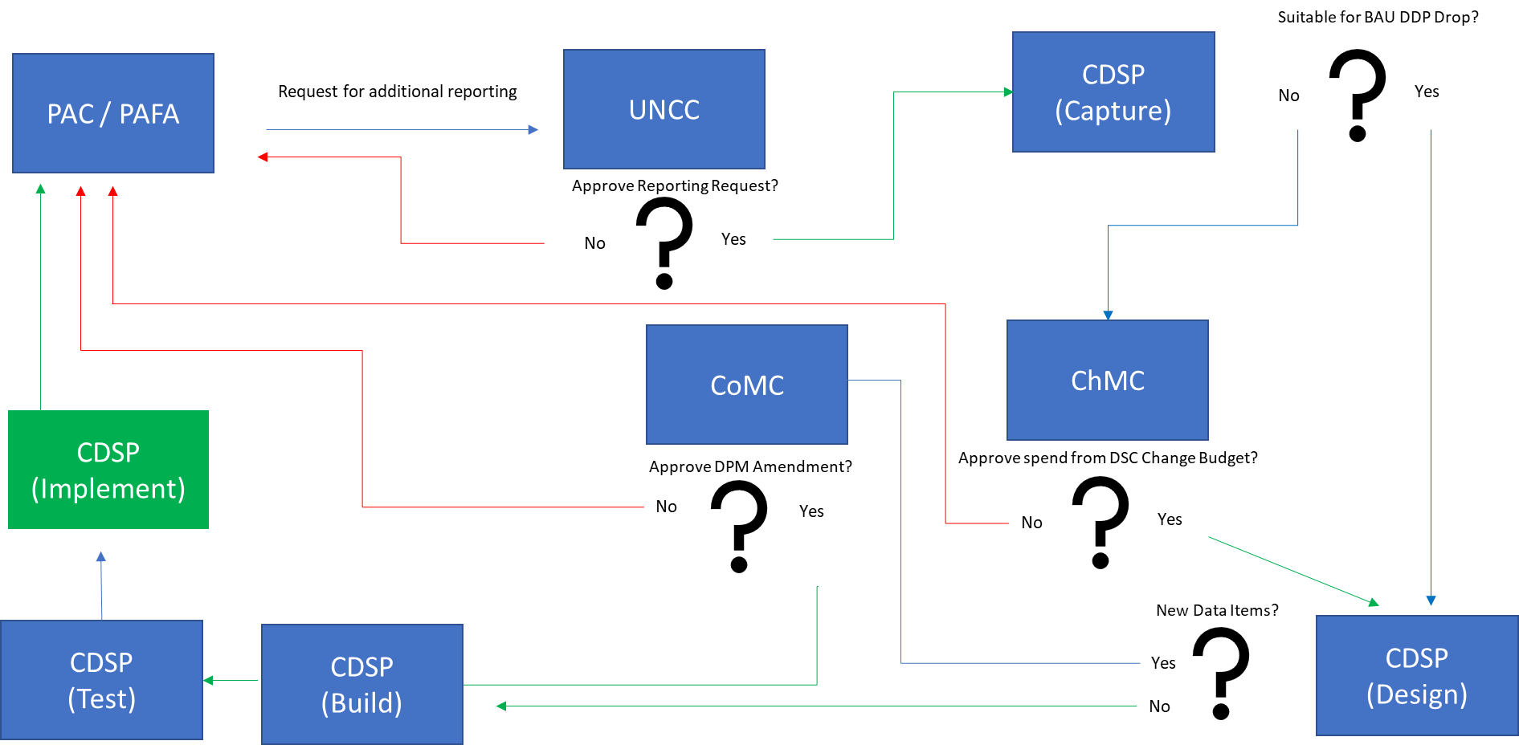
DDP PAC Report Request Process Map

Slide 5
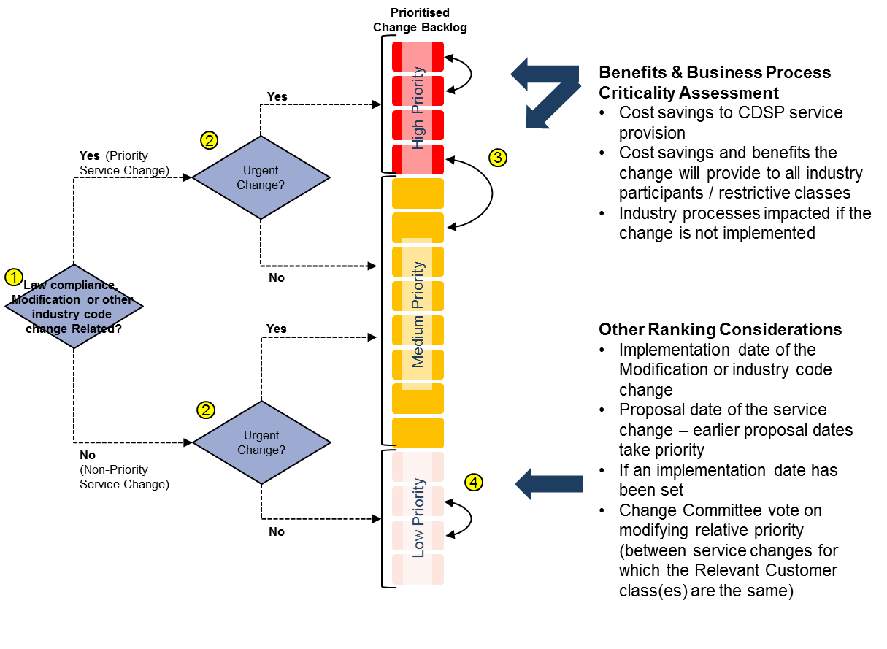
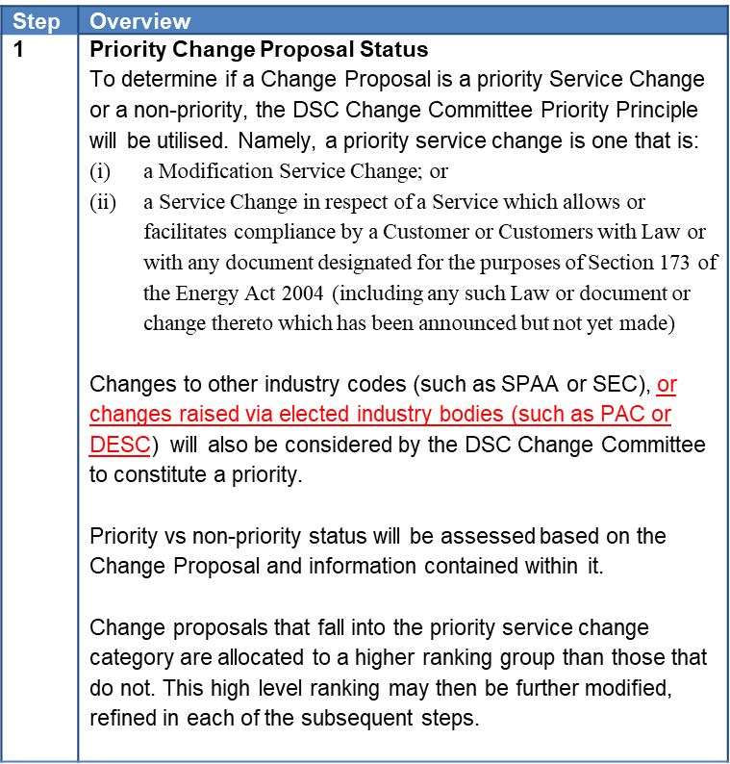
Prioritisation
Xoserve’s approach to the internal prioritisation of customer change is underpinned by a set of principles documented in the Xoserve Prioritisation and Scoping Approach document approved by ChMC in July 2017 (extracts below)
To ensure PAC changes are appropriately prioritised, with ChMC approval this document could be amended (see red text) to specifically reference PAC (full review of document underway). Discussion - Does PAC agree?
* Red text suggested change to document

Slide 6
PAC Content in ‘BAU’ DDP Scope
DDP roll out is funded via the MTB and investment budget in the CDSP Business Plan
As such, decisions regarding ‘BAU’ drop funding aren’t taken through DSC Change Management Committee
Where additional-to-BAU / focussed drop scope is required (such as in XRNs 5003 & 5013) approval to use the DSC Change Budget is sought
DDP Delivery Road Map
CDSP consults with customers as to content of future drop scope and through this process a DDP Road Map consisting of functional data categories has been developed
Categories are not unique (e.g. some AQ data items are already used in DDP despite AQ being mapped for release in 2020)
Each new drop will now require an XRN which will specify scope – this will be developed in….
The DSG is a bi-weekly industry meeting chaired by CDSP and exists as an advisory group for the DSC Change Management Committee to enable informed change solution decisions for DSC changes.
Attendance / agenda open to multiple party (including PAC / PAFA) / theme (Drop Content)
PAC / PAFA Workshops / Beta Group
Xoserve is represented at each of the monthly PAC meetings and advocate PAC requirements back into the CDSP in the interests of the committee.
We also encourage PAC participation in a ‘Beta’ Team for each DDP drop to ensure content & user experience is optimised
Delivery Sub Group

