Slide 1
Gemini Re-Platform Project Update

Slide 2
Gemini Re-Platform Project Overview
Gemini system is going through an Infrastructure Upgrade as part of this change and also moving to new virtualised infrastructure
Software upgrades due to
End of life support
Meet industry best practices
No changes are being made to the application or the functional capabilities of the system

Slide 3
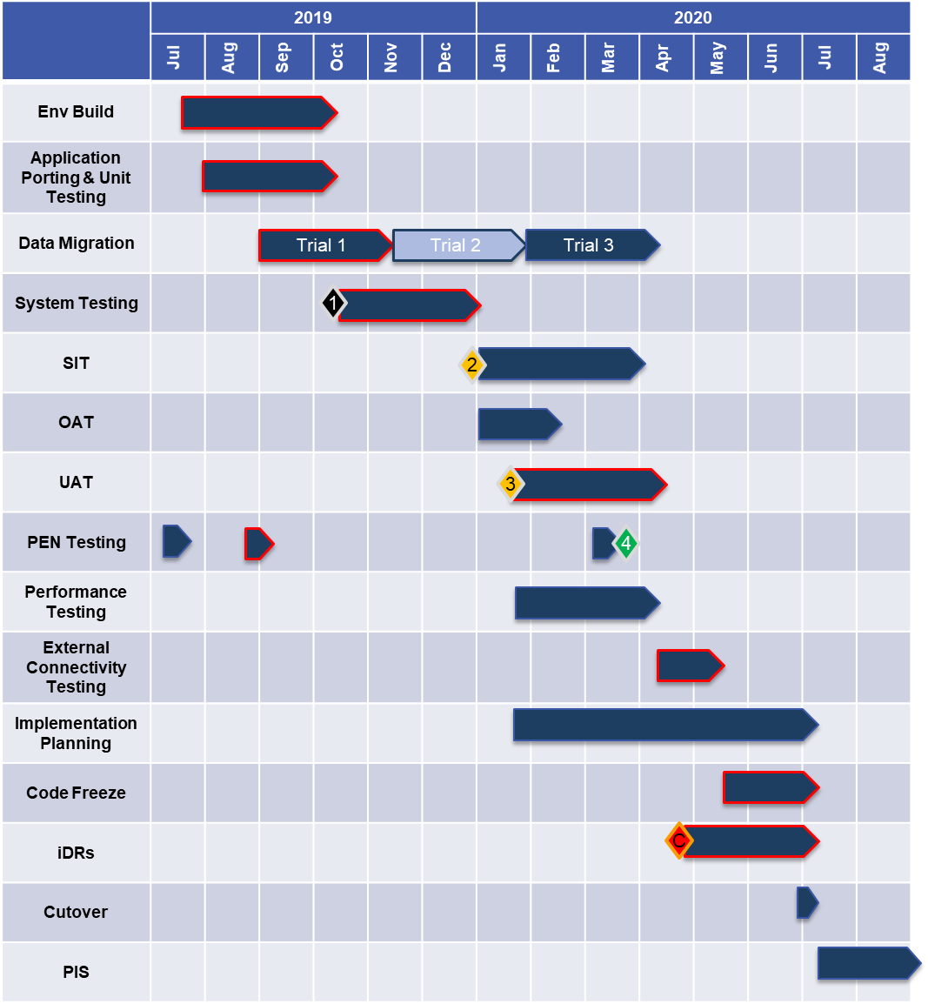
POAP

Slide 4
In Summary - Impacts to the Industry
Extended Outage
Extended system outage on Sunday 5th July. Estimated outage window is currently anticipated to be between 8 to 12 hours. Implementation planning is underway in order to determine the optimum amount of downtime required to conduct the final cutover, incremental data migration and rollback activities. Finalised system outages will be communicated through the official channels once determined.
Access to Gemini
Extended option to access Citrix via your web browser and/or update of your current Citrix receiver client, due to current version being out of support.
Functionality
The Gemini functionality will remain exactly the same and how Industry participants interact with the system.
External Connectivity Testing
All Industry participants will have the opportunity to test connectivity to the new data centre during the period 13th April to 8th May 2020.
Please contact box.xoserve.geminire-platform@xoserve.com for additional information or if you wish to participate in external connectivity test phase.

Slide 5
Any queries please email: box.gasops.businessc@nationalgrid.com
box.xoserve.geminire-platform@xoserve.com

