Slide 1
REC Data Specification and UK Link File Formats
9/10/2019

Slide 2
Data Specification Contents
Data Item Catalogue
Containing details of all the data items that are sent and received between Market Participants, Service Providers and Third Parties (such as Price Comparison Websites).
Message Catalogue
Containing the list of all messages sent/received between Market Participants, Service Providers and Third Parties. This will include the source and destination of each message, details of the data items contained within the message and the message structure.
E2E Process and ISDs
The graphical representation of the End to End (E2E) switching process (currently presented in ABACUS) and any other process defined within the REC, together with ISDs which illustrate the source, destination, flow and sequencing of messaging between parties.

Slide 3
Development Approach
Electricity Data Transfer Catalogue
Gas Supplier Data Flow Catalogue
Gas RGMA Data Flow Catalogue
Gas UK Link Manual
Metadata transformation
and migration
Metadata transformation
and migration
CSS Interface Specification
Metadata transformation to align with REC standard
REC Data Spec
Metadata transformation, consolidation and migration
Metadata transformation, consolidation and migration
Metadata transformation, consolidation and migration
Inclusion of UK Link data definitions to be considered further

Slide 4
Migration of Existing Metadata
Metadata currently held in the electricity DTC and SPAA DFCs will migrate into a single REC data catalogue.
Where possible, duplicate data items will be consolidated e.g. a single definition of postcode rather than separate gas and electricity data items.
Additional information populated to reflect the metadata standard e.g. data master and metadata owner.
User interface developed to enable the metadata held by the Code Manager to be provided to market participants and service providers e.g. online access

Slide 5
Metadata Standard
A REC Metadata Standard is being developed which will define the data attributes used to record REC data e.g. data item definition, metadata owner, data type.
This will reflect the content of existing metadata registers, plus additional attributes required for the new CSS arrangements.
In addition the meta data will support the creation of interaction sequence diagrams and other market process related artefacts, i.e. enable the representation of the flow of messages between parties to support specific use cases.

Slide 6
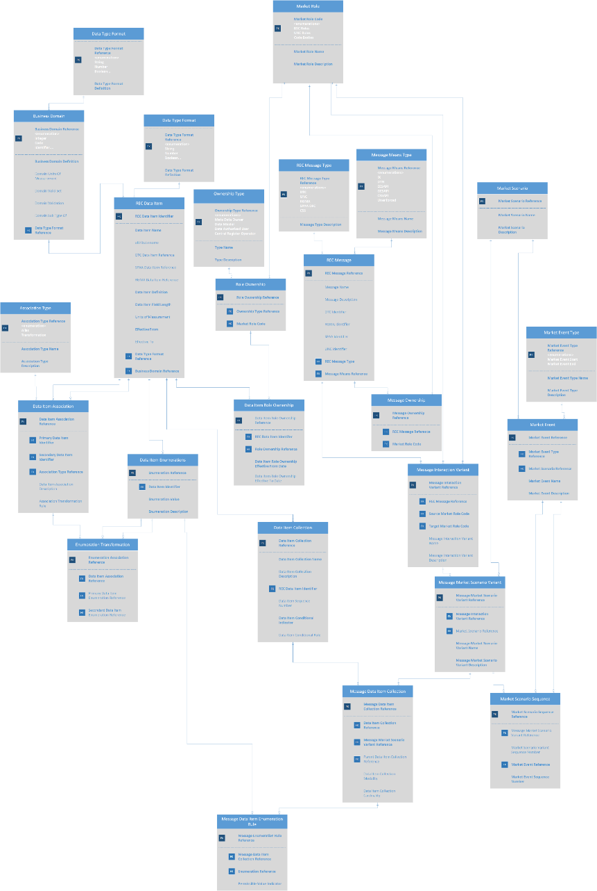
Overview of the REC Architecture Repository Metadata Model
Model is a work in progress and will be presented at the next RDUG in detail.
The model supports all of the architectural components referenced as being within the REC Technical Specification.
Key building block for the digitalisation of the REC

Slide 7
Data Items and messages / files
Will enable common model for DTC, CSS, RGMA, SPAA and UNC.
Will contain existing elements of those formats.
Will define code master, data master and master central register [if appropriate]
Messages between parties will be defined and variants of messages [e.g. different instances of the ONUPD or D0148]
Digitisation of content currently held only in documented explanatory text (e.g. annex C of the DTC).

Slide 8
Process and Sequence Flow
Will enable common model for REC message sequence interactions and business processes.
Can be based on specific use cases /market events.
Additional items to be added to the model:
Configuration Management
Business Rules (if additional to data item or message object classes)

Slide 9
Cross Code Governance Framework
REC to host the Data Specification, however control over the contents will sit with the Metadata Owner.
Metadata Owners to include REC, BSC, DCUSA and potentially UNC.
For example - changes to data flows used for BSC processes will be considered under the BSC change process and outcome reflected in REC Data Specification.
The lead code will be responsible for ensuring all impacted parties are engaged.
Cross Code Steering Group established to oversee the process

Slide 10
Development Timeline
July – Dec 2019
Jan – Mar 2020
Apr 20 – Apr 21
Define approach and metadata standard
Transformation and migration of metadata
Design and implementation of user interface
Approach paper and standard reviewed by REC Steering Board and RDUG.
Summary of approach included in Autumn consultation.
Population of Data Specification database with metadata migrated from existing data catalogues.
Consolidation of duplicate data items.
Output included in Spring consultation.
RECCo Board responsibility to ensure content is accessible to a range of individuals within a variety of organisations e.g. to support technical system development and operational activities

Slide 11
Questions for Change Management Committee
Do you agree with the proposed approach to the migration of metadata from existing data catalogues?
Do you agree that metadata relating to UK Link messages should be hosted in the REC Data Specification?
Do you agree with the proposed timelines?

