Slide 1
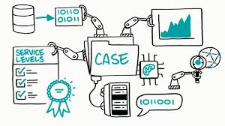
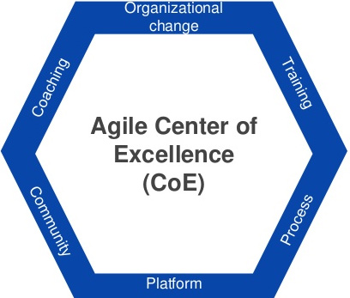
Operationally Excellent Operating Rhythm
Pain Points
Customer Propositions
Tactical Improvements
Agreed Prioritised Backlog
I feel like I’ve been woken up, I’m learning all the time and love it!
Phase 2
Notes:
We will deliver using SIP, Agile … approaches
Whilst the end-state may result in significant disruption, we must take our people with us and we must temper our ambition to a safe, sustainable velocity.

Slide 2
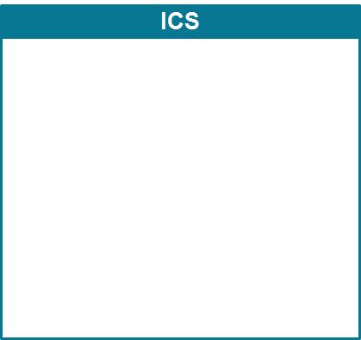
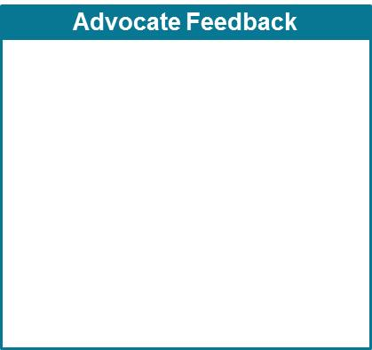
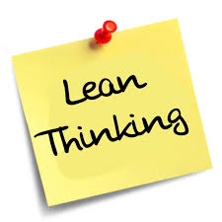
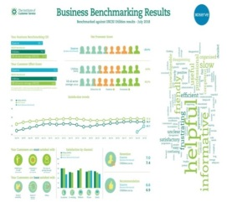
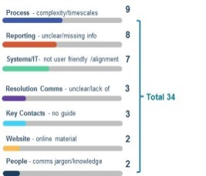
Operationally Excellent
More reliable service
(Right First Time)
CRM
360 Customer view
(cross team/ customer/ insight)
AMS
Improved customer access
(Redeploy to delight)
Reduction in operating costs
CDS
Improved communication
(Distribution Lists)
Customer feedback says.….
What we’re doing…..
Customer benefits……

