Slide 1
DSC ChMC Switching Programme Update 10th July 2019

Slide 2
Switching Programme
We continue to track at an amber status from a switching programme perspective, we are still pending clarification from the CSS physical design and closeout of open actions at CSSC DSG meetings.
The next release of the physical design is due on Thursday 1st August, we will review and comment on this design document as soon as we receive it. Review and comment discussion and tracking continues via the Ofgem Design forum, the next meeting is being held on Monday 12th August. This is the last design forum for review of the physical interface document prior to planned approval on the 23rd August at Programme Design Authority.
Sunday 21st July saw the release of the full end to end Core system and Services Integration Approach document (CSSIA). The review of this document is an industry wide activity with parties only having five days for review and comment with the deadline being Friday 26th July 2019.
Xoserve have reviewed this document and returned our comments within the deadline. The document is a fair document with the lower level detail being worked up in a number of areas at various technical working groups. These groups are yet to be set up but from our discussions with the SI we understand these will commence shortly and will run through the Autumn period.

Slide 3
Switching Programme
A revised CSS Integrated plan (CSSIP) has been released by Netcompany. Xoserve and Netcompany met week Tuesday 23rd July for a detailed walk through of the CSSIP to understand how Xoserve’s consequential plan links into the CSSIP.
This was a very constructive and collaborative meeting during which Xoserve walked through our consequential delivery plans highlighting dependencies and issues against some of the CSSIP tasks. Joint actions have been taken for corrective action and CSSIP update where required.
PWC are hosting two Industry forums for a walkthrough the revised CSSIP. This event is being held on two dates one in London and one in Solihull. The dates are as follows:
8th August – Solihull
9th August - London

Slide 4
Switching Programme
Xoserve’s detailed design phase continues with the majority of external industry workshops completed. The following workshops and topics remain:
16th August
Data Enquiry
File Formats and API’s
4th September and 17th September are both pencilled in contingency dates
Next meeting I will present to you the topics we have covered and the high level design recommendations that have passed into our build phase. These decisions have been recorded within HLSO slide decks and will be updated and published within the relevant BRD’s. We will begin to issue change packs from later this month.

Slide 5
API Discussion

Slide 6
API & File interfaces
Batch
File based (delimited)
Existing
AS-IS
Xoserve
Our Customers
API / Webhooks (JSON) & File based (delimited)
NEW secondary
API / Webhooks (JSON)
NEW primary
CSSC
CSS
Xoserve
Our Customers
File based (delimited)
Existing (Amended)
API / Webhooks (JSON)
ALL primary
API / Webhooks (JSON)
ALL secondary
FUTURE
CSS
Xoserve
Our Customers
Real-time

Slide 7
Switching Interface Flow Diagram
7

Slide 8
Proposed API Scope
Interface / File | Direction | Traditional File Format | API
Nomination Enquiry (NOM) | Inbound | Yes | Yes*
Nomination Enquiry Response (NMR) | Outbound | Yes | Yes*
Meter Point Transportation Rates | Inbound/ Outbound | No | Yes*
Settlement Data Submission (BRN) | Inbound | Yes | Yes
Settlement Data Submission Response (BRR) | Outbound | Yes | Yes
CSS Registration / Settlement Data Association (ASN) | Outbound | Yes | Yes
* = Current requirement for API delivery
Please note that the other amended file formats are not currently proposed to be replicated as APIs

Slide 9
API Landscape
This landscape will deliver real-time architecture with support for existing file-based interfaces
Our roadmap vision will look to transition from batch (file) to real-time (API) processing at a future point with full discussions with our customers via the relevant governance forums
To provide architectural consistency across all market participants, Xoserve is proposing to mirror architectural patterns proposed by CSS physical design for API's and webhooks, alongside message formats (Open API) as well as security decisions around message signatures & headers.
Given the above we recommend and welcome your analysis and review of the CSS physical design.

Slide 10
Funding status

Slide 11
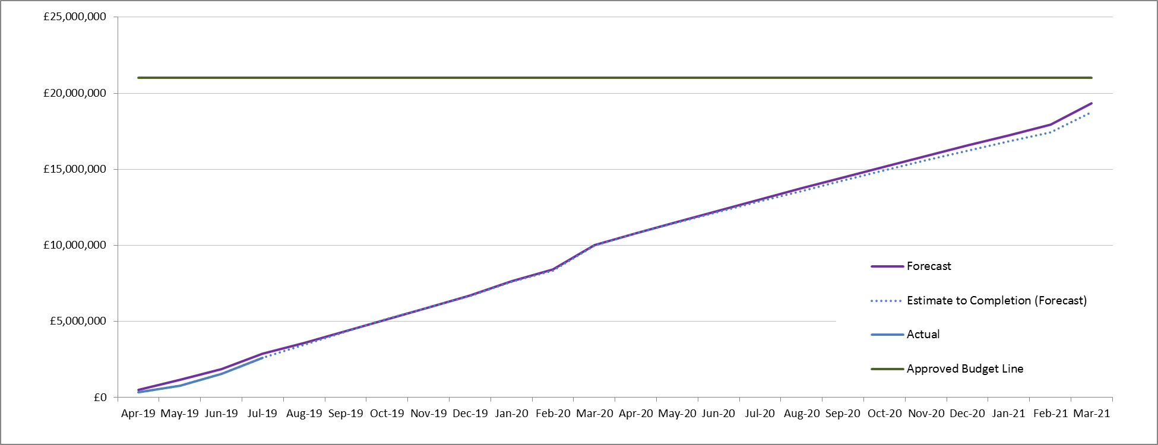
CSSC Funding Status

