Slide 1
DSC ChMC Switching Programme Update 10th July 2019

Slide 2
Switching Programme
We continue to track at an amber status from a switching programme perspective, we are still pending clarification from the CSS physical design and closeout of open actions at CSSC DSG meetings.
The next release of the physical design was released on Thursday 1st August, Xoserve have reviewed and commented on this design document. Review and comment discussion and tracking continues via the Ofgem Design forum, the next meeting is being held on Monday 12th August. This is the last design forum for review of the physical interface document prior to planned approval on the 23rd August at Programme Design Authority.
Sunday 21st July saw the release of the full end to end Core system and Services Integration Approach document (CSSIA). The review of this document was an industry wide activity with parties only having five days for review and comment with the deadline being Friday 26th July 2019.
Xoserve have reviewed this document and returned our comments within the deadline. The document is a fair document with the lower level detail being worked up in a number of areas at various technical working groups. These groups are yet to be set up but from our discussions with the SI we understand these will commence shortly and will run through the Autumn period.

Slide 3
Switching Programme
A revised CSS Integrated plan (CSSIP) has been released by Netcompany. Xoserve and Netcompany met week commencing Tuesday 23rd July for a detailed walk through of the CSSIP to understand how Xoserve’s consequential plan links into the CSSIP.
This was a very constructive and collaborative meeting during which Xoserve walked through our consequential delivery plans highlighting dependencies and issues against some of the CSSIP tasks. Joint actions have been taken for corrective action and CSSIP update where required.
PWC are hosting two Industry forums for a walkthrough the revised CSSIP. This event is being held on two dates one in London and one in Solihull. The dates are as follows:
8th August – Solihull
9th August - London

Slide 4
Switching Programme
Xoserve’s detailed design phase continues with the majority of external industry workshops completed. The following workshops and topics remain:
16th August
Data Enquiry
File Formats and API’s
4th September and 17th September are both pencilled in contingency dates
Next meeting I will present to you the topics we have covered and the high level design recommendations that have passed into our build phase. These decisions have been recorded within HLSO slide decks and will be updated and published within the relevant BRD’s. We will begin to issue change packs from later this month.

Slide 5
Funding status

Slide 6
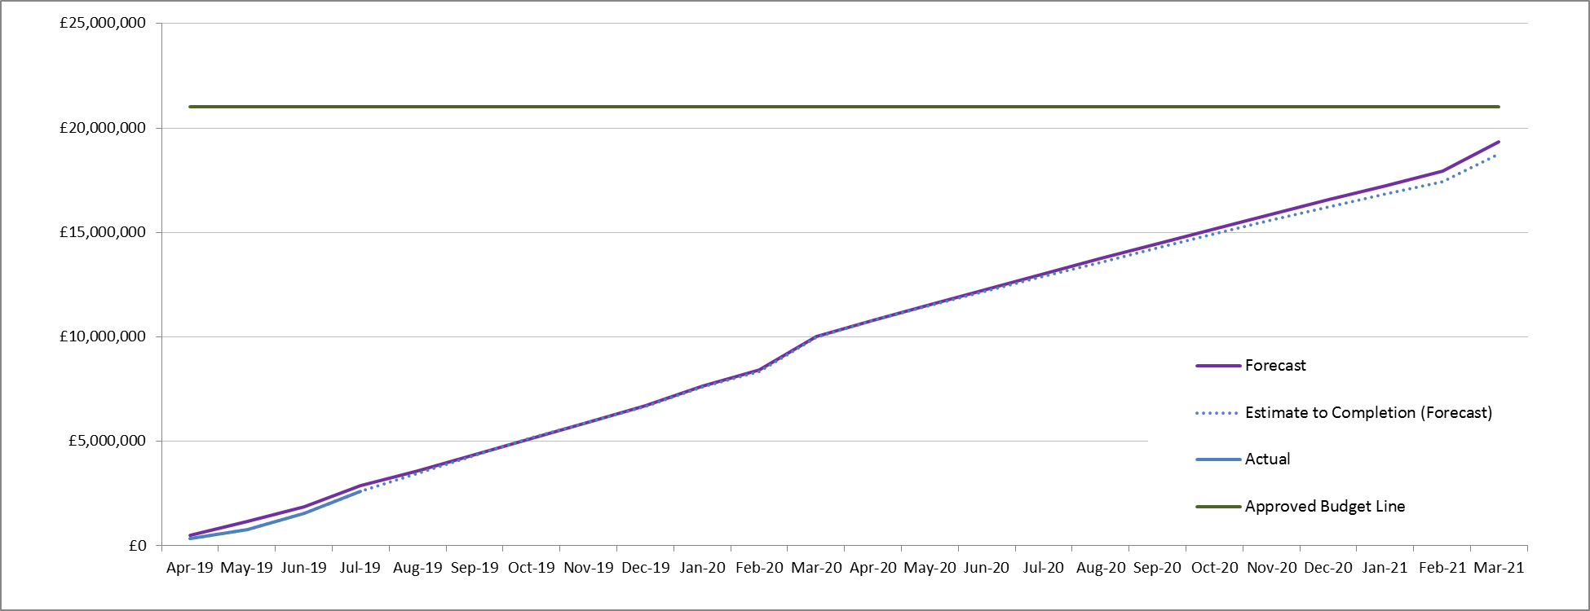
CSSC Funding Status

Slide 7
CSSC Financial Update
BP19 covers CSSC until FY 2020
Funding via Budget Planning process for BP21
2019
2020
FY 21
Internal Xoserve
assessment of costs
Based on impacts due to
CSS Design & Programme
updates
Transition &
Service Mgmt
Impacts
External
Testing
Impact assessment
CSSC Funding
Update Dec 19
Based on analysis
CSSC Funding
Update Mar 20
Based on analysis
of testing
requirements
CSSC Funding
Update July 20
Based on Transition &
Service Management
Dates to be confirmed
CSSC Funding
Update Jun 2019
Planned CoMC financial updates dependent on Programme dependencies

