Slide 1
UIG Task Force Progress Report
DSC CoMC 20/03/19

Slide 2
Background
Modification 0658: ‘CDSP to identify and develop improvements to LDZ settlement processes’ approved by Ofgem on 6th July 2018
Modification raised to authorise the CDSP to assign resources and incur costs related to a task force to investigate the causes and influencers of Unidentified Gas (UIG), with a target of reducing the volatility and scale of UIG and developing a robust predictive model for daily UIG for use by all parties.
BER for Change Reference Number XRN4695: ‘Investigating causes and contributors to levels and volatility of Unidentified Gas’ approved at ChMC on 11th July 2018
This Change Proposal added an additional service line into the DSC to enable Xoserve access to investigate, using resources and technology, causes and contributors to levels and volatility of Unidentified Gas. Xoserve is to provide monthly update reports and recommend proposals and subsequent changes or modifications for the industry.
The following slides provide:
Task force dashboard
POAP
Recommendation stats
Reporting on budget
Task force next steps

Slide 3
UIG Task Force: Dashboard
RAG
Time | G
Cost | G
Benefit | N/A
Overall RAG status:*
G
Progress since last month - key milestones | Workstream | Date | Status
Attend UIG working group | IA & AA | 22/01/19 | C
Run UIG Recommendation day under UIG work group banner | IA & AA | 28/01/19 | C
Attend CoMC | Task force | 20/02/19 | C
Attend UIG working group | Task force | 26/02/19 | C
Raise CRs & CPs to support recommendations allocated to Xoserve | Task force | 29/01/19 - completed | C
Create and publish UIG Investigation Guide | Taskforce | 15/02/19 | C
Publish post sprint executive summary | Taskforce | 15/02/19 | C
Priorities for next month – key milestones | Workstream | Date | Status
Draft Mod/support Eon – 12.1 & 12.3 - Site specific Conversion factors |  | W/c 4/03/19 | G
Draft Mod – 12.2 - Standard conversion factors |  | W/c 4/03/19 | G
Draft Mod – 3.2.1 - Automatically change meter read frequency to monthly where AQ increases above 293,000 |  | W/c 4/03/19 | G
Draft Mod – 3.2.1 – Reduce qualifying period for Class 1 |  | W/c 4/03/19 | G
Draft Mod – 3.2.1 – Automatically convert site to Class 1 and install DM equipment. |  | W/c 4/03/19 | G
Attend UIG working group |  | 25/03/19 | G
Attend March Change Management Committee |  | 13/03/19 | G
Attend March Contract Management Committee |  | 20/03/19 | G

Slide 4
Plan on Page
C
Completed activity
Delivery team milestone
Advanced Analytics
DSC ChMC governance
I
 | November |  |  |  | December |  |  |  |  | January |  |  |  | February |  |  |  | March
 | 05/11 | 12/11 | 19/11 | 26/11 | 03/12 | 10/12 | 17/12 | 24/12 | 31/12 | 07/01 | 14/01 | 21/01 | 28/01 | 04/02 | 11/02 | 18/02 | 25/02 | 04/03 | 11/03 | 18/03 | 25/03 | 01/04
I
12/12 DSC ChMC
I
09/01 DSC ChMC
I
28/01 CUSTOMER RECOMMENDATION DAY
C
13/02 DSC ChMC
I
13/03 DSC ChMC
I
07/11 DCS ChMC
15/2 Post Sprint Exec Summary
08/11 Sprint 4 Exec Summary
22/11 Sprint 5 Exec Summary
05/12 Sprint 6 Exec Summary
C
C
C
C
Develop Xoserve owned Recommendation options – update and publish recommendation tracker in line with UIG working group meetings
Develop Findings template and Recommendation Packs
Sprint 5
Sprint 6
Investigation Analysis
Sprints 4-6 to continue at the same pace and follow directly after the initial sprints to maintain momentum and ensure existing team resources are fully utilised. A 14-day stand-down period applies at any time.
15/2 Published Investigation Guide
C
Develop and manage shipper action plans (linked to Investigation Log)
Draft Mods to support recommendations
Support Mod development
22/10 Action plan template developed
Issue analysis and tracking (Investigation Tracker updated and published bi-weekly)

Slide 5
13 Findings – 85 Recommendation lines - where we are
85 recommendation lines
37 lines CLOSED
8 lines - PAC /Xoserve – underway under existing changes
3 lines – EON & Xoserve = 1 MOD0681
9 lines – Xoserve (12.2) = 1 MOD - Drafted
3 lines – Xoserve (3.2.1) = 3 MODS - Drafted
6 lines In progress
19 lines Future review
2 ongoing engagement using existing MI
1 CP4866 in progress
1 CR4867 in progress
1 CP4853 in progress
1 CR4868 in progress
7 review April
2 review May
3 review July
3 review November
4 review December
All future reviews include non task force related changes that are pending, defects with planned resolution dates, other options which may be considered if engagement/PAC reporting does not deliver results. (PAC can look to deliver these when PAC reporting is updated).
As at 04/3/19
Notes:
85 lines in recommendation tracker
37 lines closed = 3.2.1 option 1, 5, 8 & 9. 3.2.2 option 1, 2, 3, 4, 5, 7a, 8. 1 option 1,5 &8. 12.1&12.3 options 1, 5, 7, 8 & 9b. 12.2 option 1. 3.2.8 option 1, 6, 10 & 11. 3.1 option 1, 3, 4, 8 & 9. 2 option 1, 2 & 3. 13.2.2 option 1 & 2. 13.2.5 option 1, 2 & 3.
8 lines PAC/Xoserve action = 3.2.1 option 3 & 4. 3.2.2 option 10. 1 option 4 & 7. 12.1&12.3 option 3 & 6. 3.2.8 option 5.
3 lines EON/Xoserve MOD = 12.1&12.3 option 9a, 10, & 11.
9 lines Xoserve draft mod – 12.2 options 2,3,4,5,6,7,8,9&10.
3 lines Xoserve draft mod 3.2.1 options 6,7 & 10.
6 lines in progress =
2 ongoing engagement 12.1&12.3 option 2, 3.2.8 option 2 – using current MI shipper performance packs
1 CP in progress - 3.1 option 5 – 3.2.1 option 7 - CP4853 manual workaround
1 CP in progress – CP4866 removal of validation on uncorrected read
1 CR in progress – 3.2.1 option 2 - CR4867 sites over 58.6m kWh that need reconfirming
1 CR in progress – 1 option 2 - CR4868 class 1&2 read rejections
18 lines for future review =
7 review April 3.2.2 option6, 7b & 9. 1 option 3, 6 & 9. 12.1&12.3 option 4.
2 review May 2 option 5 & 6.
3 review July 3.2.1 option 11. 3.2.8 option 3 & 4.
3 review November 3.1 option 6&7, 2 option 7,
4 review December 3.2.8 option 7, 8 & 9. 2 option 4.

Slide 6
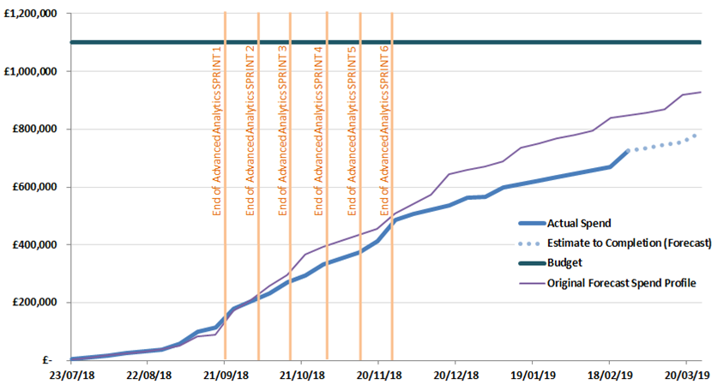
Overview Of Taskforce Funding

Slide 7
Taskforce Next Steps
Use the UIG working group as the mechanism to share progress on all recommendations where options residing with Xoserve.
Submit all draft Mods without a sponsor at March UIG Work group.
Provide updates to the “Recommendation Tracker” in line with UIG Working Group timescales.
Continue analysis on investigation lines & publish investigation tracker updates bi-weekly.
Publish any new findings/recommendations drawn from investigation lines which are currently “work in progress” when completed.
Continue the customer engagement, progress the CPs & CRs raised to support the recommendation options agreed at 28th January UIG-Recommendation session.
Supporting MOD development to progress agreed recommendation options where Xoserve have drafted the mods.
Continue the development of existing XRN’s to support the PAC report recommendations.

