Slide 1
Assessment of Release of data to MAMs via API / DES – following the SPAA RFI Meter Asset Manager Appointment Timescales RFI
CoMC on 20th February 2019
For Discussion Only

Slide 2
Background
A SPAA Request for Information about Meter Asset Manager Asset (MAM) Appointment Timescales closed out on 29th January
The purpose of the RFI was to gather industry views on a set of solution options to mitigate de-appointment and appointment of MAM’s, which will be accentuated as a result of Faster Switching
Faster Switching will accentuate existing issues where there may be a gap between the Supplier registering the Supply Point and the new MAM taking responsibility for the meter, where the old MAM has already been de-appointed. Should an issue with the meter arise during this period, it is not clear who would have responsibility for resolution.
Furthermore, once Faster Switching is in place, the switch can be withdrawn or annulled until 17:00 SED -1; MAM de- appointment/appointment flows could be triggered during this period

Slide 3
How MAMs Currently Acquire Asset Data
Prospective MAMs currently use the Request Details file (ORDET) flow to request asset details from the previous MAM
The old MAM will then send an response to the ORDET (ONDET file), which includes the necessary asset details; the ONDET file should be sent to the New MAM within two working days of receiving the ORDET
The issues described on the previous slide (bullet points 3 & 4) can occur during this two working day period.

Slide 4
Solution Option 3
Solution Option 3 within the RFI seeks views on a ‘Centralised Meter Data’ source for perspective MAMs to extract the asset information they require
Our interpretation of the solution is to increase the information we (the CDSP) provide to MAMs
As a preliminary assessment, we have compared the data items in the ONDET file to what we provide to MAMs, as specified in the Data Permissions Matrix (DPM), and what we have in UK Link

Slide 5
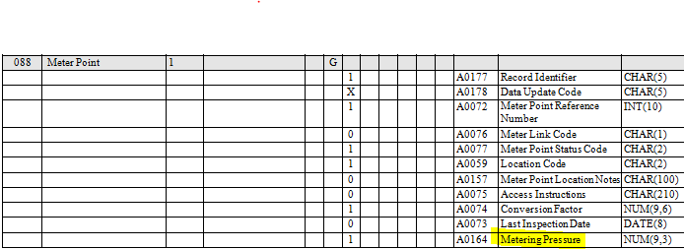
UK Link and DPM VS ONDET (Meter Point)
Key: From slides 5 to 11, the yellow data items are data items not available to MAMs via DES, telephone and other means; the highlighted blue data items will require further assessment
Transactions data items are not applicable

Slide 6
UK Link and DPM VS ONDET (Asset)
For Asset Status Code, we have Meter Status and Convertor Status

Slide 7
UK Link and DPM VS ONDET (Meter)

Slide 8
UK Link and DPM VS ONDET (Convertor)

Slide 9
UK Link and DPM VS ONDET (Register Details)

Slide 10
UK Link and DPM VS ONDET (Identifies Asset Provider)

Slide 11
UK Link and DPM VS ONDET (Name, Address, Contact Mechanism and Appointment )
After reviewing the Data Permissions Matrix and thinking about what we have in UK Link, we don’t believe that we have the data items associated with these sections of the ONDET file

Slide 12
Discussion Points
Our thoughts:
The above slides present the functional data items the CDSP can’t provide to MAMs
We advise to increase MAMs access to CDSP data from Portfolio to Community; this would mean that a MAM would be able to see data regarding sites that belong to other MAMs; we would use an API as the data delivery mechanism
Discussion Points
What does CoMC think? Would Community access be a problem for MAMs?
If we use an API, to what extent can we control the service? Does CoMC have any suggestions for data audit and control? Some MAMs may not want to share asset data (which was the view from MAMCOP on 7th February). In that case, would we implement a subscription service, where only MAMs willing to share asset data could sign up to the API.
Have we looked at the right Data Items i.e. the ONDET file?
For the Data Items we can’t provide, is this a Show Stopper? Moving additional data items into our systems for sharing data to MAMs would increase costs significantly to the construction of a new API.
Furthermore, we don’t have the Supplier ID; do you thinks MAM would require this data item?

