Slide 1
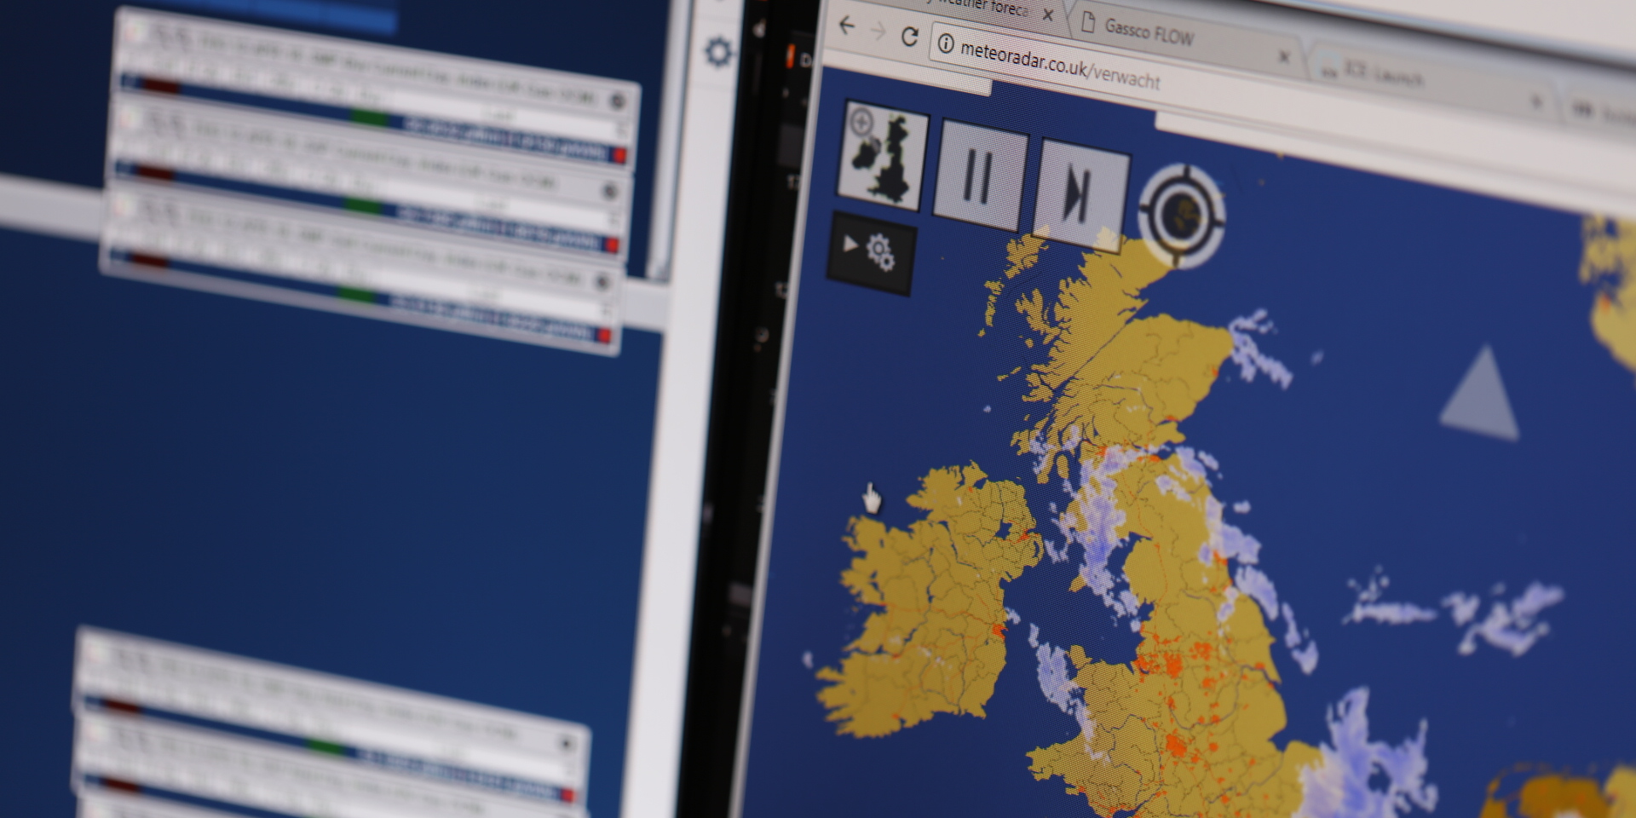


Capacity Methodologies Review 2019
Malcolm Montgomery
08-02-19

Slide 2
Timetable 2018/2019
Preliminary Consultation to start c. 15th January for 4 weeks.
Tx WG
Agree Scope of Examination
Run Tender & prepare for Examination
Examination
SEP ‘18 | OCT | NOV | DEC | JAN ‘19 | FEB | MAR | APR | MAY | JUN ‘19
Identify Changes
Informal discussions with industry
Review
Proposal with the
Authority for Direction
(2 months)
Preliminary
Consultation
Consultation
(28 days)
Review and update (14 days)
Today

Slide 3
Summary of changes
Description (Statement)
Revised NPV test - not linked to LRMC (ECR) Removal of requirement for NPV test in cases of substitution (ECR) | CLOCC updates to PARCA process CLOCC updates to baseline table (ECR, ExCR)
Process ad-hoc increases received during the PARCA window (ExCR) | Capacity Conversion (ECR, ExCR)
Withholding Daily Capacity (ExCR) | Remove clearing obligation (ECR, ExCR)
Note: some of the changes listed may be considered substantial topics, but the decisions are being taken outside of this change process, in which case it is a tidy up exercise.
Administrative updates will be carried out on all 5 Statements to update weblinks, dates etc.

