Slide 1
Change of Supplier Data Provision to Ofgem
Background of the initiative
Xoserve performs a number of activities to support our DSC Customers in meeting their obligations against Request for Information’s (RFI’s) that have been placed on them by Ofgem
One such RFI requires monthly provision of Change of Supplier datasets and associated transfer performance reports to Ofgem
This information is used to inform Ofgem’s ‘State of the Market’ annual review, amongst other market monitoring activities
What’s going on?
Over the past 6 months we have been working closely with Ofgem to make improvements to these datasets and reports
Ofgem’s requirements include presenting a consolidated view of gas and electricity switching performance data
We have constructed an interface with ElectraLink to gather electricity switching details
Our existing data capability has been utilised to create dashboards that display data in a far more interactive and dynamic way
These dashboards are currently in prototype and have been well received by Ofgem
Why are we updating Contract Management Committee?
To provide awareness to our DSC Customers
To demonstrate we are actively leveraging existing assets to enhance data services for the benefit of the market
To clarify that this is being performed at no additional cost to DSC Customers

Slide 2
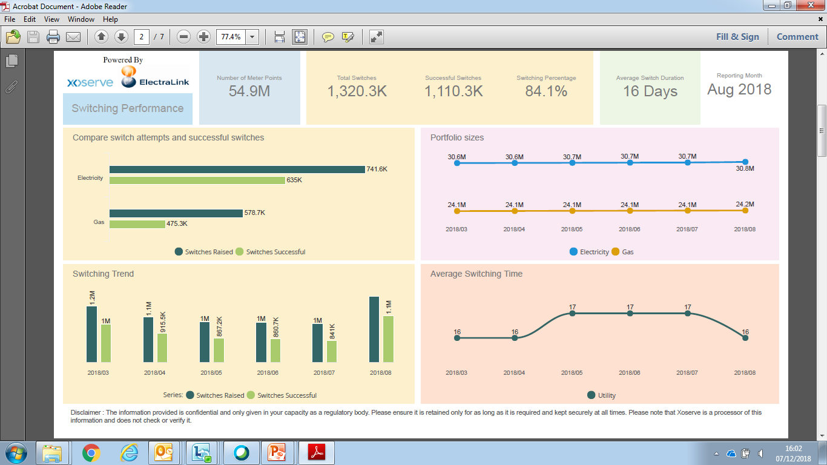
Change of Supplier Dashboard Examples
The above examples consist of dummy data and do not reflect actual figures recorded within the UK Link systems
These prototypes have been shared with Ofgem who are in the process of familiarising themselves with the layout and content
A collaboration workshop is scheduled for Q1 2019 with Ofgem to gain their feedback
We will then look to make any final changes before scheduling the reports to be put into production

