Slide 1
EU Update
Transmission Workgroup
8 January 2019

Slide 2
Brexit Update
Statutory Instruments (SIs) relating to Energy (under the EU Withdrawal Act 2018) were published on 17th December 2018 and will be laid before Parliament
The SIs ensure that the energy market continues to operate effectively in a ‘no deal’ scenario
https://www.gov.uk/eu-withdrawal-act-2018-statutory-instruments

Slide 3
Brexit Update
SIs related to gas arrangements - EU Regulations covered:
The Electricity and Gas etc. (Amendment etc.) (EU Exit) Regulations 2019; covering
Gas Regulation (715/2009)
The Gas (Security of Supply and Network Codes) (Amendment) (EU Exit) Regulations 2019; covering
Security of Gas Supply, Interoperability and Data Exchange Rules, Harmonised Tariff Structures for Gas, Balancing of Transmission Networks, Capacity Allocation Mechanisms in Gas Transmission Systems
The Electricity and Gas (Market Integrity and Transparency) (Amendment) (EU Exit) Regulations 2019; covering
Wholesale energy market integrity and transparency - ‘REMIT’

Slide 4
Brexit Update
Next Steps for UNC
We are proceeding on the basis of a no-deal outcome:
In January 2019, National Grid expects to launch the code change process
References to EU Regulations to be replaced by reference to relevant UK Statutory Instrument
References to EU institutions (eg: European Commission, ACER etc) to be removed
As far as possible, Code changes will be made via the self-governance process although ‘urgent’ procedures may be considered

Slide 5
Gas Day: Discontinuing seasonal changes of time
Settled view from EC that there will not be an agreement of Parliament and Council by March 2019 regarding time change proposal
There has been no agreement to date mostly because the MS are still at the stage of coming up with their position and having ‘internal’ public consultations
It is expected that the Parliament and Council will reach agreement in the second half of 2019 (probably October)
It is recognised by EC that a sufficient transition time is needed (most popular proposal is 18 months)

Slide 6
Gas Day: Discontinuing seasonal changes of time
Next steps
EC recommended ENTSOG to have an additional meeting with EP in January (including the ITRE Committee)
To give an overview of technical issues with regard to daylight saving issue
To express that it will be good that all Member States move together to discontinue the time change (or not)
Likely impact on Gas Day in 2021

Slide 7
GT&C Template
Creation of a standard template for GT&C for bundled capacity required under CAM (Art. 20)
Template now finalised and published on ENTSOG website: http://www.entsog.eu/sites/default/files/2018-12/PR0175-18_Press%20Release_ENTSOG%20publishes%20the%20final%20template%20of%20main%20terms%20and%20conditions%20for%20bundled%20capacity%20contracts_v2_0.pdf
Requires TSO to ‘opt in’ so no immediate impact on GB shippers

Slide 8
ACER’s workshop on conditional products
Art. 38 (4) NC CAM sets obligation to ACER by 6 April 2019 to deliver a “report on conditionalities in firm gas capacity products to asses their effect on efficient network use and integration of Union gas markets”
Workshop held on 4th Dec:
Aim: discuss the topic with all stakeholders before finalising the report
General neutrality with regard to the benefits of conditional products so far
Question to be answered within the study: Should CCP be eliminated? What would happen in this case?
Offering less firm by turning CCP into interruptible?
Investing to upgrade CCP to firm?
Impacts for the shippers?

Slide 9
ACER’s workshop on conditional products
Next Steps
Pilot Cost Benefit Analysis for a special case will be done in the report
Incorporation of stakeholders feedback from the workshop by December 18
Finalisation of the draft study by Jan 19
Publication of the final study by April 19 latest (most likely earlier)

Slide 10
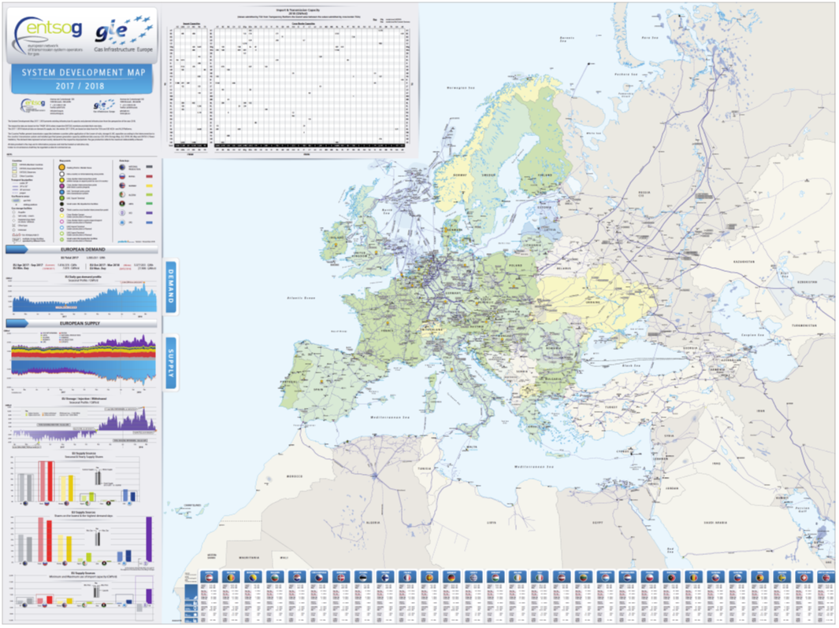
Latest GIE System Development Map now available
https://www.gie.eu/index.php/gie-publications/maps-data/system-development-map

