Slide 1
Context
On 1 September FindMySupplier went live, the website is designed to be an alternative to the M Number Phoneline service. With the intention to reduce the number of calls to the phoneline and offer a better service to consumers.
It was always intended that the site would be developed in stages, stage one (XRN 4635) involved the delivery of the minimum viable product, i.e. the ‘must have’ requirements of what was needed to provide the service via a web portal.
Phase 2 (XRN 4626.2) looks to build on this on this capability to provide, an easy to use service that would be the preferred choice of consumers.
This second phase will also involve migration of the phoneline from Cadent to Xoserve hosting.

Slide 2
Phase 2 Progress to Date
We have reviewed the requirements captured as part of the first phase to now look at what the site should and could offer and suggested priorities within this.
We have also captured some additional requirements as part of this review.
We would love to hear your views on the requirements we are suggesting.
We would also like to know if there is any appetite for industry parties to be involved in putting forward ideas for the next stage of development.

Slide 3
Some initial thoughts…
We would also be interested in any initial high level feedback you could offer specifically on the following areas:
Inclusion of Industrial data
Inclusion of links/logos to supplier and transporter websites
Contact numbers of current supplier displayed
FAQ page containing relevant information including list of all suppliers, what to do if a site is shipperless etc
Info markers providing explanation to consumers of key words
Ability to search on building name/number, street and postcode

Slide 4
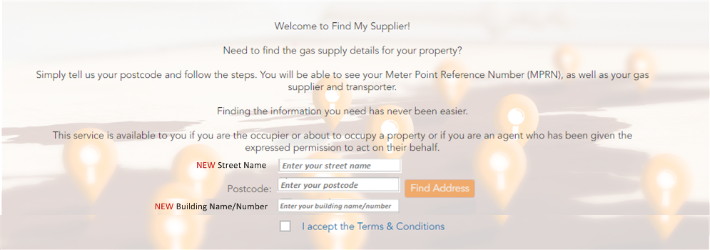
Prototype Views*
*For Demo purposes at this stage – these will evolve

Slide 5
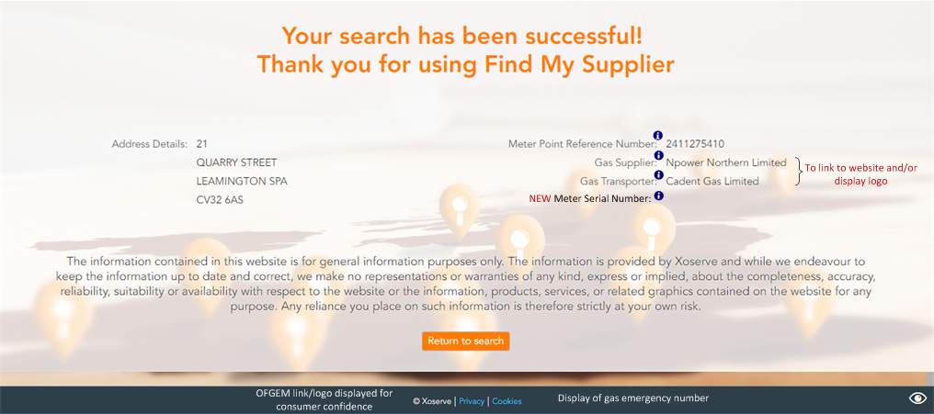
Prototype Views*
*For Demo purposes at this stage – these will evolve

