Slide 1
Extraordinary DSC ChMC
29th November 2018

Slide 2
Unidentified Gas (UIG) Reconciliation Invoice - Weighting Factors Issue

Slide 3
Contents
Summary of contents
Issue Summary
Definition of the Issue
Root Causes
Estimated financial impacts
Resolution Plan
Options for Invoice Corrections
Mitigation of future issues

Slide 4
Issue Summary
Issue Title | Incorrect Unidentified Gas (UIG) reconciliation sharing and charges issued on the Amendment Invoice
Processes Impacted | We can confirm that this issue is restricted only to the sharing of UIG reconciliation within the Amendment Invoice. It does not have any impact on nominations and allocations, and is therefore not impacting the current volatility and/or base levels that are being seen in national UIG.
Impact to Customers | The financial position for UIG charges within Amendment Invoices, dating back to the October 2017 billing month, will not be correct. Ongoing analysis into this issue has led us to conclude that this error is restricted to End User Categories (EUC) Bands 02B for classes 2 & 3 and EUC 07B for class 4 but with smaller opposite impacts to all other EUC bands. As per the attached additional information the following incorrect UIG weighting factors were held in UK Link for: • EUC Band 02B for Class 2 – 5.16 instead of 51.60 • EUC Band 02B for Class 3 – 5.15 instead of 51.50 • EUC Band 07B for Class 4 – 3.95 instead of 39.50 Financially, our high-level impact analysis into this issue suggests that the total mis-apportionment of UIG energy between billing months October 2017 to September 2018 equates to less than £50,000 across the whole market.
Cause | Ongoing analysis into this issue has led us to conclude that our UK Link system, for the Gas Year 2017/18, was holding incorrect UIG weighting factors for End User Categories (EUC) Bands 02B for classes 2 & 3 and 07B for class 4, which did not match those as set by the AUGE. Currently, our IS Operations team believe that two distinct root causes linked to the manual upload of the UIG weighting factors in UK Link, one in readiness for the October 2017 billing month and one in advance of the July 2018, August 2018, and September 2018 billing months, can be attributed to causing the inaccuracies we’re seeing in the Amendment Invoice for customer’s UIG charges.

Slide 5
How UIG is shared out
Each Shipper’s daily gas usage (“throughput”) is used as the basis of UIG Allocations each day – throughput is made up of daily measurements (Class 1 & 2) and allocations (Class 3 & 4)
Actual daily usage is weighted using UIG Weighting Factors provided by the Allocation of Unidentified Gas Expert (AUGE) each year
Once the Weighting Factors have been applied the result is referred to a “Weighted Throughput”
Following slides explain the use of Weighted Throughput in the calculations

Slide 6
Impacts on UIG Reconciliation
Weighting Factors are used in sharing out UIG reconciliation each month
UIG reconciliation is the “Equal and Opposite” of all individual reconciliations – whole amount must be re-shared to ensure that industry energy position remains “whole”
Note: Weighting Factors have been correct in the Gemini system throughout the period, daily Gas Allocations and Nominations are unaffected by this error
MONTHLY RECONCILIATION
Total LDZ
UIG
NDM – SSP and LSP
Revised UIG is shared across market using UIG Factors
Daily Metered (DM) Energy
LDZ Shrinkage

Slide 7
How is UIG reconciliation shared out?
Billing months – back to Line in the Sand
Reconciliation is performed on all sites where we have accepted read(s) or a consumption adjustment in that billing month.
Individual reconciliations (shown in red) could go back to the Line-in-the-Sand (Code Cut-Off Date in UNC)
The “equal and opposite” of the total rec energy in each LDZ is shared out in equal amounts over the previous 12 “incurred months”* of Weighted Share of latest throughput
Individual reconciliations
Ʃ recs for month
UIG share – over 12 “incurred months”) *
(Ʃ recs for month x -1) / n for each incurred month
* n = 12 months or the number of months since Project Nexus implementation if shorter

Slide 8
Calculation of Latest Throughput
Total throughput for the month is sent to UKLink SAP from Gemini (total energy as at GFD+5 and weighted total energy (using UIG factors))
Throughput needs to be adjusted each month for individual reconciliations processed
Prevailing (historic) weighting factors are used for each of the 12 months
A
B
Shipper
C
Month 1
A
B
Shipper
C
Month 1
Adjusted
Post rec
Month 2
Continues for 10 more months
Latest weighted throughputs used for UIG rec share

Slide 9
Latest view of impacted months
October ’17 incurred month was incorrect throughout the period
A further issue in August ’18 introduced the same error for November ’17 onwards up to and including August ’18 incurred month
September ’18 and October ’18 incurred months are now known to be correct, but as of October billing period, historic months have not yet been corrected

Slide 10
Root Causes
Two separate issues...
Issue 1: In Nov’17 (for the Oct’17 billing month) because of integration issues between Gemini and UKLink SAP
Issue 2: In Aug’18 (for the July’18 billing month), that also reoccurred in Sept’18 (for Aug’18 billing), which saw the UIG smearing job in UK Link initiated out of sequence...
...required the Xoserve IS Operations team to intervene with a manual workaround to ensure the Amendment Invoice was issued out on time.
When performing such manual workarounds to replicate the UK Link receipt of the interface file from Gemini, those UIG weighting factors ending with a zero for the their second decimal place was misinterpreted by our UK Link SAP system.
The UIG weighting factors held for the incurred months Sept’18 and Oct’18 are now correct within UK Link; however all previous incurred months’ weighting factors dating back to Nov’17 remain inaccurate until the impacts caused by Issue 2 are resolved.
Issue 1
Issue 2

Slide 11
High level view of impacts
High level impact assessment indicates the re-apportionment to be less than £50,000 for the period October 2017 to September 2018
Based on total reconciled energy for each of the impacted incurred months for all the affected Billing Months
E.g. Jan ‘18 – only 1 incurred month affected
Affected EUCs/Classes have been allocated c 0.1% of UIG rec – should have been allocated c 0.9% of UIG rec
Impact assessment took the difference in UIG allocation for all affected incurred months
Equal and opposite impact will be spread across all other EUCs/Classes – largest impact to EUC01/Class 4 – picks up the largest share of UIG

Slide 12
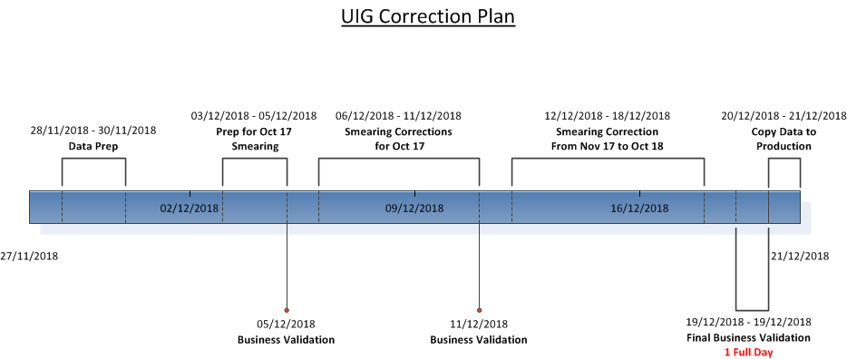
Resolution Plan

Slide 13
Invoice Correction
The following are options for issuing the adjustments, request customers to provide their preferred option for delivery of the adjustments by 4th December
Option 1 Recommended
Issue the adjustments for the whole period at the same time.
Supporting information will be provided for each billing period
The adjustments will be issued on 21st December 2018 via the Ancillary invoice process
Option 2
Issue the adjustments separately for each billing period.
Supporting information will be provided for the relevant period
The adjustments will be issued early February 2019 via the Ancillary invoice process

Slide 14
Assurance Activities
Checks by the business, process experts and IS Operations have confirmed the UIG smear and charges for the remaining periods are correct.
The activities and analysis carried out has confirmed the issue is limited to the billing periods identified (in slide 10).
There a checkpoints at each stage of the resolution plan for the business to carry out assurance before proceeding to the next stage.
Validations will also be performed before the corrected data is loaded into the UKLink SAP live system.

Slide 15
Future Prevention
Short term actions,
The functionality to trigger the UIG smear will be restricted to IS Operations and only following approval from business that all validations have completed
New controls will be introduced to ensure any manual interventions or workarounds have appropriate governance and business validations before loaded into the system
Longer term steps are around the root cause findings associated to the manual loading of information
Identify and test a mechanism to ensure no similar issues occur when manual intervention is required
Review back up and restoration plans
To better understand the behaviour seen in UK Link a dialogue will be held with SAP

Slide 16
Amendment Invoice Taskforce Update

Slide 17
Amendment Invoice Taskforce Update
32 defects outstanding as at 1st September 2018
26 defects have been fixed
6 defects outstanding
3 due to be deployed by end of November 2018
3 will be deployed in January 2019
Exclusions
Total number of exclusions outstanding on 1st September was 54,507 (meter points)
2,483 released in October
35,626 will be released on the November invoice, issued in December
16,398 will be released on the December invoice, issued in January

Slide 18
Amendment Invoice – Resolution Plan
2018
2019
Sep
Oct
Nov
Dec
Jan
Feb
Defects
Eliminate Backlog (32 @ 1/9)
3
BAU @ M+1
4
Exclusions
Eliminate Backlog to 31/10
BAU @ M+1
Offline Automation
ASP Correction file
2
Design & RCA
UBID P1
P2
1
Solution Work Packages
5
Benefits Delivery
1
Mismatch reduction will be measured & reported, visible for Oct Invoice Cycle
2
Accelerated Offline file production + backlog reduction
3
Mismatch & Exclusion reduction, will be measured & reported
4
All new defects fixed by end of following month (M+1)
5
Number of system, scheduling and procedure changes – delivering final set of mismatch fixes

Slide 19
Production AQ Defects Update

Slide 20
Issues Affecting AQs
Plan and approach agreed with customers for the defect fix, consumption/energy correction and re-calculation of the AQs.
Plan to correct AQs for all issues categorised as ‘High’ and ‘Medium’ before 1st December, the remainder to be corrected by 1st April.
All ‘High’ & Medium’ priority issues have been fixed with the exception of one (XRN4740) and the revised AQs issued on 23rd November (via the .NRL file)
Remainder of the issues will be fixed before the end of March 2019, the revised AQs will be effective from 1st April (including the Formula Year AQ & SOQ).
Total of 14 issues affecting AQs
8 have been closed and AQs re-calculated as planned. These will be effective from 1st December 2018 (notification sent on 23rd November)
214,609 Meter Points have been corrected as part of this exercise
6 outstanding issues which will be fixed and AQs re-calculated before the end of March 2019, these will be effective for 1st April (if not before).
The Formula Year AQ & SOQ will also be updated with an effective date of 1st April 2019
Approx 15,000 meter points affected

