Slide 1
Find My Supplier Route to Implementation
M Number service originates from GT Licence Obligation 31 which requires a Supply Point Information Service to be established and operated to supply information via an enquiry service. This should enable the provision of data relevant to the supply of gas to premises owned/occupied or about to be by the customer.

Slide 2
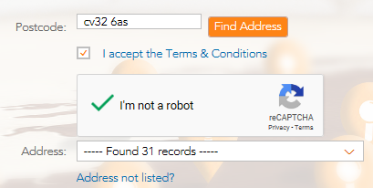
GDPR Compliance
Legal team drafted the terms and conditions, and cookies policies and privacy notice to ensure GDPR compliance.
A user is not able to search on the site without agreeing to the terms and conditions (search box is disabled).
The site is protected from scripts using the I am not a robot mechanism which asks the user to select images containing a certain object from a range of images.
On selecting an address the user has to actively confirm they are entitled to view the information by selecting “Yes”.
“If this address is correct and relates to your enquiry, please confirm that you are entitled to view the gas supply details.”

Slide 3
Overuse - Monitoring
Monitoring in place for the M Number helpline and Find My Supplier to monitor usage.
Phoneline - A report is taken of the top 20 callers to the helpline within a month this is monitored for spikes in usage. Out of 42657 calls last month (October) 5 numbers called the service over 100 times (0.01%).
Find My Supplier - A report is generated to show the amount of sessions a user device has previously had on using the site. Out of 29887 sessions in October 34 of the user devices had used the site over 100 times (0.11%)

