Slide 1
UIG Task Force
Contract Management Committee 14/11/18

Slide 2
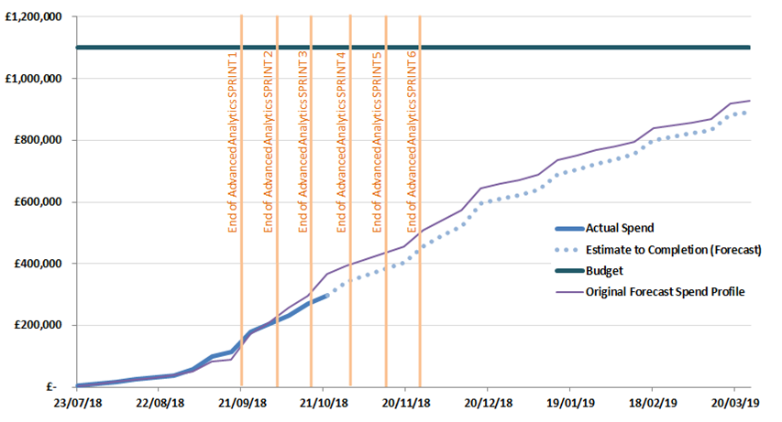
Overview Of Taskforce Funding

