Slide 1
UNC Modification 0667
South Hook Gas

Slide 2
Modification Timeline
Short timescales, however given the current PARCA application from SHG and the impact of the current methodology on parties the change is required as soon as possible
We believe that the proposed changes have no impact on other parties except for those signalling incremental capacity (of which this has a positive impact). The solution is ensuring parties have the ability to signal the correct amount of revenue, which provides certainty to both the signalling party and the rest of industry.
 |  | Week Commencing
 |  | 15-Oct-2018 | 22-Oct-2018 | 29-Oct-2018 | 05-Nov-2018 | 12-Nov-2018 | 19-Nov-2018 | 26-Nov-2018 | 03-Dec-2018 | 10-Dec-2018 | 17-Dec-2018 | 24-Dec-2018 | 31-Dec-2018 | 07-Jan-2019 | 14-Jan-2019 | 21-Jan-2019 | 28-Jan-2019 | 04-Feb-2019 | 11-Feb-2019 | 18-Feb-2019 | 25-Feb-2019 | 04-Mar-2019 | 11-Mar-2019 | 18-Mar-2019 | 25-Mar-2019 | 01-Apr-2019 | 08-Apr-2019 | 15-Apr-2019 | 22-Apr-2019 | 29-Apr-2019 | 06-May-2019 | 13-May-2019 | 20-May-2019
Process | Modification Panel
 | Workgroup Development
 | Consultation
 | Ofgem Decision
18/10 – Panel refer Modification to workgroup for development
First workgroup on 01/11 (at TxWG) and further workgroups on 06/12 and 03/01
Scope out requirement for modification
Identify any further analysis needed
17/01 – Draft Modification Report sent to Panel and then issued for consultation
07/02 – Consultation closes
11/02 – FMR available for panel on
21/02 – Modification Panel decision and subsequently referred to Ofgem for a decision

Slide 3
Workgroup Aims
Three workgroups before draft mod report put to panel
Below is a suggested timetable for meetings to discuss
 | Topics | Tasks
Meeting 1 1st Nov | Introduction Minimum Duration rule | Identify analysis requirements Initial feedback and identify additional topics for meetings 2 and 3
Meeting 2 6th Dec | NPV test in UNC (vs methodology) Review of analysis | Identify any further analysis required Update mod as required
Meeting 3 3rd Jan | tbd

Slide 4
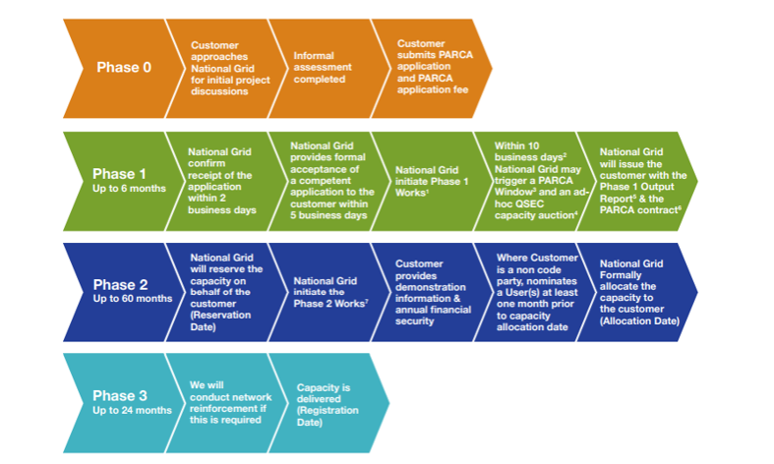
PARCA Process
In order to acquire incremental capacity parties are required to go through the Planning and Advanced Reservation of Capacity Application (PARCA) process with NGG
Phase 0
Initial Conversations
Phase 1
Desktop Studies
NPV Test
Phase 2
Planning Phase
NPV Test
Phase 3
Build Phase

Slide 5
Issues with NPV Test
In order to complete Phase 1 and reserve the incremental capacity SHG are required to complete a Net Present Value (NPV) test. There is also a NPV test at the end of Phase 2 prior to the additional capacity being formally allocated to the applicant.
As an example
In order to pass the NPV test SHG are required to signal incremental capacity in a minimum of 20 quarters out of 32 (this is the same for almost all entry terminals)
SHG are potentially required to reserve any unsold capacity that is also required during these periods (unsold is required before incremental)
Given that long term capacity is not widely bought, there is a significant burden on anyone wishing to pass this test
The time between the first and second test also adds further uncertainty, particularly the impact of GTCR

Slide 6
Proposed Solutions
In order to resolve the identified issues our proposal is to;
Insert the Entry Incremental Capacity NPV test into UNC to allow for it to be modified timely if any future issues arise
A Incremental Capacity Premium to be applied should the estimated reference price not generate sufficient revenues for a positive NPV test outcome.
This concept is based on the IP Mandatory Minimum Premium that is part of the Incremental Capacity Release at Interconnection Points within UNC, European Interconnection Document, Section E.
The Incremental Capacity Premium is an additional quantity that is added to the applicable payable price, calculated to be the minimum value required to allow the NPV test to be passed in the case where the allocation of all offered incremental capacity at the estimated reference price would not generate sufficient revenues for a positive NPV test outcome.
For example, if capacity totalling £50m on a NPV basis is required but only £30m of Incremental Capacity sales are available using the estimated reserve price, then the additional £20m required would be divided by the Incremental Capacity denominator to create the Incremental Capacity Premium in p/kWh/d, which is then applied on top of the reserve price.
Submission of incremental capacity profile ahead of the second NPV test at the end of Phase 2, the same as Phase 1 NPV test, of the PARCA process to either avoid unnecessary termination of the PARCA application or excessive revenue being collected.
This also provides an opportunity for the Incremental Capacity Premium to be recalculated. The ICP is fixed at this point and paid in addition to any capacity charges as they become due.
Ensure Incremental capacity is signalled in a minimum of 4 separate years (over the 8 year PARCA period) to ensure there is a sustained requirement for incremental capacity
The project value for the remaining duration of the PARCA application to be fixed at the time of the 1st NPV test (at the end of PARCA Phase 1).
While this mod will impact the cost to reserve capacity, we do not believe it has wider impacts than this. The mod seeks to ensure that the PARCA applicant continues to commit to 50% of the Estimated Project Value.
Notes:
The NPV test is currently in the Entry Capacity Release Methodology which does not have a modification process as such, and requires Ofgem or NGG to signal changes which are often not timely

Slide 7
Minimum Duration Rule
South Hook Gas does believes that the role of the NPV test is to ensure a PARCA applicant signals the required revenue commitment (currently 50% of Estimated Project Costs). The application of a minimum quarterly duration (e.g. 16 or 8 quarters) results in an additional, unnecessary layer to the NPV test. It also results in a number of issues, such as;
The amount of unsold on the network means that parties may be forced to reserve capacity they do not require
Example – a party requires incremental in 8 quarters due to no available capacity at the Entry Point, however due to the 16 minimum quarter duration they are required to reserve all of the unsold and incremental in an additional 4 quarters or fail the NPV test
At an Aggregated System Entry Point this could result in the party holding more capacity they have the capability to use, and also potentially locking out other industry parties from booking Long Term capacity in those quarters
The above points do not result in efficient booking or allocation of entry capacity
Given we are most likely moving to a cost allocation model the project costs and the capacity prices (which are not based on marginal costs) are completely independent of each other. Therefore having a minimum duration could result in parties over committing to the signal required
Example – a party is able to pass the NPV test by signalling capacity in 8 quarters, however by then forcing them to signal incremental capacity in 16 quarters means they are committing more than the 50% (sometimes in excess of 100%) of the project costs
Any excess revenue committed is socialised across the network resulting in discriminatory charging
This could also lead to a process which is discriminatory and anti-competitive, as entry terminals have capacity prices which are not calculated based on marginal costs
Example – two terminals have different capacity prices (Point A lower than Point B), however both have requested the same amount of incremental capacity and both have the same project costs. Due to the minimum duration, Point B may have to commit a higher revenue amount that Point A when the incremental capacity released and investment costs are the same

Slide 8
Over Recovery against NPV Trigger and Project Cost with minimum duration amounts
*Estimated Project Values (price step 5) from LRMC are used as a proxy of project cost
Assumes price step 0 CWD prices

Slide 9
Amount over recovered at NTS Entry Terminals for 16 and 8 quarter minimum durations

Slide 10
Adam Bates/Kay Riley
Email: abates@southhookgas.com/kriley@southhookgas.com
Phone: 07787 524 566

Slide 11
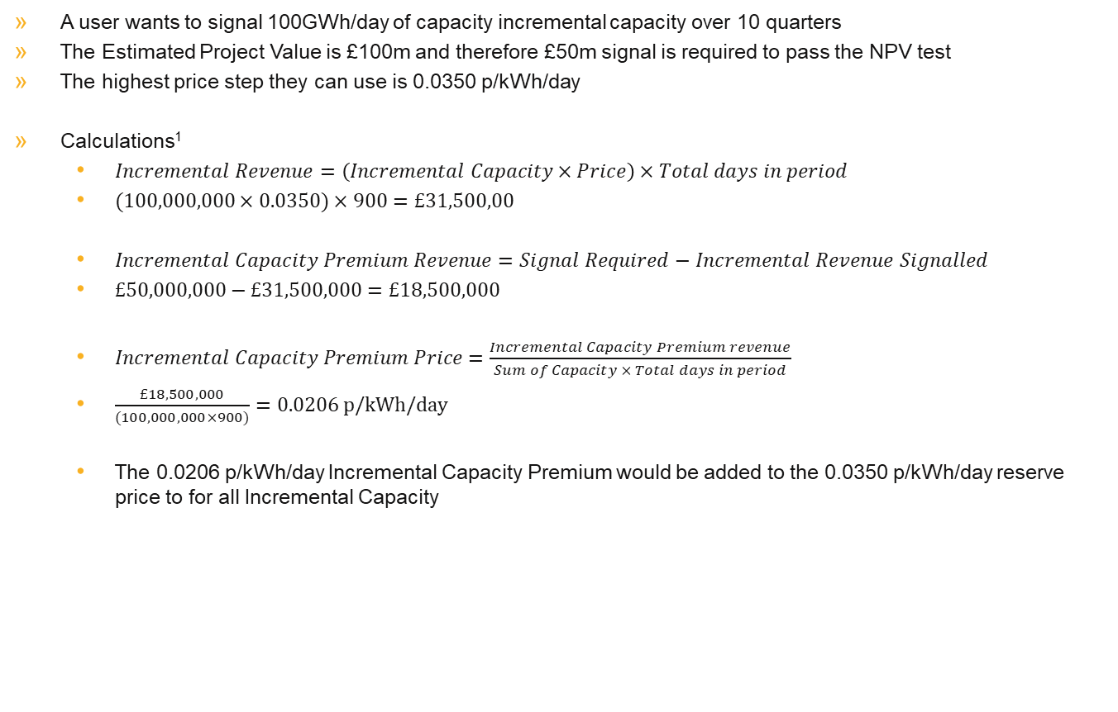
Appendix 1 – Incremental Capacity Premium Calculation Example
A user wants to signal 100GWh/day of capacity incremental capacity over 10 quarters
The Estimated Project Value is £100m and therefore £50m signal is required to pass the NPV test
The highest price step they can use is 0.0350 p/kWh/day
Calculations¹
$Incremental Revenue=\left(Incremental Capacity×Price\right)×Total days in period$
$(100,000,000×0.0350)×900=£31,500,00$
$Incremental Capacity Premium Revenue=Signal Required−Incremental Revenue Signalled$
$£50,000,000−£31,500,000=£18,500,000$
$Incremental Capacity Premium Price=\frac{Incremental Capacity Premium revenue}{Sum of Capacity × Total days in period}$
$\frac{£18,500,000}{(100,000,000×900)}=0.0206 p/kWh/day$
The 0.0206 p/kWh/day Incremental Capacity Premium would be added to the 0.0350 p/kWh/day reserve price to for all Incremental Capacity
¹For simplicity the calculation uses the following assumptions
There are 90 days in a quarter and therefore the total duration is 900 days
There is no discount factor applied

