Slide 1
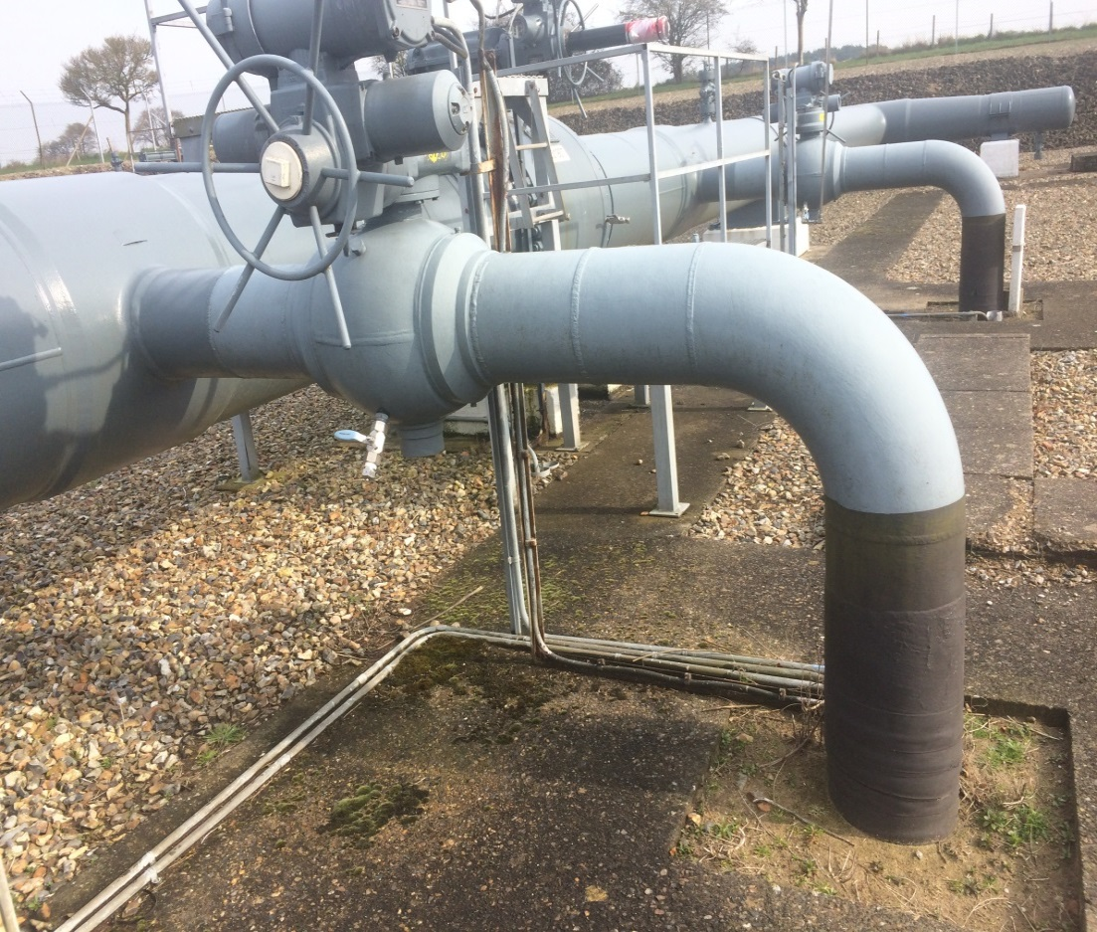
Review of OAD – Proposed Planning
Darren Dunkley
November 2018

Slide 2
Review of OAD Work Streams
The original plan was envisaged as:
Develop Process for Updating Site Owner Drawings
Develop mechanics for Maintenance Sharing & Review OAD Section G
Review OAD *
UNC Mod
* Scope to be determined i.e. agree sections before delivery approach can formulated

Slide 3
Review of OAD Revised Work Streams
UNC
Mod
Drawings
Maint’ance
OAD Refresh
Update SA
CNI
The key areas of work that have emerged are:
Redundant Assets
Shared Sites
Tri-Party Sites
Definitions

Slide 4
Review of OAD Delivery Approach (Original Proposal)
It was originally identified that a multi-phased approach may be necessary to review and update the key sections of OAD:
Phase 1
Drawings Process
Review Maintenance Sharing
OAD Sections, A, B, C, G and Supplemental Agreement
Other Key Issues (ROV’s)
Reform Offtake Committee
Phase 2
Other OAD Sections as agreed

Slide 5
Review of OAD Revised Approach (Proposed)
It was originally identified that a multi-phased approach may be necessary to review and update the key sections of OAD:
Phase 1
Section G (Maintenance)
Updated SA Template
OAD Refresh Sections, A, B and C (Quick Wins)
Redundant Assets
Shared Sites
Implement Offtake Work Group
Phase 2
CNI
Drawings Process
OAD Refresh Sections A, B and C (non Quick Wins)
Other Future Phases
Other OAD Sections as agreed

Slide 6
Review of OAD Proposed Plan
March 2019
March 2020
Phase
1 *
Phase
2
UNC Mod
UNC Mod
Future Phases
* Includes Review Report to Mod Panel

Slide 7
Review of OAD Action Required
If a multi-phased approach is still acceptable the review group needs to agree:
How many phases are required
What work will be delivered within each phase
The delivery horizon for each phase
Each phase needs to be manageable for the group to deliver, and commitment will be required from all operators to drive the changes through to implementation.

