Slide 1
Q1 & Q2 Forecast Update to CoMC
17th October 2018

Slide 2
Contents
Q1 Forecast review
Main movements
Charges impacts
Q2 Forecast
Key Messages
Timescales for updates & endorsement

Slide 3
Q1 Forecast Summary
A potential £1.7m reduction in funding requirements
Gemini project phasing (£3.5m)
CSS bid +£0.6m
UIG +£0.7m
Other minor changes +£0.1m
Deferred Income from 17/18 b/f to fund activities in 18/19
TransformUs +£2.7m
Other activities +£0.2m
TransformUs +£3.1m
Security Audit Recs +£0.3m
Other minor changes (£0.1m)

Slide 4
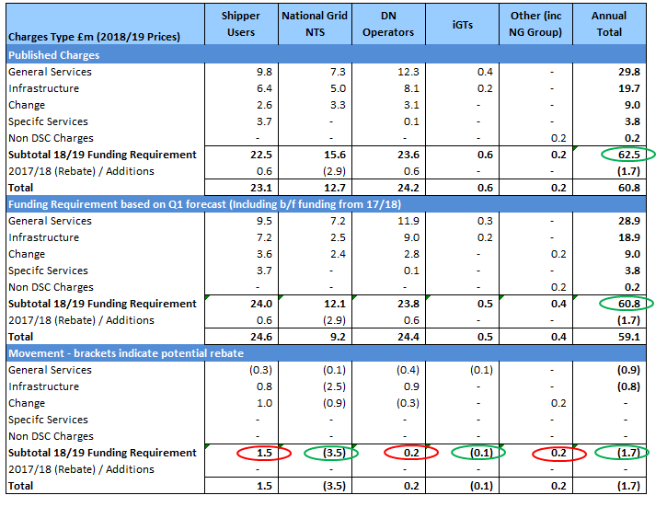
Q1 Forecast – Charges Impacts
Gemini investments timing and scope
Increases in UIG & CSS forecasts

Slide 5
Q2 Forecast – Key Messages & Update Timescales
This will be a 6 months actuals + 6 months forecast
Focus will initially be on “big ticket” items which have a material impact customer charges:-
UIG, CSS & Data / MIS - Shippers
GB Charging & Gemini Replatforming - Transmission
TransformUs project – All customers
Information Security & Enhancements – All customers
Departmental reviews (resources & 3rd party costs) will still take place but be ‘lighter touch’ than the Q1 process.
Updates to:-
CoMC – This meeting plus finished & approved update in November (subject to Board endorsement).
Implications on KVI reporting timescales - to be reviewed for next year.
XEC – 23rd October & 7th November meetings
Board endorsement – November meeting
We will report (internally) against the Q2 forecast from the November results

