Slide 1
UIG Task Force Update
CoMC 17thOctober 2018

Slide 2
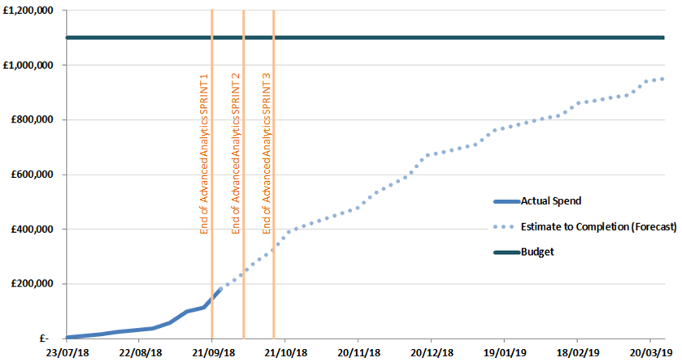
Overview Of Taskforce Funding
DSC ChMC in July approved a BER of £1.1m for XRN 4695 to enable Xoserve to lead on the investigation to the causes and contributors to levels and volatility of UIG. Included within this £1.1m exists the £350k reserved as a placeholder for UIG-related activities in Xoserve’s approved 2018 Business Plan (BP18).
The Task Force is currently tracking to forecast spend. Xoserve’s Q2 forecast process is running through October – an update will be provided in due course.
UIG Taskforce Spend Profile

