Slide 1
UIG Task Force Progress Report
Extraordinary ChMC 2nd October 2018

Slide 2
Agenda
Executive Summary
Executive Summary table of findings
Sprint 2 activities
Supporting evidence for day of week
Sprint overview
AOB

Slide 3
Executive Update
Sprint 1 the Task Force carried out a range of investigations, which have led us to identify several potential drivers of volatility of varying impact. Our most significant findings:
Components of the NDM algorithm appear to be strongly correlated with UIG.
Suggest that the UIG algorithm does not react quickly enough to significant day-on-day weather changes
The Holiday factors for significant public holidays during cold weather (i.e. Christmas and early Easter) may not reflect real usage patterns.
Additional modelling is now needed to further substantiate and quantify these findings.
Analysis confirmed that the weekend vs. weekday component of the algorithm has no correlation to UIG.
In Sprint 2 we will therefore continue the most promising current lines of investigation to validate early findings by the use of data across a wider date range.
Sprint 2 will also incorporate new areas of investigations to quantify additional UIG causes;
Accuracy of DM Nominations
The role of standard conversion factors
Assessment of NDM sample data set against daily allocated gas

Slide 4
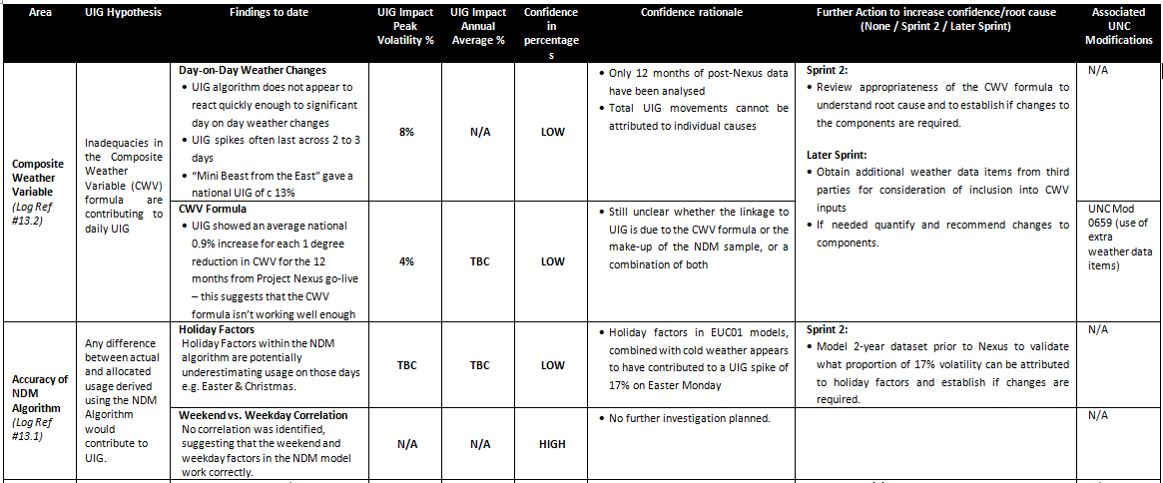
UIG Task Force: Executive Summary

Slide 5
UIG Task Force: Executive Summary

Slide 6
UIG Task Force: Executive Summary

Slide 7
Parked NDM Analysis Items
The analysis indicates that Calorific Value and Day-of-Week variables do not have a significant impact on UIG so we have parked further analysis on these items.
Key findings
The R Squared value is the percentage of UIG that can be statistically explained by the data item. An R Squared over 90% is seen as having a significant impact.
The CV average R Squared is around 2%
The Day-of-Week R Squared is less than 1%.
The P Value is the percentage chance that a result could be random. A significant P value should be less than 5%.
The CV average P value is around 9% although there is significant variations between LDZs. The low R Squared value suggests that where there is a regionally strong correlation between UIG and CV, the actual impact on UIG is very small.
The Day-of-Week average P value is around 45% suggesting no relationship with UIG.

Slide 8
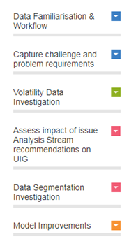
Sprint Update
1 week
3 weeks
2 weeks
2 weeks
1 week
Pre-Sprint 1
Sprint 1
Sprint 2
Sprint 3
Synthesis Report
Weather data
Temperature
Wind speed
Seasonal Data
Sprint 1 Executive Summary.
User /Property Data
Asset data/MPRN Data
Postcode
Local Distribution Zones
Sector data (Domestic and Industry)
End user category (9 )
Asset Type (Site type)
While we plan to issue a synthesis report on completion of the three sprints, we will also provide brief progress updates at the end of every sprint to inform customers on what the data is telling us.
Data Inputs
Sprint Goals
Gas Consumption and Meter point Data
AQ
System price data
Non-daily meter reads
Profile of average gas usage
MPRN
Daily consumption data
Demand calculation weighting factors

