Slide 1
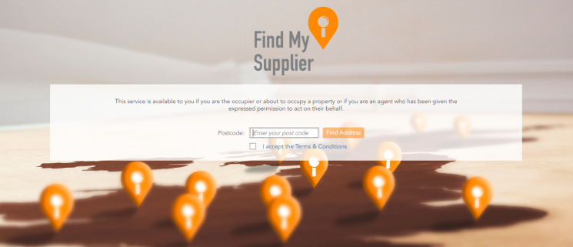
Find My Supplier
Xoserve has launched a new online version of the M Number helpline
This free to use service enables gas consumers to retrieve data online relating to their gas supply at any time
It is owned and managed by Xoserve and has been developed within JMDG and delivered in partnership with Back Office Associates
The site gives a consumer the ability to search using their postcode to find their Meter Point Reference Number (MPRN), Gas Supplier and Gas Transporter to provide them with the information they need to switch supplier

Slide 2
Find My Supplier
https://findmysupplier.energy/
The site went live on 1st September 2018
It will replace the M Number helpline as the preferred method for consumers to access their information but the two will operate in parallel
The site is in its first iteration with future enhancements planned
Usage is now around 900 users per day, and we are forecasting 35k users a month
Updates are required to external web references of the helpline to include the web address. We also need to identify what communications reference this number and add the web address alongside

