Slide 1
PRIDe in Gas Model workshop
25 July 2018

Slide 2
Agenda
Introductions
Objectives of the day
Problem statement
Overview of the PRIDe in Gas Model
Summary of approach
Timelines
Conclusions and next steps

Slide 3
Objectives for the day
Share information on the PRIDe in Gas Model
Discuss and Define the use of each PRIDe technique
Perform analysis on each PRIDe technique
  What we like
  What we don’t like (what can be changed)
Gain agreement on the overall use of the PRIDe in Gas Model
Gain agreement on timelines for implementation
Gain PAC commitment/prioritisation for next steps

Slide 4
Problem statement
Currently have limited tools to manage performance related risks in the market
Current controls are not scalable to effectively resolve a wide range of risks
  Significant risks
  Non significant risks
Ability to escalate risks is not defined

Slide 5
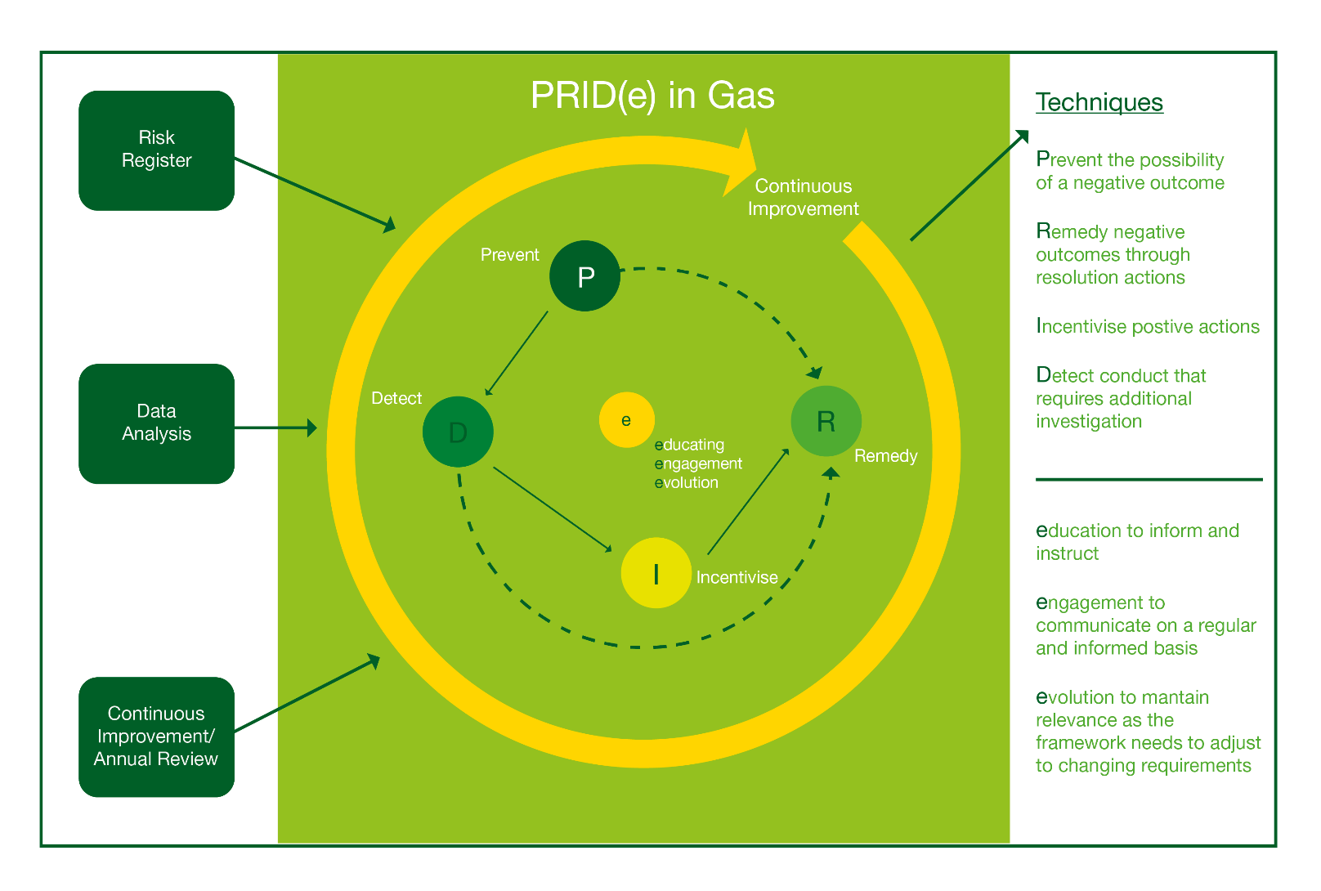
PRIDe in Gas Model

Slide 6
PRIDe in Gas Model
Complementary set of Preventive, Detective, Incentive and Remedial assurance techniques. Used flexibly to address Settlement risks
The use of any techniques under this model is the decision and discretion of the PAC based on the information it receives through the PARR and the PAFA
A risk that presents a significant impact to Settlement would necessitate the use of a stronger control
Whereas a risk that presents a smaller impact to Settlement would necessitate the use of a weaker control

Slide 7
Worked examples
Example 1:
  Correction Factor risk
Example 2:
  DM read submission

Slide 8
Prevent
Used as a first course of action to consider when presented with a risk to Settlement
Technique is always used for managing risks
It contains the use of the PARR and production of performance reports on a monthly basis
Market Entry Assessment for new entrants entering the market

Slide 10
Prevent
Control strength | Control
Low | Continue to monitor PARR reports as standing monitoring
 | Continue to monitor PARR reports for a fixed timescale before escalation decision
 | Provide education to the industry
 | Provide engagement to acknowledge performance
Medium | Consider if further analysis is required on an adhoc basis
 | Consider if further analysis is required on a frequent basis
 | Determine if current risks are being mitigated
 | Determine if escalation for other techniques is required

Slide 11
Detect
Used to further investigate and audit areas of interest
Drill down into data to find determine materiality of issues
Determine root cause if not already known via data analysis or engagement with parties
Monitoring of issue via ad-hoc developed anonymised reports
Option for issues not captured in the PARR reports to be presented and discussed
Use data requests process to provide analysis
Determine SLAs for CDSP for providing data based on data request

Slide 12
Detect
Control strength | Control
Low | Use Prevent technique to continue monitoring for a fixed timescale before escalation decision
 | Use Prevent technique to continue monitoring standing monitoring
Medium | Define and create adhoc reports as standing monitoring
 | Define requirements and timescales for CDSP data extract
 | Request data analysis from PAFA
 | Recommend further area of investigation
 | Determine if escalation for other techniques is required
 | Determine the conditions to appeal any escalation decision for incentive and remedy techniques
 | Determine if current risks are being mitigated
 | Determine if newly identified risks/issues are being mitigated

Slide 14
Incentivise
Used for persistent performance issues and encouraging positive behaviours
PAC receives non anonymised report data with names of all parties contributing to issues captured in PARR reports
PAC receives non anonymised report data with names of all parties contributing to persisting issues not captured in PARR reports
PAC will provide notice before sanctions are made
The funds recovered through the use of charges would be used for education and training market participants
PAC conducts annual review on charges to ensure they are appropriate

Slide 15
Incentivise
Control strength | Control
Medium | Determine the conditions for entering and exiting liquidated damages
 | Determine the conditions for peer comparison reporting
 | Determine the conditions to appeal any decision for liquidated damages
 | Determine the conditions to appeal any decision for peer comparison reporting
High | Determine if the significance of poor performance necessitates the use of liquidated damages
 | Determine if the significance of poor performance necessitates the use of peer comparison tables
 | Determine if performance is improving
 | Determine if current risks are being mitigated
 | Determine if escalation for other techniques is required

Slide 17
Incentivise
Can you incentivise via name and shame?
Does the liability represent the risk incurred?
  How would this be quantified?
Who pays who?
  How would cash flow be managed and redistributed?
What happens if a Party doesn’t pay?
  Escalation actions?
What if the fine is less than the cost of the benefit?
  Fit for purpose?
  Mechanism for model adjustment?

Slide 18
Remedy
Used as a last resort once other techniques have been exhausted
Used to monitor party resolution plans based on PAC exit conditions
Used to limit market participant operations until performance improves
PAFA to provide updates on resolution plan progress at agreed frequency to PAC
PAC discussion on next steps based on lack of improvement

Slide 19
Remedy
Control strength | Control
Medium | Determine the conditions to appeal any decision for escalation to UNCC
 | Determine the conditions to appeal any decision for expulsion from UNC
High | Define and create resolution plan to improve market participant performance
 | Define and create entry and exit conditions for limiting market participant operations
 | Request the PAFA to monitor resolution plan and provide updates
 | Determine if escalation to UNCC is required
 | Determine if recommendation for expulsion from UNC is required

Slide 21
Appeals process
A Market Participant can appeal the PAC’s decision to activate a PRIDe technique if they believe:
  The due process has not been followed
  The use of evidence and circumstances has either been over or under emphasised
  The evidence used has been misinterpreted
Appeal can be via email to the PAFA or PAC describing the query within 10 Working Days of a decision being made
The appeal will be considered by the PAC at their next available meeting

Slide 22
Timeline
Event | Date
Initial PRIDe workshop | 25 July 2018
Project plan agreed | August/September 2018
Revision of PRIDe model | 26 September 2018
Incentives and liabilities workshop | 26 September 2018
Revision of PRIDe model | 26 September 2018
Modification presented to PAC | 9 October 2018
Modification raised | w/c 12 November 2018
Modification process | w/c 12 November 2018 – 18 February 2019
Implementation date | 4 March 2019
Trial run using industry data | 4 March 2019 – 6 May 2019
Go live | 6 May 2019
Indicative timeline

Slide 23
PAFA@Gemserv.com

