Slide 1
UIG Task Force Funding Update
CoMC September 2018

Slide 2
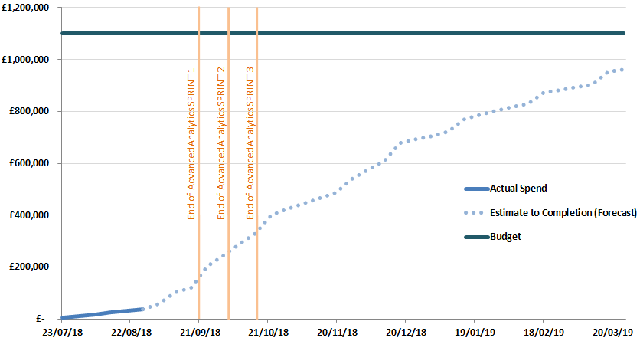
Overview of Taskforce Funding
DSC ChMC in July approved a BER of £1.1m for XRN 4695 to enable Xoserve to lead on the investigation to the causes and contributors to levels and volitity of UIG. Included within this £1.1m exists the £350k reserved as a placeholder for UIG-related activities in Xoserve’s approved 2018 Business Plan (BP18).
Xoserve’s financial Q1 forecast process has provided an initial indication of a forecast overspend against BP18, driven predominantly by UIG work (XRN4695) necessitating c.£750k.
However, uncertainty within the Q1 forecast of BP18 change initiatives not yet started, is currently offsetting this c.£750k overspend.
Xoserve will continue to monitor this position through its Q2 forecast process (running now until end of October) and will take a view during this process as to whether any additional funding is required during the 18/19 financial year.
Assuming the UIG Taskforce remains operational for its entirety and those unstarted change initiatives currently offsetting the forecast BP18 overspend are mobilised, it is the current assumption that up to c.£750k of funding will be necessary, for which Xoserve will liaise with the DSC CoMC in November to initiate charging statement amendments.
Xoserve recommend that Shippers liaise with their internal finance teams to notify them of this current estimate, should any accruals need to be adjusted.
UIG Taskforce Spend Profile

