Slide 1
UIG Resolution
Weekly Progress Update 3rd Aug 2018

Slide 2
DM read rejection update
Pot 1 Key messages
Outstanding last week = 1
Closed this week = 0
0 meter points still impacting UIG (estimated consumption not accurate)
Row Labels | DMSP | N/A | SHIPPER | MAM | XOS | Grand Total
Assigned | 0 | 0 | 0 | 0 | 0 | 0
Closed | 0 | 176 | 0 | 0 | 0 | 176
Fix in Progress | 0 | 0 | 1 | 0 | 0 | 1
New | 0 | 0 | 0 | 0 | 0 | 0
Monitor | 0 | 0 | 0 | 0 | 0 | 0
Failed | 0 | 0 | 0 | 0 | 0 | 0
Total | 0 | 176 | 1 | 0 | 0 | 177
Total number of meter point queries open |  |  |  |  |  | 1
Pot 2 Key messages
Outstanding last week = 22
New Rejections identified = 4
Closed this week = 1
12 meter points still impacting UIG (estimated consumption not confirmed as accurate)
Row Labels | DMSP | N/A | SHIPPER | MAM | XOS | Grand Total
Assigned | 11 | 0 | 1 | 4 | 0 | 16
Closed | 0 | 210 | 0 | 0 | 0 | 210
Fix in Progress | 1 | 0 | 2 | 0 | 2 | 5
Fixed | 0 | 0 | 0 | 0 | 0 | 0
New | 4 | 0 | 0 | 0 | 0 | 4
Monitor | 0 | 0 | 0 | 0 | 0 | 0
Total | 16 | 210 | 3 | 4 | 2 | 235
Total number of meter point queries open |  |  |  |  |  | 23
Accurate as of 03.08.2018

Slide 3
DM Financial Adjustments Guide
Sites where the fix has been successful and actual reads are now flowing into UKL
Shipper stated that an Adjustment is needed to fix historical period
Valid Adjustment has been submitted
Waiting on valid Adjustment submission
Waiting on Shipper decision
Shipper stated no Adj needed
Previous Adj Rejected
No Adj Received
Total Adjustments Completed
Adjustments that have been processed to billing
Adj’s that have been submitted and are in progress
Deemed Not Requiring Invoicing
Adjustment has been Invoiced
Adjustments waiting next invoice run
Adj held due to issue
Adj is being validated
Adj held due to issue
Original number of Sites estimating on Nexus Go-Live
Pending Fix
Total KWH of Invoiced Adjustments
Split of Owner
Total KWH of Adj waiting invoice

Slide 4
DM Financial Adjustments Progress
Root Cause Fixed:
176 (0)
CA Needed:
75 (+1)
New/Valid Contact Submitted:
64 (+1)
Notification of Adj Needed:
11 (0)
CA Decision Pending:
3 (-1)
No CA Required/ Closed:
98 (0)
Invalid Adj Sent:
4 (0)
No Adj Sent:
7 (0)
Invoiced:
42 (+4)
Awaiting Billing:
9 (+3)
Adj in Progress:
13 (-6)
Not Required:
5 (0)
Complete:
37 (+4)
To Be Billed:
0 (-3)
Issue With Billing:
9 (+6)
Adj Under Validation
13 (-6)
Issue With Adj:
0 (0)
POT 1: 177 (0)
Fix
Pending:
1 (0)
Kwh:
-264,166,013
(-251,763,261)
DMSP: 6 (0)
XOS: 3 (-2)
SHIP: 4 (-4)
Kwh:
0
(-9,732,206)
Accurate as of 01.08.2018
Exposure: Retrospective CA not yet invoiced = 37 (-4)
[Fix Pending] + [CA Decision Pending] + [CA Needed] – [Invoiced]

Slide 5
Exposure MPRNs – LDZ Breakdown
Exposure: Retrospective CA not yet invoiced = 37 (-4)
[Fix Pending] + [CA Decision Pending] + [CA Needed] – [Invoiced]
Exposure by LDZ
Accurate as of 01.08.2018

Slide 6
No CA Needed – LDZ Breakdown
No CA Required/ Closed:
98 (0)
No CA Needed by LDZ
Accurate as of 01.08.2018

Slide 7
Exposure MPRNs - AQ & Class
Exposure: Retrospective CA not yet invoiced = 67 (0)
[Root Cause Pending] + [CA Decision Pending] + [CA Needed] – [Invoiced]
HISTORIC
CLASS | AQ ROLL (Kwh) | MPRN
1 | 14,534,819,022 | 67
2 | 0 | 0
3 | 0 | 0
4 | 0 | 0
 | 14,534,819,022 | 67
CURRENT
CLASS | AQ ROLL (Kwh) | MPRN
1 | 9,790,576,406 | 40
2 | 333,423,941 | 21
3 | 0 | 0
4 | 177,418,161 | 6
 | 10,301,418,508 | 67
Details of outstanding MPRNs when the issue was originally reported to investigate and attempt resolution
Details of exposure MPRNs as of today
Site AQs provided at the request of industry parties.
Please note that site AQ is not an indicator of the amount of any likely consumption adjustment: this is dependent on the duration of the issue and the magnitude of the difference (if any) between original estimates and actual usage, and to what extent the business-as-usual processes have not corrected the billed position.
Accurate as of 25.04.2018

Slide 8
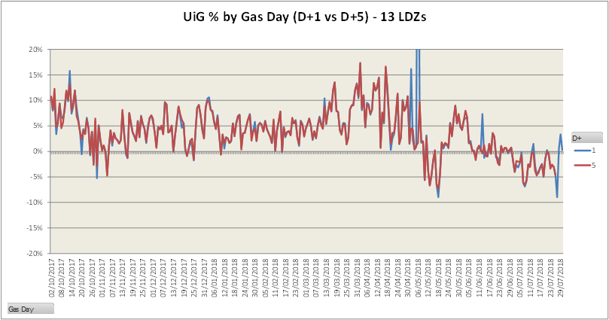
Latest UIG Volatility
Key Comments:
Gas Day 2nd May 2018 - The majority of DM Measurements for this gas day were not present in the Gemini system, in time for the first run of Allocation. This resulted in erroneously high Unidentified Gas values across all LDZs. This issue was investigated and resolved in time for the second run of Allocation.
Gas Day 6th May 2018 – NDM Allocation failed to calculate for this gas day on the first run of Allocation, affecting all LDZs. This resulted in erroneously high Unidentified Gas values (c70%) across all LDZs. This issue was investigated and resolved in time for the second run of Allocation.
Accurate as of 30.07.2018

