Slide 1
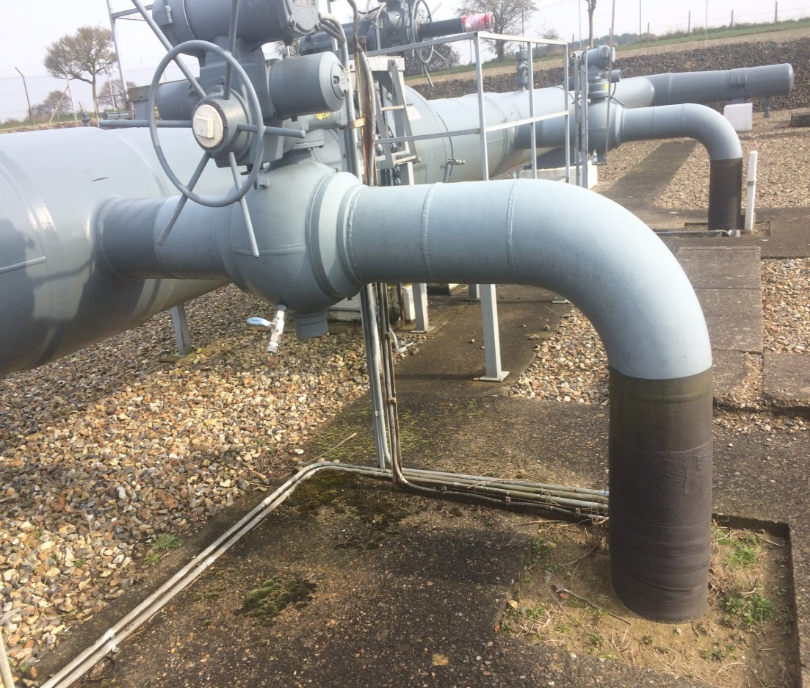
Review of OAD – Drawings Proposal
Darren Dunkley
February 2018

Slide 2
Review of OAD Proposed Approach
There are possibly 3 streams of work:
Develop Process for Updating Site Owner Drawings
Develop mechanics for Maintenance Sharing & Review OAD Section G
Review OAD *
UNC Mod
* Scope to be determined i.e. agree sections before delivery approach can formulated

Slide 3
Review of OAD Proposed Approach
If all sections of OAD require review then a multi-phase approach may be required:
Phase 1
Drawings Process
Review Maintenance Sharing
OAD Sections, A, B, C, G and Supplemental Agreement
Other Key Issues (ROV’s)
Reform Offtake Committee
Phase 2
Other OAD Sections as agreed

Slide 4
Review of OAD Proposal for Drawings
Site Owner Site User
Provide latest Approved Operational Drawing (DGN / PDF)
PSD
GA
HAZ
Start Work *
Request drawing from Site Owner
Work commences
Network Integrity Check
Updates in accordance to site owner specification
PSD
GA
HAZ
Ok
Records Office to update and store record
PDF copies sent back to Site User
Update
Supplemental Agreement
Store Copy of Drawings
* Before work commences an OAD notice must have been raised and consent granted by the Site Owner

Slide 5
Review of OAD Proposal for Drawings
Where drawings need to be updated, there will be certain specific requirements the site owner will require to be followed. These are detailed below:
Cadent Requirements
Must provide a pdf
Must provide an editable MicroStation file (dgn file)
Colour pallet
Must align to the drawings specific T/PM/RE/1 T/PM/RE/2, T/PM/RE/3 RE3, T/SP/CDO/1 Parts 1-3
Using correct Cadent borders
NGG Requirements
Must contact Richard Warrington 01604 754521 to obtain a copy of the latest Operational Drawings.
Must provide a pdf and editable MicroStation file.
Must provide a drawing Index in Excel
Must align to the drawings specification T/SP/RE/15
Other DNO’s will need to confirm their specific requirements

