Slide 1
XRN4621 - Construction of a Meter Reading where a Converter and AMR is recorded OR where a Meter with Conversion capability is fitted v2 DWG 28/06/2018 DSG 02/07/2018 (NB: 18/06/2018 v1)

Slide 2
Background
Reading construction in Nexus was highlighted prior to implementation as an issue where Converter and AMR devices are fitted at site
As [typically] AMR devices only have two ports – therefore may only obtain two indexes
In advance of Nexus, we agreed with Shippers that they needed to provide three indexes (meaning that they would need to ‘derive’ one index),
…and that we would look at this following Nexus.
IGEM Panel GM/5 requested that this group ALSO consider the construction of a Meter Reading where the device is a Meter with Conversion capability (italicised text is specific to this scenario)

Slide 3
Question for Shippers
Through this presentation we’ll go through some of the background, but the question for Shippers to consider is bold text below:
We understand from MAMs that some configurations exist which would call in converted and unconverted ONLY.
UNC doesn’t appear to envisage this scenario for Shipper provided Meter Readings.
Need assessment of numbers from Shippers of instances of Supply Meter Points sending ONLY converted + unconverted indexes – this may drive an alternative approach – e.g. make the Meter Reading ‘Optional’ in the Meter Reading records.

Slide 4
Background – What Code States:
Definition of Meter Reading (M 1.5.2)
1.5.2 For the purposes of the Code, in relation to a Supply Meter: (a) a “Meter Reading” is:
(i) the reading of the index of the Supply Meter; and
(ii) where a convertor is installed as described in paragraph 1.2.3, the converted and the unconverted readings of the convertor
except that where Transporter Daily Read Equipment and such a convertor are installed, a Meter Reading need not include both the reading under paragraph (i) and the unconverted reading under paragraph (ii) or where Remote Meter Reading Equipment and such a convertor are installed, a Meter Reading need not include the unconverted reading of the convertor under paragraph (ii);
So where it is Transporter Daily Read Equipt– states that valid combinations are:
Meter + Unconverted + Converted; OR
Meter + Converted Reading; OR
Unconverted + Converted Reading
Other AMR equipment:
Meter + Converted; OR
Meter + Unconverted + Converted
As this discussed a ‘convertor’ device – it is assumed that a Meter with Conversion capability is excluded from this clause?

Slide 5
Background – File Formats
Class 1:
M00 Record, DLC File
https://xoserve.sharepoint.com/:w:/r/sites/UKLink/_layouts/15/WopiFrame.aspx?sourcedoc=%7B08449D60-FE9A-4E82-90C1-193ABA69702E%7D&file=M00%20DAILY%20DATALOGGER%20READINGS1%20V6.3L.docx&action=default&DefaultItemOpen=1
Meter Reading
‘Mandatory Field’
Corrected Reading
‘Optional Field’ – Conditionality is that this must be provided where a converter is fitted.

Slide 6
Background – File Formats
Class 4:
U01 Record, UMR File
https://xoserve.sharepoint.com/:w:/r/sites/UKLink/_layouts/15/Doc.aspx?sourcedoc=%7BD4DB6604-5BD1-492B-A05F-887B8B0D3D8B%7D&file=U01%20UNBUNDLED%20METER%20READ%20V5L.docx&action=default&mobileredirect=true&DefaultItemOpen=1
Meter Reading
‘Mandatory Field’
Uncorrected Reading
‘Optional Field’ – Conditionality is that this must be provided where a converter is fitted.
Corrected Reading
‘Optional Field’ – Conditionality is that this must be provided where a converter is fitted.

Slide 7
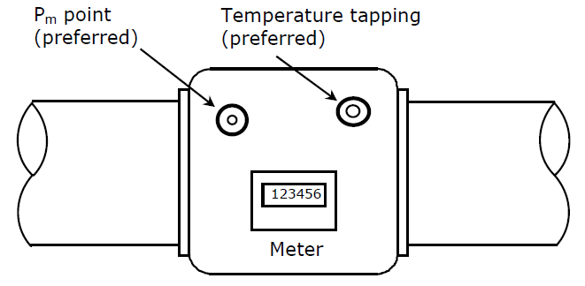
Converting Volume into useful Data.
Meter
Meter Readers
Manual Meter / Converter Reads
Pulses of Unconverted Volume
New generation meter with Logging and Comms
3rd party AMR
System
Volume
Converter
Pulses of Unconverted Volume (sometimes)
New Generation Volume Converter
With Logging and direct Comms
Pulses of
Converted (and often Unconverted) Volume
Industry IT systems
Datalogger with Comms
Note. Pulses are not 100% reliable
Datalogger /AMR with Comms

Slide 8
Valid Installation Schematics
converted
converted
Meter
Converter
AMR
unconverted
unconverted
converted
converted
Meter
splitter
Converter
AMR
meter
meter
converted
converted
Meter
splitter
Converter
AMR*
unconverted
unconverted
AMR*
meter
meter
* - this may be a second AMR device, or three channel AMR device – none are known to be installed at this time

Slide 9
Requirement Statements – Converter with AMR
UNC appears to stipulate:
So where it is Transporter Daily Read Equipt– states that valid combinations are:
Meter + Unconverted + Converted; OR
Meter + Converted Reading; OR
Unconverted + Converted Reading
Other AMR equipment:
Meter + Converted; OR
Meter + Unconverted + Converted
Requirement statements:
Transporters / DMSP - Continue to only allow Meter and Converter Readings as per records. Agree?
Define conditionality in User Reading Records in UMR, UBR and UDR to align to UNC. Agree?
We understand from MAMs that some configurations exist which would call in converted and unconverted. Need assessment of numbers from Shippers of instances of this – this may drive an alternative approach.

Slide 10
Requirement Statements - Meter with Conversion Capability
Meter with Conversion capability
Potential to be fitted on all Supply Meter Points (i.e. not AQ specific)
Will be controlled in the Meter Model table (MDD under SPAA)
Recommendation to add indicator to Meter Model table only
Recommendation NOT to change RGMA flows to include an explicit flag within flows (SPAA and UKL)
Question about consideration of new Meter Type to denoted Conversion Capability, (SPAA and UKL impacts) if included will require:
Transformation activity to revert existing Models to new Models
Risk that the Supply Meter Point has transferred to an alternative User – will require action by new User

Slide 11
Requirement Statements - Meter with Conversion Capability
UNC does not stipulate anything explicit for these scenarios, should it?
Assuming not, this will be a matter for UK Link system flows (and referred to DSC Change Managers)
Proposal to DSC Change Managers (and expected referral to DSG)
Does not mandate a UK Link system change
MP Conversion Factor should be set to 1
Reading construction:
Meter Reading index only – No Converted / Unconverted indexes expected
Applies to all Shipper User to UK Link flows (UMR; UBR; UDR; RGMA)
Resync - It is not expected to require any resync flows
Reporting – potential reporting against Meters with Conversion where MPCF<>1

